Slide 1
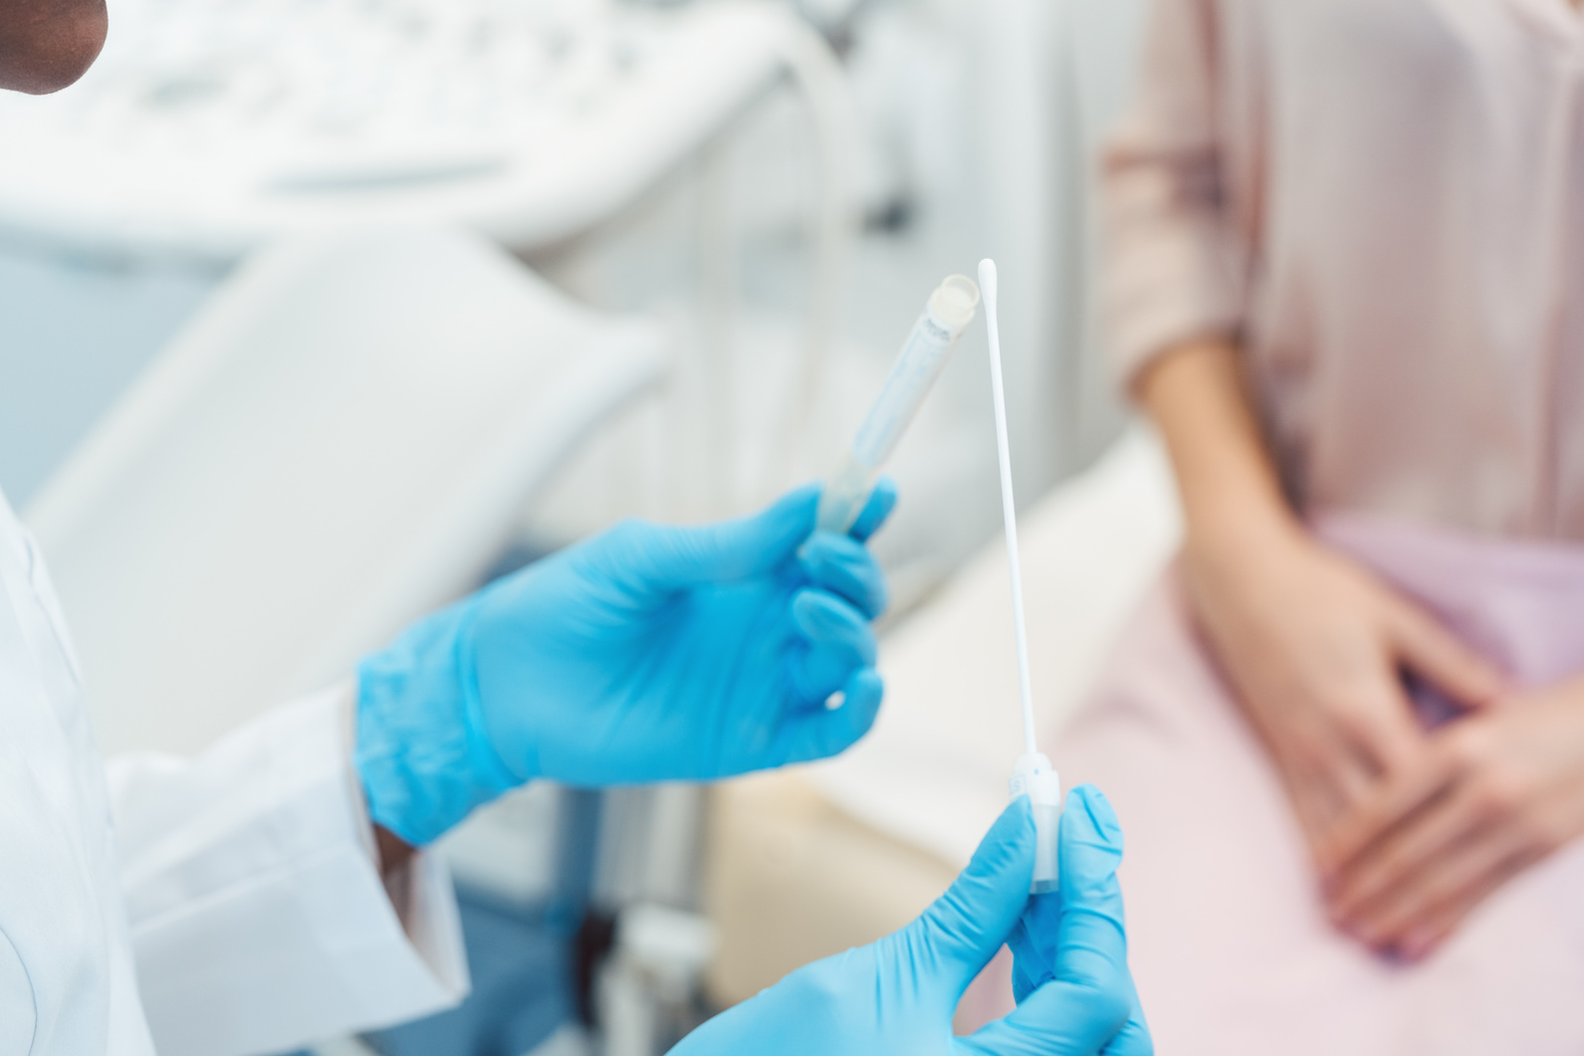

2025 EDITION
PRECISION MEDICINE:
HEALTHCARE OF THE FUTURE?

Slide 2





  01
  Define “precision medicine”.
  02
  Learn how genes can affect treatment.
LEARNING GOALS
  03
  Explore real-world examples.
  04
  Consider the benefits & challenges of precision medicine.

Slide 3


COMMUNITY AGREEMENTS
By participating in this program, you agree to...
  Speak honestly and from your own experience
  Own the impact of your words
  Listen to understand (not to respond)
  Focus on learning (not debating)
  Embrace the capacity to change our opinions
  Pass the ‘mic’
  Challenge by choice

Slide 4

DO NOW: WARM UP
  What are the goals of medicine?

Slide 5
THE GOALS OF MEDICINE
  Prevention: Recommend behaviors to prevent or decrease the chances of developing a condition.
  Diagnosis: Identify the cause of symptoms.
  Treatment: Provide effective therapies to alleviate symptoms of or manage a condition.

Slide 6





WHAT KINDS OF INFORMATION ARE USED BY DOCTORS?
Age
Body Size
Height & weight
Organ function
The kidneys & liver help our bodies process medications
Current medications
Results of medical tests
Blood tests, Imaging, Tissue samples, & increasingly - DNA!

Slide 7
WHAT CAN
WE LEARN
FROM DNA TESTS?
  Cause of disease
  Risk of future disease
  How a person’s body may respond to treatment

Slide 8

GENES & CAFFEINE
CYP1A2 is a gene that helps people metabolize caffeine.
Anahad O'Connor, New York Times (2016)
Notes:
https://archive.nytimes.com/well.blogs.nytimes.com/2016/07/12/for-coffee-drinkers-the-buzz-may-be-in-your-genes/

Slide 9
GENES & CAFFEINE
CYP1A2 is a gene that helps people metabolize caffeine.
  Fast metabolizers (40%) experience an energy boost quickly & a reduced risk of heart attacks
Anahad O'Connor, New York Times (2016)
Notes:
https://archive.nytimes.com/well.blogs.nytimes.com/2016/07/12/for-coffee-drinkers-the-buzz-may-be-in-your-genes/

Slide 10
GENES & CAFFEINE
CYP1A2 is a gene that helps people metabolize caffeine.
  Fast metabolizers (40%) experience an energy boost quickly & a reduced risk of heart attacks
  Moderate metabolizers (45%)
Anahad O'Connor, New York Times (2016)
Notes:
https://archive.nytimes.com/well.blogs.nytimes.com/2016/07/12/for-coffee-drinkers-the-buzz-may-be-in-your-genes/

Slide 11
GENES & CAFFEINE
CYP1A2 is a gene that helps people metabolize caffeine.
  Fast metabolizers (40%) experience an energy boost quickly & a reduced risk of heart attacks
  Moderate metabolizers (45%)
  Slow metabolizers (15%) experience a slower energy boost & an increased risk of heart attacks
Anahad O'Connor, New York Times (2016)
Notes:
https://archive.nytimes.com/well.blogs.nytimes.com/2016/07/12/for-coffee-drinkers-the-buzz-may-be-in-your-genes/

Slide 12

One Size Fits All
Given that we know that individual bodies respond differently based on their unique combination of factors, a new approach to medicine is emerging – precision medicine.
KEY IDEA
ONE SIZE DOES NOT FIT ALL

Slide 13
THINK ABOUT IT...
  Why might a medicine work well for one person but not another?

Slide 14
THINK ABOUT IT...
  Why might a medicine work well for one person but not another?
  Body differences
  Allergies
  Lifestyle choices
  Effects of other medications
  Genetics

Slide 15
APPROACHES TO MEDICINE
CONVENTIONAL MEDICINE
PRECISION MEDICINE
Uses a one-size-fits-all approach, designed to work for the "average patient".
Evaluates differences in a patient’s genes, environments, and lifestyle to tailor their medical treatments.
FDA (2018)
Notes:
https://www.fda.gov/medical-devices/in-vitro-diagnostics/precision-medicine

Slide 16
THINK ABOUT IT...
  For doctors, how might knowing their patients’ genetic information improve the quality of their healthcare?

Slide 17
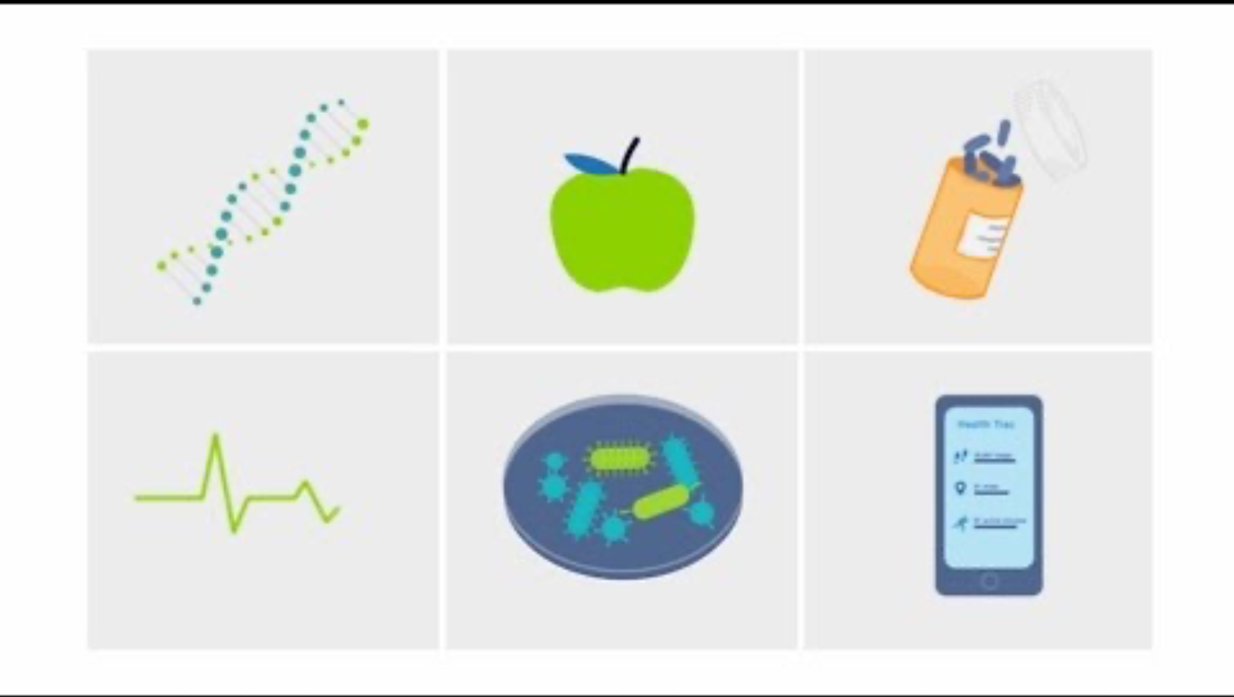
VIDEO: WHAT IS PRECISION MEDICINE?

Slide 18
PRECISION MEDICINE HOLDS THE POWER TO CHANGE LIVES...
However, many people face barriers to accessing the healthcare they need. Some people who would greatly benefit from precision medicine will not have opportunities to learn about or utilize it.

Slide 19
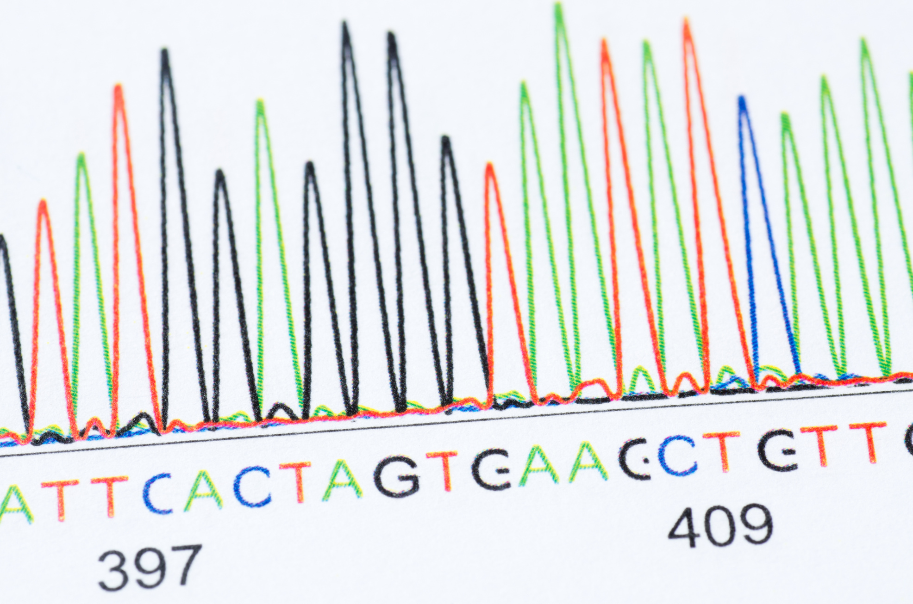

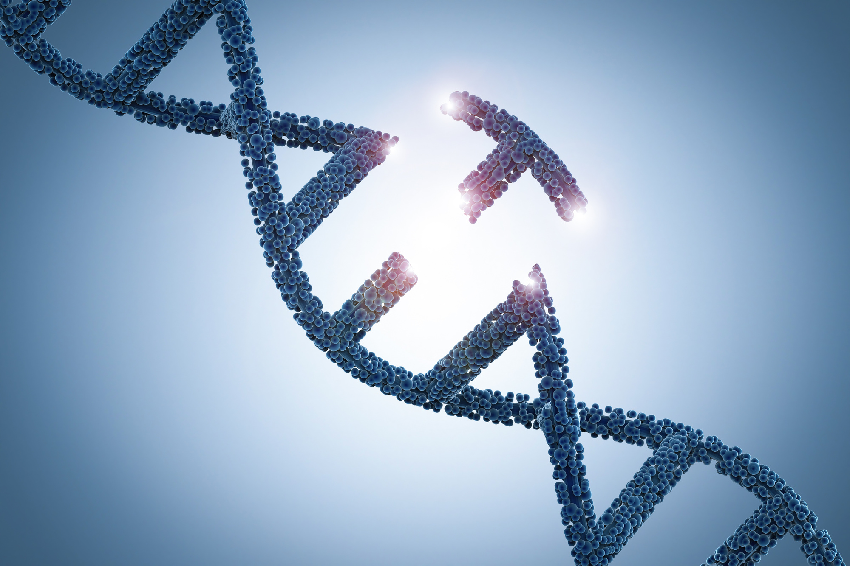
Genome sequencing
GENES & PRECISION MEDICINE
Pharmacogenetics
What are some ways genetic information is being used for precision medicine?
Genome editing

Slide 20




ELSI & PRECISION MEDICINE
As we explore different aspects of precision medicine, we will also consider the Ethical, Legal, and Social Implications (ELSI).
Ethical: Moral principles guiding the use of genetic information, such as ensuring fairness, preventing harm, and respecting individual autonomy.
Legal: Laws and regulations that protect individuals from discrimination, ensure the privacy of genetic data, and govern informed consent for genetic testing.
Social: How genetic information affects individuals, families, and communities, including issues of social stigma, equity, and access to and understanding of genetic information.

Slide 21

  01
  GENOME SEQUENCING
  GENETICS & PRECISION MEDICINE
  02
  PHARMACOGENOMICS
  03
  GENOME EDITING

Slide 22
GENOME SEQUENCING
Sequencing: reading a DNA code.
Can be used to:
  Diagnose health conditions known to have a genetic cause
  Identify risk factors for genetic conditions.
  Guide prevention & treatment decisions

Slide 23
DO NOW: GENOME SEQUENCING
  Why might a person want to get their genome sequenced?
  Why might they be concerned about getting their genome sequenced?

Slide 24
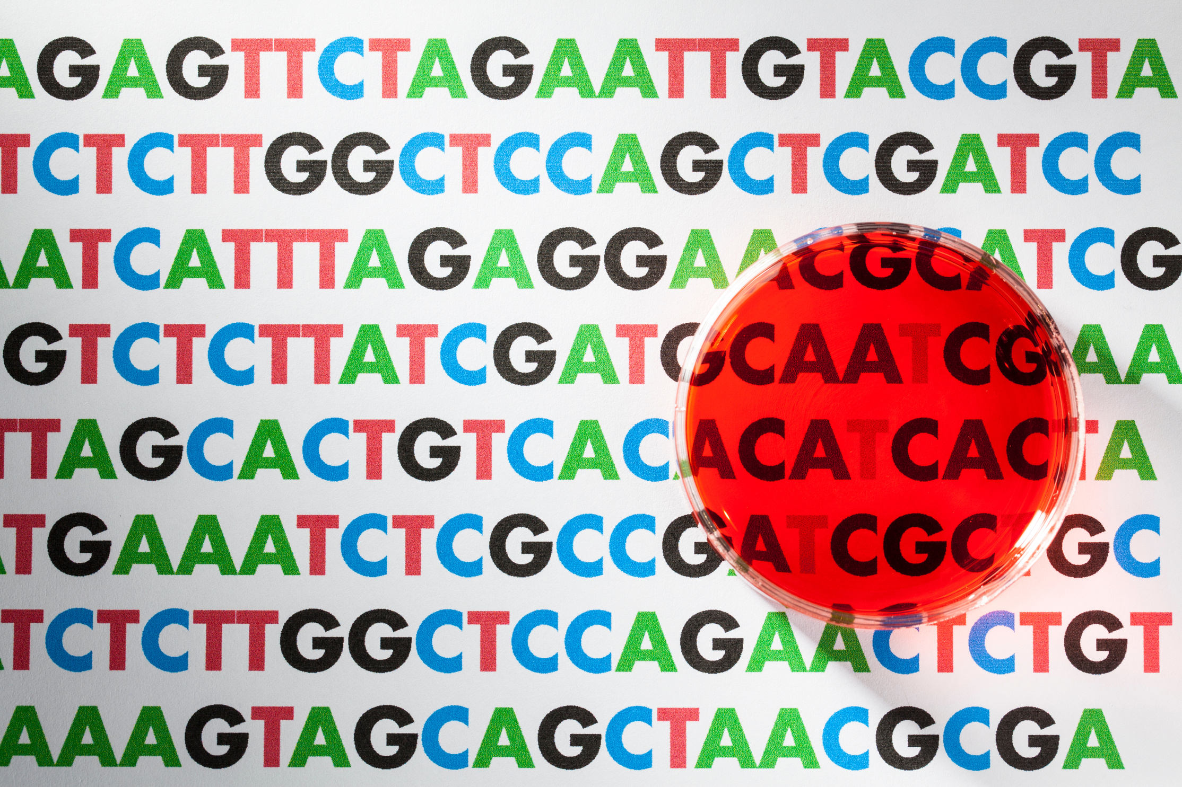
CASE STUDY:
SEQUENCING
FOR A DIAGNOSIS
In June 2019, Christina and Daniel Kettler were barely home from the hospital with their newborn, Fitz, when they received an urgent phone call. They needed to rush back immediately.
Notes:
https://www.illumina.com/company/news-center/feature-articles/baby-fitz-life-saving-diagnosis-whole-genome-sequencing.html#:~:text=Quarantined%20at%20birth,function%20properly%20and%20support%20Fitz
In June 2019, Christina and Daniel Kettler were barely home from the hospital with their newborn, Fitz, when they received an urgent phone call. They needed to rush back immediately.

Slide 25
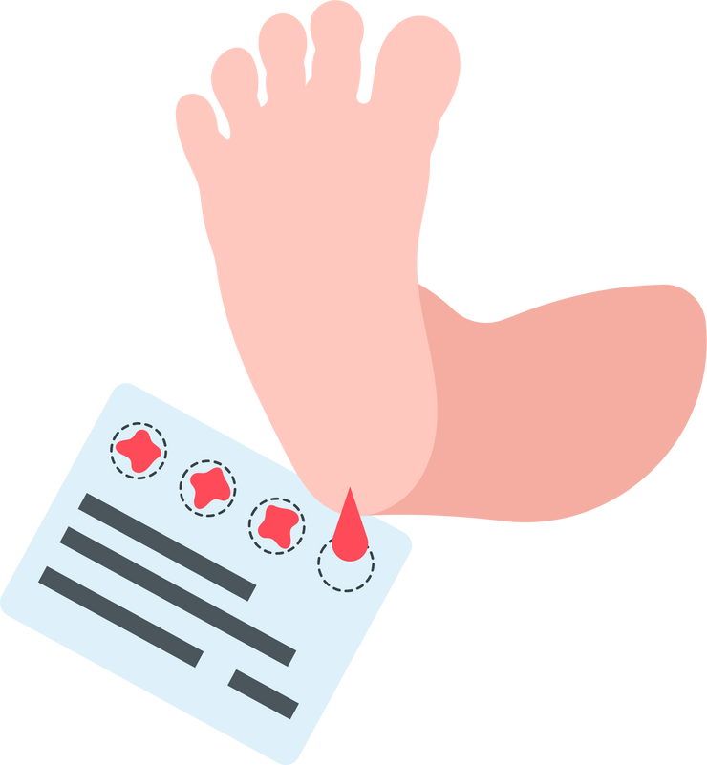
QUARANTINED AT BIRTH
A routine newborn screening, called the heel stick test, had revealed that Fitz had a rare condition called Severe Combined Immunodeficiency (SCID).
Notes:
A routine newborn screening, called the heel stick test, had revealed that Fitz had a rare condition called Severe Combined Immunodeficiency (SCID). SCID is caused by mutations in genes involved in the development and function of immune cells. The immune system is severely impaired, leading to a lack of functional T cells and B cells, which are crucial for fighting infections.
Symptoms usually appear in the first few months of life, as infants with SCID are unable to defend themselves against common infections. Many babies with SCID do not live to see their first birthday because a cold can be fatal.

Slide 26
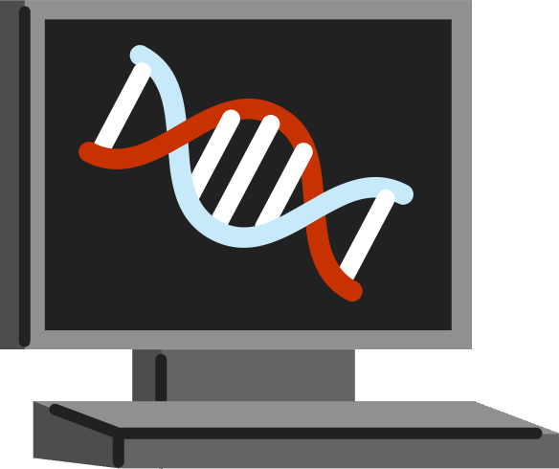
WHOLE GENOME SEQUENCING
Rapid Whole-Genome Sequencing was performed to identify the specific type of SCID Fitz had. He was diagnosed with “Artemis”, or ART-SCID, in less than four days.
Notes:
A routine newborn screening, called the heel stick test, had revealed that Fitz had a rare condition called Severe Combined Immunodeficiency (SCID). SCID is caused by mutations in genes involved in the development and function of immune cells. The immune system is severely impaired, leading to a lack of functional T cells and B cells, which are crucial for fighting infections.
Symptoms usually appear in the first few months of life, as infants with SCID are unable to defend themselves against common infections. Many babies with SCID do not live to see their first birthday because a cold can be fatal.

Slide 27
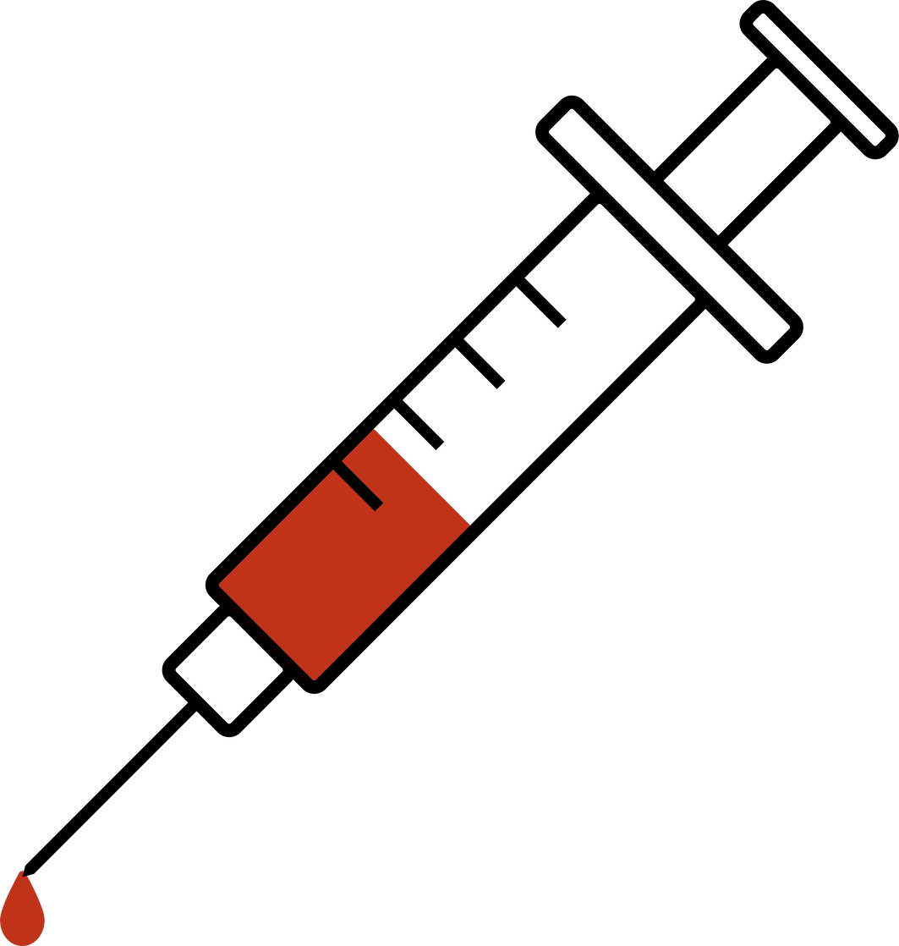



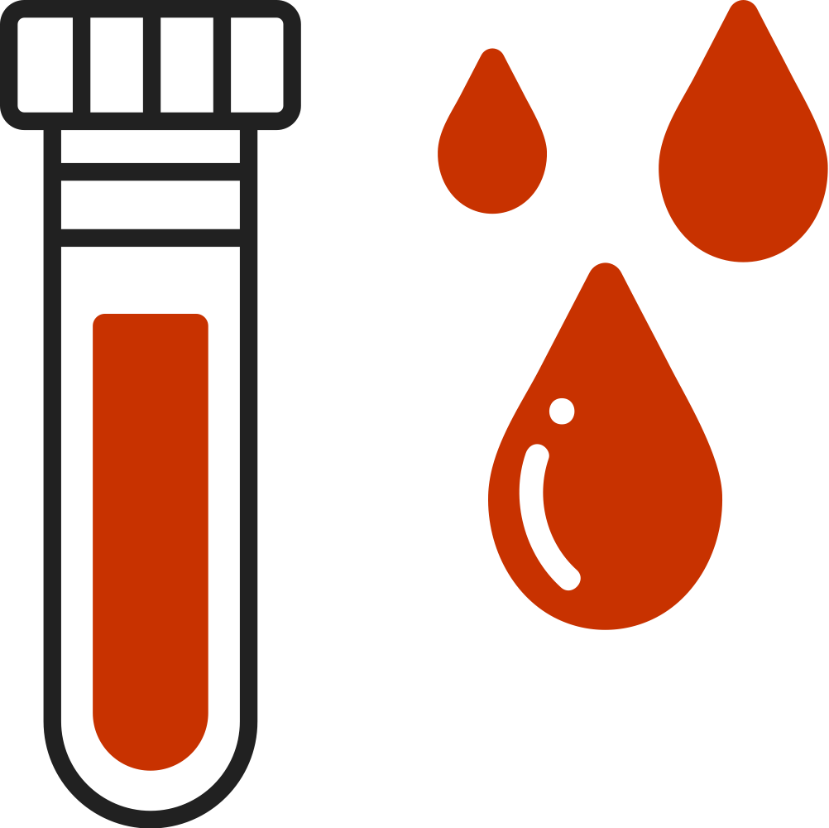
GENE THERAPY CLINICAL TRIAL
Because the Rady clinicians could name the specific gene mutation Fitz had, they knew he was eligible for a gene therapy clinical trial. Fitz was able to receive gene therapy in San Francisco.
Notes:
A routine newborn screening, called the heel stick test, had revealed that Fitz had a rare condition called Severe Combined Immunodeficiency (SCID). SCID is caused by mutations in genes involved in the development and function of immune cells. The immune system is severely impaired, leading to a lack of functional T cells and B cells, which are crucial for fighting infections.
Symptoms usually appear in the first few months of life, as infants with SCID are unable to defend themselves against common infections. Many babies with SCID do not live to see their first birthday because a cold can be fatal.

Slide 28
  01
  GENOME SEQUENCING
  GENETICS & PRECISION MEDICINE
  02
  PHARMACOGENOMICS
  03
  GENOME EDITING

Slide 29
PHARMACO-GENOMICS
Pharmacogenomics involves using a person’s DNA to determine medication...
  Safety,
  Efficacy,
  Dosing,
  & guide new drug development

Slide 30
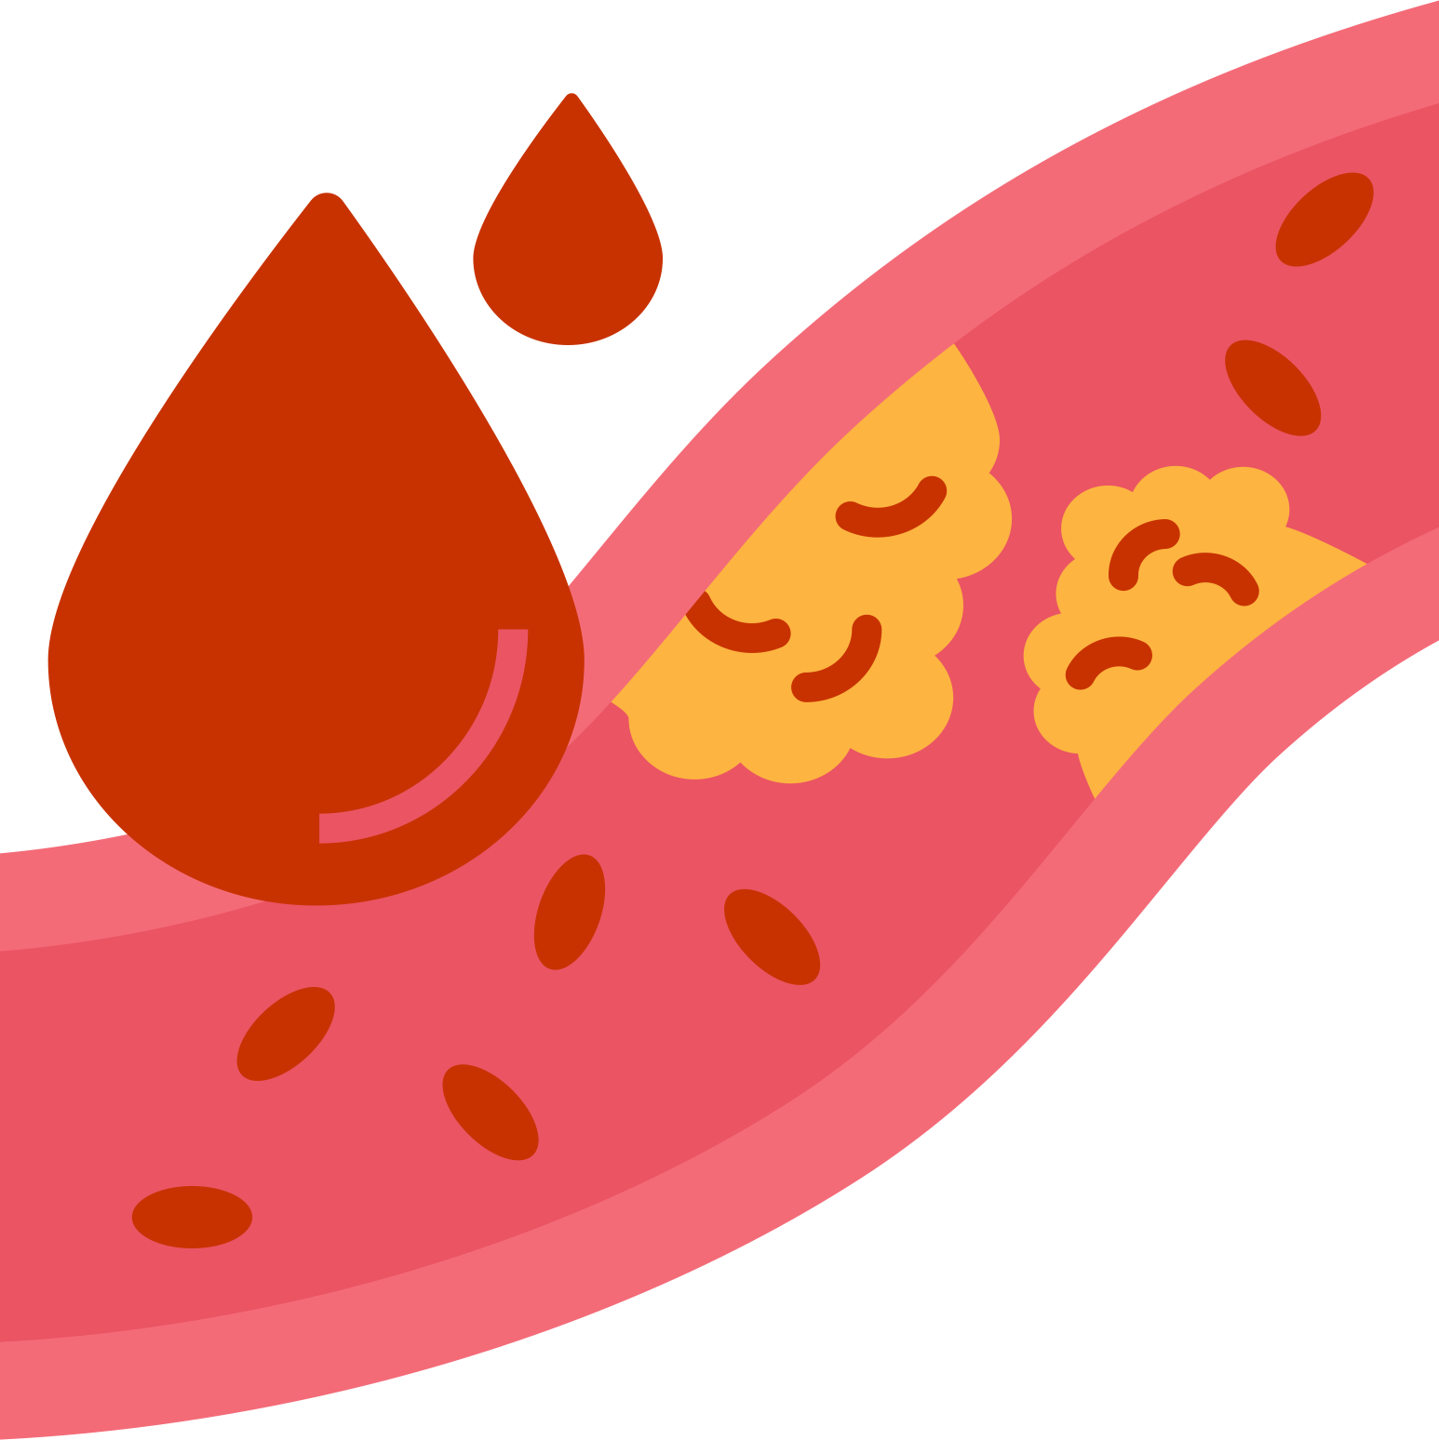

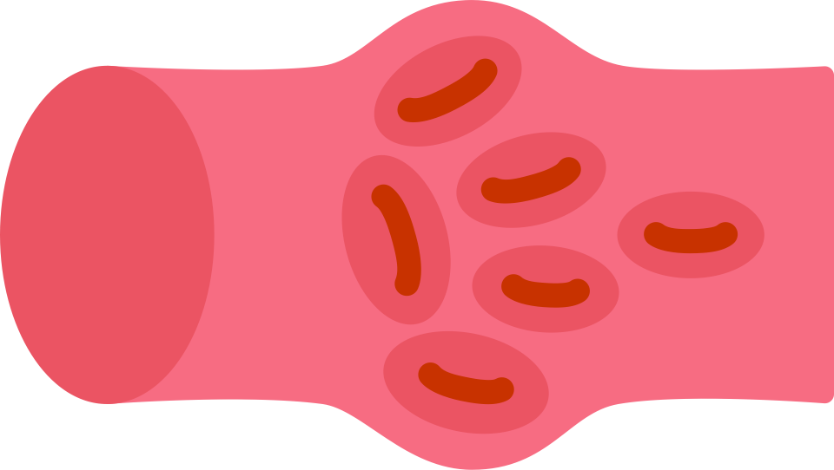

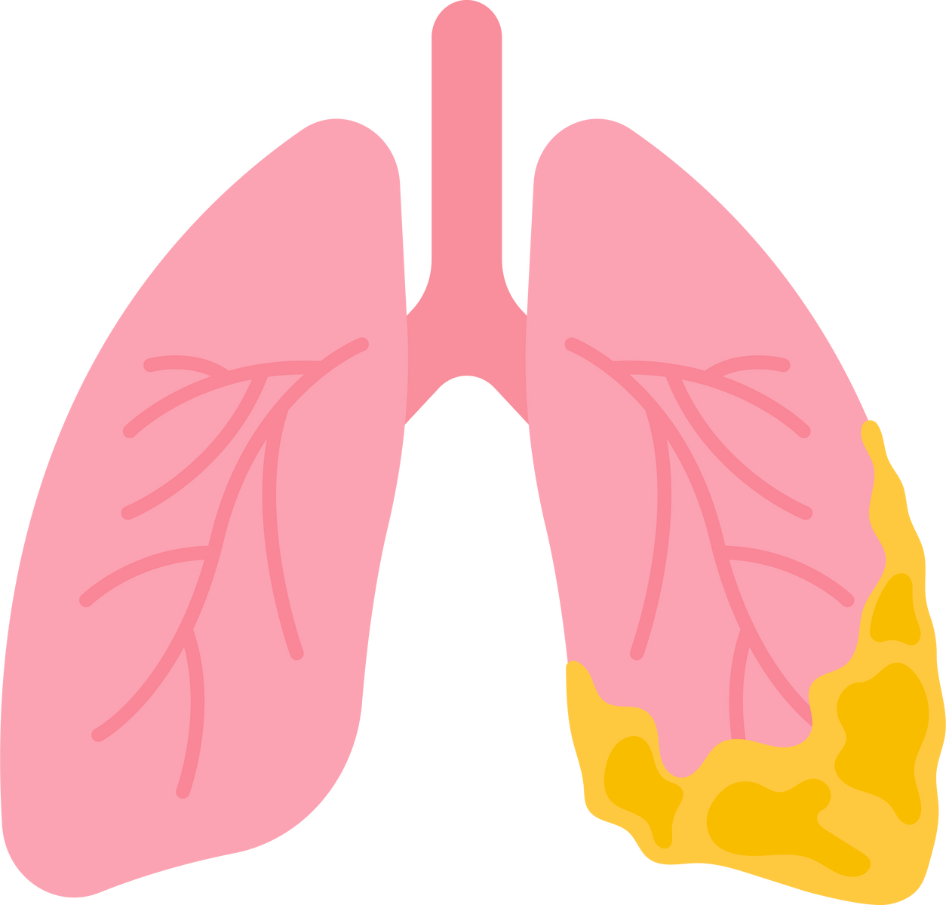

EXAMPLES OF MEDICATION
Medications that use a precision medicine approach to treatment:
Warfarin
Blood clots
Simvastatin
High cholesterol
Trastuzumab
Breast cancer
Amitriptyline
Depression
Ivacaftor
Cystic fibrosis
Tramadol
Pain
Notes:
A routine newborn screening, called the heel stick test, had revealed that Fitz had a rare condition called Severe Combined Immunodeficiency (SCID). SCID is caused by mutations in genes involved in the development and function of immune cells. The immune system is severely impaired, leading to a lack of functional T cells and B cells, which are crucial for fighting infections.
Symptoms usually appear in the first few months of life, as infants with SCID are unable to defend themselves against common infections. Many babies with SCID do not live to see their first birthday because a cold can be fatal.

Slide 31
EXAMPLES OF MEDICATION
Let’s take a closer look at Warfarin: a drug used to treat blood clots.
  How it works: It blocks the liver's ability to use Vitamin K, an essential nutrient for creating blood-clotting proteins.
Notes:
A routine newborn screening, called the heel stick test, had revealed that Fitz had a rare condition called Severe Combined Immunodeficiency (SCID). SCID is caused by mutations in genes involved in the development and function of immune cells. The immune system is severely impaired, leading to a lack of functional T cells and B cells, which are crucial for fighting infections.
Symptoms usually appear in the first few months of life, as infants with SCID are unable to defend themselves against common infections. Many babies with SCID do not live to see their first birthday because a cold can be fatal.

Slide 32
EXAMPLES OF MEDICATION
Let’s take a closer look at Warfarin: a drug used to treat blood clots.
  How it works: It blocks the liver's ability to use Vitamin K, an essential nutrient for creating blood-clotting proteins.
  Dosing: If too high, it can cause dangerous bleeding. If too low, it won't be effective at preventing clots.
Notes:
A routine newborn screening, called the heel stick test, had revealed that Fitz had a rare condition called Severe Combined Immunodeficiency (SCID). SCID is caused by mutations in genes involved in the development and function of immune cells. The immune system is severely impaired, leading to a lack of functional T cells and B cells, which are crucial for fighting infections.
Symptoms usually appear in the first few months of life, as infants with SCID are unable to defend themselves against common infections. Many babies with SCID do not live to see their first birthday because a cold can be fatal.

Slide 33
EXAMPLES OF MEDICATION
Let’s take a closer look at Warfarin: a drug used to treat blood clots.
  How it works: It blocks the liver's ability to use Vitamin K, an essential nutrient for creating blood-clotting proteins.
  Dosing: If too high, it can cause dangerous bleeding. If too low, it won't be effective at preventing clots.
  Genetics: Variations in genes such as CYP2C9 and VKORC1 influence how effective Warfarin will be in a person’s system.
Notes:
A routine newborn screening, called the heel stick test, had revealed that Fitz had a rare condition called Severe Combined Immunodeficiency (SCID). SCID is caused by mutations in genes involved in the development and function of immune cells. The immune system is severely impaired, leading to a lack of functional T cells and B cells, which are crucial for fighting infections.
Symptoms usually appear in the first few months of life, as infants with SCID are unable to defend themselves against common infections. Many babies with SCID do not live to see their first birthday because a cold can be fatal.

Slide 34
DO NOW: PHARMACOGENOMICS
  Why might a person want to use genetic information to make decisions about which medications and treatments to receive?

Slide 35
CASE STUDY:
CYSTIC FIBROSIS & TRIKAFTA
Emily Trout was 26 years old when she was listed for a double-lung transplant due to her cystic fibrosis.
Notes:
https://www.illumina.com/company/news-center/feature-articles/baby-fitz-life-saving-diagnosis-whole-genome-sequencing.html#:~:text=Quarantined%20at%20birth,function%20properly%20and%20support%20Fitz
In June 2019, Christina and Daniel Kettler were barely home from the hospital with their newborn, Fitz, when they received an urgent phone call. They needed to rush back immediately.

Slide 36
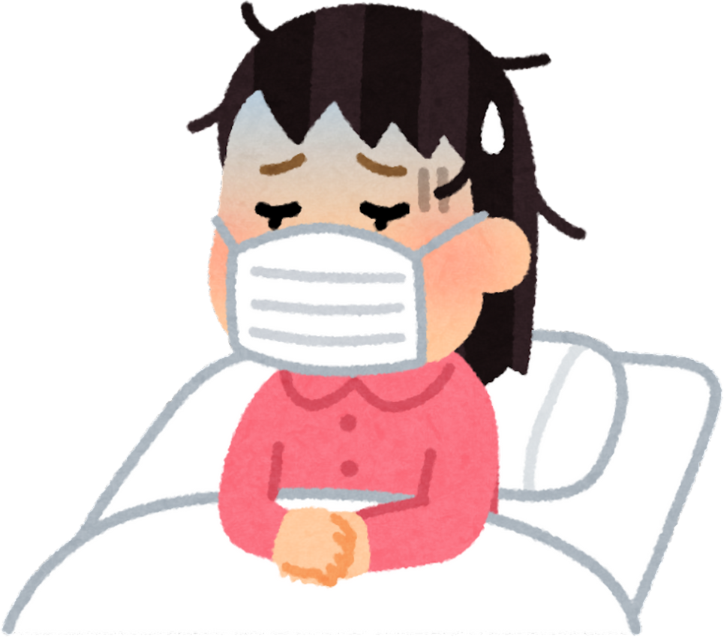
TRULY SICK ENOUGH FOR SURGERY?
Emily spent two years on the waiting list, focused on surviving each day and hoping for a call. She had declined significantly in those two years, and “felt silly for ever questioning whether [she] was sick enough to require such a radical surgery”.
Notes:
A routine newborn screening, called the heel stick test, had revealed that Fitz had a rare condition called Severe Combined Immunodeficiency (SCID). SCID is caused by mutations in genes involved in the development and function of immune cells. The immune system is severely impaired, leading to a lack of functional T cells and B cells, which are crucial for fighting infections.
Symptoms usually appear in the first few months of life, as infants with SCID are unable to defend themselves against common infections. Many babies with SCID do not live to see their first birthday because a cold can be fatal.

Slide 37
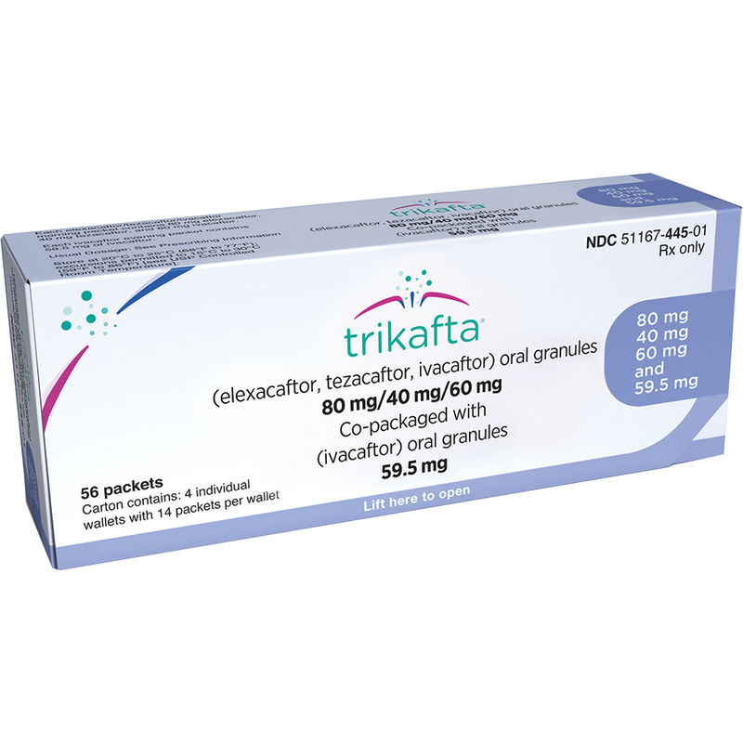
COMPASSIONATE TREATMENT
Emily was born with two rare CF gene variants. Doctors told her that the newest CF treatment, Trikafta, wasn’t designed for her variants. Though, a doctor offered to prescribe Trikafta for “compassionate use”.
Notes:
A routine newborn screening, called the heel stick test, had revealed that Fitz had a rare condition called Severe Combined Immunodeficiency (SCID). SCID is caused by mutations in genes involved in the development and function of immune cells. The immune system is severely impaired, leading to a lack of functional T cells and B cells, which are crucial for fighting infections.
Symptoms usually appear in the first few months of life, as infants with SCID are unable to defend themselves against common infections. Many babies with SCID do not live to see their first birthday because a cold can be fatal.

Slide 38
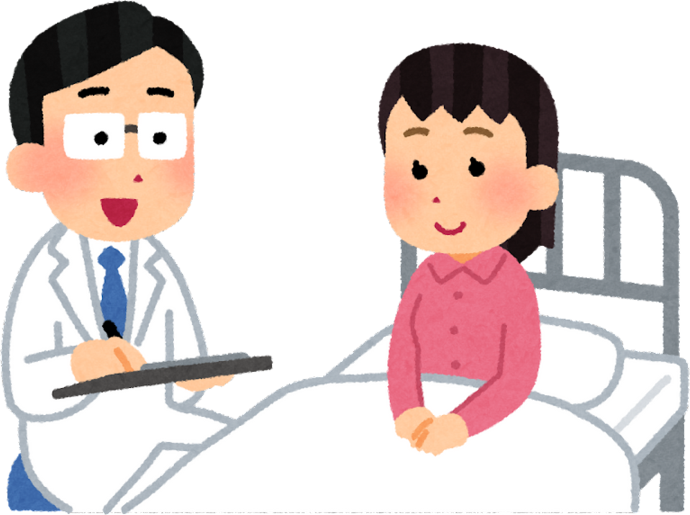
NO LONGER ON THE LIST
Within five days, Emily was out of the hospital. She stopped coughing to the point of turning purple. When her lung function increased by about 35%, she was taken off the transplant list.
Notes:
A routine newborn screening, called the heel stick test, had revealed that Fitz had a rare condition called Severe Combined Immunodeficiency (SCID). SCID is caused by mutations in genes involved in the development and function of immune cells. The immune system is severely impaired, leading to a lack of functional T cells and B cells, which are crucial for fighting infections.
Symptoms usually appear in the first few months of life, as infants with SCID are unable to defend themselves against common infections. Many babies with SCID do not live to see their first birthday because a cold can be fatal.

Slide 39
  01
  GENOME SEQUENCING
  GENETICS & PRECISION MEDICINE
  02
  PHARMACOGENOMICS
  03
  GENOME EDITING

Slide 40
GENOME EDITING
  Scientists are developing gene editing tools for certain genetic conditions that ease symptoms by targeting the underlying genetic cause.
  Only a few gene editing treatments have been approved for clinical use.

Slide 41
DO NOW: GENOME EDITING
  If you were offered a genome editing-based treatment for a health condition, what questions would you have for your doctor?

Slide 42
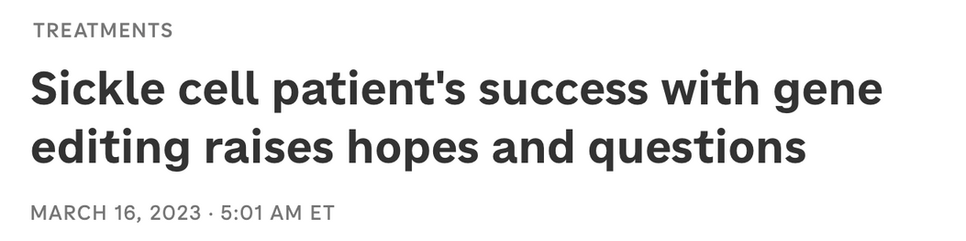

CASE STUDY:
SICKLE CELL DISEASE
NPR
In 2019, Victoria Gray became the first person to undergo a clinical trial using gene editing to modify her red blood cells to treat sickle cell disease (SCD).
Image credit: Victoria Gray (2026)
Notes:
https://www.illumina.com/company/news-center/feature-articles/baby-fitz-life-saving-diagnosis-whole-genome-sequencing.html#:~:text=Quarantined%20at%20birth,function%20properly%20and%20support%20Fitz
In June 2019, Christina and Daniel Kettler were barely home from the hospital with their newborn, Fitz, when they received an urgent phone call. They needed to rush back immediately.

Slide 43
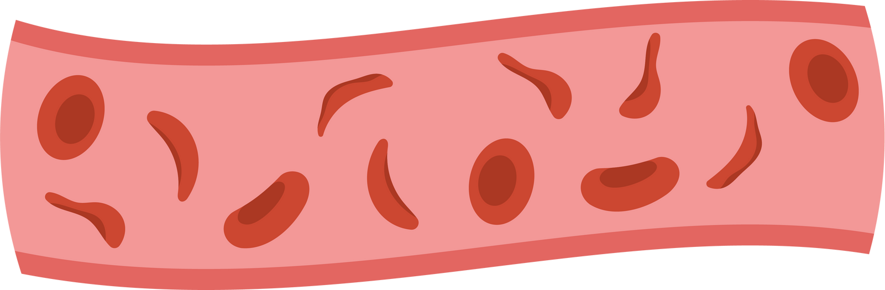
SICKLE CELL DIAGNOSIS
Victoria was diagnosed with sickle cell disease at 3 months old, when she experienced her first pain crisis. These sickle cell crises continued to occur and worsen throughout Victoria’s life. Eventually, Victoria experienced a crisis that left her unable to use her arms and legs.
Notes:
A routine newborn screening, called the heel stick test, had revealed that Fitz had a rare condition called Severe Combined Immunodeficiency (SCID). SCID is caused by mutations in genes involved in the development and function of immune cells. The immune system is severely impaired, leading to a lack of functional T cells and B cells, which are crucial for fighting infections.
Symptoms usually appear in the first few months of life, as infants with SCID are unable to defend themselves against common infections. Many babies with SCID do not live to see their first birthday because a cold can be fatal.

Slide 44
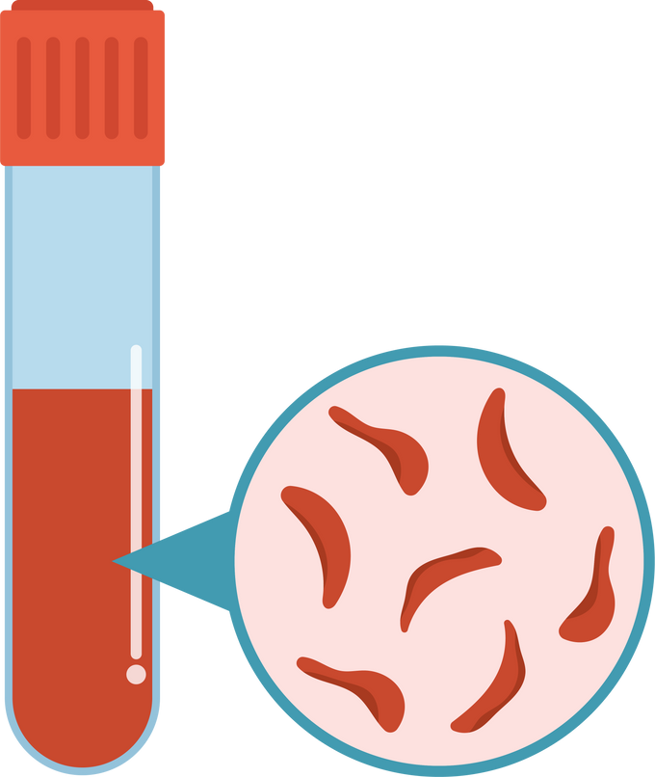

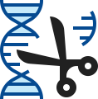
CRISPR GENE THERAPY
After over 30 years of crises and severe pain, Victoria prayed for something to change. She was prepared to undergo a bone marrow transplant using stem cells from her brother. She was in the hospital when a doctor asked if she had ever heard of CRISPR gene therapy.
Notes:
A routine newborn screening, called the heel stick test, had revealed that Fitz had a rare condition called Severe Combined Immunodeficiency (SCID). SCID is caused by mutations in genes involved in the development and function of immune cells. The immune system is severely impaired, leading to a lack of functional T cells and B cells, which are crucial for fighting infections.
Symptoms usually appear in the first few months of life, as infants with SCID are unable to defend themselves against common infections. Many babies with SCID do not live to see their first birthday because a cold can be fatal.

Slide 45
PAIN-FREE
“I would never have been able to walk this long before... It's a huge difference — night and day. I feel like I got a second chance."
2023 NPR interview
After months of an experimental cell treatment, four rounds of chemotherapy, and blood transfusions, Victoria woke up pain-free after 34 years of sickle cell pain and crises.
Notes:
A routine newborn screening, called the heel stick test, had revealed that Fitz had a rare condition called Severe Combined Immunodeficiency (SCID). SCID is caused by mutations in genes involved in the development and function of immune cells. The immune system is severely impaired, leading to a lack of functional T cells and B cells, which are crucial for fighting infections.
Symptoms usually appear in the first few months of life, as infants with SCID are unable to defend themselves against common infections. Many babies with SCID do not live to see their first birthday because a cold can be fatal.

Slide 46
DO NOW: SUMMARY
  How is “treating the patient” different from “treating the condition”?
  How might precision medicine change the future of health?

Slide 47
REFLECTION ACTIVITY
Reflect on what you’ve learned about precision medicine during class.
  List one benefit and one risk of delivering precision medicine.
  What ELSI issues should be considered when using a precision medicine approach to treat patients?
  What questions or concerns do you have about how your genetic information might be used to address your health issues in the future?

Slide 48
PRECISION MEDICINE PROJECT
Create an informational product that helps patients understand precision medicine.
Options include:
  Brochure
  Webpage
  Slide presentation
  Video
Choose one content area to focus on:
  Genome sequencing
  Pharmacogenomics
  Genome editing

Slide 49
THANKS FOR LISTENING!
FOR MORE ABOUT PERSONAL GENETICS,
VISIT PGED.ORG.

Slide 50
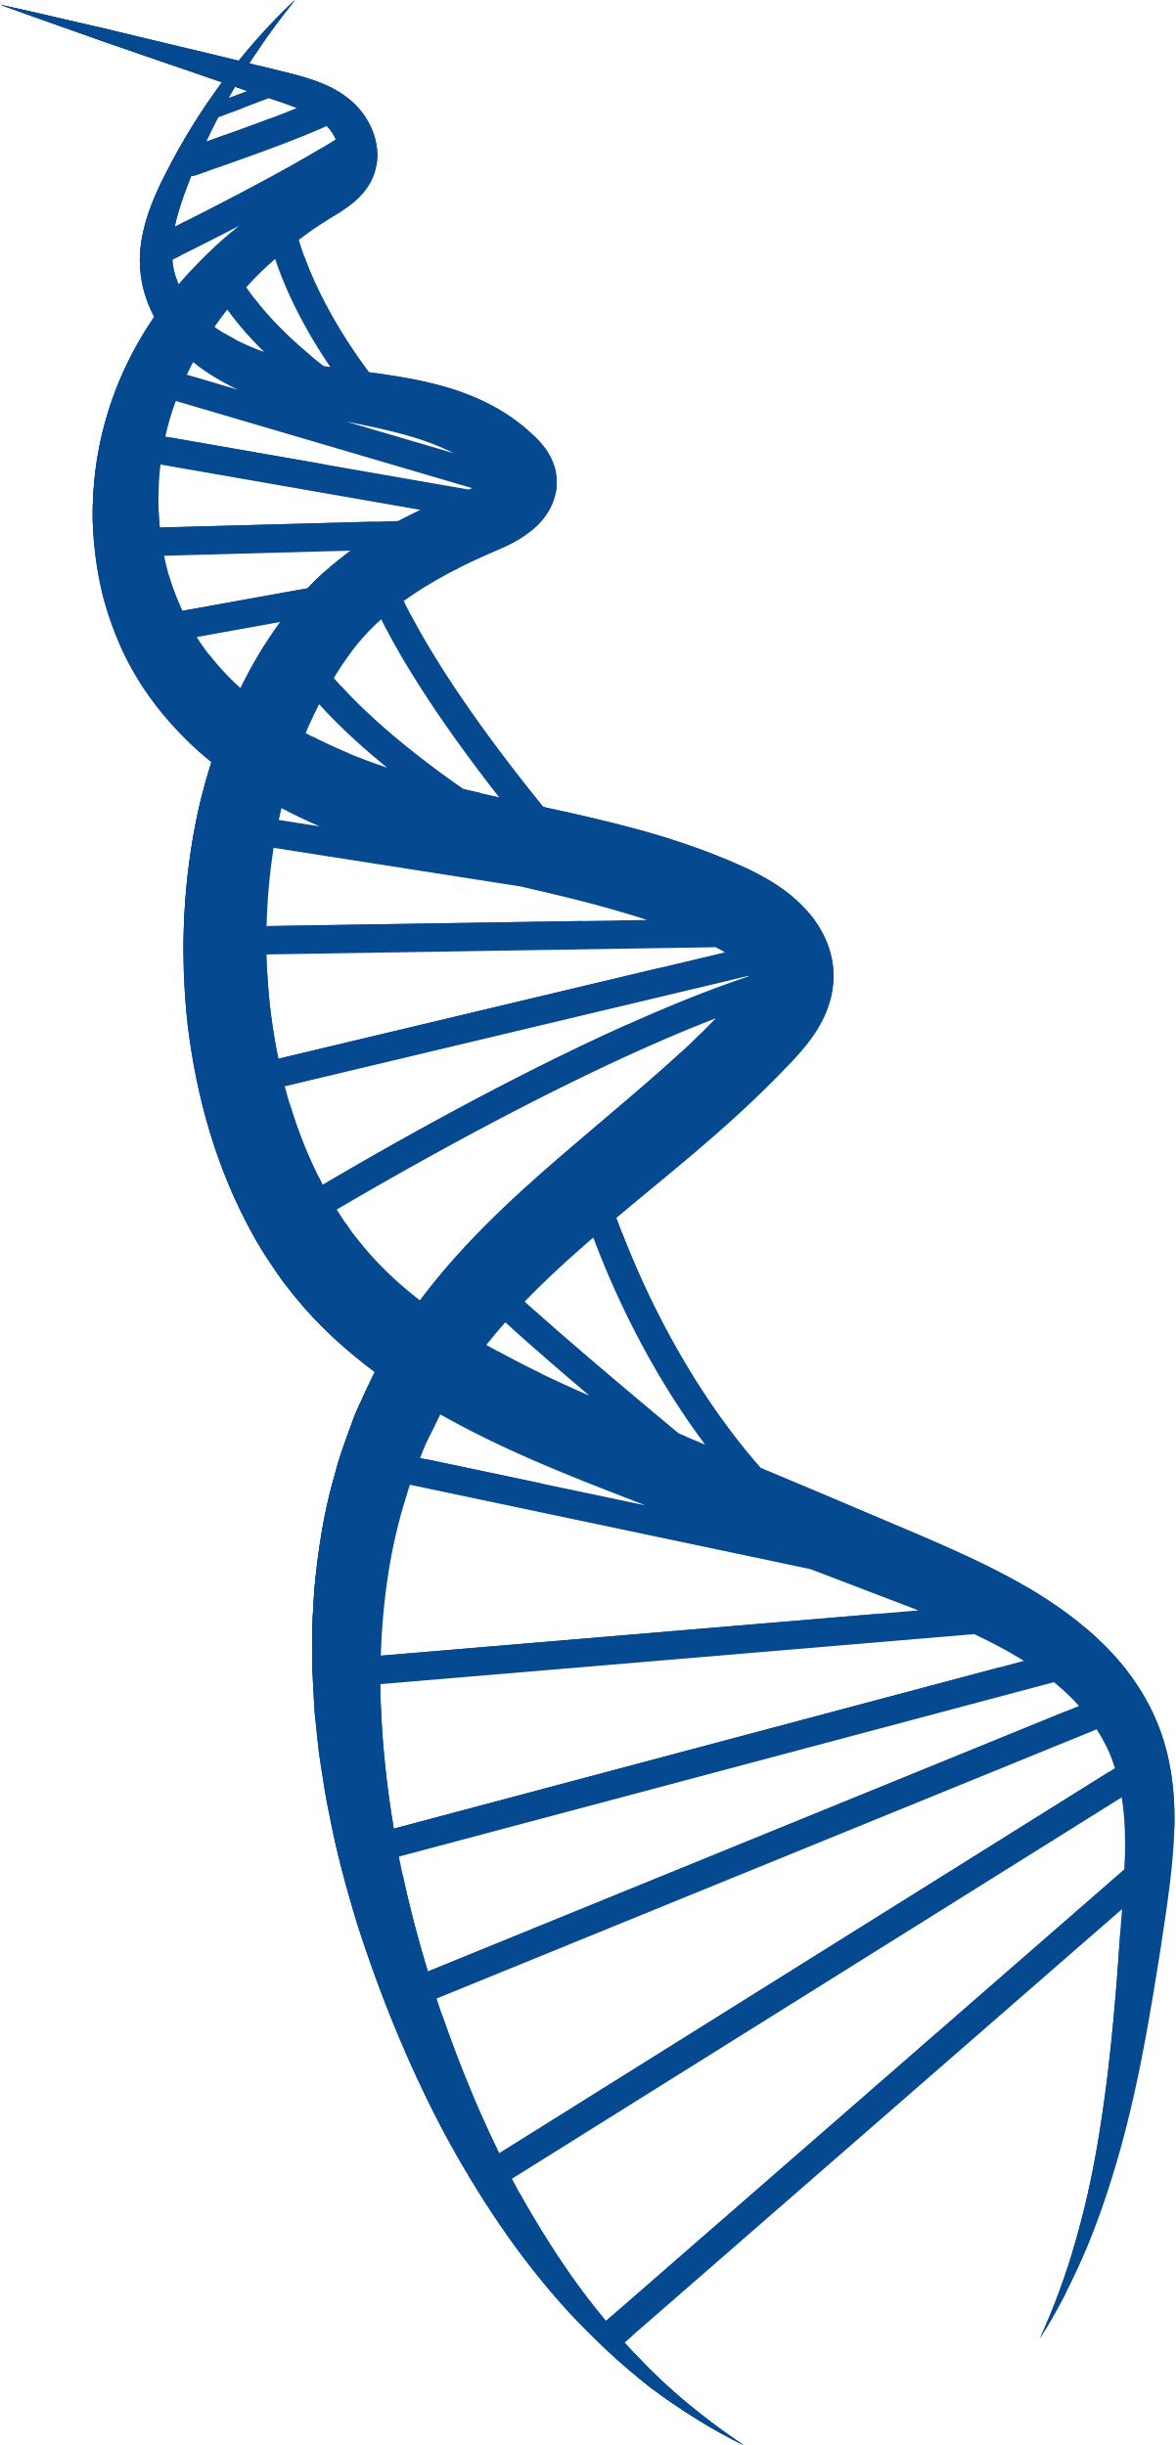


SCIENCE SUPPLEMENT
Chromosome
Nucleus
Gene
DNA molecule
Cell

