Slide 1






SHARE Your
Stance
on Personal Genetics

Slide 2


the goal of the game
What is the Goal?
The goal of the game is to identify your gut reaction to a complex or controversial idea about genetics and then build upon that idea by sharing it with others.
Players should not aim to be ‘right’, but rather to explore the complexity of the presented topics with others.
What Are the Rules?
Share Your Stance on Personal Genetics does not have typical game rules.
Rather, the “rules” for this game are gameplay agreements.
share Your Stance

Slide 3
GAMEPLAY AGREEMENTS
What Are Gameplay Agreements?
‘Gameplay agreements’, often referred to as ‘community agreements’, foster spaces intentionally shaped by, and inclusive of, all identities and social groups and encourage equitable participation of all people.
  Speak with kindness and respect.
  Converse with curiosity and empathy.
  Understand that the impact of your words can be different from the intent.
  Focus on learning, not debating.
  Critique ideas, not people.
  Welcome the option to change your mind.
  Allow each player to share their ideas.
share Your Stance

Slide 4
how to play
1) Gather 3-8 players. Prepare small pieces of paper for each player with one side labeled ‘agree’ &
the other ‘disagree’.
2) Designate one player to be the ‘reader’.
3) The reader flips over a challenge card & reads it silently. This will be their challenge for the round.
Then, they flip over a discussion card, read the ‘Big Idea’ out loud, & start a 20-second timer.
4) Before time is up, players decide whether they agree or disagree with the ‘Big Idea’ &
flip their paper to display their responses.
5) Starting with the person to the left of the reader, the players each share their responses & reasoning.
The reader shares last & completes their challenge.
6) The reader asks the discussion card’s ‘What If...?’ question. Players repeat the first part of step 5.
7) The reader places the cards in a ‘completed’ pile. The person to their left becomes the new reader.
Repeat steps 4-7 to play again!
share Your Stance

Slide 5
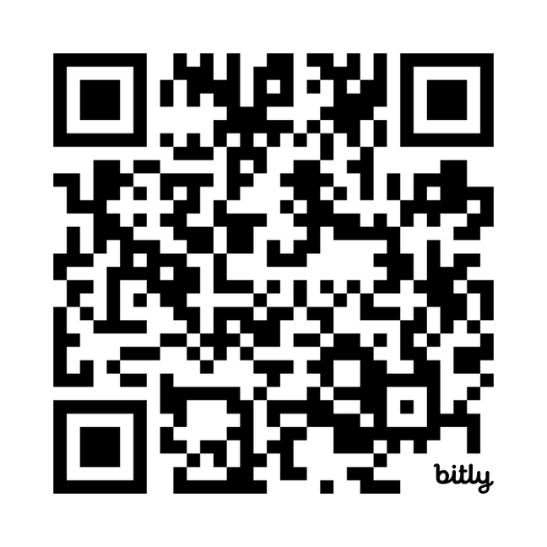
PARTICIPANT FEEDBACK FORM
Share Your Feedback with PGED
Use the QR code or link below to access the feedback form.
Participant Feedback Form
Link: bit.ly/4eD8uqV
share Your Stance

Slide 6

Ready
to play?
share Your Stance

Slide 7





AGRICULTURE

Slide 8
Nutritious food
1. THE BIG IDEA
2. WHAT IF...
We should genetically modify food crops to be more nutritious.
The genetically modified seeds were only made available to farmers in a limited number of countries?
share Your Stance

Slide 9
soil & crop health
1. THE BIG IDEA
2. WHAT IF...
Farmers should use genetically engineered microbes on their farmland to improve the health of their soil and crops.
It would be difficult to remove the microbes from the environment if they were later found to be causing ecological harm?
share Your Stance

Slide 10
GMO marketing
1. THE BIG IDEA
2. WHAT IF...
Milk that comes from a genetically modified dairy cow should be marketed as a GMO product.
The modification affects the cow’s horn size and not its milk production?
share Your Stance

Slide 11
crop traits
1. THE BIG IDEA
2. WHAT IF...
Farmers should grow genetically modified crops to increase crop yields.
The modified genes increased the crop’s sensitivity to drought or pests?
share Your Stance

Slide 12
MAKING MORE MEAT
1. THE BIG IDEA
2. WHAT IF...
I would eat meat from animals that were genetically modified to produce more muscle.
The meat was lab-grown from animal cells (not an entire living animal)?
share Your Stance

Slide 13



PRIVACY

Slide 14
DNA DATABASES
1. THE BIG IDEA
2. WHAT IF...
Law enforcement should be able to search ancestry companies’ DNA databases to identify criminals.
Law enforcement was trying to identify human remains from a cold case?
share Your Stance

Slide 15
employer decisions
1. THE BIG IDEA
2. WHAT IF...
Employers should be able to make hiring or firing decisions based on an employee’s genetic health risks.
Employers instead used genetic health information to choose work assignments and offer preventative health benefits?
share Your Stance

Slide 16
personal dna
info access
1. THE BIG IDEA
2. WHAT IF...
People should be able to learn whatever they want about their DNA because it is their body.
Parents could learn whatever they want to know about their child’s DNA before they turn 18?
share Your Stance

Slide 17
insurance coverage
1. THE BIG IDEA
2. WHAT IF...
Insurance companies should be able to request genetic information from the people they cover.
Coverage could be provided for preventative care for a person with an increased health risk?
share Your Stance

Slide 18
DATING RELATIONSHIPS
1. THE BIG IDEA
2. WHAT IF...
I would want to know if someone I was seriously dating had a strong predisposition for a genetic condition.
You were the one with the genetic predisposition?
share Your Stance

Slide 19






ENVIRONMENT

Slide 20
extinct species
1. THE BIG IDEA
2. WHAT IF...
Scientists should use genetic technologies to revive extinct animal species.
Scientists proposed to revive extinct plant species?
share Your Stance

Slide 21
atmospheric co2
1. THE BIG IDEA
2. WHAT IF...
We should genetically engineer trees to store more carbon from the atmosphere to slow the effects of global warming.
The genetically engineered trees grew faster and reproduced more quickly than unmodified trees?
share Your Stance

Slide 22
INSECT ERADICATION
1. THE BIG IDEA
2. WHAT IF...
Scientists should eradicate disease-carrying mosquito populations by editing their DNA.
Mosquito eradication had a lasting effect on the ecosystem and human population?
share Your Stance

Slide 23
RADIATION &
SPACE TRAVEL
1. THE BIG IDEA
2. WHAT IF...
Astronauts should modify their DNA to be less susceptible to the effects of radiation during space travel.
These same modifications could be used by non-astronauts to prevent skin cancer?
share Your Stance

Slide 24
pollutant removal
1. THE BIG IDEA
2. WHAT IF...
We should use genetically engineered microbes to break down plastics in landfills.
We used them to clean pollutants created by industrial processes?
share Your Stance

Slide 25
ANCESTRY

Slide 26
personal identity
1. THE BIG IDEA
2. WHAT IF...
My ancestry is an important part of my identity.
A genetic ancestry test revealed that your ancestry differed from what you expected?
share Your Stance

Slide 27
unknown relatives
1. THE BIG IDEA
2. WHAT IF...
I would take a genetic test to connect with unknown relatives.
You learned you had a sibling or half-sibling?
share Your Stance

Slide 28
Painful Past
1. THE BIG IDEA
2. WHAT IF...
I would tell my relatives if I learned something painful or shocking about our family’s past from a DNA ancestry test.
The people involved are still alive?
share Your Stance

Slide 29
sharing
family history
1. THE BIG IDEA
2. WHAT IF...
Adopted & donor-conceived children should have access to all known information about their family history & ancestry.
You were the biological parent of an adopted or donor-conceived child, and the child was seeking information about you?
share Your Stance

Slide 30
monetizing data
1. THE BIG IDEA
2. WHAT IF...
Ancestry testing companies should have the right to sell customers’ genetic data to third parties.
Customers were paid by the ancestry company to provide their data?
share Your Stance

Slide 31
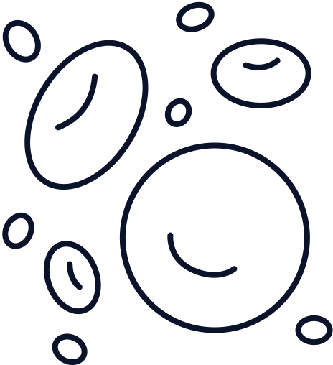



HUMAN HEALTH

Slide 32
biohacking
1. THE BIG IDEA
2. WHAT IF...
People should be able to modify their DNA as a genetic “biohack” to improve their health.
People want to biohack their DNA to change traits unrelated to their health?
share Your Stance

Slide 33
disease prevention
1. THE BIG IDEA
2. WHAT IF...
I want to find out my likelihood of developing a health condition only if there are ways to prevent or treat it.
The health condition could be passed on to your children?
share Your Stance

Slide 34
ORGAN transplants
1. THE BIG IDEA
2. WHAT IF...
I would accept an organ transplant from a pig.
The transplant is a temporary solution until a human organ is available?
share Your Stance

Slide 35
GENE THERAPY
1. THE BIG IDEA
2. WHAT IF...
I would accept gene therapy to treat a life-limiting health condition.
You would be the first person in the world to receive the treatment?
share Your Stance

Slide 36
FAMILy HEALTH
1. THE BIG IDEA
2. WHAT IF...
Relatives should share their genetic health information so people can better understand their familial health risks.
You would learn that you have a significantly increased risk for a serious health condition?
share Your Stance

Slide 37
CHALLENGE CARDS

Slide 38

perspective shift
THE CHALLENGE
Answer the opposite of your gut reaction to this topic.
share Your Stance

Slide 39

gut feeling
THE CHALLENGE
Give one word to describe how you feel about this topic.
share Your Stance

Slide 40

double trouble
THE CHALLENGE
Share two reasons for your response to the Big Idea.
share Your Stance

Slide 41

known unknowns
THE CHALLENGE
What do you wish you knew about this topic? How might you find out?
share Your Stance

Slide 42

appreciate an
alternative
THE CHALLENGE
Of the players who disagreed with you, identify who you think made the strongest case and give them props!
share Your Stance

Slide 43

on the contrary
THE CHALLENGE
Identify the most popular response shared among the group. Articulate an opposing viewpoint.
share Your Stance

Slide 44

ask your own
THE CHALLENGE
Ask your own 'What if…?’ question in place of the question on the discussion card.
share Your Stance

Slide 45

picture this
THE CHALLENGE
Identify a story (movie, book, article, etc.) that has influenced your perspective on this topic. How was the topic portrayed?
share Your Stance

Slide 46

family matters
THE CHALLENGE
Consider conversations you’ve had with family or friends about this topic or something related. What ideas emerged?
share Your Stance

Slide 47

back in time
THE CHALLENGE
Would your perspective on this topic change if you were 5-10 years younger than you are now?
share Your Stance

Slide 48

look into
the future
THE CHALLENGE
Imagine you are 20 years older than you are now. Would your perspective on this topic change?
share Your Stance

Slide 49

value judgement
THE CHALLENGE
Identify a core value that guides your perspective on this topic. Why is this value important to you?
share Your Stance

Slide 50



challenge
assumptions
THE CHALLENGE
Identify one assumption you have about this topic. Would your perspective change if your assumption was incorrect?
share Your Stance

Slide 51
thank you
for playing!

