Slide 1



Using Primary Sources to Examine the History of Eugenics
Adapted for PBS LearningMedia in partnership with WETA for use with:
2020

Slide 2
Photo: 1926. Source: American Philosophical Society, AES, Am3,575.06,44
Notes:
This display is from a Midwestern state fair in the Unites States in the 1920s. Large posters and displays about genetics became common at state fairs during this time, where there was often information about genetics related to animal breeding. The display highlights the idea that people with genetic disorders, or with perceived genetic “weaknesses”, were a burden to society. It also promoted the idea that there were people born of “inferior” or “superior” stock. Part of the goal was to promote parents of “good stock” to have large families.
Image: "Flashing light exhibit at Fitter Families Contests”, 1926. Source: American Philosophical Society, AES, Am3,575.06,44. Accessed via the Eugenics Image Archive, Dolan DNA Learning Center, Cold Spring Harbor Laboratory, ID# 5 (http://www.eugenicsarchive.org/eugenics/view_image.pl?id=5, accessed March 2, 2020).

Slide 3
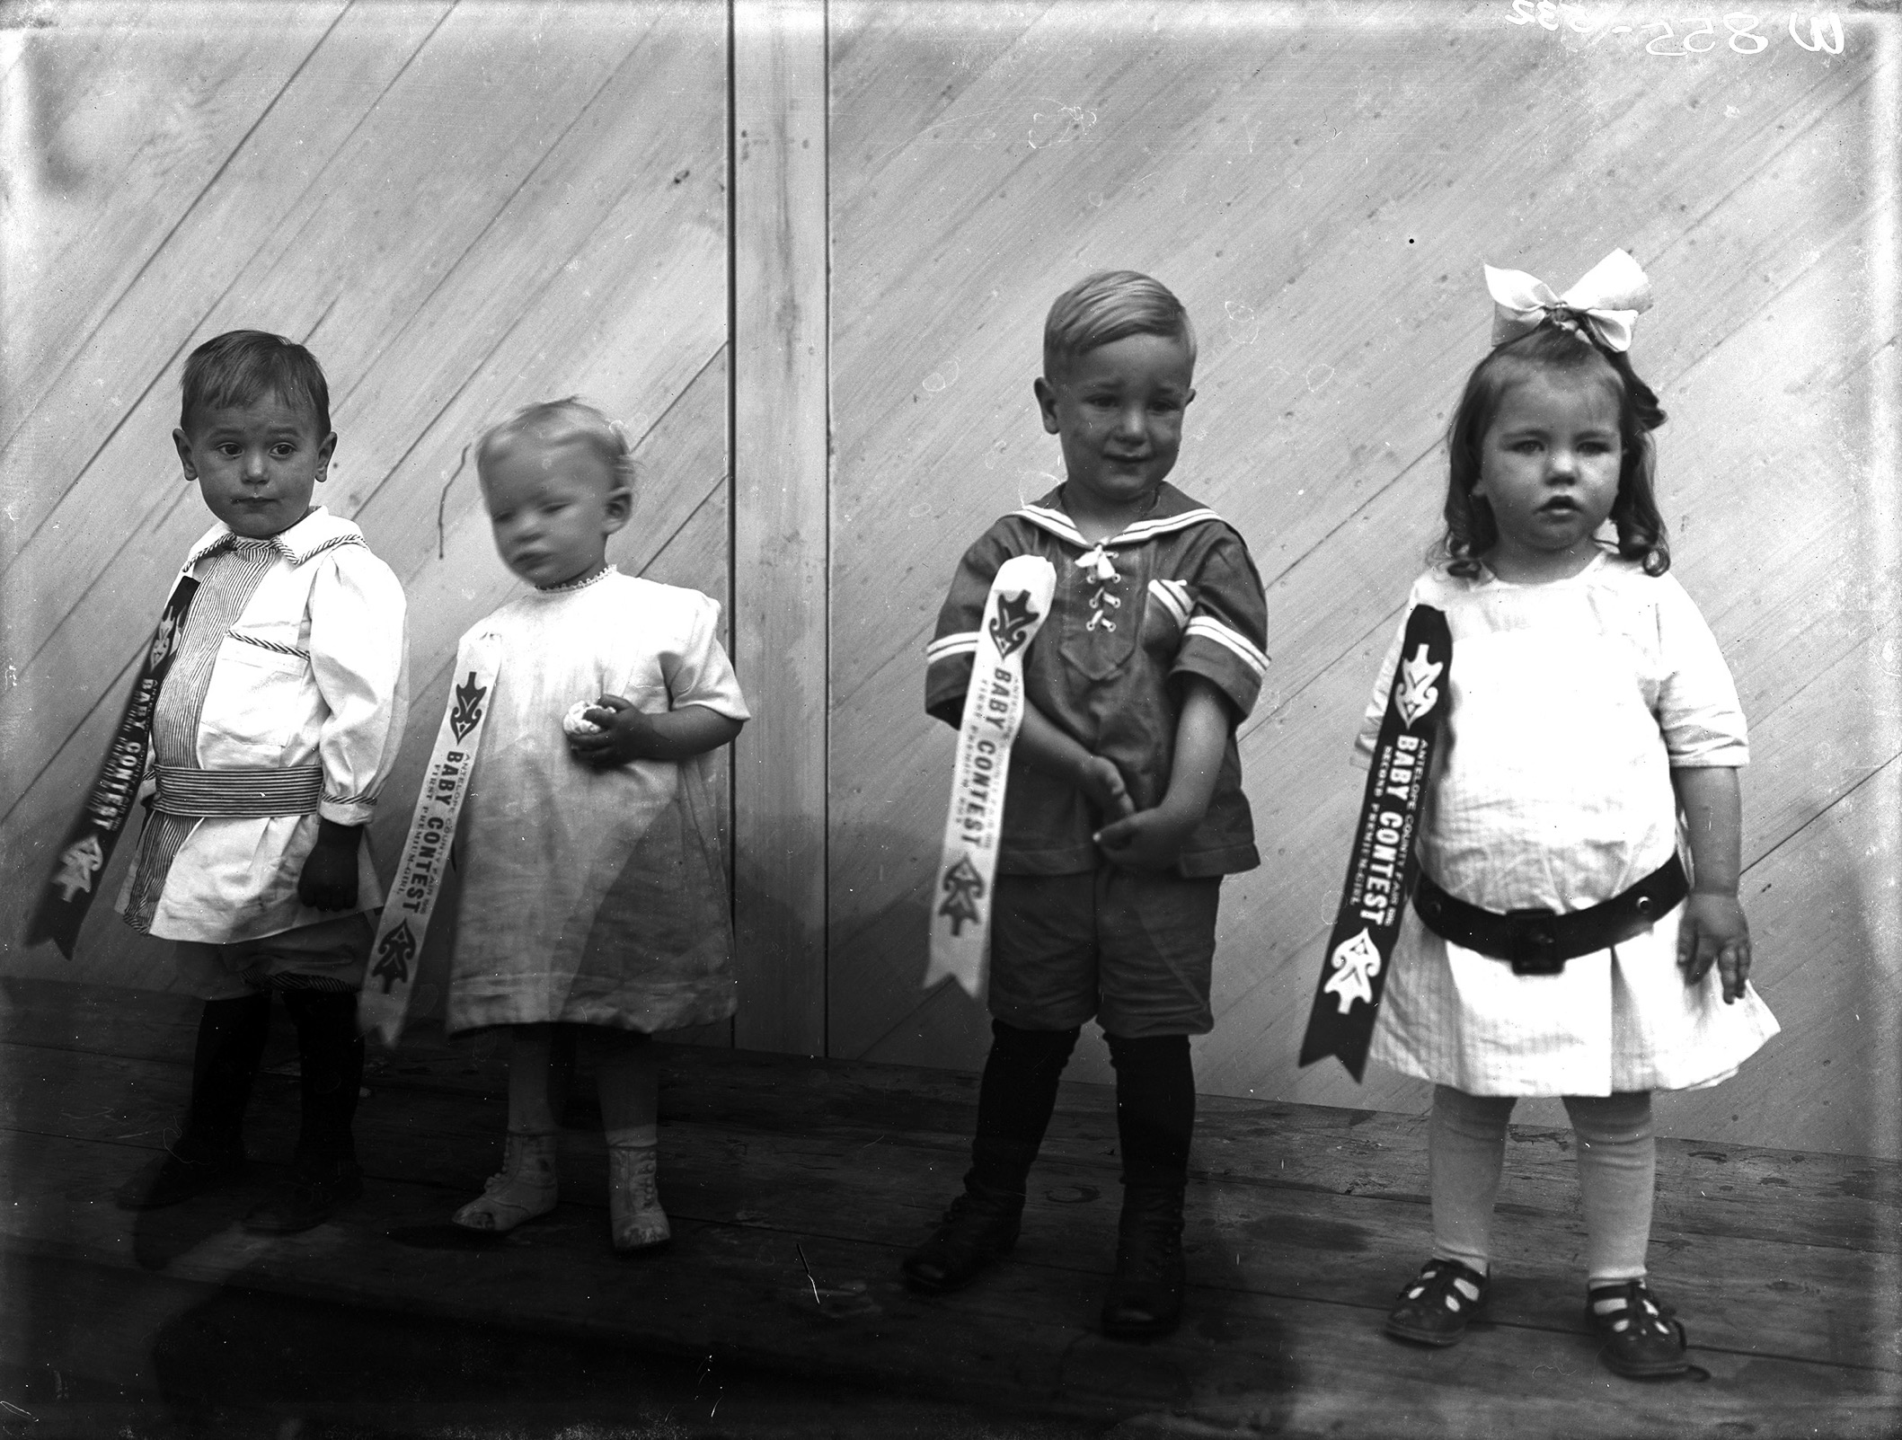
Photo by Emanuel Wolfe (1858-1933). Source: Nebraska State Historical Society, NSHS RG2836.PH0-532
Photo: circa 1925. Source: American Philosophical Society,
Fitter Families Collection, 2000.1301
Notes:
The image on the left, from a state fair, is of a “Better Baby Contest”. The contests began as a way to promote health in children and to educate parents about taking care of babies and young children. As the events evolved, children were judged on various categories related to mental and physical development. Criteria could range from height to behavior to stubbiness of fingers. The image on the right is of a prize metal awarded in such a contest. You can learn more here.
Image (left): Photo by Emanuel Wolfe (1858-1933). Source: Nebraska State Historical Society, NSHS RG2836.PH0-532.
Image (right): "Yea I Have a Goodly Heritage”, circa 1925. Source: American Philosophical Society, Fitter Families Collection, 2000.1301. Accessed via the Eugenics Image Archive, Dolan DNA Learning Center, Cold Spring Harbor Laboratory, ID# 1564 (http://www.eugenicsarchive.org/eugenics/view_image.pl?id=1564, accessed March 2, 2020).

Slide 4
Photo: circa 1929. Source: American Philosophical Society, Fitter Families Collection, 2000.1285
Photo: circa 1929. Source: American Philosophical Society, Fitter Families Collection, 2000.1284
Notes:
This pamphlet for the Kansas Free Fair was produced in 1929 by the American Eugenics Society, which promoted “racial betterment” and eugenic health. The goal of such a pamphlet was to encourage eugenic marriage and mate selection. It also provides insight into some of the misconceptions of eugenicists, including the belief that traits such as feeblemindedness, criminality, and pauperism were inherited traits.
Image (left): "Unfit Human Traits" and "Triangle of Life.”, circa 1929. Source: American Philosophical Society, Fitter Families Collection, 2000.1285. Accessed via the Eugenics Image Archive, Dolan DNA Learning Center, Cold Spring Harbor Laboratory, ID# 1568 (http://www.eugenicsarchive.org/eugenics/view_image.pl?id=1568, accessed March 2, 2020).
Image (right): "Marriages - Fit and Unfit”, circa 1929. Source: American Philosophical Society, Fitter Families Collection, 2000.1284. Accessed via the Eugenics Image Archive, Dolan DNA Learning Center, Cold Spring Harbor Laboratory, ID# 1567 (http://www.eugenicsarchive.org/eugenics/view_image.pl?id=1567, accessed March 2, 2020).

Slide 5
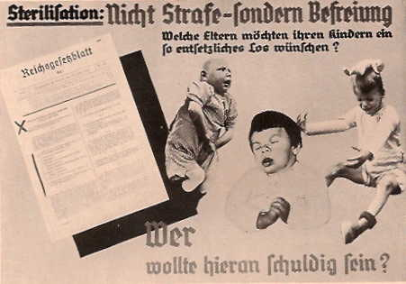
Translation German-English:
“Sterilization is liberation, not punishment”
“What parents would wish such a terrible fate for their children?”
“Who would want to be guilty of this?”
Published in Volk und Rasse, August 1936. Source: Calvin College German Propaganda Archive
Notes:
Published in Germany in 1936, this poster is part of a larger exhibition on race. The goal was to promote “positive” eugenics, encouraging healthy people to reproduce and have large families, under the mistaken assumption that healthy people did not have children with genetic disorders or heritable diseases. This particular poster promotes sterilization in order to prevent the birth of disabled children.
Image : "Sterilization is liberation, not a punishment.”, Volk und Rasse, August 1936. Accessed via the Calvin College German Propaganda Archive (https://research.calvin.edu/german-propaganda-archive/volkundrasse1936-8.htm, accessed March 2, 2020).

Slide 6
“There is no class of persons in our whole population who, unit for unit, are so dangerous or so expensive to the state; this excepts no class, not even the violently insane. These girls are much more dangerous and expensive than the ordinary insane or the ordinary feebleminded or the ordinary male criminal.
Why is this? They are dangerous because, being irresponsible wholly or in part, they become the prey of the lower class of vile men and are the most fertile source for the spread of all forms of venereal disease. They have not the sense nor the understanding to avoid disease nor any care as to its spread.
They are most expensive to the state because they are the most fruitful source of disease and mentally-defective children who are apt to become state charges.”
W.N. Bullard (1908), from article “The High-Grade Mental Defectives”
“Feeble-minded women are almost invariably immoral, and if at large usually become carriers of venereal disease or give birth to children who are as defective as themselves. The feeble-minded woman who marries is twice as prolific as the normal woman.”
W.E. Fernald (1912), from address “The Burden Of Feeble-Mindedness”
Source: Boston Medical & Surgical Journal 166(25):911-915
Source: Boston Medical & Surgical Journal 159:240-242
Notes:
Women were deemed “feeble-minded” and “promiscuous” for a variety of reasons. “Feeblemindedness” was a vague and wide-ranging designation of people being committed to mental institutions. It included women who gave birth out of wedlock, even if they were victims of rape, and women and girls who were deemed promiscuous and dangerous to the general population. This document showcases the ways in which gender and women’s lack of social and political power at the time were used to designate particular people for sterilization.
Quote (left): “Massachusetts Medical Society Annual Discourse: The Burden of Feeble-Mindedness” by Walter E. Fernald, M.D. (1912). Boston Medical & Surgical Journal 166(25):911-915. DOI: 10.1056/NEJM191206201662501. (http://www.nejm.org/doi/full/10.1056/NEJM191206201662501, accessed March 2, 2020).
Quote (right): “The high grade mental defectives,” by Bullard, W. N. (1908). Boston Medical & Surgical Journal 159:240-242. DOI: 10.1056/NEJM190808201590804 (http://www.nejm.org/doi/full/10.1056/NEJM190808201590804, accessed March 2, 2020).

Slide 7
Quotes from the Supreme Court ruling Buck v. Bell, allowing forces sterilization by the government
“Carrie Buck is a feeble-minded white woman who was committed to the State Colony…”
“She is the daughter of a feeble-minded mother in the same institution, and the mother of an illegitimate feeble-minded child.”
“The judgment finds the facts that have been recited and that Carrie Buck
is the probable potential parent of socially inadequate offspring, likewise afflicted, that she may be sexually sterilized without detriment to her general health and that her welfare and that of society will be promoted by her sterilization,
and thereupon makes the order.”
“We have seen more than once that the public welfare may call upon the best citizens for their lives. It would be strange if it could not call upon those who already sap the strength of the State for these lesser sacrifices, often not felt to be such by those concerned, in order to prevent our being swamped with incompetence. It is better for all the world, if instead of waiting to execute degenerate offspring for crime, or to let them starve for their imbecility, society can prevent those who are manifestly unfit from continuing their kind. The principle that sustains compulsory vaccination is broad enough to cover cutting the Fallopian tubes.”
“Three generations of imbeciles are enough.”
Oliver Wendell Holmes, 1927
Buck v. Bell, 274 US 200 - Supreme Court 1927
Notes:
Written by Justice Oliver Wendell Holmes, Jr., the 1927 Supreme Court Ruling Buck v. Bell, allowed forced sterilization by government agencies such as public health departments. Carrie Buck was the plaintiff in the case. This case established that the state has the right to force a person to be sterilized without his or her consent. While many cases have criticized this ruling, technically, the decision has never been overturned. Carrie Buck was born to a poor mother who was eventually committed to the Virginia State Colony for Epileptics and the Feebleminded, at which time Carrie was placed in foster care. At the age of 17, Carrie became pregnant as the result of a rape, most likely by the nephew of her foster parents. Her foster parents then committed her to the Virginia State Colony on the grounds of feeblemindedness, promiscuity and incorrigible behavior.
While at the Colony, Carrie was sterilized to prevent passing along “feeblemindedness”, which she, her mother and her daughter were all declared to exhibit. Reporters and researchers who later interviewed Carrie described her to be of average intelligence. This excerpt illustrates the idea that people deemed “feebleminded” were a burden to the state and society, and that is was better to prevent their reproducing than to pay for the problems their theoretical offspring will cause later in life.
The book “Imbeciles: The Supreme Court, American Eugenics, and the Sterilization of Carrie Buck” by Adam Cohen, 2016, explores this case and the larger movement in detail.
Quote: Buck v. Bell. 274 U.S. 200, 1927 (https://supreme.justia.com/cases/federal/us/274/200/case.html, accessed March 2, 2020).

Slide 8
Photo: circa 1935. Source: The Harry H. Laughlin Papers, Truman State University, Lantern Slides, Black Case, Section 12
Notes:
This document illustrates the reasons for which people could be sterilized by government agencies in different states. The criteria were unscientific (“moral degenerates”, “idiocy”) and often based on misunderstanding of disease – for example, eugenicists particularly targeted epileptics, as epilepsy, a neurological disorder characterized by unexpected seizures, was poorly understood and feared.
Image: "State criteria for legal eugenical sterilization”, circa 1935. Source: The Harry H. Laughlin Papers, Truman State University, Lantern Slides, Black Case, Section 12. Accessed via the Eugenics Image Archive, Dolan DNA Learning Center, Cold Spring Harbor Laboratory, ID# 948 (http://www.eugenicsarchive.org/eugenics/view_image.pl?id=948, accessed March 2, 2020).

Slide 9
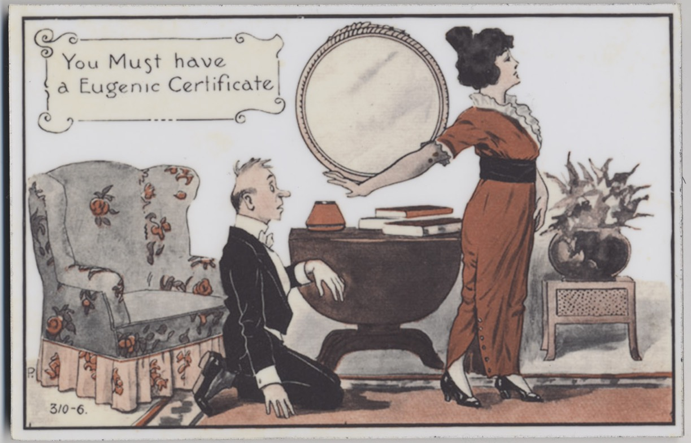
Image Courtesy of The Museum of disABILITY History, Buffalo, NY
Image: circa 1924. Source: Robert Bogdan Collection
Image: W.J. Hadden, C.H. Robinson, and M.R. Melendy, 1930.
Source: Cold Spring Harbor, Micklos, The Science of Eugenics, title pg
Notes:
Many leaders of the eugenics movement, including Francis Galton (a scientist and psychologist who coined the term “eugenics” and the phrase “nature vs. nurture”) advocated issuing “eugenic certificates” to people seeking to marry. To obtain a certificate, individuals would need to be examined by a doctor and declared eugenically fit to marry. Although these did not become widespread, some were issued by the government.
Image (top): ”You must have a Eugenic Certificate”. Courtesy of The Museum of disABILITY History, Buffalo, NY
Image (bottom): “Eugenic Certificate”, circa 1924, Source: Robert Bogdan Collection.
Image (right): "The science of eugenics and sex-life, love, marriage, maternity: the regeneration of the human race", by W.J. Hadden, C.H. Robinson, and M.R. Melendy, 1930. Source: Cold Spring Harbor, Micklos, The Science of Eugenics, title pg. Accessed via the Eugenics Image Archive, Dolan DNA Learning Center, Cold Spring Harbor Laboratory, ID# 608, p. 2 (http://www.eugenicsarchive.org/eugenics/view_image.pl?id=608, accessed March 2, 2020).

Slide 10
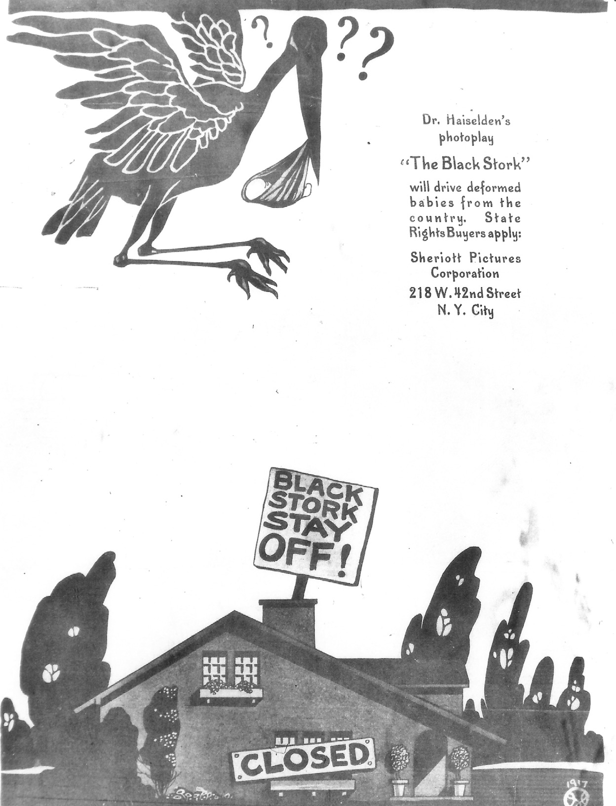
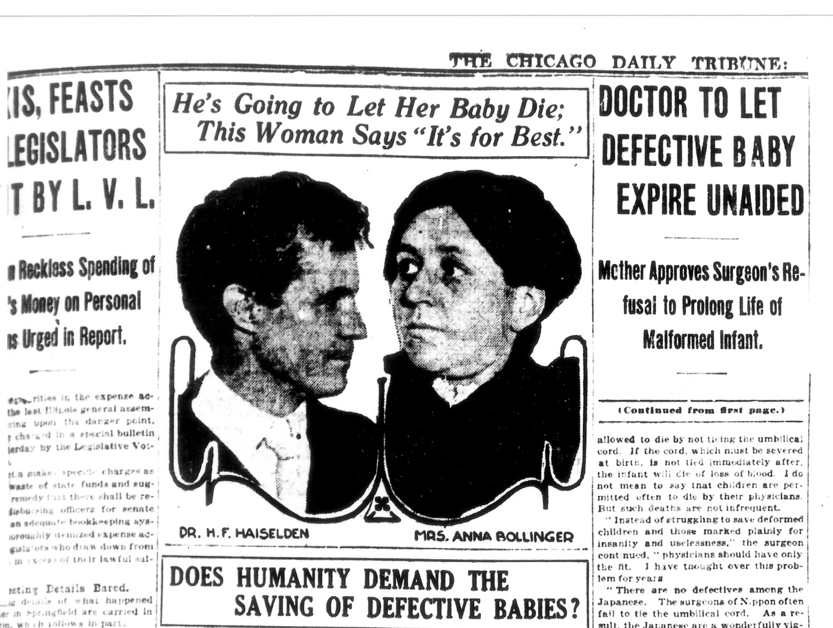
Image: The Chicago Daily Tribune, 1915. Source: Martin S. Pernick
Image: Exhibitors' Trade Review, March 1917. Source: Martin S. Pernick
Notes:
The Black Stork is a 1917 film based on the real-life case of Dr. Harry Haiselden, the chief surgeon at the German-American Hospital in Chicago, and his decision to allow the death of day-old infant John Bollinger, born to “idiocy”. The document on the right is a movie poster advertising the film, while the document on the left is a news article about the case. The case garnered much public debate about doctors’ responsibility to save “defective” babies versus their responsibility to save society from the burden of them.
Image (left): “Doctor to let defective baby expire”, The Chicago Daily Tribune, 1915. Thanks to Martin S. Pernick. This image is figure 2 in his book: ”The Black Stork: Eugenics and the Death of "Defective" Babies in American Medicine and Motion Pictures Since 1915” (New York: Oxford University Press 1996).
Image (right): “Advertisement for the Black Stork”, Exhibitors' Trade Review, March 19, 1917. Thanks to Martin S. Pernick. This image is figure 4 in his book: ”The Black Stork: Eugenics and the Death of "Defective" Babies in American Medicine and Motion Pictures Since 1915” (New York: Oxford University Press 1996).

Slide 11
Image: C.G. Campbelll, 1936. Source: Cold Spring Harbor, ERO, Eugenical News, 21
Notes:
“Eugenical News” was the main publication of the eugenics movement in the US from 1916 – 1953, published by the Eugenics Record Office (ERO) at Cold Spring Harbor Laboratory in Cold Spring Harbor, NY. The ERO was a center for genetics and human heredity research that strongly advocated forced sterilization. Its leaders were major advocates for eugenics in the US. This article promotes the so-called advances in sterilization enacted by the Nazi government in Germany in 1933 by passing the “Law for the Prevention of Genetically Diseased Offspring”. Many leading American eugenicists corresponded with and admired German eugenicists, praising their methods as a model for American eugenics.
Image: "The German Racial Policy", by C.G. Campbell, Eugenical News (vol.21:2), 1936. Source: Cold Spring Harbor, ERO, Eugenical News, 21. Accessed via the Eugenics Image Archive, Dolan DNA Learning Center, Cold Spring Harbor Laboratory, ID# 1906, p. 1 (http://www.eugenicsarchive.org/eugenics/view_image.pl?id=1906, accessed March 2, 2020).

Slide 12
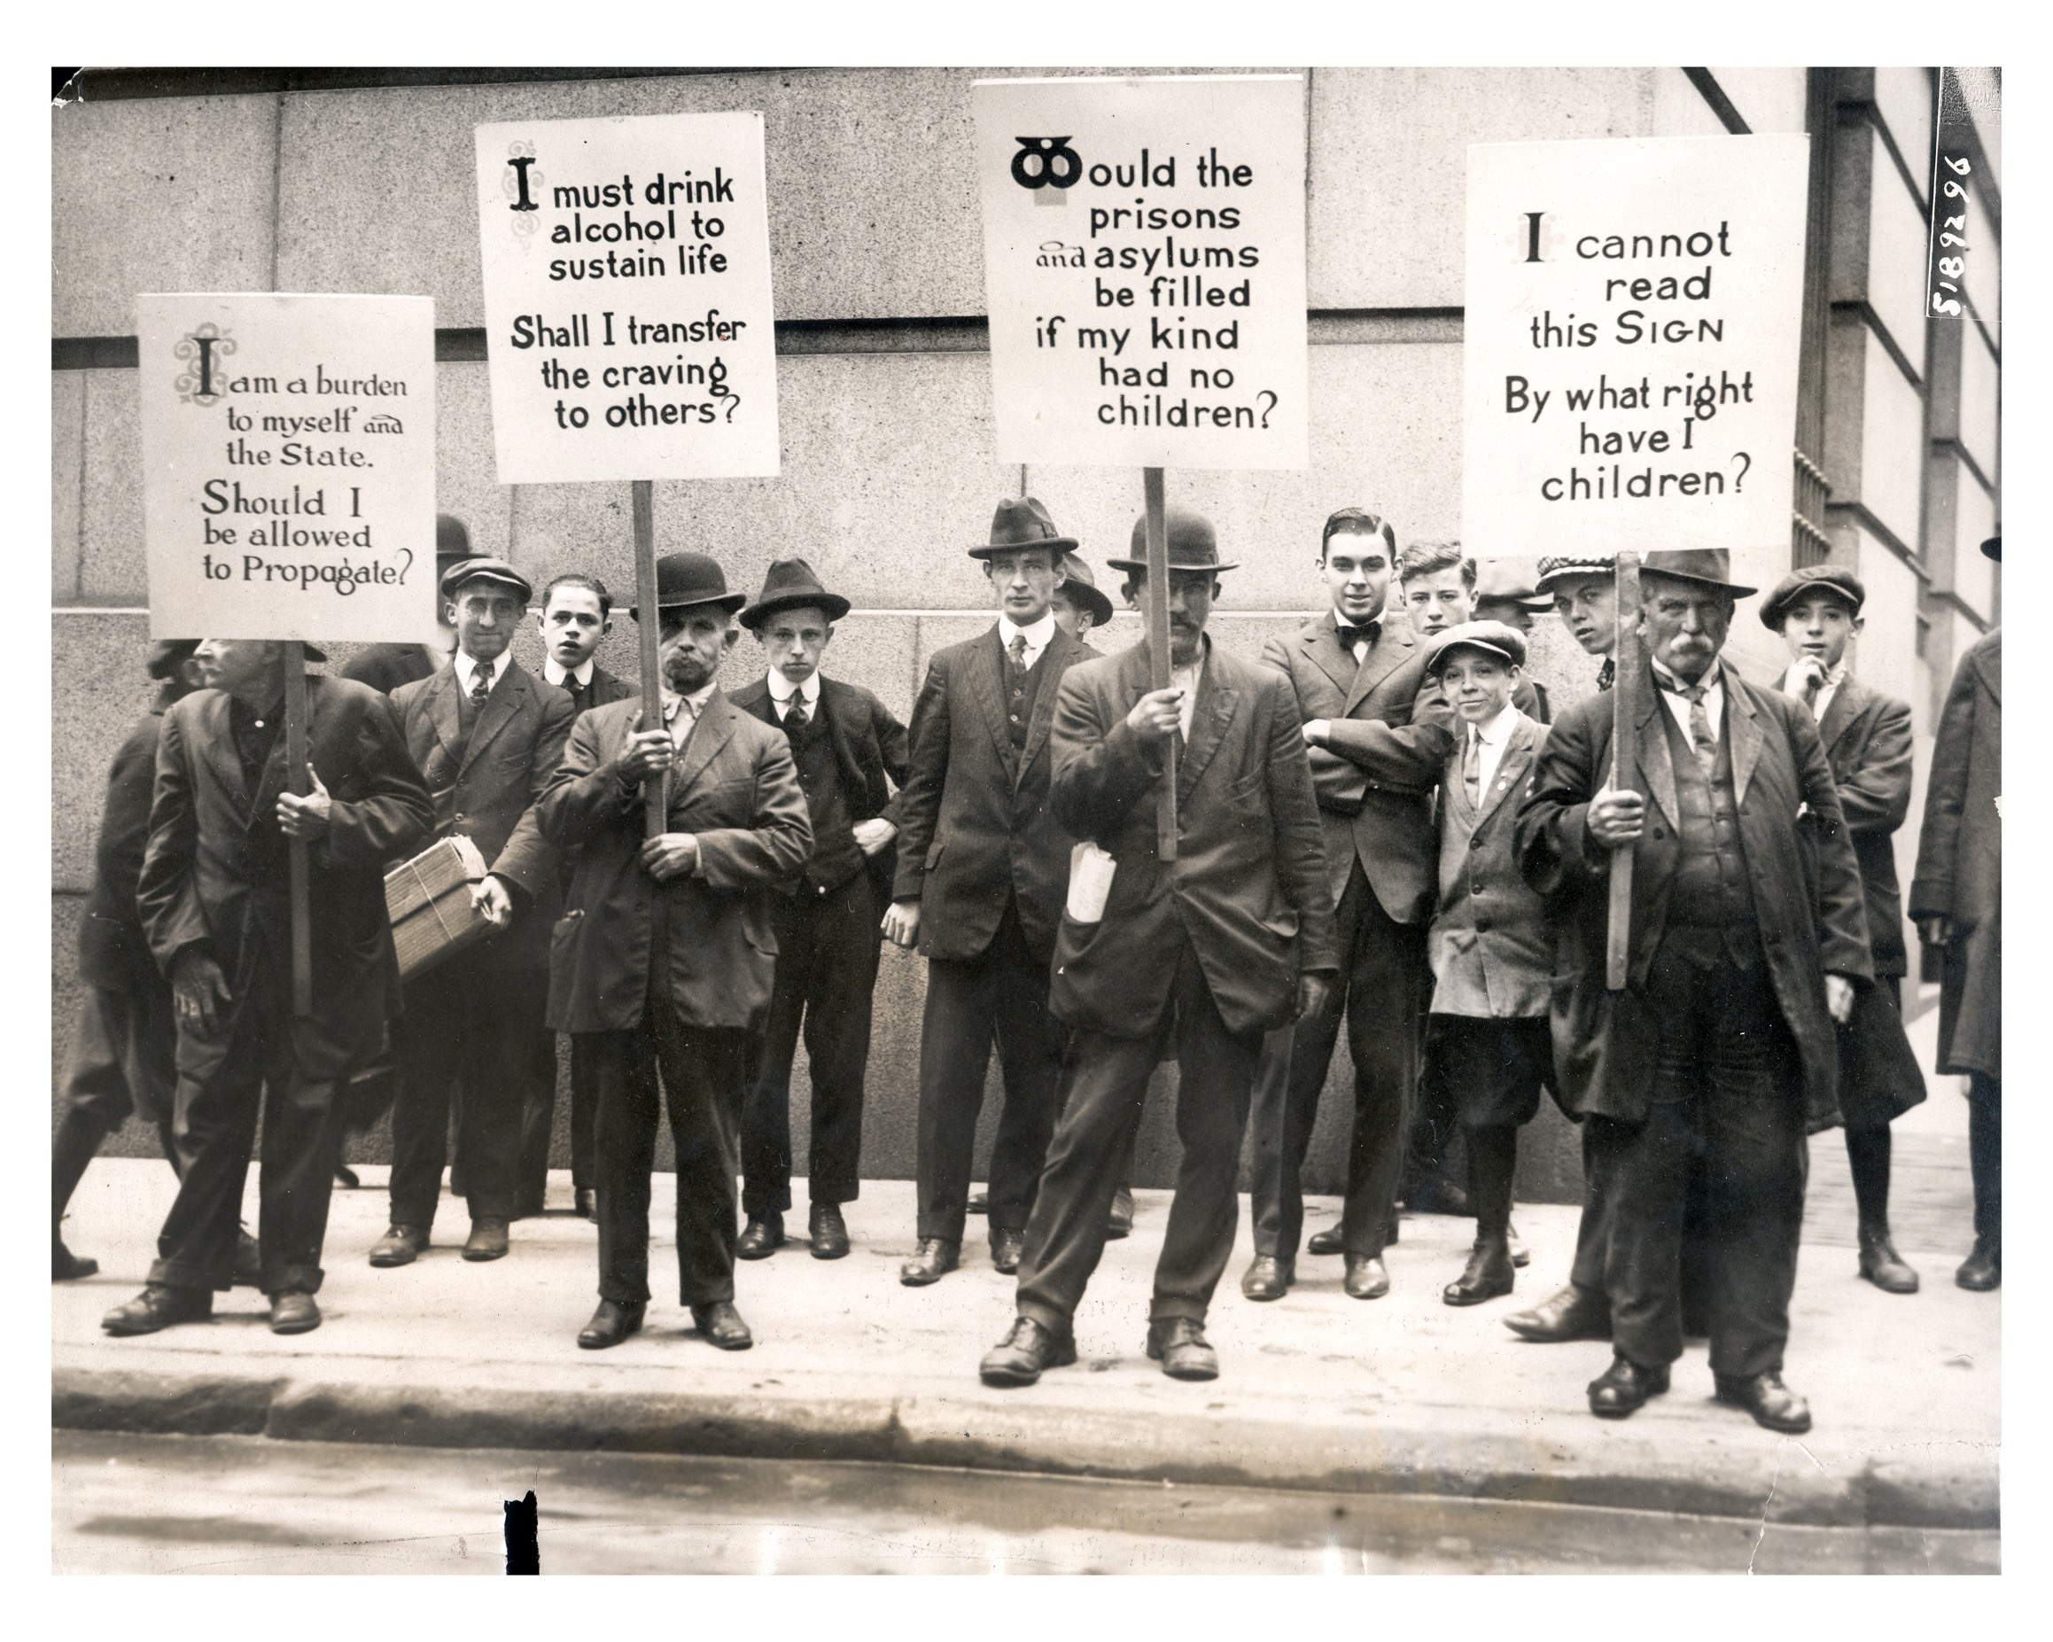
Photo by Underwood & Underwood, October 1915. Source: Wisconsin Historical Society, Image ID 2003
Notes:
Supporters of eugenics hold signs to demonstrate which groups and characteristics they believe should be prevented from reproducing.
Image: “Eugenics Demonstration on Wall Street”, by Underwood & Underwood, October 27, 1915. Source: Wisconsin Historical Society, Image ID 2003.

Slide 13
Translation German-English:
“The terrible legacy of a woman drunkard”
“894 descendants in 83 years”
“40 live in a poorhouse, 67 criminals, 7 murderers, 181 prostitutes, 142 beggars”
“437 (about 50%) were asocial, and caused 5 million DM* of costs”
* Deutsche Mark = German currency at the time
Published in Volk und Rasse, August 1936. Source: Calvin College German Propaganda Archive
Notes:
This poster, part of the series referenced in slide 5, uses the idea of prolific reproduction by people of “inferior stock” to create concern among the public that such “inferior” women must be sterilized before they can create a burden for society.
Image : "The terrible legacy of a woman drunkard.”, Volk und Rasse, August 1936. Accessed via the Calvin College German Propaganda Archive (https://research.calvin.edu/german-propaganda-archive/volkundrasse1936-8.htm, accessed March 2, 2020).

Slide 14
Image: 1924. Source: The Harry H. Laughlin Papers, Truman State University, papers, C-2-6,6
Notes:
A key belief among eugenicists was that intelligence was correlated with race and ethnicity. During the early 20th century, intelligence and psychological tests became widespread, and are now recognized as having been culturally biased to favor people of northern European descent. The US Army conducted extensive intelligence testing to assign duties to recruits. The bar graph on the left shows the percentage of men, by ethnicity, who showed “superior or very superior” intelligence.
Image: "Europe as an emigrant-exporting continent”, 1924. Source: The Harry H. Laughlin Papers, Truman State University, papers, C-2-6,6. Accessed via the Eugenics Image Archive, Dolan DNA Learning Center, Cold Spring Harbor Laboratory, ID# 1146, p. 7 (http://www.eugenicsarchive.org/eugenics/view_image.pl?id=1146, accessed March 2, 2020).

Slide 15
Image: circa 1911. Source: American Philosophical Society, ERO, MSC77,SerI,Box 44, A:35-7
Notes:
Eugenicists believed that poverty, called “pauperism” at the time, was caused by the inheritance of “bad genes”. Prior to the 20th century, poor people were typically cared for in their communities by relatives, churches and private charities. By the turn of the 20th century, government-supported welfare programs began to replace the local community support people had received. The idea that poor people and families were a burden to society became more widespread. This form for studying the inheritance of pauperism and criminality demonstrates the connection eugenicists believed existed, exploring type of pauperism, vices, crimes, status of children, etc. The idea was that not only were poverty and criminality linked, but they were also caused in part by “bad genetic stock”.
Image: "Form for studying inheritance of pauperism and criminality”, circa 1911. Source: American Philosophical Society, ERO, MSC77,SerI,Box 44, A:35-7. Accessed via the Eugenics Image Archive, Dolan DNA Learning Center, Cold Spring Harbor Laboratory, ID# 100 (http://www.eugenicsarchive.org/eugenics/view_image.pl?id=100, accessed March 2, 2020).

Slide 16
Excerpts from the New York State Patients’ Bill of Rights:
“As a patient in a hospital in New York State, you have the right, consistent with law, to:”
“(2) Receive treatment without discrimination as to race, color, religion, sex, national origin, disability, sexual orientation, age or source of payment.”
“(8) Receive complete information about your diagnosis, treatment and prognosis.
(9) Receive all the information that you need to give informed consent for any proposed procedure or treatment. This information shall include the possible risks and benefits of the procedure or treatment.”
“(12) Refuse to take part in research. In deciding whether or not to participate, you have the right to a full explanation.”
“(14) Participate in all decisions about your treatment and discharge from the hospital.”
New York State Department of Health. Publication Number 1500, version 2/2019
Notes:
Many states have created a patients’ bill of rights to ensure proper treatment to people receiving medical care. It may be a law or a set of guidelines. The goal of such bills is to allow people to be fully aware of the risks and benefits of treatment, and to provide their consent to any treatment. This stands in contrast to some medical care during the eugenics era, when patients were often not informed about a procedure they were receiving, or had received, or was performed without their approval and against their wishes.
Excerpt: “New York State Hospital Patients’ Bill of Rights”, New York State Department of Health. Publication Number 1500, version 2/2019. (https://www.health.ny.gov/publications/1500/, accessed March 2, 2020).

Slide 17
Image credits
Slide 2: Image: "Flashing light exhibit at Fitter Families Contests”, 1926. Source: American Philosophical Society, AES, Am3,575.06,44. Accessed via the Eugenics Image Archive, Dolan DNA Learning Center, Cold Spring Harbor Laboratory, ID# 5 (http://www.eugenicsarchive.org/eugenics/view_image.pl?id=5, accessed March 2, 2020).
Slide 3: Image (left): Photo by Emanuel Wolfe (1858-1933). Source: Nebraska State Historical Society, NSHS RG2836.PH0-532.
Image (right): "Yea I Have a Goodly Heritage”, circa 1925. Source: American Philosophical Society, Fitter Families Collection, 2000.1301. Accessed via the Eugenics Image Archive, Dolan DNA Learning Center, Cold Spring Harbor Laboratory, ID# 1564 (http://www.eugenicsarchive.org/eugenics/view_image.pl?id=1564, accessed March 2, 2020).
Slide 4: Image (left): "Unfit Human Traits" and "Triangle of Life.”, circa 1929. Source: American Philosophical Society, Fitter Families Collection, 2000.1285. Accessed via the Eugenics Image Archive, Dolan DNA Learning Center, Cold Spring Harbor Laboratory, ID# 1568 (http://www.eugenicsarchive.org/eugenics/view_image.pl?id=1568, accessed March 2, 2020).
Image (right): "Marriages - Fit and Unfit”, circa 1929. Source: American Philosophical Society, Fitter Families Collection, 2000.1284. Accessed via the Eugenics Image Archive, Dolan DNA Learning Center, Cold Spring Harbor Laboratory, ID# 1567 (http://www.eugenicsarchive.org/eugenics/view_image.pl?id=1567, accessed March 2, 2020).
Slide 5: Image : "Sterilization is liberation, not a punishment.”, Volk und Rasse, August 1936. Accessed via the Calvin College German Propaganda Archive (https://research.calvin.edu/german-propaganda-archive/volkundrasse1936-8.htm, accessed March 2, 2020).
Slide 8: Image: "State criteria for legal eugenical sterilization”, circa 1935. Source: The Harry H. Laughlin Papers, Truman State University, Lantern Slides, Black Case, Section 12. Accessed via the Eugenics Image Archive, Dolan DNA Learning Center, Cold Spring Harbor Laboratory, ID# 948 (http://www.eugenicsarchive.org/eugenics/view_image.pl?id=948, accessed March 2, 2020).

Slide 18
Image credits
Slide 9: Image (top): Accessed via the Museum of disABILITY History, Prevention Exhibit, image 8 (https://www.museumofdisability.org/virtual-museum/medicine- wing/prevention-exhibit/, accessed March 2, 2020).
Image (bottom): “Eugenic Certificate”, circa 1924, Source: Robert Bogdan Collection.
Image (right): "The science of eugenics and sex-life, love, marriage, maternity: the regeneration of the human race", by W.J. Hadden, C.H. Robinson, and M.R. Melendy, 1930. Source: Cold Spring Harbor, Micklos, The Science of Eugenics, title pg. Accessed via the Eugenics Image Archive, Dolan DNA Learning Center, Cold Spring Harbor Laboratory, ID# 608, p. 2 (http://www.eugenicsarchive.org/eugenics/view_image.pl?id=608, accessed March 2, 2020).
Slide 10: Image (left): “Doctor to let defective baby expire”, The Chicago Daily Tribune, 1915. Thanks to Martin S. Pernick. This image is figure 2 in his book: ”The Black Stork: Eugenics and the Death of "Defective" Babies in American Medicine and Motion Pictures Since 1915” (New York: Oxford University Press 1996).
Image (right): “Advertisement for the Black Stork”, Exhibitors' Trade Review, March 19, 1917. Thanks to Martin S. Pernick. This image is figure 4 in his book: ”The Black Stork: Eugenics and the Death of "Defective" Babies in American Medicine and Motion Pictures Since 1915” (New York: Oxford University Press 1996).
Slide 11: Image: "The German Racial Policy", by C.G. Campbell, Eugenical News (vol.21:2), 1936. Source: Cold Spring Harbor, ERO, Eugenical News, 21. Accessed via the Eugenics Image Archive, Dolan DNA Learning Center, Cold Spring Harbor Laboratory, ID# 1906, p. 1 (http://www.eugenicsarchive.org/eugenics/view_image.pl?id=1906, accessed March 2, 2020).
Slide 12: Image: “Eugenics Demonstration on Wall Street”, by Underwood & Underwood, October 27, 1915. Source: Wisconsin Historical Society, Image ID 2003.
Slide 13: Image : "The terrible legacy of a woman drunkard.”, Volk und Rasse, August 1936. Accessed via the Calvin College German Propaganda Archive (https://research.calvin.edu/german-propaganda-archive/volkundrasse1936-8.htm, accessed March 2, 2020).
Slide 14: Image: "Europe as an emigrant-exporting continent”, 1924. Source: The Harry H. Laughlin Papers, Truman State University, papers, C-2-6,6. Accessed via the Eugenics Image Archive, Dolan DNA Learning Center, Cold Spring Harbor Laboratory, ID# 1146, p. 7 (http://www.eugenicsarchive.org/eugenics/view_image.pl?id=1146, accessed March 2, 2020).
Slide 15: Image: "Form for studying inheritance of pauperism and criminality”, circa 1911. Source: American Philosophical Society, ERO, MSC77,SerI,Box 44, A:35-7. Accessed via the Eugenics Image Archive, Dolan DNA Learning Center, Cold Spring Harbor Laboratory, ID# 100 (http://www.eugenicsarchive.org/eugenics/view_image.pl?id=100, accessed March 2, 2020).

Slide 19
References
Slide 6: Quote (left): “Massachusetts Medical Society Annual Discourse: The Burden of Feeble-Mindedness” by Walter E. Fernald, M.D. (1912). Boston Medical & Surgical Journal 166(25):911-915. DOI: 10.1056/NEJM191206201662501. (http://www.nejm.org/doi/full/10.1056/NEJM191206201662501, accessed March 2, 2020).
Quote (bottom): “The high grade mental defectives,” by Bullard, W. N. (1908). Boston Medical & Surgical Journal 159:240-242. DOI: 10.1056/NEJM190808201590804 (http://www.nejm.org/doi/full/10.1056/NEJM190808201590804, accessed March 2, 2020).
Slide 7: Quote: Buck v. Bell. 274 U.S. 200, 1927 (https://supreme.justia.com/cases/federal/us/274/200/case.html, accessed March 2, 2020).
Slide 16: Excerpt: “New York State Hospital Patients’ Bill of Rights”, New York State Department of Health. Publication Number 1500, version 2/2019. (https://www.health.ny.gov/publications/1500/, accessed March 2, 2020).

