Slide 1
Sex, Genetics & Athletics
2021 edition

Slide 2
Do Now: Discuss the following with the person (or people) next to you:
Imagine you are an elite female athlete competing at the international level.
You identify as a woman and haven’t considered other possibilities. One of your competitors questions whether you are “truly biologically female” and anonymously asks officials to investigate your sex.
The group that makes the rules about who can compete is deciding whether you qualify as a female and should be able to participate.
How do you think you would respond to this type of investigation?
What do you think the investigation might involve?
What could the other athlete be thinking about?
Notes:
In this “Do Now” activity, students are asked to consider how it might feel to have your peers question your sex in response to exceptional athletic performance.

Slide 3

This scenario describes the situation of Caster Semenya and others
Tab59, CC BY 2.0
Caster Semenya celebrates a victory in London in 2012.
Notes:
This might seem like an invented scenario, but it is based on the real-life experience of world champion middle-distance runner Caster Semenya. Students are asked to consider a question they may have never thought about – what was Caster Semenya’s experience like when she learned someone was questioning her sex?
Caster Semenya is a world champion runner who experienced her competitors questioning if she was a “real woman,” in part because of her running victories, her rapid improvement in performance, and her muscular appearance. The group referenced in the slide represents the International Association of Athletics Federations (IAAF) (now called World Athletics) and the International Olympic Committee (IOC), two organizations that make decisions about who is allowed to participate in sporting events, set policies that apply to all athletes and are often seen as models for other organizations. Teachers can expect students’ answers to run the gamut, from students who have never considered such a question, to others who have had their own sex or gender identity questioned in some way, to others who are firm in their belief that designating people as male or female is a simple task. This may be a sensitive topic for students to talk about. We recommend the guide “Facilitating Challenging Conversations in the Classroom” from Washington University in St. Louis if you are looking for resources about establishing classroom norms and expectations.
Image: “La sud africaine: Caster Semenya, médaille d'argent aux 800m” by Tab59, accessed July 19, 2021 (https://commons.wikimedia.org/wiki/File:Caster_Semenya_London_2012.jpg). Available under a Creative Commons Attribution-ShareAlike 2.0 Generic license (https://creativecommons.org/licenses/by-sa/2.0/).

Slide 4
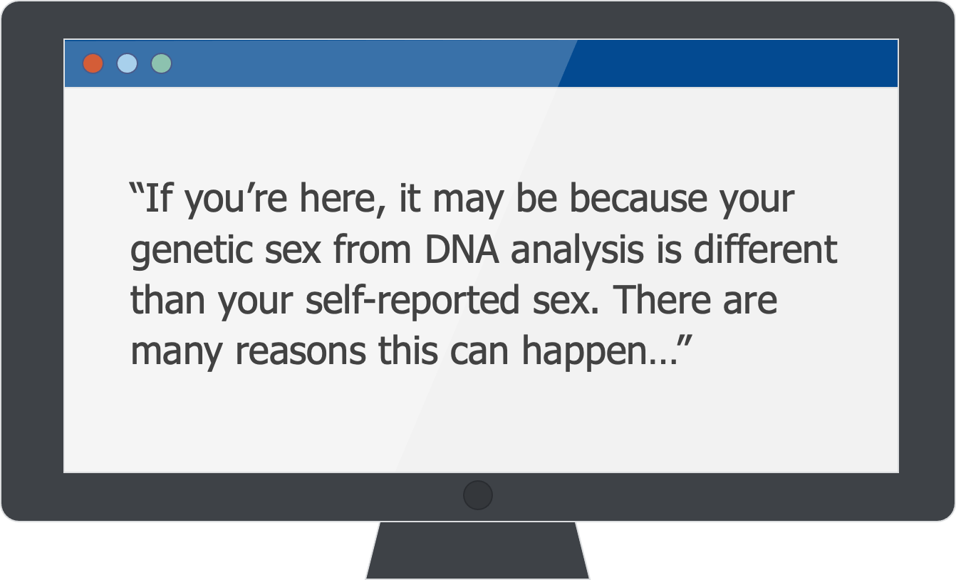
People may get unexpected information about their sex chromosomes from genetic tests
Excerpt from 23andMe website on “How 23andMe Uses Your Self-Reported Sex”
Notes:
Learning unexpected information about one’s biological sex is not just the purview of elite athletics – direct-to-consumer (DTC) genetic testing can also reveal previously unknown differences of sex development. Many people take genetic tests to get a sense of ancestry, health risks or carrier status. Some individuals are surprised when their test results reveal that they have a different complement of sex chromosomes than expected. It is common enough for people to receive results that don’t align with their self-reported sex that DTC test providers have created a landing page for questions. Overall, learning about our DNA means we are learning a lot about the breadth of variation in human populations.

Slide 5

How is sex determined?
Notes:
To understand this situation, we need to understand how sex is determined. For many, it’s a lot more complicated than is often taught.

Slide 6



Human Sex Determination:
How We’re Taught it Works
XX
XY
Notes:
What most of us learn in biology class is that in humans, sex is determined by the X and Y chromosomes with females having XX chromosomes and males having XY. A person with XX chromosomes will develop ovaries, a uterus and a vagina; estrogen will be the dominant sex hormone, and at puberty breasts will develop. A person with XY chromosomes will develop a penis and testes, testosterone will be the dominant sex hormone, and facial hair will begin to appear at puberty. It all seems very straightforward.

Slide 7
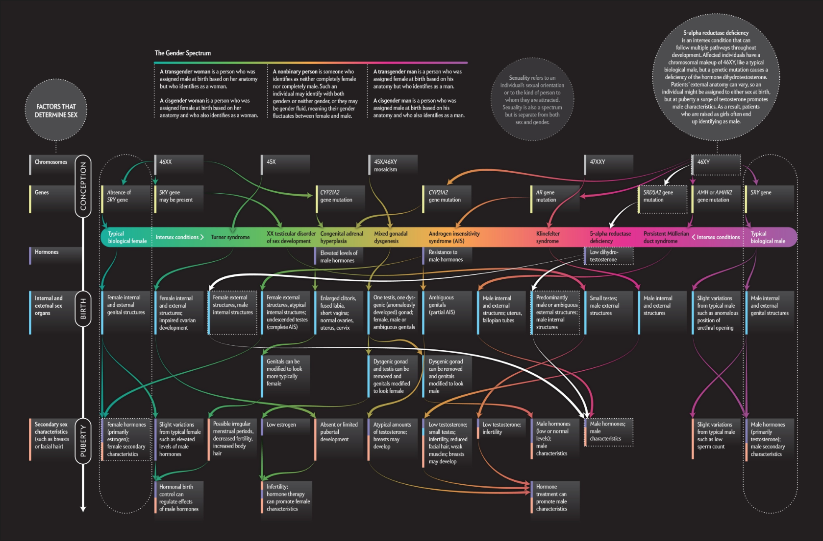
Human Sex Determination: How it Actually Works
Pitch Interactive and Amanda Montañez, Reproduced with permission. Copyright © 2017 SCIENTIFIC AMERICAN, a Division of Nature America, Inc. All rights reserved.
Notes:
The reality of human sex determination is complicated, as is illustrated in this infographic from Scientific American. Without going into all the details, the far-right column that has a dotted line circling it is the typical XY male as described in the previous slide. The column second from the left is the typical XX female. Everything in between illustrates differences in sex development that are often left out of the discussion. People whose sexual development follows one of these other pathways are called intersex. Intersex people account for approximately 1.7% of the population, making intersex variations about as common as having red hair or green eyes. (Teachers or students interested in exploring this infographic in more detail can find it at “Beyond XX and XY: The Extraordinary Complexity of Sex Determination”).

Slide 8

What’s the Difference Between
Sex & Gender?
SEX
GENDER
Classification of people into male, intersex, and female
Based on physical characteristics including:
  Chromosomes
  Sex hormones
  Reproductive organs
A person’s sense of being a man, woman, both, or neither
Based on societal ideas about masculinity and femininity
A person’s gender may be different than a gender typically associated with their sex assigned at birth
Notes:
The terms “sex” and “gender” are often confused, but these two words have separate and distinct meanings and are not interchangeable. “Sex” refers to the classification of people into “male”, “intersex”, and “female” based on physical characteristics, including chromosomes, sex hormones, and reproductive organs. “Gender” refers to behavioral, social and other factors pertaining to the meaning or role of being a “man”, “woman”, both, or neither. A person’s gender identity may be different than the one typically associated with their sex assigned at birth.
In this lesson, the focus is on sex as it relates to athletics – specifically the division of athletics into men’s and women’s events (see note below on confusing language) and the history of sex testing of athletes in the women’s events. This is not a lesson on transgender athletes.
Note: Students may notice that while sports are divided by sex (male vs. female), the categories are named using gendered terms (men’s vs. women’s events). This is an example of the confusion that is caused by using these terms interchangeably.

Slide 9
Sports are often divided by sex, but how is “sex” determined?
Anatomy
DNA
Hormones
Schematic created by pgEd (Robin Bowman)
Notes:
In an effort to provide fair competition and increased athletic opportunities for women, sports are often divided into separate categories by sex. Elite sports, such as the Olympics or “world championship” races are overseen by international organizations that set rules and guidelines for athletes and include The International Olympic Committee (IOC) and World Athletics (formerly the International Association of Athletics Federations (IAAF)). Since the mid-20th century, these organizations have used various methods for verifying the sex of athletes competing in women’s events, including examining athletes’ a) anatomy, b) DNA, and c) hormones.
Schematic: created by pgEd (Robin Bowman).

Slide 10
The Beginning of Women’s Athletics
1928
First Olympic Games in which women could compete in track and field events
Following the Berlin games, president of US Olympic Committee, Avery Brundage, demands “examination for sex ambiguities in all women competitors.”
1936
Notes:
Since women were first allowed to compete in track and field events in the 1928 Olympic Games, there have been voices suspicious of “un-feminine” levels of performance. After the 1936 Berlin games, the president of the US Olympic Committee, Avery Brundage, was worried about the threat of “hermaphrodite” athletes compromising the “integrity” of women’s sports, and “demanded examination for sex ambiguities in all women competitors.” (The word “hermaphrodite”, used here because it is a direct quote, is now considered to be pejorative. “Intersex” is the accepted word to refer to individuals who do not easily fit into the male/female sex binary.)
The next three Olympic Games were canceled due to World War II. By the time they returned in 1946, international sports organizations had begun sex testing competitors in women’s events. The slides that follow provide an overview of the 70-year history of “sex/gender tests” for female athletes in international sporting events. (Historically, these were referred to as “gender tests”.) For more background on this era, see, “In the 1930’s, Intersex Athletes Worried Olympic Officials about the Future of Women’s Sport,” by Isaac Eger in Timeline. This article is part of the pre-reading for students.

Slide 11

Anatomy
DNA
Hormones
Schematic created by pgEd (Robin Bowman)
Notes:
Let’s look at the various ways sports governing bodies have tried to define sex, starting with anatomy.
Schematic: created by pgEd (Robin Bowman).

Slide 12
The Beginning of Sex Testing in Women’s Athletics
Anatomy
International Association of Athletics Federations (IAAF) requires competitors in women’s events to submit medical certificates to verify their sex.
Few trust this process, believing it is too easy to cheat when certificate is coming from a doctor in the athlete’s home country.
1944
Notes:
Beginning in 1944, the IAAF required competitors in women’s events to submit a medical certificate from their home country verifying their sex. (The IOC did the same in the first post-war Olympic Games in 1946.)

Slide 13
More Anatomy-based Tests
Anatomy
Despite objections, IAAF requires competitors in women’s events to form a “nude parade” past three gynecologists; at the Commonwealth Games, they undergo gynecological exams to prove their sex.
1966
Notes:
Suspicions about certain countries falsifying their tests resulted in the 1966 decision from the IAAF to examine the genitals of athletes in women’s events. In some cases, the athletes were required to take part in a “nude parade”, in which they walked in front of a panel of doctors at international competitions. “Nude parades” caused a controversy and were abandoned by the IOC in favor of what they considered to be a more scientific effort to assess sex.

Slide 14

Anatomy
DNA
Hormones
Schematic created by pgEd (Robin Bowman)
Notes:
Thus, began the era of DNA-based sex tests in women’s athletics.
Schematic: created by pgEd (Robin Bowman).

Slide 15
DNA-based Tests
DNA
IAAF begins chromosome assessment by swabbing the cheek of all participants in women’s events. (International Olympic Committee followed suit for 1968 Olympic Games.)
1967 - 1990’s
What were these tests looking for?
Notes:
In 1967, the IOC and IAAF switched to lab tests to check the sex chromosomes. These tests were used until the 1990s. What were these tests looking for?

Slide 16


At the DNA level, “sex” is primarily associated with the X and Y chromosomes
DNA
Typical Female
Typical Male
X
X
X
Y
Schematic created by pgEd (Nadine Vincenten)
Notes:
The challenges of sex testing in sports can be illuminated by examining the biology of sex. At a genetic level, “sex” in humans – the physical and reproductive differences between males and females – is primarily correlated with the sex chromosomes. In typical females, cells contain two X chromosomes, while in typical males, there is one X and one Y chromosome. The X and Y chromosomes share a small number of genes. However, the Y is about one-third the size of the X and has less than one-tenth the number of genes.
Schematic: created by pgEd (Nadine Vincenten).

Slide 17
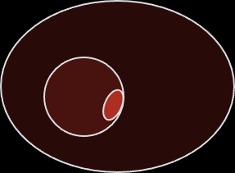

One test looked for a Barr body - evidence of a second X chromosome
DNA
Typical Female
Typical Male
Nucleus
Nucleus
Cell
Cell
Barr body
Barr body present
Barr body absent
Schematic created by pgEd (Robin Bowman)
Notes:
One DNA-based test looked for the presence of a Barr body – an inactivated X chromosome – in the athletes’ cells. In individuals with two X chromosomes, one of the X chromosomes in each cell is inactivated and condensed. The inactivated X chromosome appears as a dark spot, called a Barr body, near the edge of the nuclear membrane when viewed under a microscope. In this era, the presence of a Barr body was generally considered to confirm female sex – and allowed the athlete to participate in the women’s events.
Note: As XX individuals carry more genetic material than XY individuals, one X in each cell undergoes X-chromosome inactivation (because excessive or inadequate function of genes may lead to developmental issues in the fetus as well as diseases such as cancer).
Schematic: created by pgEd (Robin Bowman).

Slide 18

Another test looked for the SRY Gene
DNA
Typical Female
Typical Male
SRY gene
SRY gene absent
SRY gene present
Schematic created by pgEd (Nadine Vincenten)
Notes:
Another DNA-based test looked for the presence of the SRY gene. Many genes, on the sex chromosomes as well as the other 22 pairs, play important roles in forming the testes and the ovaries (the reproductive organs, or gonads, where sperm and egg cells mature). Some of these genes, such as the SRYgene typically found on the Y chromosome, actively suppress the development of the ovaries and promote the development of the testes. Other genes do the opposite and encourage the growth of ovaries and suppress the development of testes. From 1967-1990’s, any athlete having an SRY gene would be deemed male and ineligible to compete in women’s competitions.
For more, please see, “How Sex Development Works,” from The University Health Network and The Hospital for Sick Children.
Schematic: created by pgEd (Nadine Vincenten).

Slide 19
Sex is Not Binary
DNA
We often think of sex in humans as binary - existing in two distinct categories - male and female.
Some people are intersex - born on a spectrum between “typical” males and females.
Notes:
Although we often think of sex in humans as binary – existing in two distinct and mutually-exclusive categories of male and female – this over-generalization does not accurately represent the genetic and biological complexity of sex determination. While typical males and females have physical and chromosomal differences, there is a small but significant portion of the population whose sex does not conform to the commonly understood categories. These individuals with differences in sexual development (DSDs) are referred to as “intersex.”
Note: It is important to note that this spectrum of sex does not map neatly onto the spectrum of gender identity. Like individuals who are chromosomally male or female, intersex individuals may identify as a man, woman, both or neither. In fact, the varying gender identities of intersex individuals reinforce the complexity of how human gender is matched onto sex. Intersex people with biological features that do not match their chromosomal sex are more likely than the average population to identify as a different gender than the one they are assigned to or raised as. At the same time, their gender identity usually cannot be predicted from the “maleness” or “femaleness” of their sexual features.

Slide 20
Two Categories of Intersex Variations
DNA
Sex Chromosome Aneuploidy
Having an atypical number of sex chromosomes
Other Variations that Affect Sexual Development
These conditions may affect anatomy, hormone production, the body’s response to hormones, or any combination of the above.
Notes:
Broadly, there are two categories of biological bases for intersex traits: (1) having an atypical number of sex chromosomes (sex chromosome aneuploidy), or (2) having a typical combination of sex chromosomes but possessing other genetic variants that affect how the reproductive system develops. We will explore examples of each on the following slides.

Slide 21
Two Categories of Intersex Variations
DNA
Sex Chromosome Aneuploidy
Turner syndrome (X)
Klinefelter syndrome (XXY)
XYY syndrome (XYY)
Triple X syndrome (XXX)
Mosaicism (XX/X, XY/X, XX/XXY, others)
Other Variations that Affect Sexual Development
Notes:
Intersex traits caused by having an atypical number of sex chromosomes (sex chromosome aneuploidy) are fairly common. Examples include Turner syndrome (X), Klinefelter syndrome (XXY), XYY syndrome (XYY) and triple X syndrome (XXX). Individuals with sex chromosome aneuploidy have a wide range of physical, cognitive, and reproductive characteristics.
It is also possible for certain groups of cells in the developing fetus to lose one of the sex chromosomes, resulting in a “mosaic” individual who has some cells that contain XY (or XX) while others contain only a single X. Other mosaic individuals may have some cells with XX chromosomes and others with XXY. An athlete with XX/XXY mosaicism may develop as a typical female and have no idea they have a Y chromosome until they fail a sex verification test based on the presence of the SRY gene.
Aneuploidies and mosaicism often develop in the course of gamete formation or early embryonic development, and typically are not inherited from one’s biological parents.

Slide 22
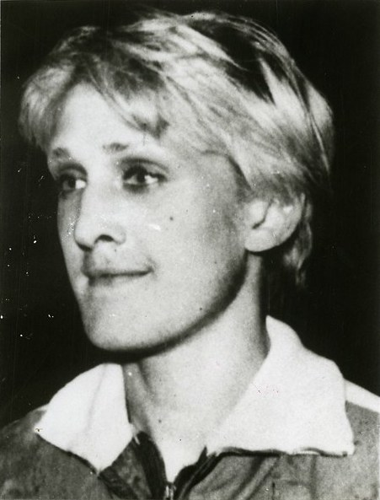
Ewa Kłobukowska
DNA
Polish Olympic sprinter, has an intersex variation called “genetic mosiacism”, which is a type of aneuploidy, with some cells that are chromosomally XX and some that are XXY. In 1967, she became the first athlete to fail the “gender verification tests” of athletics authorities due to her “extra” chromosome and was stripped of her medals and world records.
Smithsonian Institution Archives, no known copyright restrictions.
Notes:
Ewa Kłobukowska, a Polish Olympic sprinter, has an intersex variation called “genetic mosaicism” in which some cells contain XX chromosomes and others contain XXY. In 1967, she was the first athlete to fail the genetic “gender verification tests” of athletics authorities, due to her extra chromosome, and was stripped of her medals and world records.
Image: “Ewa Klobukowska (b. 1946)”, Acc. 90-105 - Science Service, Records, 1920s-1970s, Smithsonian Institution Archives, accessed July 19, 2021 (https://www.flickr.com/photos/smithsonian/5494508884/). Available with no known copyright restrictions.

Slide 23
Two Categories of Intersex Variations
DNA
Sex Chromosome Aneuploidy
Turner syndrome (X)
Klinefelter syndrome (XXY)
XYY syndrome (XYY)
Triple X syndrome (XXX)
Mosaicism (XX/X, XY/X, XX/XXY, others)
Other Variations that Affect Sexual Development
Androgen insensitivity syndrome (AIS)
  Body either completely or partially unable to metabolize androgens (hormones related to male sexual development)
  XY individuals with AIS have less-developed male features than typical males
Notes:
Another group of intersex individuals have typical combinations of sex chromosomes (XX or XY) but possess genetic variants that affect how the reproductive system develops. Individuals with these genetic variations often have gonads that are nonfunctional (called “streak gonads”) or, in very rare cases, have both testicular and ovarian tissues (an “ovotestis”). External sex organs and secondary sexual features may take a range of forms - typical for what might be expected from their sex chromosomes, opposite of what might be expected, or ambiguous.
Of these intersex variations, Androgen Insensitivity Syndrome (AIS) is one of the most common. Androgens are hormones that promote male sexual development and masculinization of the body. Testosterone is an example of an androgen. In AIS, genetic variation in the androgen receptor gene decreases the body’s ability to respond to androgens. Because of this decreased ability to respond to androgens, AIS causes individuals with XY chromosomes to have less-developed male features than typical males. This can occur even if they have high levels of androgens circulating in their bloodstream. In cases of complete AIS (CAIS), a person with XY chromosomes would have sexual features of a typical female, but internal testes in place of ovaries.

Slide 24

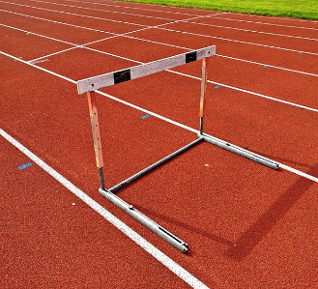
María José Martínez-Patiño
DNA
In 1986, Spanish hurdler María José Martínez-Patiño was disqualified after a sex verification test showed she had XY chromosomes. She protested the disqualification based on having androgen insensitivity syndrome (AIS) and was eventually reinstated. She is now a professor and has written extensively on AIS and sex testing in sports.
Open Clip Art Library, Open Domain.
Santeri Viinamäki, CC BY-SA 4.0
Notes:
In 1986, Spanish hurdler María José Martínez-Patiño was disqualified after a sex verification test showed she had XY chromosomes. She protested the disqualification based on having androgen insensitivity syndrome (AIS) and was eventually reinstated. She is now a professor of sports science and has written extensively on AIS and sex testing in sports. This is an example of a person who has a typical number of chromosomes (meaning, no evidence of aneuploidy) but possesses other genetic variants that affect how the reproductive system develops.
For a first-hand account of what this experience was like for Martínez-Patiño, see “A Woman Tried and Tested”, by Martínez-Patiño, MJ, Lancet 2005;366:S38.
Image (left): “Flag of Spain”, from Open Clip Art Library, accessed July 19, 2021 (https://en.wikipedia.org/wiki/File:Flag_of_Spain.svg). Public Domain.
Image (right): “Hurdle on athletic track”, by Santeri Viinamäki, accessed July 19, 2021 (https://commons.wikimedia.org/wiki/File:Hurdle_on_athletic_track.jpg). Available under a Creative Commons Attribution-ShareAlike 4.0 International license (https://creativecommons.org/licenses/by-sa/4.0/deed.en).

Slide 25
Two Categories of Intersex Variations
DNA
Sex Chromosome Aneuploidy
Turner syndrome (X)
Klinefelter syndrome (XXY)
XYY syndrome (XYY)
Triple X syndrome (XXX)
Mosaicism (XX/X, XY/X, XX/XXY, others)
Other Variations that Affect Sexual Development
Androgen insensitivity syndrome (AIS)
Congenital adrenal hyperplasia
  Can cause a range of sex characteristics, from typically male, to combined male and female characteristics, to typically female in individuals with XX chromosomes
Notes:
Congenital adrenal hyperplasia (CAH) is an intersex variation in which production of androgens is increased. Elevated androgen levels can lead to a range of typically male sexual features in XX individuals. (While CAH can also affect individuals with XY chromosomes, it does not result in intersex traits.) Teachers will note there is not an athlete featured in this lesson to highlight CAH, but that does not mean there are no athletes with this condition competing and impacted by sex testing.

Slide 26
Two Categories of Intersex Variations
DNA
Sex Chromosome Aneuploidy
Turner syndrome (X)
Klinefelter syndrome (XXY)
XYY syndrome (XYY)
Triple X syndrome (XXX)
Mosaicism (XX/X, XY/X, XX/XXY, others)
Other Variations that Affect Sexual Development
Androgen insensitivity syndrome (AIS)
Congenital adrenal hyperplasia
Other genetic or developmental variations
Notes:
There are many other variations that may affect sexual development, but we are focusing here on those that are relevant to women in athletics. For that reason, we are not discussing differences of sex development (DSDs) that affect individuals who would likely be identified as male. People competing in men’s categories have not be subject to sex verification testing.
To explore other DSD’s, see slide 7.

Slide 27
Two Categories of Intersex Variations
DNA
Sex Chromosome Aneuploidy
Turner syndrome (X)
1 in 2,000-2,500 females
Klinefelter syndrome (XXY)
1 in 500-600 males
XYY syndrome (XYY)
1 in 1,000 births
Triple X syndrome (XXX)
1 in 1,000 females
Mosaicism (XX/X, XY/X, XX/XXY, others)
Other Variations that Affect Sexual Development
Androgen insensitivity syndrome (AIS)
2-5 per 100,000
Congenital adrenal hyperplasia
1 in 1,000 (mild form) to 1 in 15,000 (severe form)
Other genetic or developmental variations
Notes:
Estimates of the prevalence of individual DSDs vary, and many intersex people may never learn that they are intersex.

Slide 28
How common on intersex variations?
DNA
Intersex variations, as a group, are quite common, occurring in as much as 1.7% of the population.
Intersex “invisibility”
  Choose not to share personal information
  Many intersex people don’t know they are intersex.
    No outward signs
    Surgeries performed during infancy or early childhood
Notes:
While each individual DSD is considered rare, being intersex is fairly common. Intersex traits occur in up to 1.7% of the population (with estimates varying due to differing definitions of what counts as intersex).
However, intersex variations are often considered “invisible”. Many intersex people choose not to share this personal information about themselves. Others are not aware they are intersex, either because they never had outward signs or, because of the common practice of performing surgeries during infancy or early childhood to make intersex bodies conform to the male/female binary. These surgeries are often medically unnecessary and involve parents and/or doctors deciding about whether to make their child appear male or female. Their decision does not always align with the child’s eventual sense of self, and sometimes the child is never told about the surgery or is lied to about the reason for it. This “invisibility” can lead us to think that being intersex is very rare when, in fact, most of us likely know at least one person who is intersex. Teachers may want to help students understand these numbers by thinking about how many people attend their school or live in their town as a reference point.

Slide 29
DNA-based Tests
DNA
1992
IAAF ends chromosomal testing.
1999
IOC discontinues sex testing.
Both organizations reserve the right to examine athletes if someone were to “challenge” their femaleness.
Notes:
Both the IAAF and the IOC ended compulsory chromosomal sex testing of all competitors in women’s events in the 1990s. However, they reserved the right to examine athletes if someone were to “challenge” their femaleness.

Slide 30
Anatomy
DNA
Hormones
Schematic created by pgEd (Robin Bowman)
Notes:
Testing hormone levels replaced chromosomal testing as a way to determine eligibility to participate in women’s events.

Slide 31
Hormone-based Tests
Hormones
Testosterone levels used to determine eligibility to compete in women’s events
2000
Notes:
Starting in 2000, athletes’ testosterone levels were used to determine eligibility. Like earlier methods of sex testing, this too would be controversial.

Slide 32
What is Testosterone?
Hormones
A hormone
Produced in both male and female bodies
Important for:
  Growth and strength of bones and muscles
  Puberty-related changes in males
Essential for the body’s overall health
Notes:
Testosterone is a hormone produced in both male and female bodies. Testosterone has many effects on the body, including promoting the growth and strength of bones and muscles and causing many of the puberty-related changes in males. While testosterone is the primary sex hormone in males and estrogen is the primary one in females, both hormones are produced in all humans, with levels varying from one individual to the next. Both testosterone and estrogen are required for the body’s overall function in both male and female bodies, and imbalances in the levels of these hormones can affect health.

Slide 33
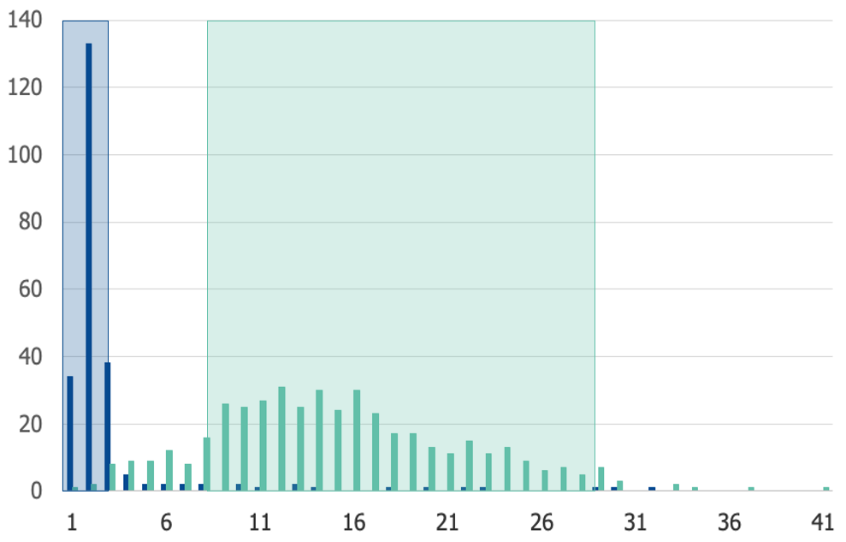
Testosterone levels vary from one person to the next
Hormones
10 nmol/L threshold
Female athletes (n=231)
Female reference range for non-elite athletes
Male athletes (n=445)
Male reference range for non-elite athletes
Number of Athletes
Initial IAAF rule requires testosterone level <10 nmol/L to compete in women’s events
Testosterone (nmol/L)
Data from Healy et al (2014)
Notes:
This slide is animated to allow students to see the distribution of male and female testosterone levels before introducing the 10 nmol/L limit.
a) Testosterone levels vary from one person to the next. This image shows a comparison of testosterone levels between male and female elite athletes. The areas in the shaded boxes show the reference ranges considered “normal” for non-elite athletes (<2.7 nanomoles per liter (nmol/L) for females, 8.4-28.7nmol/L for males). While there is a difference in the distribution of testosterone levels between males and females, notice there is significant overlap of the ranges, with both males and females ranging from nearly 0 to over 30 nmol/L.
b) When hormone testing began to be used to determine eligibility, the IAAF set an initial threshold of 10 nmol/L for competitors in women’s competitions. Those with testosterone levels above the cutoff would have to have surgery or take medication to lower and maintain their testosterone level below the 10 nmol/L threshold to compete.
Data from: M. L. Healy, J. Gibnet, C. Pentecost, M. J. Wheeler, and P. H. Sonksen. (2014) Endocrine profiles in 693 elite athletes in the postcompetition setting. Clinical Endocrinology 81, 294-305

Slide 34
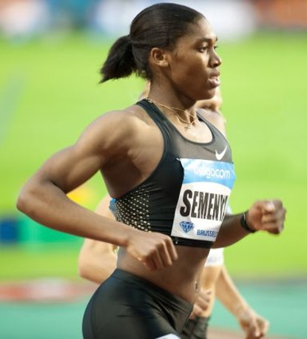

Caster Semenya & Dutee Chand
Hormones
South African 800m Olympic and world champion Caster Semenya was disqualified from competition due to naturally elevated testosterone in 2009.
Erik van Leeuwen, GFDL
Indian Olympian and national 100m champion Dutee Chand was disqualified due to naturally elevated testosterone in 2014.
CC BY-SA 4.0
Notes:
In 2008, Caster Semenya, a South African middle-distance runner specializing in the 400m, 800m and 1500m events, emerged as an international talent. In 2009, the IAAF requested that Semenya be subjected to sex testing due to suspicions raised by her performance and, in particular, her rapid improvement in performance. This led to her disqualification from competition due to her natural testosterone levels being higher than the 10 nmol/L threshold. Feeling she had no other choice, Semenya began taking medication to lower her testosterone levels so she could compete.
In 2014, Dutee Chand, a 100m sprinting champion from India, was also disqualified due to hyperandrogenism, or naturally elevated testosterone. She refused to undergo treatment for her hyperandrogenism, arguing that it was unfair that she was required to undergo medically unnecessary treatments to continue to compete.
Image (left): “Caster Semenya at the 2010 Memorial Van Damme, Brussels, Belgium”, by Erik van Leeuwen, accessed July 19, 2021 (https://commons.wikimedia.org/wiki/File:Caster_Semenya_2010_Memorial_Van_Damme.jpg). Available under the terms of the GNU Free Documentation license (https://www.gnu.org/licenses/fdl-1.3.html).
Image (right): “Dutee Chand won the bronze medal in 22nd Asian Athletics Championships in Bhubaneswar.” accessed July 19, 2021 (https://commons.wikimedia.org/wiki/File:Dutee_Chand.jpg). Available under a Creative Commons Attribution-ShareAlike 4.0 International license (https://creativecommons.org/licenses/by-sa/4.0/deed.en).

Slide 35
Legal Challenges
Hormones
2014
Chand brought legal challenges against IAAF
Court suspended 10 nmol/L limit and ordered IAAF to provide scientific evidence of testosterone improving performance
2015
Notes:
In 2014, after being dropped from India’s national team, Chand sued the IAAF over the testosterone rule. This was the beginning of a long legal battle over hormone-based sex testing. Chand’s lawsuit resulted in the court ruling that the IAAF must suspend the regulation until providing scientific evidence to support the legitimacy of this 10 nmol/L threshold for athletes to compete in the women’s division.

Slide 36
Three Questions Needed to Be Answered
Hormones
Do naturally occurring elevated testosterone levels confer an athletic advantage?
If so, at what level (of testosterone) does that advantage become unfair?
Are testosterone-based eligibility requirements discriminatory?
Notes:
At the heart of the lawsuit were three main questions: 1) Do naturally occurring elevated testosterone levels confer an athletic advantage? 2) If so, at what level (of testosterone) does that advantage become unfair? 3) Are testosterone-based eligibility requirements discriminatory? The court gave the IAAF two years to provide scientific evidence to support their claim.

Slide 37
Results of IAAF Study
Hormones
The IAAF study looked at 21 women’s events. They found that competitors with the highest testosterone levels performed significantly* better in 5 of those events (the number in parentheses shows how much of an advantage):
Hammer throw (4.53% further)
Pole vault (2.94% higher)
400m hurdles (2.78% faster)
400m (2.73% faster)
800m (1.78% faster)
2018
*In statistics, a “significant” difference is one that is mathematically determined unlikely to be due to chance.
Notes:
The IAAF hired scientists to study the testosterone levels of elite track-and-field athletes. Of the 21 women’s events studied, researchers found that athletes with the highest levels of testosterone performed significantly better than those with the lowest levels in five events – the 400m, 400m hurdles, 800m, hammer throw and pole vault.
The number in parentheses shows how much of an advantage.
Hammer throw (4.53% further)
Pole vault (2.94% higher)
400m hurdles (2.78% faster)
400m (2.73% faster)
800m (1.78% faster)
This study looked at the testosterone levels of competitors in the IAAF World Championships in 2011 and 2013.
Note: In statistics, a “significant” difference is one that is mathematically determined unlikely to be due to chance.

Slide 38
New IAAF Regulations
The IAAF decided to apply a new 5 nmol/L testosterone limit on:
Hammer throw (4.53%)
Pole vault (2.94%)
400m hurdles (2.78%)
400m (2.73%)
800m (1.78%)
1500m (no significant advantage)
1 mile (not included in the study)
Female athletes (n=231)
Female reference range
for non-elite athletes
5 nmol/L threshold
10 nmol/L threshold
Male athletes (n=445)
Male reference range
for non-elite athletes
Number of Athletes
Testosterone (nmol/L)
Data from Healy et al (2014)
Notes:
This slide is animated to introduce the two major changes to the regulations separately.
a) In 2018, after completing their study, the IAAF decided to reinstate their testosterone regulations, but with a narrower focus. Under the new regulations, testosterone limits only apply to athletes with DSDs participating in certain women’s events – international races between 400m and 1 mile. This includes the 1500m race, which showed no statistically significant advantage to those with elevated testosterone, as well as the 1-mile race, which was not included in the study. As students will note from the slide, the new regulations do not apply to hammer throw or pole vault, both of which did show statistically significant correlation.
This decision to apply the rules to the 1 mile and 1500m, and not the hammer throw or pole vault, was very controversial. Additionally, there are concerns about the study design, implementation and data used. The study has been critiqued for including data from athletes who had been disqualified for doping, and for using duplicated or “phantom” data (e.g., race time data points for which no match was found in the official race times from the events that those data supposedly came from, and the authors of this work themselves admit to “the presence of errors”).
b) They also lowered the testosterone limit for these events from 10 nmol/L to 5 nmol/L.
Note: The study also looked at male athletes in the same World Championship events. No significant difference was found between male athletes in the highest and lowest testosterone tertiles for any event.
Data from: M. L. Healy, J. Gibnet, C. Pentecost, M. J. Wheeler, and P. H. Sonksen. (2014) Endocrine profiles in 693 elite athletes in the postcompetition setting. Clinical Endocrinology 81, 294-305

Slide 39
Discussion Questions
How do you think the IAAF chose which events would have a lower testosterone limit for eligibility?
Imagine you were responsible for creating these rules. What information would you want to base your decision on?
Notes:
Discussion questions give students a chance to wrestle with what will appear to some as a contradiction - the study identified some events where performance is impacted by testosterone, but the list of events covered by the new rules do not align with those in the study. Student answers will vary, but common questions that might come up are: “How meaningful are the <5% advantages in a competition?”; “How would you decide where to set the testosterone level threshold, if one is deemed necessary?”; “Would each event need its own threshold, or can there be one threshold that applies to all events?”. Teachers may wish to create an activity where students more deeply examine this particular controversy but it is outside the scope of this lesson.

Slide 40
Hormone-based Tests are the Current Standard
Hormones
Court rules that, although setting a testosterone limit for eligibility is discriminatory, it is “necessary, reasonable, and proportionate”.
All legal challenges exhausted. The IAAF rule stands.
2019
Notes:
In 2019, all legal challenges were exhausted and the IAAF ruling took effect.

Slide 41
What does this mean for Chand & Semenya?
Hormones
Athletes have these options:
Lower testosterone levels via medication or surgery
  Dutee Chand may compete - new regulations do not apply to the 100m event
  Caster Semenya must keep testosterone level below 5 nmol/L to run the 800m
Participate in an event not covered by the regulation
Enter only non-international competitions (not covered by the rule)
Compete in the men’s division
Possibly compete in another, distinct, third division that does not yet exist
“I am a woman and I am a world-class athlete. The IAAF will not drug me or stop me from being who I am.” -Caster Semenya
Notes:
What do the new IAAF regulations mean for Chand and Semenya? The new IAAF rules for athletes with DSDs apply only to athletes competing in international races between 400m and 1 mile. Since Dutee Chand competes in the 100m, she is free to compete.
Caster Semenya, as an 800m racer, is subject to the regulations. Competitors in these events have several options: 1) lower and maintain their testosterone levels below the threshold for at least 6 months via medication or surgery to remove testicular tissue that may elevate testosterone; 2) participate in an event not covered by the regulation; 3) enter non-international competitions not governed by this rule; 4) compete in the men’s division; or 5) possibly compete in another, distinct, third division that does not yet exist.
Semenya, in an article in the Los Angeles Times, responded to the ruling saying, “I am a woman and I am a world-class athlete. The IAAF will not drug me or stop me from being who I am.”
For several viewpoints on these questions, see “Track’s New Gender Rules Could Exclude Some Female Athletes,” by Jeré Longman, April 2018, New York Times. Also: “Sex, Sport, and Why Track and Field’s New Rules on Intersex Athletes Are Essential,” by Doriane Lambelet Coleman, April 2018, New York Times.

Slide 42
Classroom Exercise
You are the doctor responsible for verifying the sex of competitors in the women’s 800m race in an international track and field competition. Using the information given for each athlete, mark on the chart whether they pass or fail each type of sex verification test.
Notes:
This slide introduces the classroom activity in which students imagine being the medical doctor responsible for determining whether athletes pass sex-verification tests to compete in women’s 800m race at an international competition. The exercise is intended to give students the chance to reflect on the complexity of biological sex and increase their knowledge of biological concepts. The classroom activity reinforces the information offered in these slides and requires students to synthesize what they have learned about differences in sexual development and the various methods of sex verification tests used by international athletics organizations.

Slide 43
After the Exercise:
Debrief and Discussion
How did you make the decision to pass or fail athletes who have traits associated with both male and female sexes?
How did it feel to make your decisions?
Describe your thought process. Did you wish you had more information or was the information you had enough?
What impact do you think your decision could have on the lives of the athletes involved?
Notes:
This slide poses questions for discussion after completing the classroom activity. Debriefing is a critical part of the activity to give students opportunity to discuss 1) how they made their decisions, 2) how categorizing these athletes made them feel, and to 3) process the difficulty of the exercise and limitations of a binary system of sex classification.

Slide 44
Science, sex verification & fairness: What does the future hold?
Why do athletic oversight organizations focus on testosterone levels and not other physical characteristics?
Why are athletic oversight organizations setting lower- or upper-limits for women’s events but not for men’s?
Might we switch to competitive categories based on something other than sex?
Notes:
Many questions remain about the current and future practice of sex testing in athletics. Critics question the singular focus being placed on testosterone levels, and not other physical characteristics such as height, lean body mass or lung capacity, which are known to confer performance advantage. Others point out that sex verification in sports has always only targeted athletes in the women’s division, not those in the men’s. Many also note the seeming contradiction in having an upper testosterone-level threshold for women’s events, but neither an upper nor lower threshold for men’s events. Will testosterone levels remain the metric by which eligibility is decided? Might there be another method by which athletes could be sorted to offer fair competition?

Slide 45


Resources to Learn More:
Radiolab Presents: Gonads: Dutee
NIH: Numeric Sex Chromosome Variations
AXYS: Association for X and Y Chromosome Variations
interAct: Advocates for Intersex Youth
Notes:
While this lesson highlights the issues of elite athletes, the broader concepts apply to everyone, and can be used to facilitate discussions about fairness and destigmatize differences in sexual development and genetic differences in general. This slide lists resources for further inquiry and support.
Radiolab Presents: Gonads: Dutee
NIH: Numeric Sex Chromosome Variations
AXYS: Association for X and Y Chromosome Variations
interAct: Advocates for Intersex Youth

Slide 46
Image Credits
Slide 3: Image: “La sud africaine: Caster Semenya, médailled'argent aux 800m” by Tab59, accessed July 19, 2021
(https://commons.wikimedia.org/wiki/File:Caster_Semenya_London_2012.jpg). Available under a Creative Commons Attribution-ShareAlike2.0 Generic license
(https://creativecommons.org/licenses/by-sa/2.0/).
Slide 7: Image: “Beyond XX and XY: The Extraordinary Complexity of Sex Determination”, by Pitch Interactive and Amanda Montañez, September 1, 2017, Scientific American
(https://www.scientificamerican.com/article/beyond-xx-and-xy-the-extraordinary-complexity-of-sex-determination/). Reproduced with permission. Copyright © 2017
SCIENTIFIC AMERICAN, a Division of Nature America, Inc. All rights reserved.
Slide 9: Schematic: created by pgEd (Robin Bowman).
Slide 11: Schematic: created by pgEd (Robin Bowman).
Slide 14: Schematic: created by pgEd (Robin Bowman).
Slide 16: Schematic: created by pgEd (Nadine Vincenten).
Slide 17: Schematic: created by pgEd (Robin Bowman).
Slide 18: Schematic: created by pgEd (Nadine Vincenten).
Slide 22: Image: “Ewa Kłobukowska (b. 1946)”, Acc. 90-105 - Science Service, Records, 1920s-1970s, Smithsonian Institution Archives, accessed July 19, 2021
(https://www.flickr.com/photos/smithsonian/5494508884/). Available with no know copyright restrictions.

Slide 47
Image Credits
Slide 24: Image (left): “Flag of Spain”, from Open Clip Art Library, accessed July 19, 2021 (https://en.wikipedia.org/wiki/File:Flag_of_Spain.svg). Public Domain.
Image (right): “Hurdle on athletic track”, by Santeri Viinamäki, accessed July 19, 2021 (https://commons.wikimedia.org/wiki/File:Hurdle_on_athletic_track.jpg).
Available under a Creative Commons Attribution-ShareAlike 4.0 International license (https://creativecommons.org/licenses/by-sa/4.0/deed.en).
Slide 30: Schematic: created by pgEd (Robin Bowman).
Slide 34: Image (left): “Caster Semenya at the 2010 Memorial Van Damme, Brussels, Belgium”, by Erik van Leeuwen, accessed July 19, 2021
(https://commons.wikimedia.org/wiki/File:Caster_Semenya_2010_Memorial_Van_Damme.jpg). Available under the terms of the GNU Free Documentation license
(https://www.gnu.org/licenses/fdl-1.3.html).
Image (right): “Dutee Chand won the bronze medal in 22nd Asian Athletics Championships in Bhubaneswar.” accessed July 19, 2021
(https://commons.wikimedia.org/wiki/File:Dutee_Chand.jpg). Available under a Creative Commons Attribution-ShareAlike4.0 International license
(https://creativecommons.org/licenses/by-sa/4.0/deed.en).

Slide 48
References
Slide 4: Excerpt: “How 23andMe Uses Your Self-Reported Sex”, 23andMe, accessed July 19, 2021
(https://customercare.23andme.com/hc/en-us/articles/360010964373-How-23andMe- uses-your-self-reported-Sex).
Slide 33: Data from: M. L. Healy, J. Gibnet, C. Pentecost, M. J. Wheeler, and P. H. Sonksen. (2014) Endocrine profiles in 693 elite athletes in the postcompetition setting.
Clinical Endocrinology 81, 294-305
Slide 39: Data from: M. L. Healy, J. Gibnet, C. Pentecost, M. J. Wheeler, and P. H. Sonksen. (2014) Endocrine profiles in 693 elite athletes in the postcompetition setting.
Clinical Endocrinology 81, 294-305
Slide 42: Excerpt: “Caster Semenya appeals testosterone ruling: ‘The IAAF will not drug me’.”, by Associated Press, Los Angeles Times, accessed July 19, 2021
(https://www.latimes.com/sports/olympics/la-sp-caster-semenya-appeals-testosterone-ruling-20190529-story.html).

