Slide 1

Engineering the world around us: Genome editing and the environment
2020 edition

Slide 2
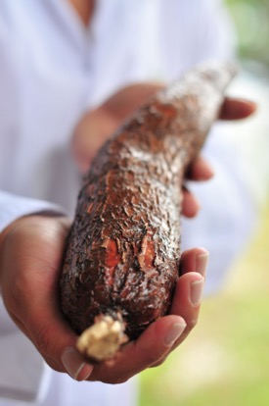
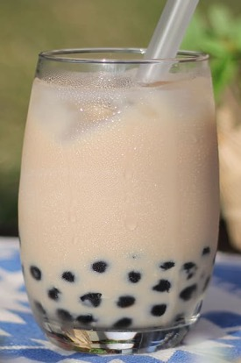
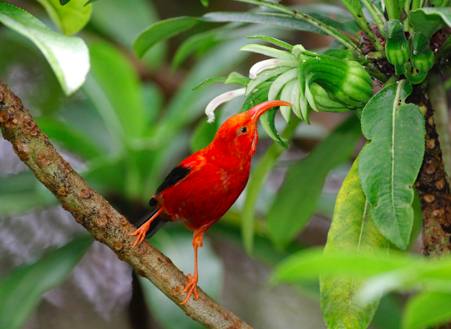
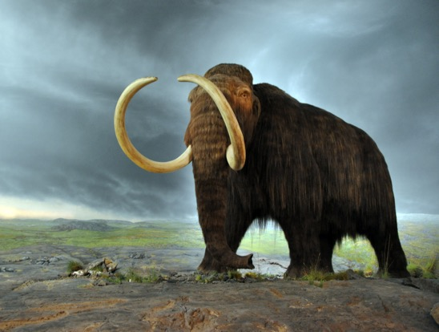
How could genome editing impact our environment?
Agriculture case study: Using genome editing to lower the toxicity of an important food crop – cassava.
Cassava
pxfuel.com
Neil Palmer, CC BY-SA 2.0
Insect-borne disease case study: Using genome editing to engineer mosquitoes to prevent them from infecting Hawaiian honeycreepers with avian malaria.
Honeycreeper
USFWS – Pacific Region,
CC BY-NC 2.0
De-extinction and permafrost preservation case study: Using genome editing to bring back the woolly mammoth to help prevent thawing of permafrost.
Mammoth
Mammut, CC BY-SA 2.0
Notes:
This lesson plan explores the use of genome editing in tackling a variety of ecological problems. Students will be given the chance to consider the application of genetic technologies in three different situations: (1) agriculture, (2) insect-borne disease, and (3) de-extinction and permafrost preservation. The lesson plan is divided into three sections, one for each case study. Each case study includes its own “Do Now” and discussion questions.
Image (top-left): “Cassava root 2” by Neil Palmer, accessed February 05, 2020 (https://www.flickr.com/photos/ciat/4627298692/in/photostream/). Available under a Creative Commons Attribution-ShareAlike 2.0 Generic license (https://creativecommons.org/licenses/by-sa/2.0/).
Image (top-right): Public domain picture, accessed February 05, 2020. (https://www.pxfuel.com/en/free-photo-xaizx)
Image (middle): “'I'iwi - Vestiaria coccinea” by USFWS - Pacific Region, accessed February 05, 2020 (https://www.flickr.com/photos/usfwspacific/36474996884/in/photolist-npj4sr-agb8jE-iVSK5i-QTfSa9-bsZRZr-XzaTNC-Yymcbo-YymaNd-wUE7m-4Wh3K5-4WgVnf-dvuz71-agb8hj-4Warst-4WeEo3-4Waswx-4WgEiL-ag8n28-4WeHBL-DVaASc-4WapjV-4Wh2Wo-4WhaKN-8WFCfh-ag8m1r-9V1gHh-29L7nri-MQqdKq). Available under a Creative Commons Attribution-NonCommercial 2.0 Generic license (https://creativecommons.org/licenses/by-nc/2.0/).
Image (bottom): “Woolly Mammoth” by Mammut, accessed February 05, 2020 (https://commons.wikimedia.org/wiki/File:Woolly_mammoth.jpg). Available under a Creative Commons Attribution-Sharealike 2.0 Generic license (https://creativecommons.org/licenses/by-sa/2.0/).

Slide 3

What is genome editing?
Genome editing is making a change to an organism’s DNA at a specific site.
CRISPR is a genome editing tool that can be used to make these specific DNA changes.
Ernesto del Aguila III
Notes:
What is genome editing? In the past decades, scientists have developed a range of genetic technologies that can change the characteristics of an organism by deliberately modifying its genetic material. These approaches are collectively known as “genetic engineering”. One type of genetic engineering is the introduction of a gene into an organism to give it a new trait - for example, making bacteria that produce human insulin that can then be used as medicine.
This lesson plan focuses on “genome editing”, a type of genetic engineering, used for making specific, targeted changes to an organism’s own DNA. One of the genome editing techniques that has generated the most excitement, due to its efficiency and ease of use, is called “CRISPR” (“clustered regularly interspaced short palindromic repeats”). Originally discovered in bacteria (see sidebar), CRISPR is now being used as a tool with applications in many areas, including medicine, agriculture, and the environment. For example, scientists are investigating the use of CRISPR to “correct” genetic variants that cause diseases, with the goal of curing genetic diseases such as hemophilia, cystic fibrosis, and sickle cell disease. (For more on the use of CRISPR and related genome editing tools, please see pgEd’s lesson plan on “Genome editing and CRISPR” and this article on recent developments in research and clinical trials.) CRISPR might also be used in other organisms (not humans) to address ecological issues impacting human health and safety.
Image: “CRISPR Cas9” by Ernesto del Aguila III, accessed February 05, 2020 (https://www.flickr.com/photos/nihgov/41124064215/in/photolist-25DZzxV-ZZM4aG-GKPyT4-2dg5nVs-GRLDp2-jR9gc-ZZM4gJ-RdHQX8-2az1MzU-dAausS-2az1MNQ-Yoax7G-ZZM3Zm-2az1MUb-GP4zR6-YLKyN8-pgBYK3-ACo21-ybZbZ3-YJdu4y-ysEjeQ-ZZM475-R3PK5C-ysCUjh-ysCSuq-WQmDqw-2ceKuAW-YoayiQ-yrfMxq-28vLdcd-ybXr89-2fb9Cow-25a5gZa-YLKykp-2g9mKKf-2g9mmDX-2g9mkNo-yrgw1w-2g9mjjw-2g9miRT-2g9mFNn-2g9mkeH-yujLht-2g9mGXm-2g9mhPC-YLKyZF-2g9mjBk-ybZrzf-yujhna-yujwnK). Public domain.

Slide 4
Do Now: Discuss the following with the person (or people) next to you:
Cassava
You live in a rural village and your relatives are suffering from Konzo, a disease that causes paralysis. You rely on a plant called cassava as your main source of food. Cassava naturally produces a toxin. At high concentration, this toxin can make people sick with Konzo. However, soaking the cassava in water for a couple of days before eating it prevents this problem.
Scientists have proposed to genetically alter the cassava plant to make it less dangerous. You wonder whether providing a clean source of water, such as a well, to your village could be a better solution. What are the questions you have for the scientists about their plan?
Notes:
Do Now. Students will discuss the scenario, which asks them to consider the application of genome editing to an urgent health issue. The aim of the discussion is to highlight some of the complex environmental and economic issues, as well as the role that scientists might/should play in collaborating with the people that are impacted by their work.
Student answers will vary. For example, students may ask: “What if the genetic alteration makes cassava less safe?”, “Will the alteration of the cassava plant truly fix all the Konzo-related problems that the villagers are facing?”, and “Will people who are already poor be asked to pay for the altered cassava plant seeds?”.

Slide 5
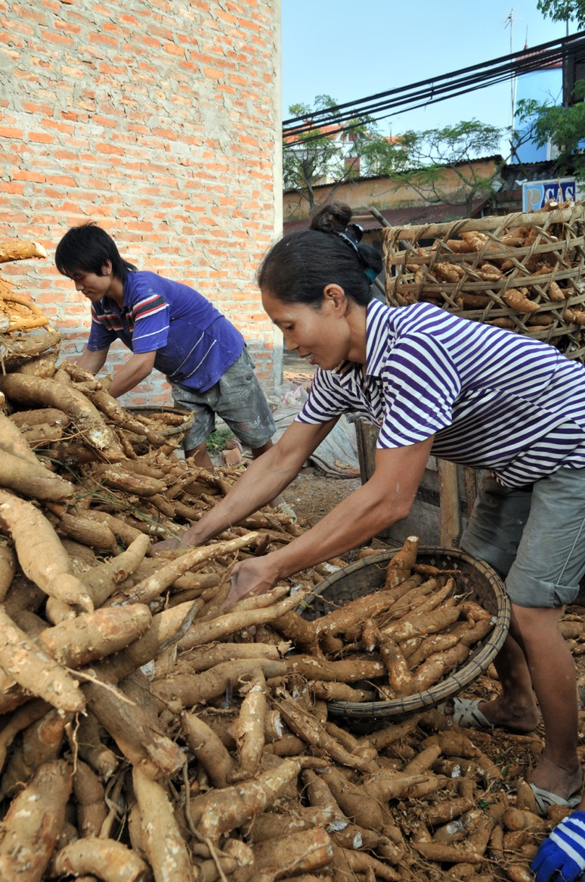
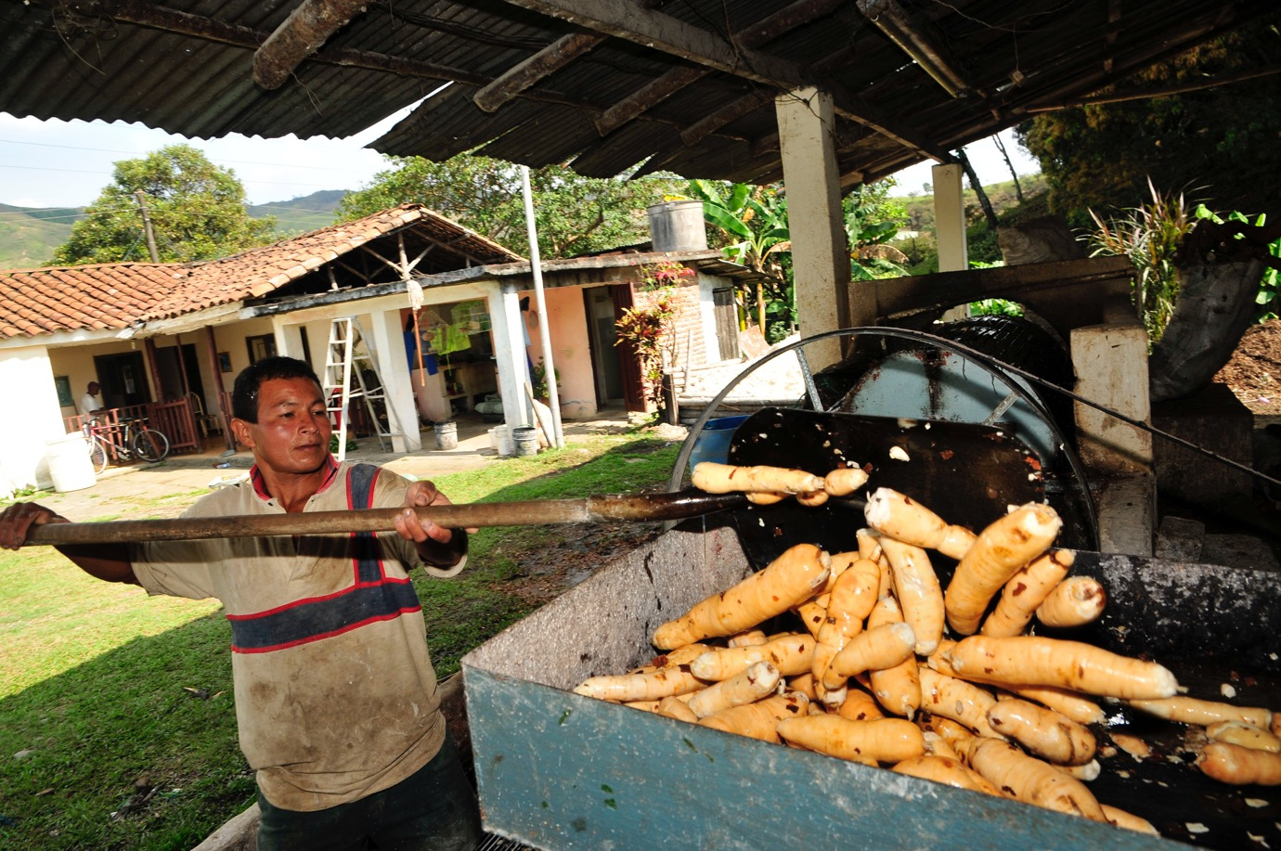
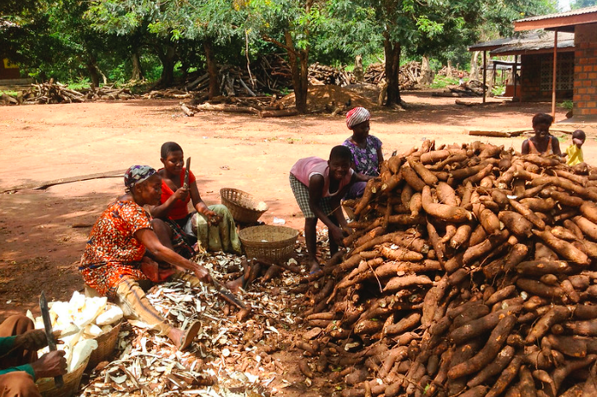
Cassava is an important food crop for over 800 million people worldwide
Cassava
Colombia, South America
Vietnam, Asia
Image left: Neil Palmer, CC BY-SA 2.0
Image middle: IFPRI-IMAGES, CC BY-NC-ND 2.0
Image right: Neil Palmer, CC BY-SA 2.0
Ghana, Africa
Notes:
Cassava is an important crop for over 800 million people worldwide. Cassava is a high-calorie food that can grow in nutrient-poor soil and tolerate drought. It is invaluable for populations in Asia and South America, as well as Africa, where it is eaten regularly by up to 40% of the population. Increasingly, the use of cassava is gaining popularity across the world - for example to make the “bubbles” in bubble tea.
Image (left): “NP Cassava processing 6” by Neil Palmer, accessed February 05, 2020 (https://www.flickr.com/photos/ciat/5867707606). Available under a Creative Commons Attribution-ShareAlike 2.0 Generic license (https://creativecommons.org/licenses/by-sa/2.0/).
Image (middle): “A group work to peel the cassava for processing” by IFPRI -IMAGES, accessed February 05, 2020 (https://www.flickr.com/photos/ifpri/14664017485). Available under a Creative Commons Attribution-NonCommercial-NoDerivs 2.0 Generic license (https://creativecommons.org/licenses/by-nc-nd/2.0/).
Image (right): “Vietnam cassava processing 16” by Neil Palmer, accessed February 05, 2020 (https://www.flickr.com/photos/ciat/4071072936/in/photostream/). Available under a Creative Commons Attribution-ShareAlike 2.0 Generic license (https://creativecommons.org/licenses/by-sa/2.0/).

Slide 6
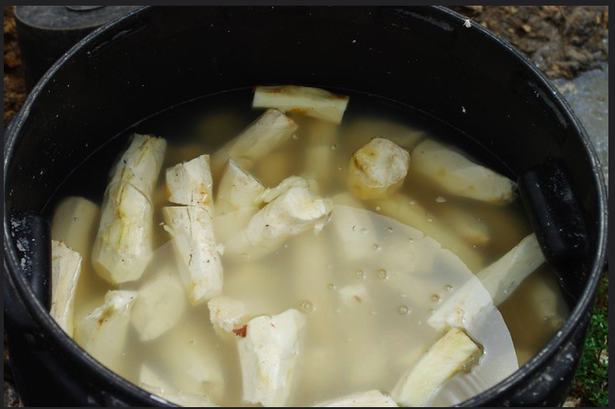
Cassava can cause a disease called Konzo
Cassava
Cassava naturally produces a toxin, which is present at higher levels when the plant is grown in drought conditions.
At high levels, this toxin can cause Konzo, a disease that leads to paralysis and can potentially be deadly.
Soaking the cassava in water and eating a protein-rich diet can prevent Konzo and make cassava a safe source of food.
Konzo is a disease of poverty, because poverty often limits access to water and a protein-rich diet.
IITA, CC BY-NC-SA 2.0
Notes:
Depending on how it is grown and prepared, cassava can cause a disease called Konzo. Cassava plants naturally produce a toxin that can cause Konzo, a disease that leads to paralysis and can potentially be deadly (see sidebar). This is particularly problematic when cassava is grown in arid conditions. Still, there are different approaches for avoiding Konzo. First, soaking cassava in water for several days reduces the plant’s toxicity. Second, eating a protein-rich diet can help the body to break down the toxin more effectively. While these solutions may appear to be relatively simple, their implementation can be difficult due to systemic and historical barriers. In parts of Africa where Konzo is prevalent, European colonialism has left behind extreme poverty. Access to water and protein-rich foods is scarce, and people who are affected by paralysis are often not able to make the trip to the nearest river or well to collect the water needed for soaking the cassava. Moreover, waiting several days to soak cassava is not possible for people who are urgently hungry. This is why Konzo is considered a disease of poverty. Furthermore, Konzo maintains the cycle of poverty, as people with the disease lose the ability to work and collect water. We recommend teachers read: “Poverty Plus a Poisonous Plant Blamed for Paralysis in Rural Africa” by Amy Maxmen, National Public Radio.
How might genome editing help improve health and reduce disease for the people who rely on cassava?
Image: “Peeled cassava soaked in a tub for fermentation” by IITA, accessed February 05, 2020 (https://www.flickr.com/photos/iita-media-library/4535105072/in/photolist-qQQiDy-6W2ghP-2dtKUFA-2cseyvw-PN3p7H-2ejmsZY-28TApDd-ZAvhkT-DP5tJQ-24vtKGg-7UKAJL-2aXhHqx-qtAA6u-cKbhwY-mUj5QZ-mUm62q-mUj5vk-mUj5ka-rpnyA6-bQaEP8-mUm5uJ-mUm423-pRZGJ-71WUAa-qtAtnj-SfQqju-RmEqek-SYQEnY-23Mvrvz-7gH4B1-HWUtWG-8r2Lq7-PawwES-t7EXys-9z7Fxn). Available under a Creative Commons Attribution-NonCommercial-ShareAlike 2.0 Generic license (https://creativecommons.org/licenses/by-nc-sa/2.0/).

Slide 7
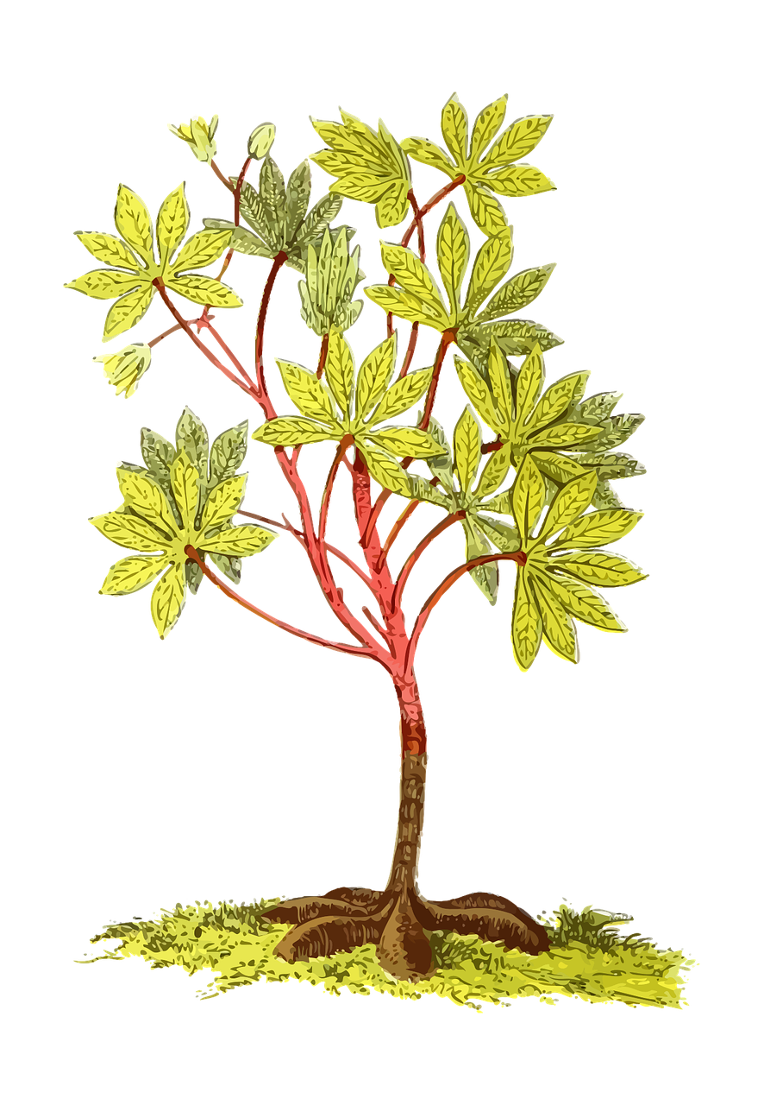

Genome editing of the cassava’s DNA could be used to lower the plant’s toxicity.
Cassava
Cassava has 2 genes that are responsible for the plant’s toxic effects.
CRISPR could be used to edit these genes to reduce the toxicity of cassava.
CRISPR
Schematic created by pgEd (Nadine Vincenten)
Notes:
Editing the cassava’s DNA could lower the plant’s toxicity. Two genes are responsible for the toxicity of cassava. Scientists have proposed using a genome editing technique called CRISPR to make specific changes to these genes with the goal of reducing the plant’s toxicity. One major advantage of using CRISPR to introduce genetic changes is that it is much faster than traditional breeding methods. Furthermore, CRISPR technologies can be applied to local varieties of the cassava plant, thus maintaining characteristics of the plant that make it well-suited to the region where it will be grown. The researchers are hoping to improve on current CRISPR methods, which introduce some foreign DNA into the target organism, so they are developing a new approach called ‘DNA-free CRISPR’. Using the DNA-free CRISPR method, the cassava would only carry its own DNA, which would sidestep regulatory hurdles surrounding GMOs in certain countries (see sidebar) and allow the product to become available for use much faster. This project is in the early stages in 2020.
Schematic: created by pgEd (Nadine Vincenten). Using open access illustration on Pixabay.com, accessed February 05, 2020. (https://pixabay.com/vectors/america-cassava-edible-food-manioc-1299770/)

Slide 8

Major questions and considerations
Cassava
Could genome editing negatively affect the plant’s drought-tolerance, a very beneficial trait for many regions across the globe?
Could genome editing of cassava make the plant more vulnerable to insects? If so, would farmers need to use pesticides to grow their crop?
Will someone own the edited plants? What about the seeds?
Should efforts in preventing Konzo lie with this genome editing approach? Or should the focus be on breaking the cycle of poverty? Might a combination of approaches be the best way forward?
Neil Palmer, CC BY-SA 2.0
Notes:
Scientists and communities are considering the risks and benefits of using genome editing to lower cassava toxicity. Using genome editing to lower the cassava’s toxicity could have unintended consequences. For example, the cassava’s toxicity appears to be correlated with its ability to tolerate drought, as the drier the circumstances are, the more toxin the plant produces. Could the edits negatively affect the plant’s drought-tolerance, a beneficial trait for growing in many regions across the globe? Furthermore, cassava’s toxicity is thought to provide a defense against insects. Could the edited cassava plants require farmers to use pesticides in order to grow their crop? Lastly, what will the economic implications be? Who will own the plants as well as the seeds of the edited cassava? Will farmers be able to afford this new crop?
As students consider the use of genome editing to make cassava safer and more sustainable, what are other possible approaches? The DNA sequence of the cassava plant, published in 2016, allows scientists to better understand the genes involved in toxicity. Could this provide a roadmap for using conventional breeding methods to choose cassava varieties with specific beneficial genetic traits? Stepping back further, Konzo is a disease of poverty with lack of access to water and protein-rich food being the main contributors. Should disease prevention efforts focus on a genetic solution? Or should the focus be on breaking the cycle of poverty that is at the root? Might a combination of approaches be the best way forward?
Image: “Cassava root 2” by Neil Palmer, accessed February 05, 2020 (https://www.flickr.com/photos/ciat/4627298692/in/photostream/). Available under a Creative Commons Attribution-Sharealike 2.0 Generic license (https://creativecommons.org/licenses/by-sa/2.0/).

Slide 9
Do Now: Discuss the following with the person (or people) next to you:
Honeycreeper
You are a scientist. You are visiting an island where a species of birds is in danger of extinction because they suffer from a disease that is given to them through mosquito bites. You think that the best way to rescue the birds is to use genome editing to wipe out the mosquitoes on the island.
You know that the people who live on the island need to be partners in this project. How do you establish such a partnership? What is the information you need to gather from them, and what is the most important information for you to share? What are you looking to learn?
Notes:
Do Now. Students will discuss the scenario in which they imagine themselves as a scientist consulting with a community to explore a controversial idea: using genetically modified mosquitoes to combat malaria infections.
Student answers will vary. For example, ideas to establish a partnership may include: (1) setting up a lab in the affected area, (2) hiring staff from the island who can provide local expertise, and (3) hosting a series of meetings to have dialogue with the general public. Engaging local communities is important from an ethical point of view to build trust between scientists and the public and to ensure informed consent for projects going forward in their environment. Furthermore, community partnerships can bring to the table diverse types of knowledge [e.g., local entomology (study of insects) and epidemiology as well as local social structures and politics], which can lead to the development of better strategies for addressing the problem. Examples of on-going gene drive (see slide 12) projects - how they have interacted with and impacted local communities - can be found in this article.

Slide 10
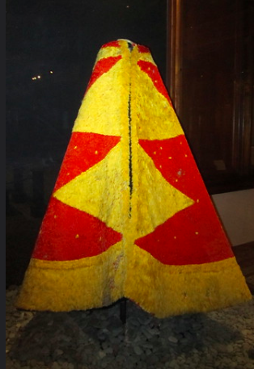
The Hawaiian honeycreeper is at risk of extinction
Honeycreeper
This 'ahu'ula, or feather cloak, is thought to have belonged to Chief Kalani'ōpu'u (d. 1782) of Hawai'i Island
USFWS – Pacific Region, CC BY-NC 2.0
Wally Gobetz, CC BY-NC-ND 2.0
Notes:
Hawaiian honeycreepers - colorful birds that are culturally important to the Indigenous people of Hawaii and beloved by many people all over the world - are at risk of extinction. The people of Hawaii and others are seeking a solution to protect Hawaiian honeycreepers from going extinct. Honeycreepers are an important part of the ecosystem on the Hawaiian islands and hold historical and cultural importance as well. The Indigenous peoples of Hawaii have used feathers from honeycreepers to make ceremonial cloaks called ahu’ula and helmets known as mahiole.
However, the population of Hawaiian honeycreepers is dwindling, in part because their habitat is being destroyed by human activity. Another threat to the survival of these birds are mosquitoes that carry an avian form of malaria. Avian malaria is a bird disease caused by parasites that spread to the honeycreepers through mosquito bites. Hawaiian honeycreepers are specifically adapted for life in Hawaii, where mosquitoes did not exist until the 1800s. As such, these species of honeycreepers have no natural defense against avian malaria. Since the early 2000s, the population of Hawaiian honeycreepers has fallen an average of 68% (in their main living area) to 94% (at the outer edges of their habitat).
Image (left): “'I'iwi - Vestiaria coccinea” by USFWS - Pacific Region, accessed February 05, 2020 (https://www.flickr.com/photos/usfwspacific/36474996884/in/photolist-npj4sr-agb8jE-iVSK5i-QTfSa9-bsZRZr-XzaTNC-Yymcbo-YymaNd-wUE7m-4Wh3K5-4WgVnf-dvuz71-agb8hj-4Warst-4WeEo3-4Waswx-4WgEiL-ag8n28-4WeHBL-DVaASc-4WapjV-4Wh2Wo-4WhaKN-8WFCfh-ag8m1r-9V1gHh-29L7nri-MQqdKq). Available under a Creative Commons Attribution-NonCommercial 2.0 Generic license (https://creativecommons.org/licenses/by-nc/2.0/).
Image (right): “O'ahu - Honolulu: Bishop Museum - Hawaiian Hall - Kalani'ōpu'u's 'ahu'ula” by Wally Gobetz, accessed February 05, 2020 (https://www.flickr.com/photos/wallyg/4827161644). Available under a Creative Commons Attribution-NonCommercial-NoDerivs 2.0 Generic license (https://creativecommons.org/licenses/by-nc-nd/2.0/).

Slide 11
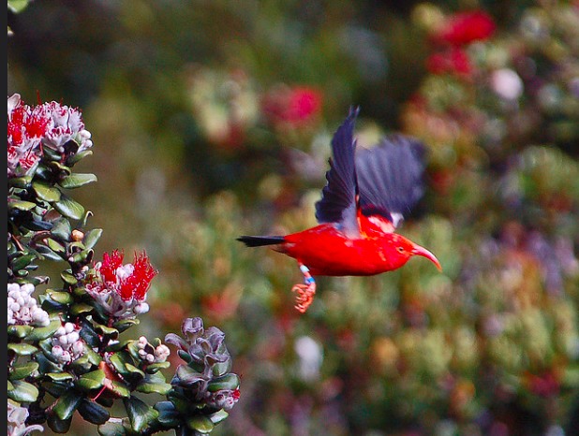
Environmental changes are increasing the threat of avian malaria
Honeycreeper
Avian malaria is a bird disease caused by parasites that infect the honeycreepers via mosquito bites.
The honeycreepers are forced to live at higher altitudes where it is too cold for the mosquitoes to survive.
For food, honeycreepers need to travel into the valleys. This puts them at risk of malaria infection.
Average temperatures in Hawaii are increasing, which allows the mosquitoes to live higher-and-higher up the mountains. This is putting the honeycreepers at risk of extinction.
U.S. Fish and Wildlife Service Headquarters, CC BY 2.0
Notes:
Environmental changes are increasing the threat of avian malaria to Hawaiian honeycreepers, driving these birds closer to extinction. Since the introduction of mosquitoes and avian malaria to the Hawaiian islands in the 1800s, honeycreepers have been forced to live at higher altitudes where the temperatures are too low for the mosquitoes to survive. However, to gather food, the birds have to travel into the valleys, where they are at risk of malaria infection. With average annual temperatures increasing in Hawaii, mosquitoes are now able to survive at higher and higher altitudes. This is shrinking the honeycreepers’ habitat even further and bringing them to the brink of extinction.
How can Hawaiian honeycreepers be preserved? Habitat restoration is part of the solution, but other approaches may be needed as well. One of the possibilities being considered is the use of genome editing. (For more on this as well as other ideas being explored, see this summary of a meeting between scientists, policymakers and community stakeholders: “To Restore a Mosquito Free Hawaii”.) How might genome editing help prevent the Hawaiian honeycreepers from going extinct?
Image: “i'iwi in flight” by U.S. Fish and Wildlife Service Headquarters, accessed February 05, 2020 (https://www.flickr.com/photos/usfwshq/6867763786). Available under a Creative Commons Attribution 2.0 Generic license (https://creativecommons.org/licenses/by/2.0/).

Slide 12
Genome editing of mosquitoes could be used to prevent avian malaria infection
Honeycreeper
2 genome editing approaches to combat avian malaria:
Mosquito with genetic trait of interest
Mosquito with genetic trait of interest &
GENE DRIVE
Wild mosquito
Wild mosquito
Introduce genetic trait that will wipe out mosquito population
50% chance of passing trait to offspring
100% chance of passing trait to offspring
Introduce genetic trait that prevents mosquito from carrying malaria parasite
Schematic created by pgEd (Nadine Vincenten)
Notes:
This slide is animated to introduce this concept to students in three steps.
a) Editing the DNA of mosquitoes could be used to prevent them from infecting Hawaiian honeycreepers with avian malaria. Two approaches have been suggested: (1) to introduce a genetic trait in the mosquitoes that would greatly reduce and possibly fully eliminate the mosquito population, and (2) to introduce a genetic trait in the mosquitoes that would make them unable to carry the avian malaria parasite, so they can no longer transmit the parasite to the honeycreepers.
b) The challenge of introducing these genetic traits into the population of mosquitoes living in the wild is that, under normal sexual reproduction, the trait will only be passed to ~50% of the next generation. This means that the trait would not spread very widely in the Hawaiian mosquito population.
c) To address this problem, a genetic technology known as a “gene drive” could be used to increase the likelihood that a genetic trait will be passed to the next generation. In this way, a gene drive allows for a specific trait to quickly spread in a population. With the advent of CRISPR, the gene drive approach has become a practical reality. For a more detailed explanation of gene drives, see slide 21.
Schematic: created by pgEd (Nadine Vincenten). Using open access image on svgsilh.com, accessed February 05, 2020. (https://svgsilh.com/image/1465064.html)

Slide 13
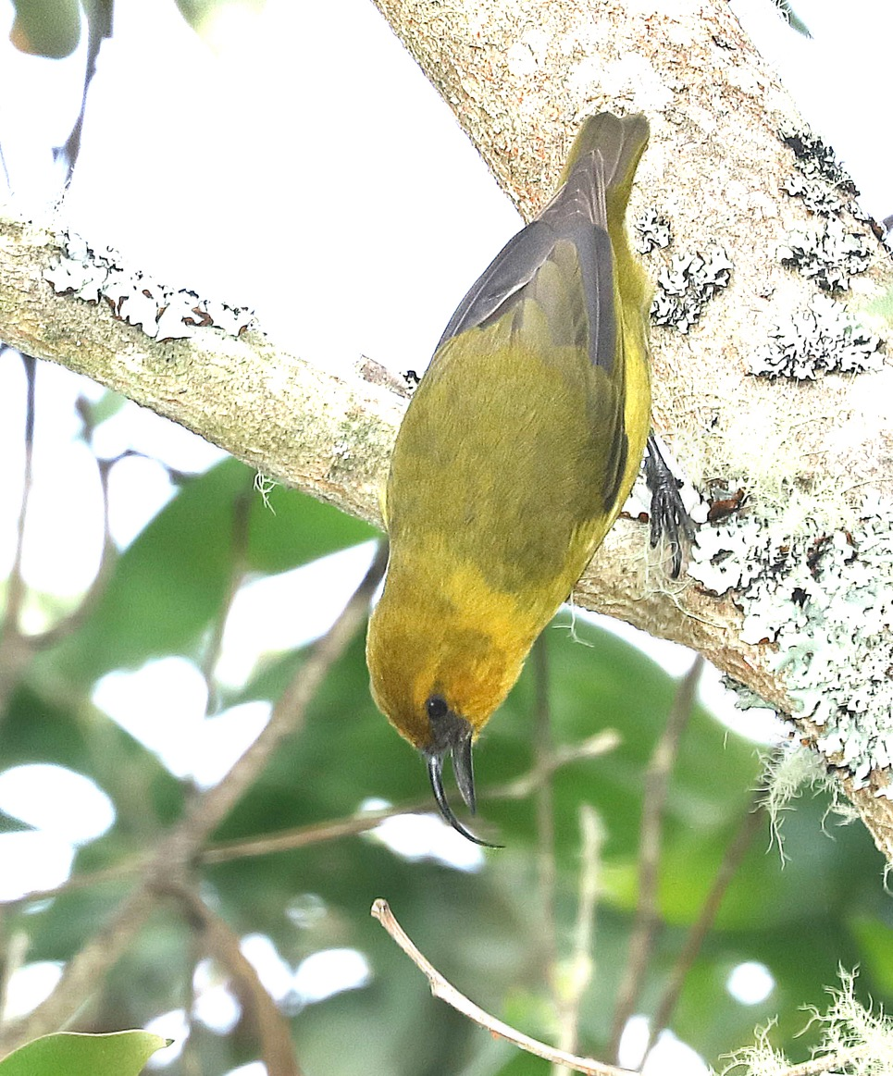
Major questions and considerations
Honeycreeper
Which of the two genetic engineering approaches would be most beneficial for Hawaii?
What might be some unintended consequences of either of these approaches?
Can we prevent the gene drive from spreading a genetic trait beyond the Hawaiian mosquito population?
What are reasonable risks and worthwhile benefits in trying to prevent the Hawaiian honeycreeper from going extinct?
Who are the key people to involve in the decision about whether to use a genome editing approach?
Alan Schmierer
Notes:
Multiple viewpoints and issues need to be considered as scientists and communities weigh the risks and benefits of using genetically-engineered mosquitoes to prevent the extinction of the Hawaiian honeycreeper. Using genome editing could help to halt the rapid decline of the Hawaiian honeycreeper population; however, there are several aspects of this approach that need further consideration.
1. Which genetic trait would be the most beneficial to introduce into the wild mosquito population: (1) one that would greatly reduce and possibly eliminate the mosquito populations, or (2) one that would prevent the mosquitoes from carrying the avian malaria parasite? Given that the mosquitoes are not native to Hawaii, wiping them out could be considered as a “reset button”. However, what if the mosquitoes have become an integral part of the ecosystem during the ~200 years that they have been present in Hawaii? What if other species are now dependent on the mosquitoes for their survival? In this light, preventing mosquitoes from carrying the avian malaria parasite instead of possibly wiping out the mosquito population might be preferable. However, these mosquitoes are known to be able to carry a number of diseases that can affect animals as well as humans (e.g., Western equine encephalitis and West Nile virus). Preventing the mosquitoes from carrying avian malaria parasites will not prevent them from transmitting these other diseases.
2. Could the use of a gene drive to rapidly spread the genetic trait of interest through the Hawaiian mosquito population have far-reaching effects (e.g., spreading the genetic trait beyond the target population)? For example, a gene drive targeted to wipe out the local mosquito population on Hawaii could end up driving this species to extinction across the globe. Scientists are trying to design built-in “safety mechanisms” to limit the effects of the gene drive to the target species or even to reverse the gene drive if unintended consequences arise.
3. As students consider the use of genome editing to combat avian malaria in Hawaii, what are other possible approaches? In urban areas, methods such as (a) limiting the sources of standing water where mosquitoes breed (called "source reduction"); (b) targeted application of insecticides; and (c) using devices that attract and kill female mosquitoes (called "lethal ovitraps") have proven to be successful in controlling mosquito populations. However, these approaches are challenging and costly to apply in the rural and forested areas of Hawaii where the honeycreepers live. Another possible method is the Sterile Insect Technique (SIT), which involves releasing male mosquitoes into the wild that are either infertile or produce offspring that do not survive long enough to reproduce. This method can be successful in eliminating a local mosquito population, but may not work if the released males do not compete effectively with the wild male mosquitoes for breeding with wild females. SIT is considered “self-limiting” as the trait that causes the mosquitoes to be infertile (or produce offspring with limited survival) dies with them.
As described above, each approach brings risks for unintended consequences as well as potential benefits. For example, eliminating the mosquitoes could save Hawaiian honeycreepers from going extinct, but, at the same time, another species that has come to depend on these mosquitoes for food could be pushed to the brink of extinction. What are reasonable risks and worthwhile benefits? These are questions that require strong partnerships with communities to gather diverse expertise (such as knowledge of local entomology and epidemiology as well as local social structures and politics) for developing strategies to save the Hawaiian honeycreepers.
Image: “AKIAPOLA'AU (8-30-2017) hakalau forest national wildlife refuge, hawaii co, hawaii -08 male” by Alan Schmierer, accessed February 05, 2020 (https://flickr.com/photos/sloalan/36977826146/in/photostream/). Public Domain.

Slide 14
Do Now: Discuss the following with the person (or people) next to you:
Mammoth
You are a farmer in Siberia, tending animals and vegetables on your land. You heard a team of scientists are hoping to bring the woolly mammoth back from extinction. These animals once roamed exactly where you live. How do you feel about this plan? What are your questions about it?
Notes:
Do Now. Students are asked to discuss the scenario about the use of genome editing to bring back extinct species.
When students are asked to imagine this project from the perspective of people living on the land that the revived animals would occupy, students are likely to express skepticism or excitement. Some might express concern about the possibility that Indigenous people living in areas of the world where woolly mammoths used to roam (e.g., Siberia, Alaska, Canada, and Greenland) are not part of the decision-making process and stand to lose more and more of their land.

Slide 15

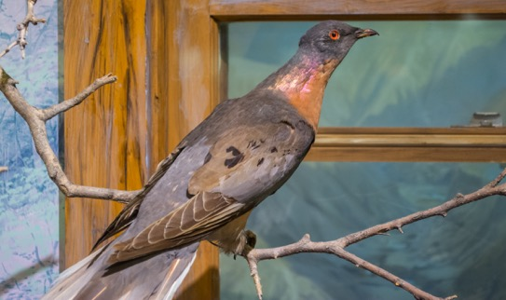
What is de-extinction?
Mammoth
De-extinction is the process of reviving an extinct species or creating an organism that resembles an extinct species
Tasmanian Tiger
Moa
Passenger Pigeon: Tim Evanson CC BY-SA 2.0
Moa: Joseph Smith
Tasmanian Tiger: artist unknown
Woolly Mammoth: Mammut, CC BY-SA 2.0
Passenger Pigeon
Woolly Mammoth
Notes:
What is de-extinction? De-extinction is the process of reviving an extinct species or creating an organism that resembles an extinct species. Genome editing tools have made this a possibility that some people are interested to consider. The woolly mammoth is often cited as one of the most compelling candidates for de-extinction. In natural history museums, displays of woolly mammoths, with their unique features that symbolize the Ice Age (Pleistocene), have long sparked the imagination. One of the reasons mammoths are being considered for de-extinction is the potential role they could play in slowing the thawing of permafrost. The project to bring them back would require a mix of high-tech and low-tech solutions, and highlights some of the moral and ecological dilemmas in the field. We will explore this idea in the next couple of slides.
Image (Passenger Pigeon): “passenger pigeon - Cleveland Museum of Natural History” by Tim Evanson, accessed February 05, 2020 (https://www.flickr.com/photos/timevanson/34800477455). Available under a Creative Commons Attribution-ShareAlike 2.0 Generic license (https://creativecommons.org/licenses/by-sa/2.0/).
Image (Moa): “South Island Giant Moa, Dinornis robustus (forground) and Pachyornis elephantopus (background)” by Joseph Smith, accessed February 05, 2020 (https://en.m.wikipedia.org/wiki/File:Giant_moa.jpg). Public Domain.
Image (Tasmanian Tiger): “Tasmanian tiger.jpg”, artist unknown, accessed February 05, 2020 (https://commons.wikimedia.org/wiki/File:Tasmanian_tiger.jpg). Public Domain.
Image (Woolly Mammoth): “Woolly Mammoth” by Mammut, accessed February 05, 2020 (https://commons.wikimedia.org/wiki/File:Woolly_mammoth.jpg). Available under a Creative Commons Attribution-Sharealike 2.0 Generic license (https://creativecommons.org/licenses/by-sa/2.0/).

Slide 16
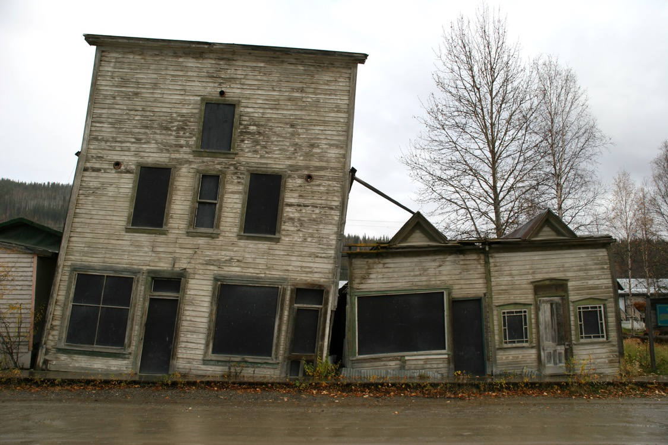
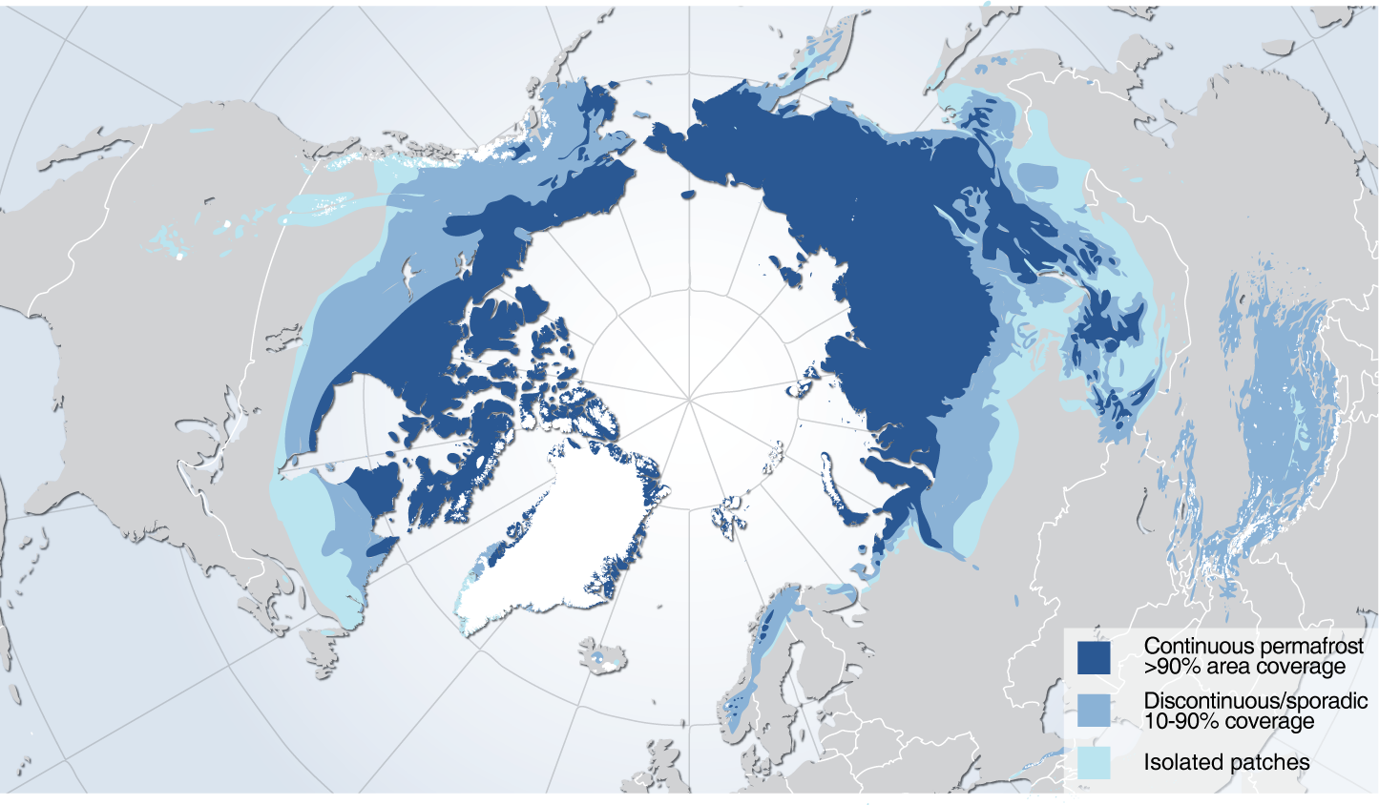
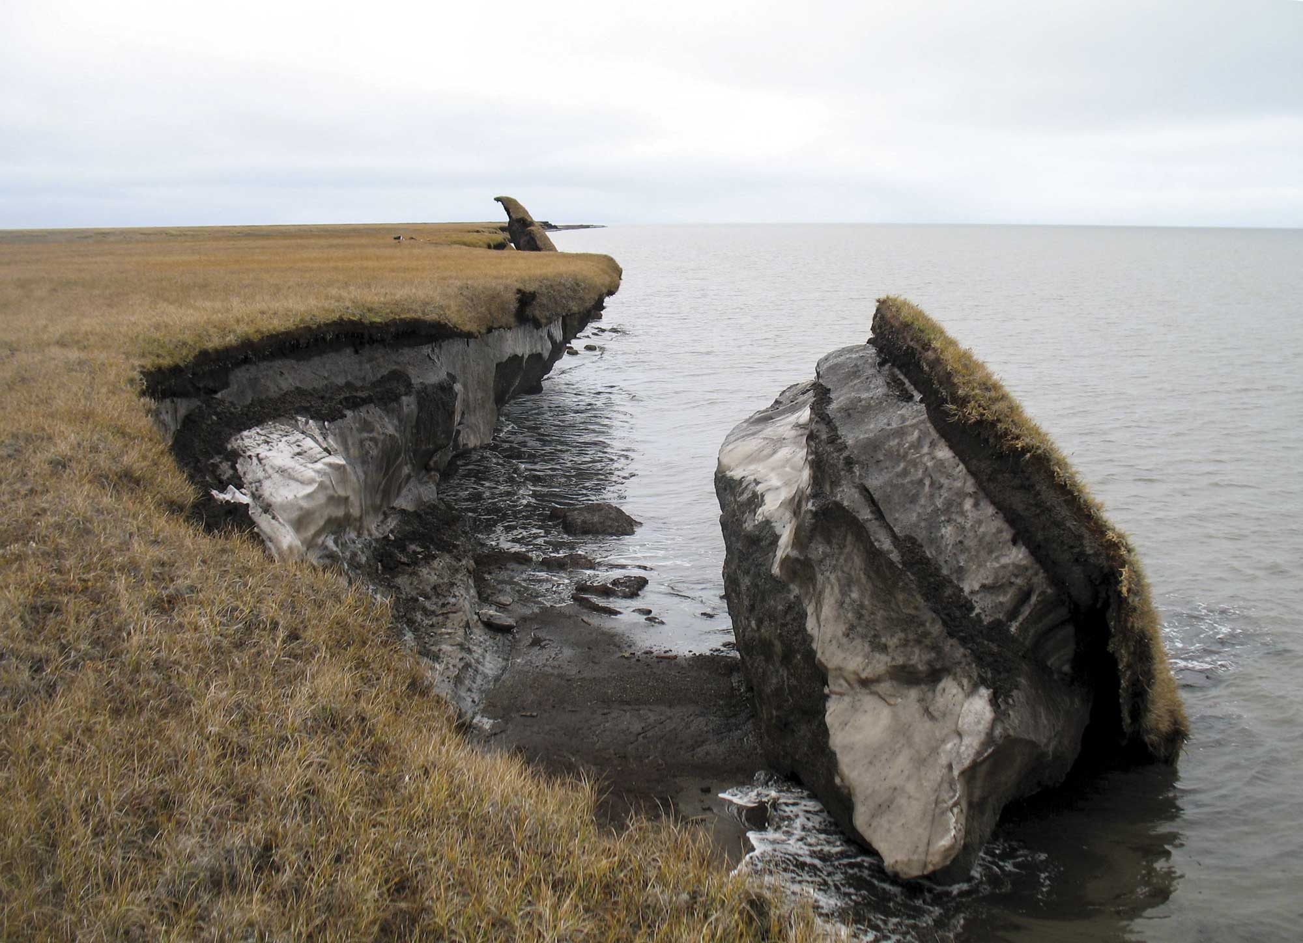
The thawing permafrost has a big impact on our environment
Mammoth
Houses shifting due to permafrost thawing.
Coastal erosion due to permafrost thawing.
Image (left): GRID Arendal, CC BY-NC-SA 2.0
Image (top-right): Terry Feuerborn, CC BY-NC 2.0
Image (bottom-right): USGS
Notes:
The thawing of permafrost has a big impact on our environment. The permafrost is a layer in the ground that remains below 32ºF (0ºC) for at least two years in a row. Permafrost is found in areas where the average temperature rarely gets above freezing - on land as well as below the ocean floor. Approximately 20% of the earth’s land surface is permafrost, which is mainly found in tundra and taiga landscapes of the Northern Hemisphere (e.g., in Siberia, Alaska, Canada, and Greenland). As average global temperatures rise, the total area of permafrost is shrinking. Thawing of the permafrost is a particular concern because the frozen soil stores significant amounts of carbon that, if released into the Earth’s atmosphere, could have significant global impact. It is estimated that the permafrost contains twice as much carbon as is found in the Earth’s atmosphere today. According to current models, as much as 5-15% of the carbon stored in permafrost soils will be released into the atmosphere by the end of this century. This carbon is released in the environment in the form of carbon dioxide and methane, two greenhouse gases that trap infrared radiation near the Earth’s surface and therefore could accelerate the rise of average temperatures around the globe. In regions such as Alaska (where 85% of the land has permafrost), the infrastructure is increasingly affected as the solid frozen foundations disappear. Furthermore, permafrost is thought to contain frozen and preserved bacteria and viruses. The concern is that these pathogens might revive when the permafrost melts and could (re-)introduce diseases into the world for which we have no natural defenses or treatments.
Image (left): “Permafrost extent in the Northern Hemisphere” by GRID Arendal, accessed February 05, 2020 (https://www.flickr.com/photos/gridarendal/31551866533). Available under a Creative Commons Attribution-NonCommercial-ShareAlike 2.0 Generic license (https://creativecommons.org/licenses/by-nc-sa/2.0/).
Image (top-right): “Gold Rush Buildings, Dawson City, YukonTerritory, Canada, 2005” by Terry Feuerborn, accessed February 05, 2020 (https://www.flickr.com/photos/travfotos/249343703/). Available under a Creative Commons Attribution-NonCommercial 2.0 Generic license (https://creativecommons.org/licenses/by-nc/2.0/).
Image (bottom-right): “Climate Impacts to Arctic Coasts” by USGS, accessed February 05, 2020 (https://www.flickr.com/photos/usgeologicalsurvey/32682616471). Public Domain.

Slide 17


How might thawing permafrost be slowed or even reversed?
Mammoth
Tundra & Taiga
Grassland
Tundra & Taiga
Grassland
(large grazers present)
SUMMER: Grasses reflect sunlight more effectively than the dark shrubs and trees of the tundra and taiga.
WINTER: Large grazers present in grassland ecosystems disrupt the snow blanket and expose the ground below to the cold winter air.
Schematic created by pgEd (Nadine Vincenten)
Notes:
How might thawing permafrost be slowed or even reversed? One idea to protect the thawing permafrost is to undertake a massive effort to return the current tundra and taiga landscapes to grassland biome that covered this region thousands of years ago. This would entail large herds of grazers (such as deer, horses, and bison) roaming the landscape to help establish and maintain the grasslands. During the short summer, grasslands keep the ground cooler as their light color reflects sunlight more effectively than the dark-colored shrubs and trees of the tundra and taiga, respectively. During winters, when snow covers the ground, the grazers in the grassland biome keep the ground cooler. In tundra and taiga biomes, the snow acts as a “blanket” that protects the ground below from the bitterly cold winter temperatures. By contrast, in grassy landscapes, grazing herds of herbivores disrupt this snow blanket by tamping down the snow and disturbing the snow cover as they look for food underneath. This compaction and removal of snow exposes the ground below to the cold winter air, which prevents the permafrost from thawing and may even expand this frozen layer, allowing for more carbon to be contained.
Schematic: created by pgEd (Nadine Vincenten). Using open access images on PublicDomainPictures.net (grass) and Needpix.com (bush), accessed February 05, 2020. (https://www.publicdomainpictures.net/en/view-image.php?image=36593&picture=green-grass-clipart and https://www.needpix.com/photo/286734/bush-shrub-green-nature-plant-lush-landscape-botany-growth).

Slide 18
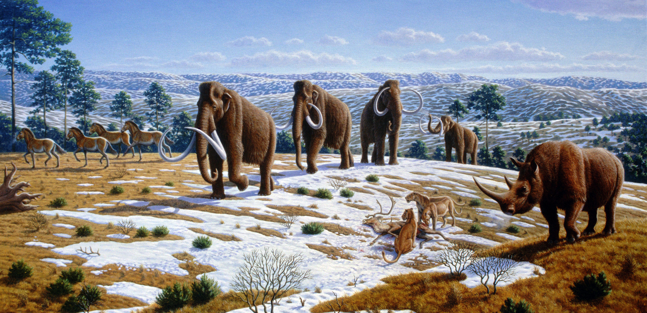
Pleistocene Park and the Woolly Mammoth.
Mammoth
Mauricio Antón, CC BY 2.5
Notes:
Pleistocene Park: a test case for restoring grasslands in Siberia. To test the idea that recreation of a grassland biome could prevent thawing of permafrost, researchers have gathered a number of grazing animals (such as elk, musk oxen, and reindeer) in a 5,000-acre reserve called the Pleistocene Park in Siberia. Preliminary data suggest that this effort lowers the ground’s temperature and slows the thawing of the permafrost, keeping more of the greenhouse gases trapped in the frozen soil (more on these data at “Born to rewild” by Eli Kintisch, Science). While encouraging, this effect would need to be translated on a larger scale to combat the thawing of permafrost globally. Large herds of big grazers would be needed to disrupt the mossy tundra and forested taiga landscapes and recreate the grassland biome of the past. A key animal in this landscape was the woolly mammoth, which was largely extinct by the end of the Pleistocene epoch (roughly 10,000 years ago).
Could de-extinction of large woolly mammoth herds recreate the vast grassland biome and help to preserve the permafrost?
Image: “Ice age fauna of northern Spain - Mauricio Antón.jpg” by Mauricio Antón, accessed February 05, 2020 (https://commons.wikimedia.org/wiki/File:Ice_age_fauna_of_northern_Spain_-_Mauricio_Ant%C3%B3n.jpg). Available under a Creative Commons Attribution 2.5 Generic license (https://creativecommons.org/licenses/by/2.5/deed.en).

Slide 19
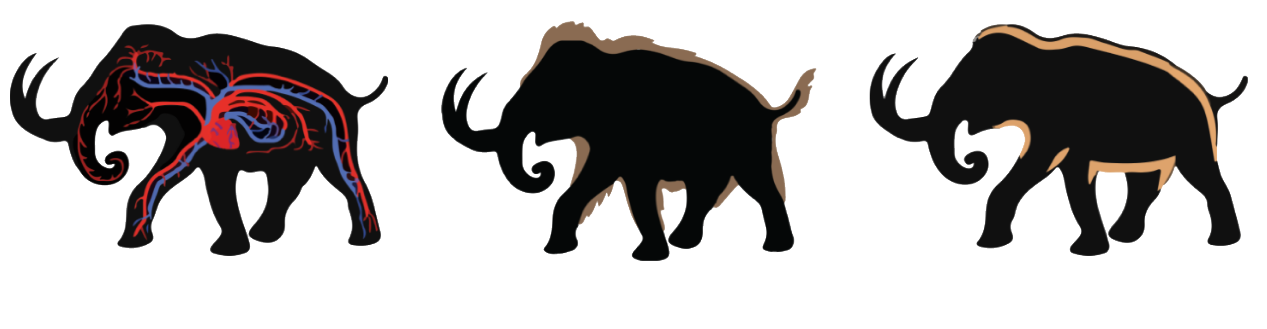
Genome editing could be used to make a cold-resistant “woolly” elephant
Mammoth
Blood oxygen release at low temperatures
Thick hair protects from the elements
More fat under skin for insulation and fasting
Image by Ben Novak, Revive & Restore
Notes:
A leading strategy is using CRISPR to introduce some genetic traits from woolly mammoths into the DNA of its close relative, the Asian Elephant. In other words, the goal of the woolly mammoth de-extinction project is to create a cold-resistant “woolly” elephant, sometimes called a “mammophant”. Though a number of technical hurdles remain, this project was able to get underway because of (1) the discovery of preserved mammoth DNA; (2) the existence of a close living relative of the mammoth, the Asian elephant; and (3) the availability of genome editing tools, such as CRISPR. By analyzing preserved (though highly degraded) mammoth DNA, scientists have been able to identify genes responsible for key traits that helped the mammoth to survive in cold climates. These traits include longer hair, more fat under the skin, and a circulatory system adapted to cold temperatures. Using CRISPR, researchers are introducing these traits into Asian elephant cells in a laboratory setting. This is possible because Asian elephants and woolly mammoths are closely related, sharing 99.96% of their DNA. To make a mammophant, hundreds or maybe thousands of genome edits are likely needed. As of 2020, CRISPR has been used to introduce some woolly mammoth traits in the DNA of Asian elephant cells, and this work is on-going.
Still, if this project is to go forward, several steps and challenges lie ahead. Once the Asian elephant cells have been edited (thus creating mammophant cells), these cells could then be used to generate a mammophant embryo. That embryo could then be transferred into the uterus of an Asian elephant, with the goal of starting a pregnancy that would give rise to a baby mammophant.
Image: By Ben Novak, Revive & Restore, accessed February 05, 2020 (https://reviverestore.org/projects/woolly-mammoth/progress-to-date/). Permission for use granted by Ryan Phelan.

Slide 20
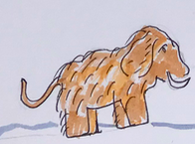
Major questions and considerations
Mammoth
Is it okay to use the Asian elephant, an endangered animal, for this project?
Where would the newly created animals live? And how is the voice of people currently living in these lands weighed in this discussion?
Is it okay to introduce a newly revived species into an existing ecosystem when the impact is not clear?
Do we have an obligation to try any and all efforts to prevent thawing of the permafrost?
Illustration created by pgEd (Dana Waring)
Notes:
Multiple viewpoints and issues need to be considered as scientists and communities weigh the risks and benefits of using genome editing to make a cold-resistant Asian elephant. Beyond the technical challenges of creating a mammophant, described in slide 19, there are a number of ecological and ethical questions as well.
1. Is it acceptable to use the Asian elephant, an endangered species, in this project? There could be risks to an animal used as a surrogate to carry a mammophant pregnancy. Researchers working on this project have suggested the use of an artificial womb to eliminate the surrogacy issue; however, this technology is still in its infancy and could not yet support the development of a mammophant to term. Further concerns exist around the use of Asian elephants in raising the mammophants after they are born. Elephants are very social animals, and the social effects of this project on both the Asian elephants and the mammophants present many unknowns. For example, how would we ensure appropriate rearing and socialization of the mammophants that will provide them with the necessary skills to live in mammophant herds and survive cold climates, when the Asian elephants cannot continuously live there? How would the Asian elephant herd be affected when baby mammophants are introduced? Or when those mammophants are subsequently removed from the herd to inhabit tundra and taiga landscapes?
However, this project may also yield unexpected benefits for preserving the Asian elephant. When scientists working on the mammoth de-extinction project heard about a strain of herpes virus that is deadly for Asian elephant calves, both in captivity and in the wild, they began an effort that may lead to a cure for this disease.
2. Where would the newly de-extincted animals live? There are people currently living in the tundra and taiga landscapes where the mammophants are suggested to be introduced. How will their voices be weighed in this discussion – specifically, the voices of Indigenous peoples in these regions who, throughout history, have seen their claims to land being stripped away?
3. If mammophants are introduced, how would they impact the local ecosystems? There are some examples of success when an animal is reintroduced to its habitat (see National Science Foundation's Understanding the ecological role of wolves in Yellowstone National Park). However, given that mammoths have been extinct for several thousands of years, it is hard to know what impact they might have. Should we proceed when the consequences of introducing newly revived species into wild ecosystems might have outcomes that are hard to predict?
4. Do we have an obligation to try any and all efforts to prevent thawing of the permafrost even if those efforts are expensive, have a high risk of failure, could disrupt existing ecosystems and biomes, or require the use of endangered animals? How do we balance the risks of proceeding with this project with the risks of not proceeding, if there is a chance, however small, that the mammophants could play a role in preventing the release of carbon from the permafrost?
Illustration: created by pgEd (Dana Waring ).

Slide 21
Science Supplement – Gene Drives
Schematic created by pgEd (Nadine Vincenten)
Notes:
Science supplement - Gene Drives. Mosquitoes carry two sets of chromosomes, one inherited from each of their biological parents. This means that, for each gene, there are two copies (or alleles) present. These alleles do not necessarily have the same sequence, though it is possible that they do. When a mosquito reproduces, it will pass one copy of each of its genes to its offspring. In other words, there is a 50% chance that a certain allele will be passed on to the next generation. Under these conditions (left panel), spreading a specific genetic trait of interest (left panel: red) through the entire mosquito population is inefficient.
Gene drive mechanisms increase the likelihood that a specific genetic trait will be passed to the next generation (right panel). Rather than a 50% chance, the trait (right panel: red) could be inherited by most, if not all, of the offspring, thus allowing it to spread through a population at a much faster rate. The way this is achieved is by introducing the genetic sequence that codes for a DNA-cutting enzyme (right panel: blue) together with the genetic trait of interest (right panel: red). When the DNA-cutting enzyme is produced (right panel: scissors), it will cut the chromosome that does not carry the trait of interest. The cell’s repair mechanism will fix this break by using the corresponding sequence from the intact chromosome (which includes the genetic trait of interest and the sequence of the DNA-cutting enzyme; right panel: red + blue) as a template. In other words, the DNA-cutting enzyme (right panel: blue) “drives” the inheritance of the genetic trait of interest (right panel: red) as well as itself (right panel: blue) so that, in the ideal case, 100% of the offspring receive the genetic trait of interest.
In the honeycreeper case study, two genome editing approaches were proposed to combat avian malaria: (1) one that would prevent the mosquitoes from carrying the avian malaria parasite and (2) one that would greatly reduce or possibly eliminate the mosquito populations. The first approach can be achieved by introducing genes that encode antibodies that attack the malaria parasite. By introducing these genes (represented by red in right panel) together with a DNA-cutting enzyme (represented by blue in right panel), this genetic trait can efficiently be spread through the wild mosquito population in Hawaii. This would result in mosquitoes that, when infected with malaria, have an immune system that attacks the parasite so they can no longer transmit the parasite to the honeycreepers.
The second approach involves using a gene drive (represented by blue in right panel) to spread an edited version of a gene called doublesex through the mosquito population (represented by red in right panel). Female mosquitoes that receive two copies of the altered doublesex gene from their biological parents are unable to reproduce. When the altered doublesex gene drive is initially introduced in the population, most mosquitoes will have at least one parent that does not carry the altered doublesex gene. As the gene drive spreads further through the population, the number of mosquitoes that receive an altered doublesex gene from both biological parents increases. This also means an increase in the number of females that cannot reproduce, causing the mosquito population to collapse and possibly be wiped out.
With advances in genome editing researchers have been working on generating gene drive tools that can have widespread application beyond the mosquito example discussed here. In particular, CRISPR provides a DNA-cutting enzyme called Cas9 that is very specific and efficient and can be applied in a wide variety of organisms.
Schematic: created by pgEd (Nadine Vincenten). Using open access image on svgsilh.com, accessed February 05, 2020. (https://svgsilh.com/image/1465064.html)

Slide 22
Image credits
Slide 2: Image (top-left): “Cassava root 2” by Neil Palmer, accessed February 05, 2020 (https://www.flickr.com/photos/ciat/4627298692/in/photostream/). Available under a Creative Commons Attribution-ShareAlike 2.0 Generic license (https://creativecommons.org/licenses/by-sa/2.0/).
Image (top-right): Public domain picture, accessed February 05, 2020. (https://www.pxfuel.com/en/free-photo-xaizx)
Image (middle): “'I'iwi - Vestiaria coccinea” by USFWS - Pacific Region, accessed February 05, 2020 (https://www.flickr.com/photos/usfwspacific/36474996884/in/photolist-npj4sr-agb8jE-iVSK5i-QTfSa9-bsZRZr-XzaTNC-Yymcbo-YymaNd-wUE7m-4Wh3K5-4WgVnf- dvuz71-agb8hj-4Warst-4WeEo3-4Waswx-4WgEiL-ag8n28-4WeHBL-DVaASc-4WapjV-4Wh2Wo-4WhaKN-8WFCfh-ag8m1r-9V1gHh-29L7nri-MQqdKq). Available under a Creative Commons Attribution-NonCommercial 2.0 Generic license (https://creativecommons.org/licenses/by-nc/2.0/).
Image (bottom): “Woolly Mammoth” by Mammut, accessed February 05, 2020 (https://commons.wikimedia.org/wiki/File:Woolly_mammoth.jpg). Available under a Creative Commons Attribution-Sharealike 2.0 Generic license (https://creativecommons.org/licenses/by-sa/2.0/).
Slide 3: Image: “CRISPR Cas9” by Ernesto del Aguila III, accessed February 05, 2020 (https://www.flickr.com/photos/nihgov/41124064215/in/photolist-25DZzxV-ZZM4aG- GKPyT4-2dg5nVs-GRLDp2-jR9gc-ZZM4gJ-RdHQX8-2az1MzU-dAausS-2az1MNQ-Yoax7G-ZZM3Zm-2az1MUb-GP4zR6-YLKyN8-pgBYK3-ACo21-ybZbZ3-YJdu4y-ysEjeQ- ZZM475-R3PK5C-ysCUjh-ysCSuq-WQmDqw-2ceKuAW-YoayiQ-yrfMxq-28vLdcd-ybXr89-2fb9Cow-25a5gZa-YLKykp-2g9mKKf-2g9mmDX-2g9mkNo-yrgw1w-2g9mjjw- 2g9miRT-2g9mFNn-2g9mkeH-yujLht-2g9mGXm-2g9mhPC-YLKyZF-2g9mjBk-ybZrzf-yujhna-yujwnK). Public domain.
Slide 5: Image (left): “NP Cassava processing 6” by Neil Palmer, accessed February 05, 2020 (https://www.flickr.com/photos/ciat/5867707606). Available under a Creative Commons Attribution-ShareAlike 2.0 Generic license (https://creativecommons.org/licenses/by-sa/2.0/).
Image (middle): “A group work to peel the cassava for processing” by IFPRI -IMAGES, accessed February 05, 2020 (https://www.flickr.com/photos/ifpri/14664017485). Available under a Creative Commons Attribution-NonCommercial-NoDerivs 2.0 Generic license (https://creativecommons.org/licenses/by-nc-nd/2.0/).
Image (right): “Vietnam cassava processing 16” by Neil Palmer, accessed February 05, 2020 (https://www.flickr.com/photos/ciat/4071072936/in/photostream/). Available under a Creative Commons Attribution-ShareAlike 2.0 Generic license (https://creativecommons.org/licenses/by-sa/2.0/).
Slide 6: Image: “Peeled cassava soaked in a tub for fermentation” by IITA, accessed February 05, 2020 (https://www.flickr.com/photos/iita-media- library/4535105072/in/photolist-qQQiDy-6W2ghP-2dtKUFA-2cseyvw-PN3p7H-2ejmsZY-28TApDd-ZAvhkT-DP5tJQ-24vtKGg-7UKAJL-2aXhHqx-qtAA6u-cKbhwY- mUj5QZ-mUm62q-mUj5vk-mUj5ka-rpnyA6-bQaEP8-mUm5uJ-mUm423-pRZGJ-71WUAa-qtAtnj-SfQqju-RmEqek-SYQEnY-23Mvrvz-7gH4B1-HWUtWG-8r2Lq7- PawwES-t7EXys-9z7Fxn). Available under a Creative Commons Attribution-NonCommercial-ShareAlike 2.0 Generic license (https://creativecommons.org/licenses/by-nc-sa/2.0/).

Slide 23
Image credits
Slide 7: Schematic: created by pgEd (Nadine Vincenten). Using open access illustration on Pixabay.com, accessed February 05, 2020. (https://pixabay.com/vectors/america-cassava-edible-food-manioc-1299770/)
Slide 8: Image: “Cassava root 2” by Neil Palmer, accessed February 05, 2020 (https://www.flickr.com/photos/ciat/4627298692/in/photostream/). Available under a Creative Commons Attribution-Sharealike 2.0 Generic license (https://creativecommons.org/licenses/by-sa/2.0/).
Slide 10: Image (left): “'I'iwi - Vestiaria coccinea” by USFWS - Pacific Region, accessed February 05, 2020 (https://www.flickr.com/photos/usfwspacific/36474996884/in/photolist-npj4sr-agb8jE-iVSK5i-QTfSa9-bsZRZr-XzaTNC-Yymcbo-YymaNd-wUE7m-4Wh3K5-4WgVnf- dvuz71-agb8hj-4Warst-4WeEo3-4Waswx-4WgEiL-ag8n28-4WeHBL-DVaASc-4WapjV-4Wh2Wo-4WhaKN-8WFCfh-ag8m1r-9V1gHh-29L7nri-MQqdKq). Available under a Creative Commons Attribution-NonCommercial 2.0 Generic license (https://creativecommons.org/licenses/by-nc/2.0/).
Image (right): “O'ahu - Honolulu: Bishop Museum - Hawaiian Hall - Kalani'ōpu'u's 'ahu'ula” by Wally Gobetz, accessed February 05, 2020 (https://www.flickr.com/photos/wallyg/4827161644). Available under a Creative Commons Attribution-NonCommercial-NoDerivs 2.0 Generic license (https://creativecommons.org/licenses/by-nc-nd/2.0/).
Slide 11: Image: “i'iwi in flight” by U.S. Fish and Wildlife Service Headquarters, accessed February 05, 2020 (https://www.flickr.com/photos/usfwshq/6867763786). Available under a Creative Commons Attribution 2.0 Generic license (https://creativecommons.org/licenses/by/2.0/).
Slide 12: Schematic: created by pgEd (Nadine Vincenten). Using open access image on svgsilh.com, accessed February 05, 2020. (https://svgsilh.com/image/1465064.html)
Slide 13: Image: “AKIAPOLA'AU (8-30-2017) hakalau forest national wildlife refuge, hawaii co, hawaii -08 male” by Alan Schmierer, accessed February 05, 2020 (https://flickr.com/photos/sloalan/36977826146/in/photostream/). Public Domain.
Slide 15: Image (Passenger Pigeon): “passenger pigeon - Cleveland Museum of Natural History” by Tim Evanson, accessed February 05, 2020 (https://www.flickr.com/photos/timevanson/34800477455). Available under a Creative Commons Attribution-ShareAlike 2.0 Generic license (https://creativecommons.org/licenses/by-sa/2.0/).
Image (Moa): “South Island Giant Moa, Dinornis robustus (forground) and Pachyornis elephantopus (background)” by Joseph Smith, accessed February 05, 2020 (https://en.m.wikipedia.org/wiki/File:Giant_moa.jpg). Public Domain.
Image (Tasmanian Tiger): “Tasmanian tiger.jpg”, artist unknown, accessed February 05, 2020 (https://commons.wikimedia.org/wiki/File:Tasmanian_tiger.jpg). Public Domain.

Slide 24
Image credits
Slide 15: Image (Woolly Mammoth): “Woolly Mammoth” by Mammut, accessed February 05, 2020 (https://commons.wikimedia.org/wiki/File:Woolly_mammoth.jpg). Available under a Creative Commons Attribution-Sharealike 2.0 Generic license (https://creativecommons.org/licenses/by-sa/2.0/).
Slide 16: Image (left): “Permafrost extent in the Northern Hemisphere” by GRID Arendal, accessed February 05, 2020 (https://www.flickr.com/photos/gridarendal/31551866533). Available under a Creative Commons Attribution-NonCommercial-ShareAlike 2.0 Generic license (https://creativecommons.org/licenses/by-nc-sa/2.0/).
Image (top-right): “Gold Rush Buildings, Dawson City, YukonTerritory, Canada, 2005” by Terry Feuerborn, accessed February 05, 2020 (https://www.flickr.com/photos/travfotos/249343703/). Available under a Creative Commons Attribution-NonCommercial 2.0 Generic license (https://creativecommons.org/licenses/by-nc/2.0/).
Image (bottom-right): “Climate Impacts to Arctic Coasts” by USGS, accessed February 05, 2020 (https://www.flickr.com/photos/usgeologicalsurvey/32682616471). Public Domain.
Slide 17: Schematic: created by pgEd (Nadine Vincenten). Using open access images on PublicDomainPictures.net (grass) and Needpix.com (bush), accessed February 05, 2020. (https://www.publicdomainpictures.net/en/view-image.php?image=36593&picture=green-grass-clipart and https://www.needpix.com/photo/286734/bush- shrub-green-nature-plant-lush-landscape-botany-growth).
Slide 18: Image: “Ice age fauna of northern Spain - Mauricio Antón.jpg” by Mauricio Antón, accessed February 05, 2020 (https://commons.wikimedia.org/wiki/File:Ice_age_fauna_of_northern_Spain_-_Mauricio_Ant%C3%B3n.jpg). Available under a Creative Commons Attribution 2.5 Generic license (https://creativecommons.org/licenses/by/2.5/deed.en).
Slide 19: Image: By Ben Novak, Revive & Restore, accessed February 05, 2020 (https://reviverestore.org/projects/woolly-mammoth/progress-to-date/). Permission for use granted by Ryan Phelan.
Slide 20: Illustration: created by pgEd (Dana Waring).
Slide 21: Schematic: created by pgEd (Nadine Vincenten). Using open access image on svgsilh.com, accessed February 05, 2020. (https://svgsilh.com/image/1465064.html)

