Slide 1

DNA, Crime, and Law Enforcement
2020 edition

Slide 2
Do Now: Discuss the following with the person (or people) next to you:
You are a business owner. In the past two weeks, your manager has found a pile of human feces in the warehouse on more than one occasion. The manager thinks some unhappy workers may be the ‘devious defecators’ and proposes using a DNA test to find the culprit.
As the business owner, do you go forward with DNA testing your employees to identify the “devious defecators”?
Notes:
The scenario for this “Do Now” activity will help students begin to consider the topics covered in the lesson. This “Do Now” exercise is based on the “devious defecator” case, which is outlined in slide 3. Detailed notes on the “Do Now” are on page 6.

Slide 3
The first case to go to trial under the Genetic Information Non-discrimination Act:
The “Devious Defecators”
Pixabay.com
Notes:
A recent court case highlighted how the Genetic Information Non-discrimination Act (GINA) protects employees from genetic testing in the work environment. The scenario described on slide 2 is based on a real-life story, where someone had been repeatedly defecating in a grocery warehouse in Atlanta. The manager suspected it was Dennis Reynolds and Jack Lowe, who worked for the company. As the employer, the manager asked that they submit a DNA sample to test if they were in fact the “devious defecators”, a nickname coined in the media to describe this case. Reynolds and Lowe, afraid of losing their jobs, agreed to a DNA test. The results indicated that they were not the perpetrators. However, it was illegal for the manager to ask for a DNA sample, because the Genetic Information Non-Discrimination Act (GINA) forbids employers from asking for DNA from their employees. The men sued their employer and won $2.25 million dollars in damages to be shared between them. This was the first case that went to trial under GINA (other cases were previously settled without a trial). It shows how the law protects employees from employers seeking genetic information to make a decision to fire employees. For more information on this case please see “‘Devious Defecator’ Case Tests Genetics Law” by Gina Kolata, May 2015, The New York Times.
Image: Open access illustration on Pixabay.com (accessed June 18, 2019). https://pixabay.com/illustrations/graphic-poop-emoji-emoticon-smiley-3769877/

Slide 4
Genetic Information Nondiscrimination Act
(GINA)
This federal law:
Forbids employers to use genetic information to make hiring, firing, and promotion decisions.
Forbids group and individual health insurers from using genetic information to adjust premiums, add or drop people from policies, or deny coverage.
Notes:
GINA is a federal law that prohibits employers and health insurance providers from discriminating on the basis of genetic information. GINA was passed by the United States Congress in 2008. This law prohibits employers from making hiring, firing, or promotion decisions based on a person's genetic information. GINA also prohibits health insurers from using genetic information (1) to deny a person the right to buy health insurance and (2) to raise or lower the cost for buying health insurance.
There are exceptions and limitations to what GINA covers. For example, GINA does not apply to employers with fewer than 15 employees. In addition, GINA’s protections do not extend to all types of insurance. For example, life insurance and long-term care insurance (which helps pay for a person's care if they need many months or years of medical or nursing because of a condition or illness) are not covered by GINA. It is important to be aware of these exceptions, so people can consider the potential benefits of learning about their genetic information against the risk that they may be denied coverage for these types of insurance as a result.

Slide 5
DNA, Crime and Law Enforcement
Uses of DNA as a Forensic tool
DNA databases
Limitations
Notes:
This presentation consists of 3 parts: ‘DNA databases’, ‘uses of DNA as a forensic tool’, and ‘limitations’. The first part of this lesson explores the DNA databases that are used to aid criminal investigation, how these databases of genetic information are created, and how their composition has changed over time. In the second part of the lesson plan, the focus shifts to the ways in which DNA can be used as a forensic tool to: (1) identify suspects; (2) identify victims and missing persons; and (3) provide evidence to support exonerations. The third and final part of the presentation acts to ensure students grasp that, although DNA is a powerful tool in forensic investigations, there are a number of limitations and controversies surrounding its use, from both technical and societal perspectives.

Slide 6
DNA databases
What is a criminal DNA database?
Offender database:
Database of DNA profiles collected from people who are arrested or convicted of a crime
Forensic database:
Database of DNA profiles that were collected at crime scenes.
suspects
Big Idea: Compare DNA from the forensic and offender databases to find matches
Notes:
Criminal DNA databases are generally broken into two parts: DNA from offenders and DNA collected at crime scenes. A forensic database stores DNA profiles from samples collected at crime scenes, and an offender database stores DNA profiles from people who have been arrested, charged or convicted of a crime. The two databases are compared to one another in an effort to identify possible suspects of the crime being investigated. The Nature Education article “Forensics, DNA Fingerprinting, and CODIS” provides a scientific overview of how DNA profiles are generated.

Slide 7
DNA databases
U.S. criminal DNA databases
  CODIS (the Combined DNA Index System):
    The FBI’s program for linking the federal,
state and local DNA profiles in a single database.
  CODIS statistics (as of May 2020):
      DNA profiles from 14,240,876 people are in the “offender index.”
      DNA profiles from 1,026,054 samples found at crime scenes are in the “forensic index.”
      Includes DNA profiles from 3,998,467 arrestees
Data from https://www.fbi.gov/services/laboratory/biometric-analysis/codis/ndis-statistics, accessed July 9, 2020
Notes:
U.S. criminal DNA databases are overseen by various branches of government. In the United States, each state maintains its own database and may share information with the Federal Bureau of Investigation’s (FBI’s) database, known as the Combined DNA Index System (CODIS). There are also international law enforcement databases, such as Interpol. Updated federal statistics as well as breakdowns by state are available on the FBI’s CODIS statistics website. According to this website, “as of May 2020, CODIS has produced over 514,982 hits assisting in more than 503,968 investigations”. CODIS now includes profiles of “arrestees,” meaning, people who have been arrested but not necessarily charged or convicted. As of 2018, 31 states and Puerto Rico have statutes allowing for DNA collection from certain arrestees (see Slides 10 and 11 for further details).
Data from: https://www.fbi.gov/services/laboratory/biometric-analysis/codis/ndis-statistics, accessed July 9, 2020.
Image: Open access image of the CODIS logo (https://commons.wikimedia.org/wiki/File:CODIS_logo.png), accessed June 16, 2019.

Slide 8
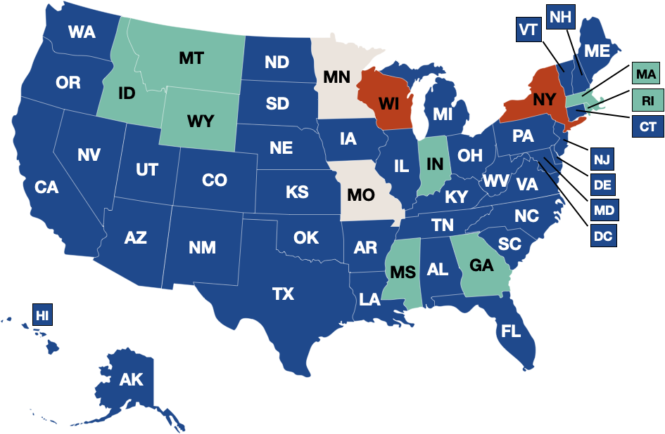
DNA databases
What types of crimes require a person to provide a DNA sample?
All felony convictions (8 states)
All felony and misdemeanor convictions (2 states)
All felony and some misdemeanor convictions (38 states)
Some felony and misdemeanor convictions (2 states)
Data from http://www.ncsl.org/Documents/cj/ConvictedOffendersDNALaws.pdf accessed June 12, 2019
Image created by pgEd (Nadine Vincenten)
Notes:
What types of crimes require a person to provide a DNA sample? In the US, states regulate the types of offenses that require offenders to provide a DNA sample, which is then added to a criminal DNA database. Some states only require DNA samples from offenders of felonies, whereas others also include misdemeanors. The statistics on the slide are taken from the National Conference of State Legislatures. A felony is considered the most serious category of crime and includes violent crimes, many sex offenses and many drug-related crimes. A misdemeanor, such as trespassing, is a criminal offense that is less serious than a felony and often punished by a fine or short jail term.
Data from: http://www.ncsl.org/Documents/cj/ConvictedOffendersDNALaws.pdf, accessed June 12, 2019
Image: created by pgEd (Nadine Vincenten) using data from http://www.ncsl.org/Documents/cj/ConvictedOffendersDNALaws.pdf accessed June 12, 2019

Slide 9

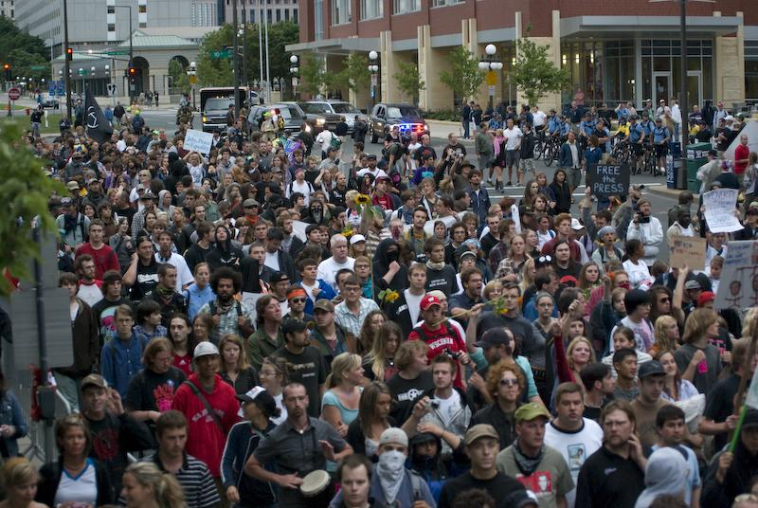
DNA databases
Misdemeanors can include:
Disorderly conduct
(Example: Protests)
Graffiti
Duncan C, CC BY-NC 2.0
MattIndustries, public domain
New York, Wisconsin (all felonies & misdemeanors)
Notes:
Misdemeanor offenses that require offenders to provide a DNA sample in some states can occur for graffiti painting and being part of a protest. Law enforcement agencies argue that collecting DNA samples from people who commit misdemeanors helps catch people who may have already committed more serious crimes, or who may in the future. Privacy advocates, such as the New York Civil Liberties Union, argue that the scope of DNA collection is too broad, will have negligible effects on public safety, and increases the risk of wrongful prosecutions and convictions.
Image (left): “Graffiti” by Duncan C (https://www.flickr.com/photos/duncan/14981645124/in/photolist/ ), accessed June 16, 2019. Available under a Creative Commons Attribution-NonCommercial 2.0 Generic license (https://creativecommons.org/licenses/by-nc/2.0/).
Image (right): “RNC 2008 day2 Protest” by MattIndustries (https://en.wikipedia.org/wiki/File:RNC2008_day2_protest_by_matt_sandy.jpg), accessed June 16, 2019. Public Domain.

Slide 10
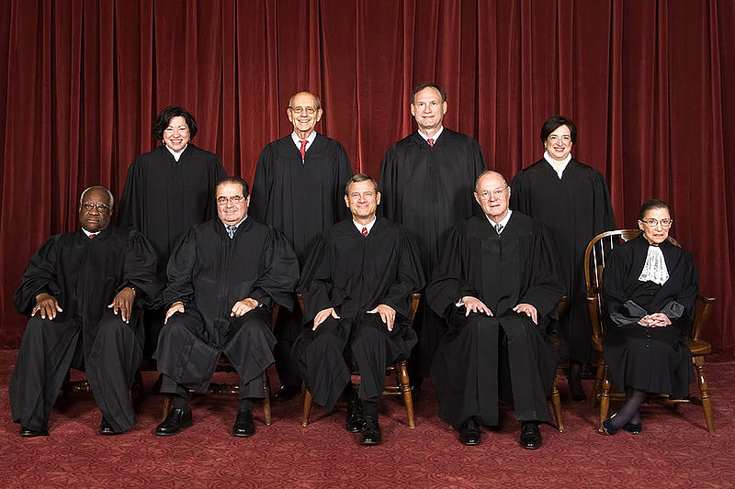
Supreme Court rules 5-4 that DNA can be taken from arrestees (2013)
DNA databases
Steve Petteway, Collection of the Supreme Court of the United States, public domain
Maryland versus King
Notes:
In a 5-4 vote on the Maryland v. King case, the Supreme Court expanded the rights of law enforcement to collect DNA from people who were arrested. In 2009, Alonzo King was arrested for assault, and his DNA was collected in the course of the arrest. Maryland authorities used his DNA sample from the arrest to search a forensic DNA database. They found a match linking King to an unsolved rape from 2003, and he was charged and sentenced to life in prison for this crime. The question of whether it is legal to collect DNA from an arrestee made its way to the US Supreme Court in Maryland v. King. In a 5-4 ruling, the Supreme Court ultimately decided it is constitutional to take DNA samples from arrestees for the purpose of linking a suspect to other possible crimes. In its majority opinion, the Court argued that a DNA profile is fundamentally the same as a fingerprint, used to confirm identity, and that people who are arrested should expect diminished privacy protections. The Court was sharply divided, and the dissenting justices argued that DNA collection from arrestees is a violation of the 4th amendment, which forbids unreasonable search and seizure.
Image: “Supreme Court US 2010.” Via Wikimedia Commons (https://commons.wikimedia.org/wiki/File:Supreme_Court_US_2010.jpg, accessed Jan 28, 2016). Public Domain.

Slide 11
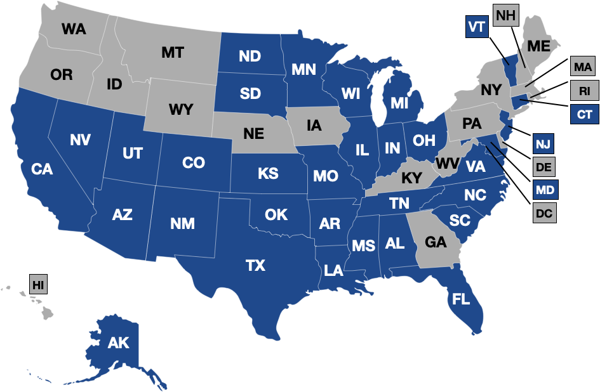
DNA databases
State law varies: DNA collection from arrestees
States with DNA arrestee laws
Data from http://www.ncsl.org/Documents/cj/Arrestee_DNA_Laws.pdf, accessed June 12, 2019
Image created by pgEd (Nadine Vincenten)
Notes:
DNA collection from arrestees has expanded since the Supreme Court decision in 2013. Since the Maryland v. King case, U.S. state laws vary regarding the collection of DNA samples from arrestees to be added to an offender database. State laws can mandate DNA collection from those arrested or charged, but not convicted, for certain crimes. The map on this slide illustrates, as of 2019, states with DNA arrestee laws (shaded in blue), while those in grey represent states with no DNA arrestee laws. This slide illustrates that the laws on DNA collection (if arrested) vary from state to state. For further information: National Conference of State Legislatures: DNA Arrestee Laws 2018 Update.
Data from: http://www.ncsl.org/Documents/cj/Arrestee_DNA_Laws.pdf, accessed June 12, 2019
Image: created by pgEd (Nadine Vincenten) using data from http://www.ncsl.org/Documents/cj/Arrestee_DNA_Laws.pdf, accessed June 12, 2019

Slide 12
DNA databases
What has changed since CODIS was established in 1994?
The databases are expanding
People arrested can be required to give police a DNA sample (without being charged or convicted)
Data from https://www.fbi.gov/about-us/lab/biometric-analysis/codis/codis_brochure and https://www.fbi.gov/services/laboratory/biometric-analysis/codis/ndis-statistics (accessed June 11, 2019)
Notes:
Since CODIS was established in 1994 it has continued to expand. This slide highlights how quickly the CODIS databases are growing. Between 2000 and 2019, over 13 million offender profiles were added to the offender DNA database. Evidence suggests that the databases grew more quickly as a result of the Maryland v. King Supreme Court decision, which allows DNA collection from arrestees. For updated CODIS statistics, please refer to https://www.fbi.gov/services/laboratory/biometric-analysis/codis/ndis-statistics.
Data from: https://www.fbi.gov/about-us/lab/biometric-analysis/codis/codis_brochure and https://www.fbi.gov/services/laboratory/biometric-analysis/codis/ndis-statistics (accessed June 11, 2019)

Slide 13
What is familial searching?
Uses of DNA as a Forensic tool
Familial searching targets biological relatives of people already in a DNA database.
Law enforcement agencies compare DNA from a crime scene to DNA profiles already in the database. If a perfect match is not found, they may look for individuals with a similar DNA profile, as this might suggest a familial relationship.
Notes:
Familial searching allows law enforcement to connect people in ways the original system did not anticipate. The original intent of CODIS was to find perfect matches - linking a possible criminal to a crime scene with the DNA matched on every single marker that was examined. Now, law enforcement agencies are increasingly also using a technique called ‘familial searching’, which uses specialized software to intentionally search DNA databases to identify people whose DNA is similar, but not a perfect match, to DNA found at a crime scene. As we share part of our DNA with our biological relatives, the assumption is that the similarity in DNA occurs because the identified person is a family member of the actual suspect. This means that criminals who have never been arrested or convicted - and whose DNA has therefore not been entered in an offender DNA database - can still be identified through a family member whose DNA is present in such a database. In the United States, as of 2020, crime labs in about 12 states are conducting familial searching. On the other hand, Maryland and Washington DC have formally prohibited this method of identifying suspects. The use of familial searching is evolving, and a matter of debate within law enforcement, privacy, civil rights and legislative communities. For more information, please see: “Familial DNA searching- an emerging forensic investigative tool.” by Sara Debus-Sherrill and Michael B. Field, January 2019, Science & Justice.
Now that we have seen how criminal DNA databases are created and how their composition and use has changed over time, let’s have a look at how this DNA can be used as a forensic tool to: (1) identify suspects; (2) identify victims and missing persons; and (3) provide evidence to support exonerations.

Slide 14
Uses of DNA as a Forensic tool
Identify Suspects:
“The Grim Sleeper”
Lonnie Franklin was identified to be the serial killer known as “The Grim Sleeper” through familial searching.
Photo of Lonnie Franklin via Los Angeles police department
Notes:
Familial searching has been used to identify suspects. In the period of 1985-1988, there was a string of unsolved murders of black women in Los Angeles. Many of the victims were killed with the same gun, so police suspected it was a serial killer. In 2007, a murder took place that investigators were able to link to the 1980s murders through DNA evidence. The serial killer was given the nickname “The Grim Sleeper”, because police thought he had taken a break (or “slept”) for a long period of time between the killings. However, they now believe he probably never “slept”, as he has been linked to multiple murder cases that happened during his supposed “break”. When law enforcement compared the likely killer’s DNA against an offender DNA database, they did not find a perfect match. However, using familial searching, they did identify someone whose DNA was very similar: Christopher Franklin. Christopher Franklin was too young to be the murderer, but his father, Lonnie Franklin, was of an age where it was possible that he was the killer. Police obtained a DNA sample from Lonnie Franklin by following him to a restaurant and, with an officer posing as an employee, collected tableware and pizza crust with his DNA on it. Lonnie Franklin’s DNA was a perfect match with the DNA found at the crime scenes, and he was arrested. He was convicted and sentenced to death in 2016 for the murders of ten women and girls, but police think he may have murdered more than 25 people. In March of 2020 he was found unresponsive in his cell and pronounced dead.
Image: photo via Los Angeles police department

Slide 15
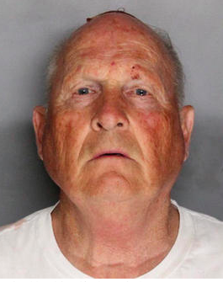
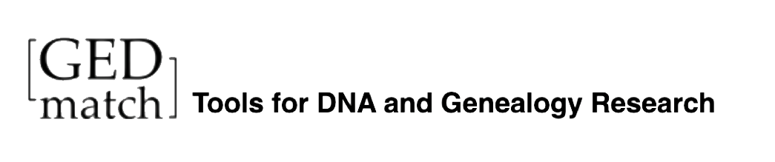
Uses of DNA as a Forensic tool
Identify Suspects:
“The Golden State Killer”
The search was aided by a DNA match from a database created to find relatives for family history/genealogy hobbyists.
Photo of Joseph James DeAngelo via Sacramento county police department
Notes:
Suspects are being identified not just through criminal databases - but also genealogy databases designed for researchers and hobbyists. The “Golden State Killer” is a serial killer and rapist who committed at least 13 murders and over 50 rapes between 1974 and 1986 in California. After failing to find a match in the government-created databases, investigators in this case uploaded the perpetrator’s DNA to an open-source genealogy database, called GEDmatch. GEDmatch is a privately-created database that welcomes people to upload their DNA analysis from private companies like 23andMe or Ancestry.com, in the hopes of building a large community for people seeking familial connections. Law enforcement found a genetic connection in the database – a distant cousin of the suspected killer. Using genealogical research to construct a family tree, investigators narrowed down the possible suspects and, with additional DNA testing, an arrest was made. In 2020, Joseph James DeAngelo pleaded guilty in exchange for a sentence of life in prison instead of the death penalty.
This case is an example of how quickly a new technique can take hold. Though GEDmatch was not developed to be a legal tool, in the months after the arrest of the suspected “Golden State Killer”, law enforcement agencies used the database to make arrests in several other “cold cases”. Some people have reacted positively to this news by saying that any and all methods are justified in the pursuit of solving crimes. Others have voiced concern regarding the fact that if even one biological relative uploads their DNA to a genealogy database like GEDmatch, then some of their shared DNA is also part of a system that is now being used for law enforcement reasons. In fact, using another genealogy database similar to GEDmatch, the investigators in the Golden State Killer case originally suspected an Oregon man was responsible for the crimes. A warrant was obtained to take his DNA sample and his biological relatives were exposed to further investigations, before it was ultimately determined that none of them were viable suspects.
GEDmatch later changed its terms of service so that DNA profiles are now by default opted out of use for law enforcement investigations. Users can choose to opt-in, but only a small percentage have chosen to do so. GEDmatch has since been taken over by the forensic genomics firm Verogen, raising new concerns over privacy and the use of personal data.
Image: photo via Sacramento county police department

Slide 16
Uses of DNA as a Forensic tool
Identify Victims and Missing Persons:
“Abuelas de Plaza de Mayo”
“Grandmothers” in Argentina who demonstrated against the torture and disappearance of dissidents by Argentina’s military dictatorship during the “Dirty War” (1976-83).
Babies born to these “disappeared” individuals would be given to families with ties to the military.
Abuelas worked with geneticists to develop tests to identify their grandchildren so they could be reunited.
Monica Hasenberg, CC BY-SA 3.0
Notes:
Grandmothers in Argentina pioneered one of the applications of DNA in forensic investigations - using it as a tool to reunite separated biological relatives. During Argentina’s “Dirty War” (1976-1983), Argentina’s military dictatorship declared a war against those suspected of being left wing “communist opponents”. War tactics included killings, torture, abduction or the “disappearing” of children. Top officers gave the “disappeared” children away to military couples and pregnant people were major targets. Identities of children were erased. As a result, the “Abuelas de Plaza de Mayo” (Grandmothers of the Plaza de Mayo), organized in response to their grandchildren’s disappearance. Weekly demonstrations in front of the presidential palace gained international attention, including from geneticists.
In 1984, Dr. Mary-Claire King, a geneticist from the University of California, Berkeley teamed up with Dr. Ana Maria DiLonardo, a geneticist from Buenos Aires, Argentina. They developed a test that could identify a genetic link between the grandmothers and their grandchildren using mitochondrial DNA. Mitochondrial DNA is a part of our DNA that is generally passed down to offspring via the egg and not via the sperm. Thus, this type of DNA provides a genetic link from the grandchildren, via their biological mothers, to the Grandmothers, who were trying to find them.
For more information please see: “40 years later, the mothers of Argentina’s 'disappeared' refuse to be silent” by Uki Goñi, April 2017, The Guardian.
Image: “Archivo:Madres y Abuelas entrando a la ESMA en el acto de traspaso de la ESMA” by Monica Hasenberg (https://es.wikipedia.org/wiki/Archivo:Madres_y_Abuelas_entrando_a_la_ESMA_en_el_acto_de_traspaso_de_la_ESMA.jpg, accessed June 18, 2019). Available under a Creative Commons Attribution-Share Alike 3.0 Generic License (https://creativecommons.org/licenses/by-sa/3.0/).

Slide 17
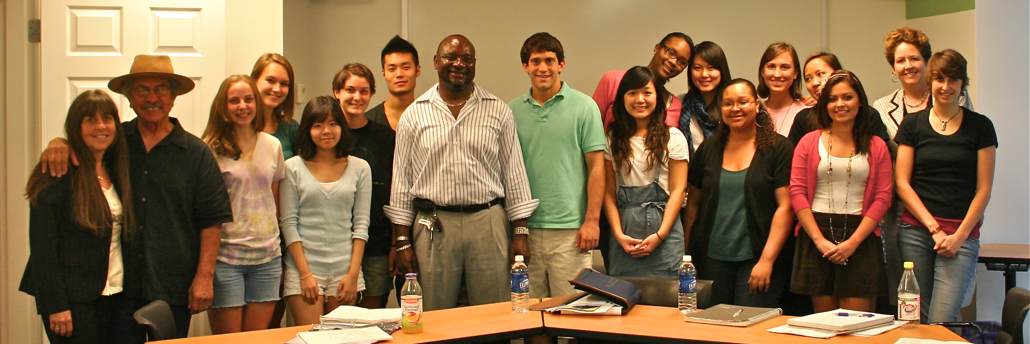
Uses of DNA as a Forensic tool
Provide evidence to support exonerations:
Darryl Hunt
Darryl Hunt speaking with students at Duke University in 2009
Robin Kirk, CC BY 2.0
Darryl Hunt was freed after serving 19 years in prison for a crime he did not commit.
Notes:
DNA can be used to exonerate people wrongly incarcerated, such as Darryl Hunt. Darryl Hunt was freed after serving 19 years in prison for a crime he did not commit. In 1984, he was sentenced to life in prison for the murder of journalist Deborah Sykes. In 1994, a DNA test showed that Darryl’s DNA did not match the DNA found at the crime scene, but nonetheless his appeal was rejected. He was exonerated in 2003 after further DNA testing proved that he was not the perpetrator.
DNA evidence collected at the crime scene was compared to a DNA offender database. They didn’t find a perfect match - but did find someone whose DNA was quite similar. With that information, investigators were able to narrow their search to the brothers of that person and, through their investigation, police identified Willard Brown as a suspect. Investigators were able to show that DNA from a cigarette discarded by Willard Brown matched the DNA found at the crime scene of Deborah Sykes’ murder. Following Brown’s confession, Darryl Hunt was exonerated. Hunt became an activist and educator, and was awarded $1.6 million dollars in damages from the city of Winston-Salem, North Carolina. Sadly, Hunt took his own life in March 2016.
Image: “Darryl Hunt with students” by Robin Kirk (https://www.flickr.com/photos/rightsatduke/3929801870/, accessed June 15, 2019). Available under a Creative Commons Attribution 2.0 Generic License (https://creativecommons.org/licenses/by/2.0/). Cropped top and bottom.

Slide 18




DNA is a powerful forensic tool, but it has its limitations
Limitations
DNA Transfer
Germany’s Phantom Serial Killer
A DNA Blunder
Primary transfer
DNA
DNA
DNA
Secondary transfer
DNA
DNA
DNA
Tertiary transfer
DNA
DNA
Daekow, CC BY-SA 4.0
Schematic created by pgEd (Nadine Vincenten)
Notes:
DNA is a powerful forensic tool, but it has its limitations. Forensic technologies are increasingly sophisticated, but crime scene conditions can make collecting and interpreting DNA complicated. People ’shed’ different amounts of DNA, and secondary and tertiary transfer of DNA, as illustrated on the slide, can be sources of contamination. Investigators who rely on DNA evidence often face many technical challenges (see slide for details). Some of these challenges are described in detail in “How Forensic DNA Evidence Can Lead to Wrongful Convictions” by Naomi Elster, December 2017, JSTOR Daily. Taking these factors into account, it is important for students to realize that the mere presence of someone’s DNA at a crime scene is not necessarily sufficient for conviction. An example of this is the story of Germany’s “Phantom Serial Killer”. German investigators spent years on the hunt for a female serial killer, as they repeatedly found her DNA at multiple crime scenes. However, it turned out that this DNA actually belonged to a female factory worker, who had accidentally and repeatedly contaminated forensic laboratory materials with her own DNA. (“The Mystery of the Phantom of Heilbronn” by Elizabeth Gasiorowski-Denis, July 2016, ISO News).
Another limitation of DNA as a crime solving tool is related to the available DNA at a crime scene. It may be limited in amount, of poor quality, and a mixture of many individuals’ genetic material; all of which can result in an incomplete DNA sample of the perpetrator. With an incomplete DNA sample from which to generate a profile, there is an increased risk of identifying the wrong person as a suspect. In 2013, the National Institute of Standards and Technology (NIST) performed a study to see how well different forensics labs across the US could identify suspects, working from samples with a varied degree of complexity. The results showed that for a simple sample with DNA from only 2-3 people, the participating labs identified suspects correctly or chose to label them “inconclusive”. However, for more complex samples, with DNA from multiple people at varied ratios, the participating laboratories did not give consistent results. In one example in this study, 69% of the forensic labs came to an incorrect identification. This highlights the limits of forensic technologies and the risks of incorrectly identifying someone as a suspect in an investigation. For more on this study see “NIST interlaboratory studies involving DNA mixtures (MIX05 and MIX13): Variation observed and lessons learned.”
Image: “Forensic scientist use swab for recover DNA evidence” by Daekow (https://commons.wikimedia.org/wiki/File:DNA-evidence.jpg, accessed June 18, 2019). Available under a Creative Commons Attribution-Share Alike 4.0 International License (https://creativecommons.org/licenses/by-sa/4.0/).
Schematic: created by pgEd (Nadine Vincenten). Inspired by https://pdfs.semanticscholar.org/b503/fc9202c4b6cc2ac783d326430b9402450987.pdf?_ga=2.67130705.1115836614.1560885755-196440035.1560885755, figure 11, accessed June 18, 2019.

Slide 19
Advances in forensic DNA technologies might disproportionately affect certain populations
Limitations
Data from https://www.bjs.gov/content/pub/pdf/p16.pdf, https://www.bjs.gov/content/pub/pdf/fjs1314.pdf, and https://ucr.fbi.gov/crime-in-the-u.s/2016/crime-in-the-u.s.-2016/topic-pages/tables/table-21 (accessed June 12, 2019)
Notes:
Advances in forensic DNA technologies might disproportionately affect certain populations. The growth in DNA collection has led to worries that existing racial biases in the American criminal justice system will be reinforced and amplified. US government data from the FBI (see 2016 data here) and the Bureau of Justice Statistics (see most recent data here and here), have shown that communities of color are disproportionately affected by the criminal justice system. This is particularly the case for Black, Hispanic and Native American people. As can be seen on the graph, these communities are arrested, charged, and incarcerated at higher percentages than their representation in the US population. These racial differences translate into over-representation of DNA from Black, Hispanic and Native American people being collected in criminal databases.
Data from: https://www.bjs.gov/content/pub/pdf/p16.pdf, https://www.bjs.gov/content/pub/pdf/fjs1314.pdf, and https://ucr.fbi.gov/crime-in-the-u.s/2016/crime-in-the-u.s.-2016/topic-pages/tables/table-21 (accessed June 12, 2019)

Slide 20
Image credits
Slide 3: Open access illustration on Pixabay.com (accessed June 18, 2019). https://pixabay.com/illustrations/graphic-poop-emoji-emoticon-smiley-3769877/
Slide 7: Open access image of the CODIS logo (https://commons.wikimedia.org/wiki/File:CODIS_logo.png), accessed June 16, 2019.
Slide 8: Image created by pgEd (Nadine Vincenten) using data from http://www.ncsl.org/Documents/cj/ConvictedOffendersDNALaws.pdf accessed June 12, 2019
Slide 9: Image (left): “Graffiti” by Duncan C (https://www.flickr.com/photos/duncan/14981645124/in/photolist/ ), accessed June 16, 2019. Available under a Creative Commons Attribution-NonCommercial 2.0 Generic license (https://creativecommons.org/licenses/by-nc/2.0/).
Image (right): “RNC 2008 day2 Protest” by MattIndustries (https://en.wikipedia.org/wiki/File:RNC2008_day2_protest_by_matt_sandy.jpg), accessed June 16, 2019. Public Domain.
Slide 10: “Supreme Court US 2010.” Via Wikimedia Commons (https://commons.wikimedia.org/wiki/File:Supreme_Court_US_2010.jpg, accessed Jan 28, 2016). Public Domain.
Slide 11: Created by pgEd (Nadine Vincenten) using data from http://www.ncsl.org/Documents/cj/Arrestee_DNA_Laws.pdf, accessed June 12, 2019
Slide 14: Photo via Los Angeles police department
Slide 15: Photo via Sacramento county police department
Slide 16: “Archivo:Madres y Abuelas entrando a la ESMA en el acto de traspaso de la ESMA” by Monica Hasenberg (https://es.wikipedia.org/wiki/Archivo:Madres_y_Abuelas_entrando_a_la_ESMA_en_el_acto_de_traspaso_de_la_ESMA.jpg, accessed June 18, 2019). Available under a Creative Commons Attribution-Share Alike 3.0 Generic License (https://creativecommons.org/licenses/by-sa/3.0/).
Slide 17: “Darryl Hunt with students” by Robin Kirk (https://www.flickr.com/photos/rightsatduke/3929801870/, accessed June 15, 2019). Available under a Creative Commons Attribution 2.0 Generic License (https://creativecommons.org/licenses/by/2.0/). Cropped top and bottom.
Slide 18: “Forensic scientist use swab for recover DNA evidence” by Daekow (https://commons.wikimedia.org/wiki/File:DNA-evidence.jpg, accessed June 18, 2019). Available under a Creative Commons Attribution-Share Alike 4.0 International License (https://creativecommons.org/licenses/by-sa/4.0/).
Schematic: created by pgEd (Nadine Vincenten). Inspired by https://pdfs.semanticscholar.org/b503/fc9202c4b6cc2ac783d326430b9402450987.pdf?_ga=2.67130705.1115836614.1560885755-196440035.1560885755, figure 11, accessed June 18, 2019.

Slide 21
References
Slide 7: Data from: https://www.fbi.gov/services/laboratory/biometric-analysis/codis/ndis-statistics, accessed June 11, 2019.
Slide 8: Data from: http://www.ncsl.org/Documents/cj/ConvictedOffendersDNALaws.pdf, accessed June 12, 2019
Slide 11: Data from: http://www.ncsl.org/Documents/cj/Arrestee_DNA_Laws.pdf, accessed June 12, 2019
Slide 12: Data from: https://www.fbi.gov/about-us/lab/biometric-analysis/codis/codis_brochure and https://www.fbi.gov/services/laboratory/biometric-analysis/codis/ndis-statistics (accessed June 11, 2019)
Slide 19: Data from: https://www.bjs.gov/content/pub/pdf/p16.pdf, https://www.bjs.gov/content/pub/pdf/fjs1314.pdf, and https://ucr.fbi.gov/crime-in-the-u.s/2016/crime-in-the-u.s.-2016/topic-pages/tables/table-21 (accessed June 12, 2019)

