Slide 1



Genetics, History and the American Eugenics Movement
Adapted for PBS LearningMedia in partnership with WETA for use with:
2020

Slide 2
Why is learning about the American eugenics movement useful when studying genetics?
Past
What was the US eugenics movement and who was impacted?
Present
What are the new health, medical and ethical advances in genetics?
Future
How do we access the benefits and reduce the harm in genetics?
Notes:
This lesson is divided into three sections. It begins with an overview of the ways in which genetic technology is currently being used and its implications for health, medicine and ethics. The lesson then traces the history of the American eugenics movement through historical events and documents. Finally, the lesson concludes by highlighting efforts to halt eugenic practices and looks ahead to emerging issues at the intersection of genetics, health, and informed consent.

Slide 3
Section 1: The Present
What are the new health, medical and ethical advances in human genetics?
Genetic screening
Gene therapy
Genetic engineering
Notes:
Section One focuses on the present, highlighting some of the new health, medical and ethical advances in human genetics. The slides that follow first present examples of genetic screening being used to make medical and reproductive decisions, then move to editing the genetic information in cells through gene therapy for sickle cell disease and genetic engineering of embryos. The section ends with questions about whether our ability to edit the human genome will lead to a new era of eugenics.

Slide 4

Genetic is used to help make
health and medical decisions
A genetic test revealed actor Angelina Jolie carried a mutation in the BRCA1 gene. She chose to undergo a double mastectomy as a result.
Genetic testing can sometimes help guide what medicines are the safest and most effective for an individual to take.
Image: Gage Skidmore, CC BY 2.0
Notes:
Genetics is increasingly used in medicine to diagnose diseases, to identify potential health risks as well as options for prevention, and to choose medicines that are safer and more effective for each patient. Here, we give two examples. 1) Actor Angelina Jolie used genetic testing to identify the genetic risks of breast cancer that runs in her biological family, which informed choices about her own medical care. (She chose a mastectomy to reduce her cancer risk.) 2) Drug metabolism can be impacted by a person’s genetic profile, and this can affect the dosage or whether the medicine is prescribed at all. The prescription bottle could represent any number of medicines, including ones commonly prescribed to young people. Details on these stories and examples can be found in pgEd’s “Introduction to Personal Genetics” lesson plan (http://pged.org/lesson-plans/#intro).
Image (left): Angelina Jolie, Angelina Jolie, https://www.flickr.com/photos/gageskidmore/4860509634/in/photolist-8pvobf-8nFErg-9b3Ve6-8nJMfh, CC BY SA 2.0.
Image (right): Prescription bottle image courtesy of Dana Bateman

Slide 5
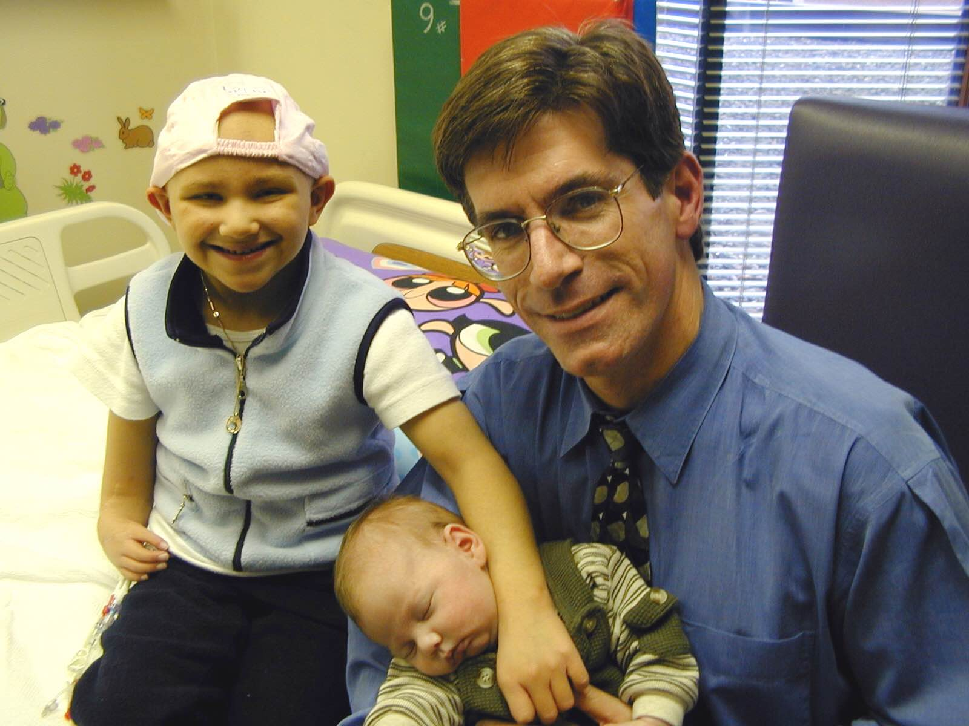
Families using genetics to prevent deadly childhood diseases: Molly & Adam Nash
Illness: Fanconi anemia (disorder of DNA repair)
Cure: PGD, umbilical cord blood stem cells
Photo by Mark Engebretson, University of Minnesota
Notes:
Although genetic testing has been used for decades to select certain traits in human embryos, the story of the Nash family brought it into the public eye. Pictured are siblings Molly and Adam Nash. Molly was born in 1994 with a deadly disorder called Fanconi Anemia (FA), a genetic condition that often leads to cancer. As a young child, Molly needed a stem cell transplant to save her life. Her parents wanted another baby and decided to use a method of embryo screening with the goal of conceiving a child who would not have FA and would be a perfect donor match for Molly. Using in vitro fertilization (IVF) and preimplantation genetic diagnosis (PGD) (technologies described in further detail in pgEd’s Genetics and Reproduction lesson plan (http://pged.org/lesson-plans/#reproduction)), Molly's brother, Adam, was conceived. When Adam was born in 2000, stem cells from his umbilical cord were donated to his sister. Since the transplant, Molly has recovered and both children are doing well.
The Nash family was one of the first in the United States to go public with their use of PGD for donor matching. While many people were supportive, the Nashes also faced criticism that Adam was a “designer baby” and suffered unjust risks, conceived only to help his sister. ‘Little Frankenstein’ conceived so Minnesota doctors could save sister, is now a happy teen”, (http://www.startribune.com/little-frankenstein-is-now-a-happy-teenager/430032513/) Star Tribune, and video from ABC news, “Nash family opens up”. (https://www.youtube.com/watch?v=_djfH_-yPdA)
Image: Photo by Mark Engebretson, University of Minnesota.

Slide 6
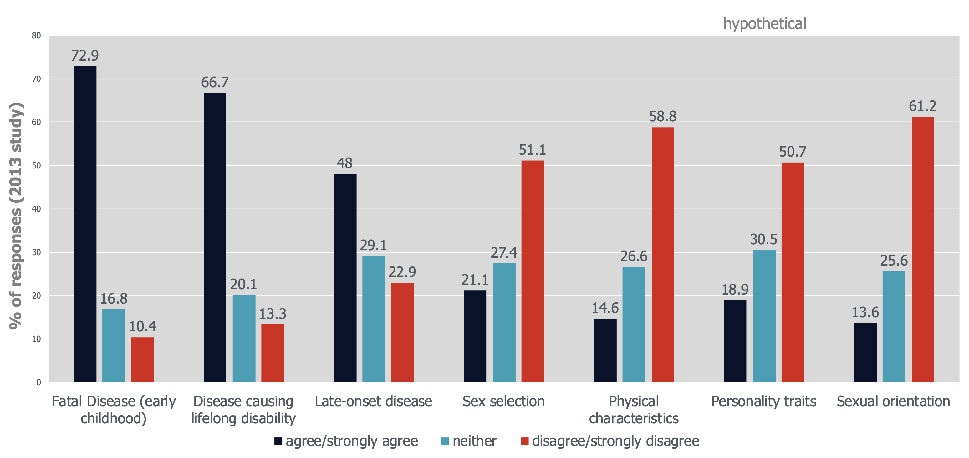
Screening in embryos:
Survey of acceptable uses
n=1006
Survey of the US public. Data from Winkelman WD, Journal of Assisted Reproduction and Genetics (2015)
Notes:
People have a range of opinions about the uses and limits of embryo screening, including the use of donor matching (as the Nash family did). In a 2015 study, a majority of the Americans surveyed thought it was acceptable to use PGD to select embryos in order to avoid serious illness or disability, or to identify a match for stem cell donation. Note that close to 20% of people stated it would be acceptable to screen for personality traits and other complex characteristics, which are poorly understood and not suited to this sort of technology. These results provide the basis for a discussion to ensure students understand that it is difficult to discover the genetic contributions to traits as complicated as personality, intelligence, sexual orientation, and strength. Another important point to make to students is that people could see this survey and feel a sense of marginalization, because of worries that some of their traits are undervalued by others and could be erased.
Image: Created with data from: Winkelman, W.D., Missmer, S.A., Myers, D. et al. J Assist Reprod Genet (2015) 32: 665 https://doi.org/10.1007/s10815-015-0456-8

Slide 7

Gene therapy is a potentially powerful tool in treating serious disease
Research is on-going to develop gene therapies for conditions such as sickle cell disease
Courtesy of National Human Genome Research Institute, genome.gov
Notes:
Beyond embryo screening, genetic technology now can be used to alter a person’s DNA as treatment for disease – a concept known as gene therapy. One technique that has attracted particular attention is called “genome editing.” Clinical trials of genome editing to treat the blood disorder, sickle cell disease (SCD), are currently underway. One approach involves altering a patient’s cells to produce a naturally-occurring protein that is normally shut off in adults, with the goal of creating healthy red blood cells. These changes in the blood cells, which would not be passed down to future generations, are showing promise for patients in these early days of clinical trials. Details on the scientific ideas are included in pgEd’s “Genome editing and CRISPR” lesson (http://pged.org/lesson-plans/#CRISPR) and in this NPR News article, “New gene therapy shows promise for patients with Sickle Cell disease” (https://www.wbur.org/commonhealth/2019/03/08/gene-therapy-sickle-cell), March 2019, by Karen Weintraub.
Image: Courtesy of National Human Genome Research Institute, NIH, genome.gov. Open access. Image located at (https://www.genome.gov/news/news-release/Systematic-review-study-supports-that-sickle-cell-trait-increases-risk-for-some-health-conditions), accessed April 2019.

Slide 8
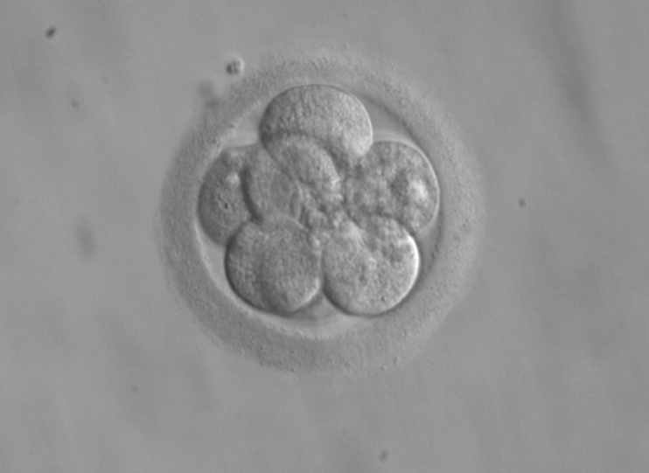
Genetic engineering reportedly used to alter human embryos, resulting in the birth of twin girls in 2018
ekem (courtesy: RWJMS IVF Program), public domain
Notes:
An area of scientific, legal, religious, and ethical debate is the use of genome editing in embryos, such that changes would be passed on to future generations. Since 2015, researchers have edited the genomes of embryos, but stated that they had not implanted those embryos into a person’s womb. In November 2018, a scientist claimed that the first two children had been born with genes that had been edited in the embryonic stage. In this case, genome editing was used in an attempt to confer immunity to HIV infection. Lacking verified and reviewed results, the details of this work are unclear and have left the world with many unanswered questions. This case brings attention to many profound ethical issues about potential applications of genome editing in humans. As this story has unfolded in the media, the apparent departure from the accepted process around reviewing, authorizing, and conducting medical research has also drawn particular scrutiny.
Image: 8-cell human embryo, day 3” by ekem, Courtesy: RWJMS IVF Program (https://commons.wikimedia.org/wiki/File:Embryo,_8_cells.jpg, accessed Jan 13, 2017). Public domain

Slide 9
“New eugenics” and “designer babies”:
What are the underlying concerns?
Eugenics lurk in the shadow of CRISPR
Robert Pollack, Science (May 22, 2015)
What’s the difference between genetic engineering and eugenics?
Robert Gebelhoff, Washington Post (February 22, 2016)
Designer babies aren’t futuristic. They’re already here.
Are we designing inequity into our genes?
Laura Hercher, MIT Technology Review (October 22, 2018)
Scientists confront the ghost of eugenics
Amy Marcus, Wall Street Journal (August 17, 2018)
Notes:
While many hope that genetic technologies can help to prevent or treat disease, there are many fears as well that the use of genetics (particularly when applied to reproduction) will lead to what is sometimes referred to as “the new eugenics” and “designer babies.” These terms are often a short-hand to talk about worries that genetics will be used unfairly, to discriminate against groups of people, including people with disabilities. Another major fear is that only the wealthy will have access to the newest advances. Pause at this slide to ask students the question posed on the slide: “What are the underlying concerns?”. Teachers can expect answers that include many of the concerns listed above – and this is the transition point in the lesson between the current state of genetics and the history of eugenics in the US and beyond.
From this point on in the lesson, students will learn about the American eugenics movement. They will explore the philosophies and agendas that drove the policies that allowed forced sterilizations, which aimed to prevent certain people passing on what were deemed “negative” traits to future generations. With a foundation in the history of the movement and an awareness of the people who were harmed and those who fought to end these unjust practices, students will be better informed to assess the benefits and implications of genetic technologies.

Slide 10

Section 2: The Past
What was the American eugenics movement and who was impacted?
Eugenic ideology
Legal implementation
Play clip from The Gene: An Intimate History
(courtesy of WETA)
Notes:
Section Two presents an overview of the American eugenics movement, including the historical context, underlying ideology, and legal implementation of eugenic practices.
We recommend pausing on this slide to show students the accompanying clip from The Gene: An Intimate History.

Slide 11
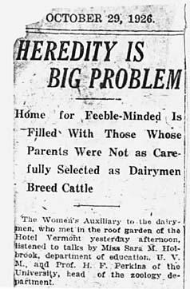
American eugenics movement
Began in US in early 1900s
Social movement that worked to “improve” society by encouraging or discouraging people to have babies
Promoted reproduction by people or groups with “positive” qualities
Discouraged or sometimes stopped reproduction by groups with “negative” qualities
State and Federal laws addressing issues ranging from immigration to mandatory sterilization
Notes:
The American eugenics movement began in the early 20th century. The main goal was to improve society and reduce the burden of people who some considered to be inferior. That is, just as screening for intelligence and other “desirable” characteristics would be acceptable to some people today, it was similarly acceptable in previous decades.
Image: Burlington Free Press, October 29, 1926, p. 1. Clipping from Paul Amos Moody Papers, Box 181, Truman Allen file, University of Vermont Archives. Courtesy of Vermont Eugenics: A Documentary History (http://www.uvm.edu/~eugenics/images/hpbfp102926.html, accessed Oct 10, 2018).

Slide 12
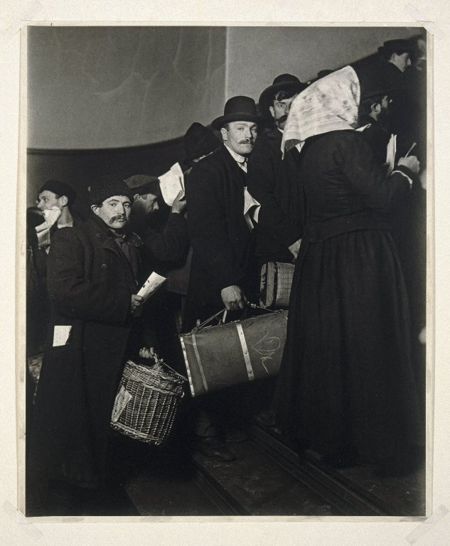
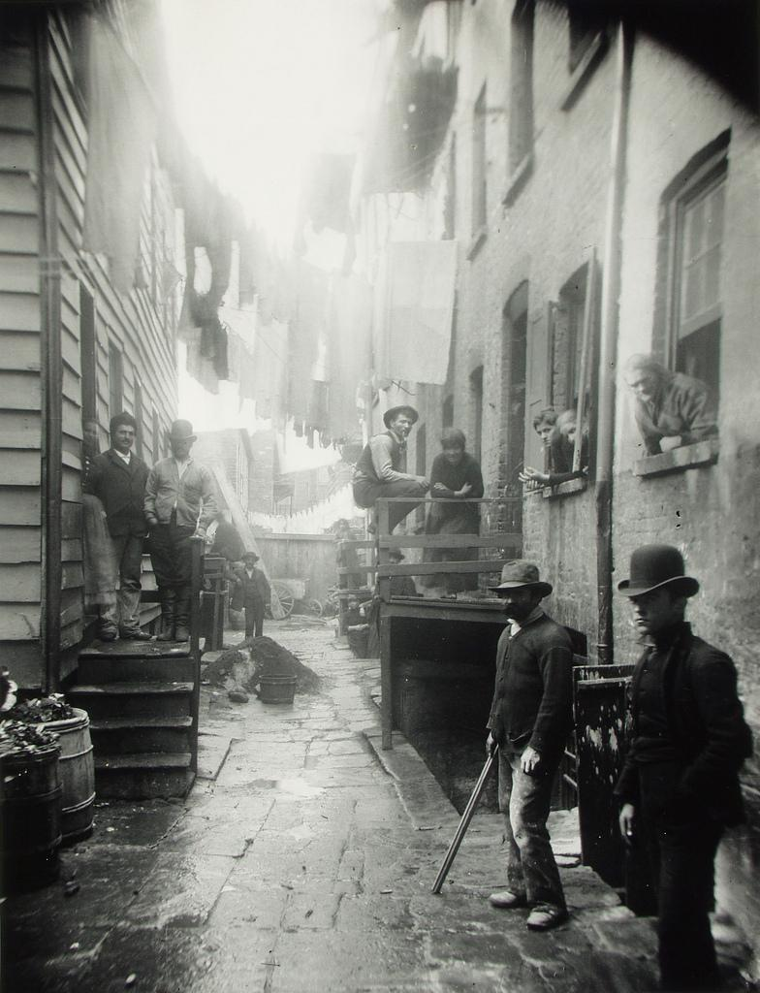
A changing American society:
Immigration and urbanization
Photo by Lewis Hine (via the Brooklyn Museum)
Photo by Jacob Riis (via the Preus Museum)
Notes:
The late 19th and early 20th centuries brought an enormous amount of change to the United States. The nation began to shift from an agrarian to an industrial economy and society, millions of immigrants arrived, and cities grew at an exponential rate. These changes created social challenges, including increased poverty, slums, disease and child labor. Eugenicists believed that immigrants from Southern Europe were genetically inferior, as were people living in poverty (i.e., they were poor because they were genetically predisposed to be lazy). Although incorrect, eugenicists believed that preventing poor people and immigrants from reproducing, thereby reducing the population of genetically inferior individuals, would solve many societal issues.
The Immigration Restriction Act of 1924 was strongly influenced by eugenicists, who lobbied and worked closely with members of Congress to shape the legislation. The act severely restricted immigration, particularly of Eastern European Jews, Italians (as well as other Southern Europeans), and Africans, and banned the immigration of Arabs and Asians. This act prevented thousands of European Jews attempting to flee the Nazis from entering the United States during the 1920s and 30s. According to the US Department of State website, “In all of its parts, the most basic purpose of the 1924 Immigration Act was to preserve the ideal of U.S. homogeneity.” Learn more about the impact of eugenics on US immigration here: https://history.state.gov/milestones/1921-1936/immigration-act and here: http://www.eugenicsarchive.org/html/eugenics/essay9text.html.
Image (center): “Climbing into the Promised Land Ellis Island” by Lewis Hine, circa 1908. Source: Online Collection of the Brooklyn Museum. Via Wikimedia Commons (https://commons.wikimedia.org/wiki/File:Brooklyn_Museum_-_Climbing_into_the_Promised_Land_Ellis_Island_-_Lewis_Wickes_Hine.jpg, accessed Feb 1, 2016).
Image (right): “Bandit’s Roost” by Jacob Riis, 1888. Via the Preus Museum (https://www.flickr.com/photos/preusmuseum/5389939434/in/photolist-9dhRdf, accessed Feb 1, 2016).

Slide 13
Making the case for eugenics:
Arguing certain people are destined to become a “burden”
Photo: 1906. Source: American Philosophical Society, ERO, MSC77,Ser1,Box35: Trait Files
Notes:
Despite many scientists’ skepticism and outright rejection, some people began defining different levels of intelligence through the use of specific tests. It was around this time that IQ tests were created. This illustration shows how people were categorized by the mental age that eugenicists believed they would reach and the type of work eugenicists believed they would be able to perform. Part of the goal of eugenicists was to show that “genetically inferior” people would become a burden to society.
Image: "Exhibit of work and educational campaign for juvenile mental defectives”, 1906. Source: American Philosophical Society, ERO, MSC77,Ser1,Box35: Trait Files. Accessed via the Eugenics Image Archive, Dolan DNA Learning Center, Cold Spring Harbor Laboratory, ID# 348 (http://www.eugenicsarchive.org/eugenics/view_image.pl?id=348, accessed March 2, 2020). pgEd has cropped the original image.

Slide 14
“Fitter Family” contests: 1920s-1940s
Georgia State Fair 1924
Photo: 1924. Source: American Philosophical Society, ERO, MSC77,SerVI,Box 4, FF Studies, KS Free Fair
Notes:
Various states and organizations promoted “positive” eugenics by encouraging people who were deemed superior to have more children. The first “Fitter Family” contest, which was based on "Better Babies" contests, was held at the Kansas State Fair in 1920. Both types of contests took a deterministic view of genetics and biology and assumed that there were “good genes” for characteristics such as honesty, morality and industriousness that were passed on to children. The Red Cross originally sponsored these competitions; families were judged in categories including size of family, attractiveness, health and generosity.
Image: "Fitter Families contestants at Georgia State Fair, Savannah”, 1924. Source: American Philosophical Society, ERO, MSC77,SerVI,Box 4, FF Studies, KS Free Fair. Accessed via the Eugenics Image Archive, Dolan DNA Learning Center, Cold Spring Harbor Laboratory, ID# 190 (http://www.eugenicsarchive.org/eugenics/view_image.pl?id=190, accessed March 2, 2020).

Slide 15
Laws against interracial marriage
Photo: W. A. Plecker, 1924 Source: American Philosophical Society, Dav, B:D27.,Harriman, Mrs. E.H.
Notes:
Many states had laws forbidding interracial marriage from the late 17th century until 1967, when the Supreme Court ruled in Loving v. Virginia that such laws were unconstitutional. Eugenic ideas lent a new set of justifications for such laws by providing a pseudoscientific explanation for the perils of “race-mixing.” For a more detailed explanation, read a short piece by legal historian Paul Lombardo: http://www.eugenicsarchive.org/html/eugenics/essay7text.html.
Image: "The New Virginia Law to Preserve Racial Integrity”, by W. A. Plecker, Virginia Health Bulletin (vol. 16:2), 1924. Source: American Philosophical Society, Dav, B:D27.,Harriman, Mrs. E.H.. Accessed via the Eugenics Image Archive, Dolan DNA Learning Center, Cold Spring Harbor Laboratory, ID# 436, p. 1 (http://www.eugenicsarchive.org/eugenics/view_image.pl?id=436, accessed March 2, 2020). pgEd has cropped the original image.

Slide 16

Forced sterilizations were common in Puerto Rico
Eugenics sterilization law in effect from 1937 to 1960
“In 1976, the US Department of Health, Education, and Welfare reported that over 37% of women of childbearing age in Puerto Rico had been sterilized. The vast majority were in their twenties.”
Poverty that resulted largely from colonization was used as justification for eugenics
http://Ordover, N. (2014, February 24). Puerto Rico. Retrieved September 18, 2018, from http://eugenicsarchive.ca/discover/tree/530ba18176f0db569b00001b
Notes:
Surgical sterilization, a procedure that prevents a person from reproducing, was a key tool of eugenics programs throughout the United States. Sterilization techniques could include hysterectomy, tubal ligation (“tying tubes”) and vasectomy. Forced sterilization programs were underway in many places by 1937, including Puerto Rico and other US territories. Under Law 116, one-third of women in their twenties were sterilized in Puerto Rico according to a report from the United States Department of Health, Education and Welfare. As such, the impact of that law persisted for generations. While overpopulation was cited as the reason for widespread poverty on the island – and therefore a justification for the sterilizations – historians argue that the history of colonization and the sugar industry better explain the poverty on the island. Additionally, Puerto Rico was without full constitutional rights until 1947 and did not have a democratically elected governor until 1948. Law 116 remained in effect in Puerto Rico until 1960. For a brief overview of the eugenics efforts in Puerto Rico, see: http://eugenicsarchive.ca/discover/tree/530ba18176f0db569b00001b

Slide 17
Carrie Buck:
Sterilized without her consent
Photo by A.H. Estabrook, 1924. Source: Arthur Estabrook Papers, Special Collections & Archives, University at Albany, SUNY.
Notes:
Eugenicists used the US legal system to create a pathway for programs where people could be sterilized by local and state public health authorities. Carrie Buck was born in 1906 to a poor mother who was eventually committed to the Virginia State Colony for Epileptics and the Feebleminded. Carrie was placed in foster care. At age 17, Carrie became pregnant as the result of being raped, most likely by the nephew of her foster parents. Her foster parents then committed her to the Virginia State Colony on the grounds of feeblemindedness, promiscuity and incorrigible behavior. In 1927, Carrie was the plaintiff in the Supreme Court case Buck v. Bell, which established that the state has the right to force a person to be sterilized without their consent. Carrie was sterilized to prevent passing along “feeblemindedness,” which she, her mother and her daughter were all declared to exhibit. (Note: Reporters and researchers who later interviewed Carrie described her to be of average intelligence.) While many cases have criticized the Buck v. Bell ruling, technically, the decision has never been overturned.
Image: "Carrie and Emma Buck at the Virginia Colony for Epileptics and Feebleminded, taken by A.H. Estabrook the day before the Buck v. Bell trial in Virginia”, by A.H. Estabrook, 1924. Source: Arthur Estabrook Papers, Special Collections & Archives, University at Albany, SUNY. Accessed via the Eugenics Image Archive, Dolan DNA Learning Center, Cold Spring Harbor Laboratory, ID# 1924, p. 1 (http://www.eugenicsarchive.org/eugenics/view_image.pl?id=1287, accessed March 2, 2020).

Slide 18
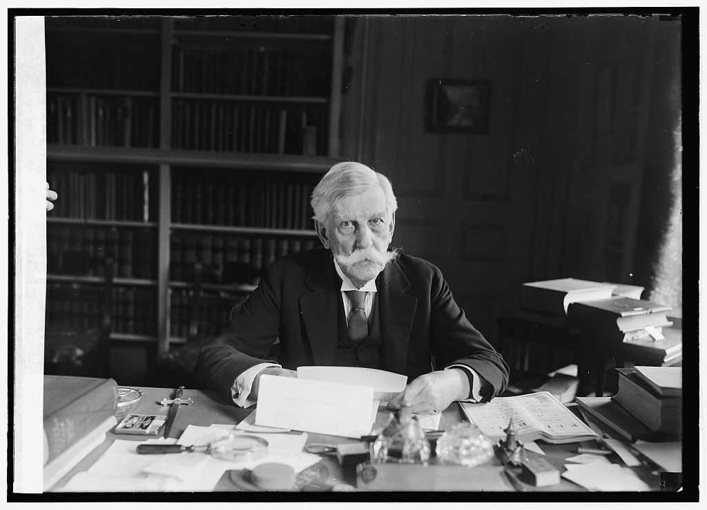
Supreme Court ruling:
Buck v. Bell allows forced sterilization
“…society can prevent those who are manifestly unfit from continuing their kind…
Three generations of imbeciles are enough.”
-Justice Oliver Wendell Holmes, Jr.
US Library of Congress
Quote source: Buck v. Bell, 274 US 200 – Supreme Court 1927
Notes:
In 1927, the 8-1 ruling in Buck v. Bell established the right of the state to sterilize people deemed unfit to procreate. Supreme Court justice Oliver Wendell Holmes, writing an opinion that represented the majority of the justices, argued that the interest of the state to improve the gene pool superseded that of the individual’s right to maintain bodily integrity. He wrote:
"We have seen more than once that the public welfare may call upon the best citizens for their lives. It would be strange if it could not call upon those who already sap the strength of the State for these lesser sacrifices, often not felt to be such by those concerned, to prevent our being swamped with incompetence. It is better for all the world, if instead of waiting to execute degenerate offspring for crime, or to let them starve for their imbecility, society can prevent those who are manifestly unfit from continuing their kind. The principle that sustains compulsory vaccination is broad enough to cover cutting the Fallopian tubes. Three generations of imbeciles are enough."
(https://supreme.justia.com/cases/federal/us/274/200/)
Image: “Justice Oliver Wendell Holmes,” circa 1924, United States Library of Congress. (http://loc.gov/pictures/resource/npcc.26412/, accessed Feb 1, 2016).

Slide 19
Pedigrees used to justify sterilization
Photo: circa 1935. Source: The Harry H. Laughlin Papers, Truman State University, Lantern Slides, IBM Box,Box 10
Notes:
The pedigree was an important tool that eugenicists used to trace the pattern of inheritance in a family. This slide shows a pedigree from a woman sterilized by the state of Maine. Eugenicists “scored” family members and traced the lineage of “defective” as well as “superior” individuals. Pedigrees traced traits such as immoral behavior, degeneracy, criminality, disease, shiftlessness, intelligence and feeblemindedness. While there was essentially no sound scientific basis for the inheritance of these types of characteristics, the creation of pedigrees based on these characteristics, nevertheless, helped to establish these ideas as legitimate science. For a critique of eugenics research, refer to the essay by expert Garland E. Allen: http://www.eugenicsarchive.org/html/eugenics/essay5text.html.
Image: "Family-stock of a woman sterilized by the state of Maine”, circa 1935. Source: The Harry H. Laughlin Papers, Truman State University, Lantern Slides, IBM Box,Box 10. Accessed via the Eugenics Image Archive, Dolan DNA Learning Center, Cold Spring Harbor Laboratory, ID# 958 (http://www.eugenicsarchive.org/eugenics/view_image.pl?id=958, accessed March 2, 2020).

Slide 20
American eugenics and German Nazism
“Now that we know the laws
of heredity, it is possible to a large extent to prevent unhealthy and severely handicapped beings from coming into the world. I have studied with interest the laws of several American states concerning prevention of reproduction by people whose progeny would, in all probability, be of no value or be injurious to the racial stock.”
-Adolf Hitler (1931), quoted in Hitler – Memoirs of a Confidant by Otto Wagener
“Germany is perhaps the most progressive nation in restricting fecundity among the unfit [...] In America it is probable that the sentiment of the people is not ready for the adoption of the German plan, and will be inclined to restrict compulsory sterilization to a small proportion of those who might properly be regarded as especially fit subjects for this treatment. Until public sentiment can be molded to look at the matter in a scientific spirit, it will be necessary to employ moral persuasion in getting the largest possible number of assents to advice for the application of this treatment.”
-Editorial in New England Journal of Medicine (1934)
Notes:
This slide shows a quote from Adolf Hitler in 1931, recalled in the memoirs of former Nazi major general and Hitler’s economic advisor, Otto Wagener. This quote was one of several instances recorded in Hitler’s conversations and writings in which he claimed to have learned from American eugenic policies. The slide also includes an excerpt from a 1934 editorial in the New England Journal of Medicine, one of the most prestigious medical publications in the United States, which commended the sterilization program implemented in Nazi Germany.
German scientists and eugenicists were greatly influenced by the work of prominent American eugenicists, the two groups exchanging papers and visiting one another’s labs and offices. The United States passed its first law allowing sterilization in 1907, 26 years before Germany passed their laws. The Rockefellers, who were oil and banking magnates, used their family wealth through their foundation to help support the German eugenics program. They funded the program where Josef Mengele worked before he became a physician at Auschwitz, for which he is known as the “Angel of Death”. (Note: The Rockefeller Foundation later paid to relocate approximately 300 Jewish scholars out of Germany to escape Hitler’s regime.) After a 1934 visit to Germany, where over 5,000 people were being sterilized each month, California eugenics leader C. M. Goethe stated to a colleague:
"You will be interested to know that your work has played a powerful part in shaping the opinions of the group of intellectuals who are behind Hitler in this epoch-making program. Everywhere I sensed that their opinions have been tremendously stimulated by American thought... I want you, my dear friend, to carry this thought with you for the rest of your life, that you have really jolted into action a great government of 60 million people.”
[Black, Edwin, War Against the Weak: Eugenics and America’s Campaign to Create a Master Race (Dialog Press, 2003).]

Slide 21
Nuremberg Code - 1947
4 of the 10 directives for Human Subjects Research
1. The voluntary consent of the human subject is absolutely essential…
2. The experiment should be such as to yield fruitful results for the good of society, …
4. The experiment should be so conducted as to avoid all unnecessary physical and mental suffering and injury.
9. During the course of the experiment the human subject should be at liberty to bring the experiment to an end…
Notes:
The Nuremburg Code was established in 1947 as a result of the “Doctor’s Trial,” which was intended to bring justice to victims of medical experimentation in Nazi Germany. Among the lengthy list of crimes that were prosecuted in the trial were the Nazi’s efforts to develop mass sterilization techniques that could be performed without the victims being aware of it, including secretly exposing them to dangerous x-rays. The Nuremberg Code sought to prevent such atrocities from happening again by establishing protections around voluntary consent and safety in medicine and research. One of the core protections of the Nuremberg Code is the informed consent of willing participants. These codes have guided the development of many medical and research studies with positive outcomes, including successful clinical trials and drug development. Details on the x-ray experiments can be found on page 49 of Trials of War Criminals: Before the Nuremberg Military Tribunals under Control Council Law No. 10. Vol. I, U. S. Government Printing Office, 1949 (https://www.loc.gov/rr/frd/Military_Law/pdf/NT_war-criminals_Vol-I.pdf).
However, the Nuremberg Code was not a cure-all, and, as slides 20-24 show, it did not halt unethical practices related to the American eugenics movement and forced sterilization. By WWII, many scientists in the US had largely rejected earlier scientific theories that had provided the justification for the eugenics movement, but many of these ideas about who was and who was not fit to reproduce had already taken root in many state governments and public health initiatives. With the weight of the US legal system behind the practice, due to Buck vs. Bell, sterilizations continued. In many cases, forced sterilizations came to a halt through the activism and advocacy of the groups of people being targeted. To learn more about an example of unethical research practice that occurred despite the existence of the Nuremberg Code, see “US Public Health Service Syphilis Study at Tuskegee (https://www.cdc.gov/tuskegee/timeline.htm)”

Slide 22
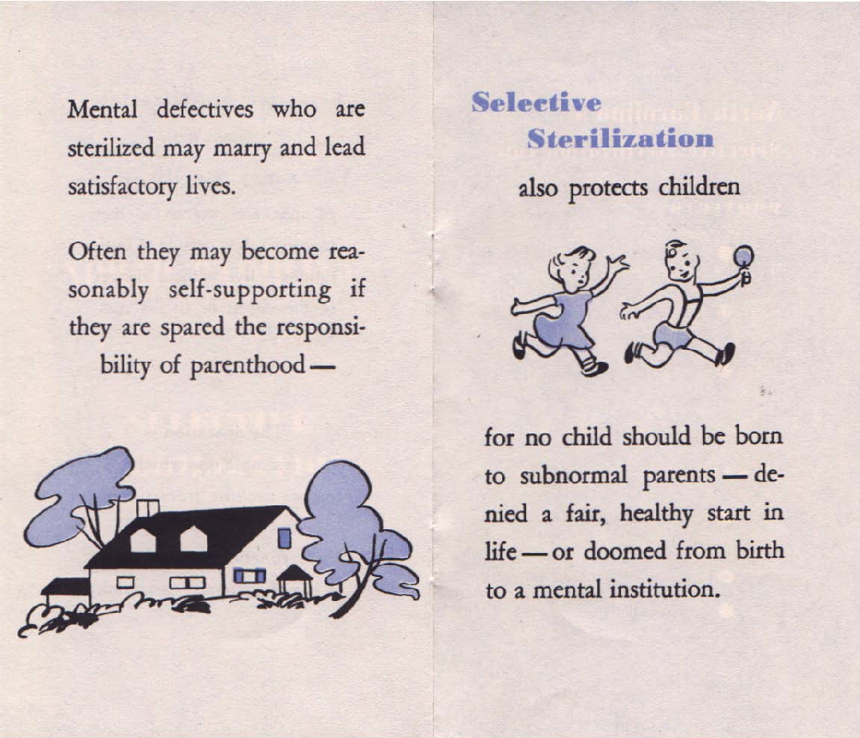
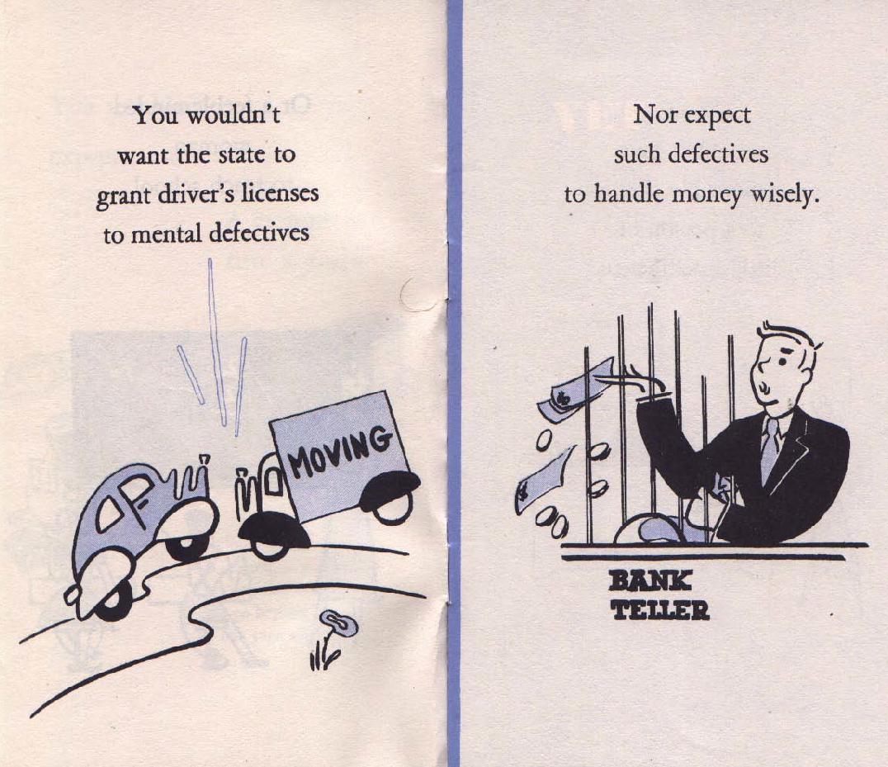
Pamphlet from the Human Betterment League of North Carolina - 1950
Via the North Carolina State Documents Collection. State Library of North Carolina
Notes:
This pamphlet, which aimed to persuade the public about the merits of sterilization, was published by an organization called the Human Betterment League of North Carolina. James Hanes (of the Hanes clothing and hosiery company) founded the organization in 1947. The goal of the organization was to promote the sterilization of those deemed mentally unfit. North Carolina had an aggressive state-run push to sterilize people. Initially, 85% of those sterilized were women and girls; in the 1960s, the sterilization of men largely ended, at which point 99% of those sterilized were women and girls. Many were rape victims who were deemed “promiscuous.” Others were considered to be intellectually inferior, classified as “morons,” “idiots” or “feebleminded.” People with mental illness as well as physical illness, such as epilepsy, were also sterilized.
According to the task force established in 2011 by North Carolina Governor Beverly Perdue, 2,990 of the almost 7,600 sterilizations in North Carolina were performed on people between the ages of 10 and 19. The total number of 7,600 includes only those operations directed by the state eugenics board and not those performed locally, and likely unreported, by an individual doctor or hospital.
Image: “You wouldn’t expect –” Human Betterment League of North Carolina, 1950. Via the North Carolina State Documents Collection. State Library of North Carolina (http://digital.ncdcr.gov/cdm/ref/collection/p249901coll37/id/14969, accessed Oct 10, 2018).

Slide 23
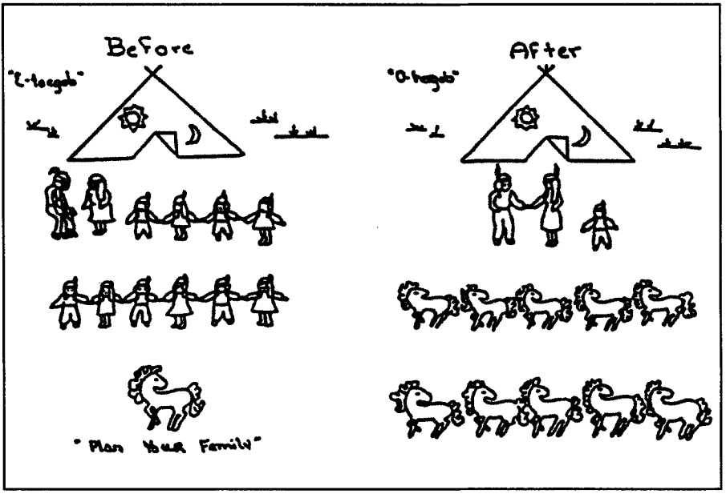
Indigenous people in the US were targeted for forced sterilization
U.S. Department of Health, Education and Welfare (via Akwesasne Notes Vol. 6 Number 5)
Notes:
Indigenous people were specifically targeted for sterilization, as part of a longer history of mistreatment and erasure of Indigenous people in the United States (“Indigenous” refers to ethnic groups who are the original inhabitants of a geographic area, before the later arrival of settler or colonial populations). This image, produced by the US Department of Health, Education and Welfare in 1974, sought to link sterilization to increased wealth and happiness. The image depicts a larger family with 10 children, parents who are unhappy, and less wealth, represented by the lone horse. In 1976, the US Government Accounting Office released its finding that 3,406 sterilizations were performed at 4 of the 12 Indian Health Service (IHS) centers between 1973-1976. Given the number of stories they and other community members had heard about indigenous women being forcibly sterilized, Dr. Constance Redbird Pinkerton (a Choctaw-Cherokee physician) and Marie Sanchez (a chief tribal judge) each decided to conduct their own research. Through their efforts to document the experiences of many indigenous people, they found significant differences with the number of procedures that were recorded. As a result, some researchers believe that the number of women who were sterilized is much higher than initially reported. Adding to the trauma of these events is the evidence that many of the sterilizations, often done without consent, were conducted at IHS centers that were intended to help and support people living on reservations. Read more at “The Little-Known History of the Forced Sterilization of Native American Women” from JSTOR Daily (https://daily.jstor.org/the-little-known-history-of-the-forced-sterilization-of-native-american-women/).
Image: Public domain. From the US department of Health, Education and Welfare, 1974. Via Akwesasne Notes Vol. 6 Number 5, Jan 1975) https://www.law.berkeley.edu/php-programs/centers/crrj/zotero/loadfile.php?entity_key=QFDB5MW3

Slide 24
Section 3: The Future
How do we access the benefits and reduce the harm in genetics?
Efforts to safeguard against future injustices
Notes:
Section Three highlights the work of activists, policymakers and scientists to bring awareness to the stories of those affected by eugenics practices and right the wrongs of the past, ushering in a new era of safeguards against future injustices.

Slide 25
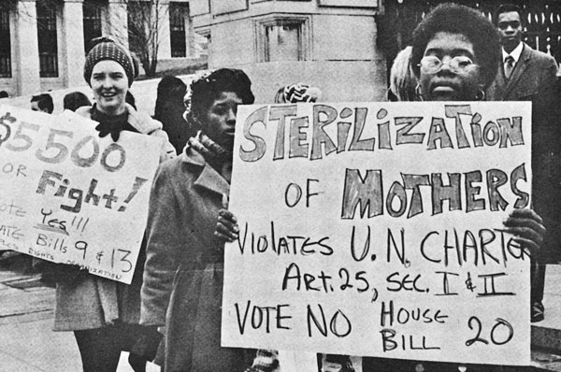
Protests against forced sterilization began to change minds and policies
Southern Conference Educational Fund (SCEF)
Notes:
Protests against forced sterilization took place around the nation during the 1970s, including the one in North Carolina depicted in this slide. Though many individuals opposed the practice from the start, protests against forced sterilization grew out of the civil rights and women’s movements. Many states, including California, outlawed the practice in the mid and late 1970s. Though the Buck v. Bell Supreme Court decision allowing the practice has never been overturned, many cases at the state and federal level reject these ideas.
Image: The Southern Conference Educational Fund (SCEF), Louisville, Ky. Via U.S. National Library of Medicine (https://www.nlm.nih.gov/exhibition/forallthepeople/carousel64.html, accessed May 1, 2019).

Slide 26
Madrigal v. Quilligan advances the cause of informed consent
Latinx women in California were sterilized without consent or under coercive circumstances, such as being in active labor.
They sued the doctors and hospital where they were sterilized.
Did not win the 1978 case but it was a catalyst for a social/legal change.
As a result of the case, hospital changed its practices to include:
  No longer threatening to take away welfare benefits if woman refused sterilization.
  Consent forms translated into several languages.
  Waiting periods for women to weigh their options.
Notes:
People continued to protest federal sterilization laws in court, as illustrated in this slide about the 1978 Madrigal v. Quilligan case. Madrigal v. Quilligan was a federal class action suit against the doctors and Los Angeles County Hospital, brought by ten working-class Latinx women who were forcibly sterilized or sterilized without their consent. The case was inspired by women talking with one another and coming forward, and more broadly, by the Chicano Movement that sought rights and fair treatment for Mexican migrants, among others. While the judge decided in favor of the defendants, the case was key in revising the way in which informed consent was carried out in the medical industry. Until the lawsuit, consent forms were only in English and consent was often sought during active labor and with threats of withholding everything from pain medicine to future welfare benefits. Additionally, rules such as waiting periods for decisions about sterilization after birth were implemented. The details of this case are described in the documentary “No Más Bebés” and in the article, “When Doctors Took ‘Family Planning’ into Their Own Hands” from the New York Times (https://www.nytimes.com/2016/02/01/magazine/when-doctors-took-family-planning-into-their-own-hands.html).

Slide 27
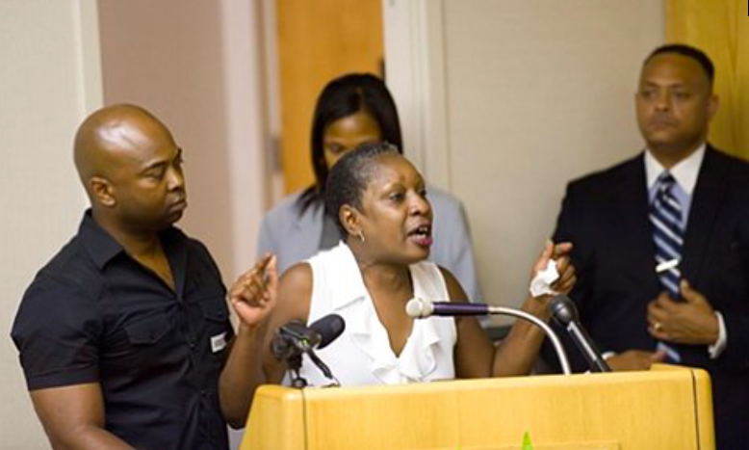
Secretly sterilized at age 14, Elaine Riddick successfully fought for recognition and compensation in North Carolina
Watch an Associated Press 3-minute long video about Elaine Riddick: https://www.youtube.com/watch?v=IWanJoxW2s4&t=10s
Photo permission via Adam David Kissick, https://www.adamkissick.com
Notes:
Elaine Riddick has been an outspoken survivor of North Carolina’s forced sterilization program. She was born into poverty and raised by her grandmother. At the age of 13, she was raped by a man in her neighborhood and became pregnant. She gave birth in March 1968 and was sterilized immediately afterward without her knowledge or consent. Her grandmother, who was illiterate, signed the consent form for sterilization out of fear that Elaine would be sent to an orphanage if she refused. Elaine did not discover what had happened to her until she married and tried to conceive a child. In 2011, the governor of North Carolina established a commission to determine how much to compensate Elaine and the estimated 1,500 to 2,000 other living victims of sterilization. There was much debate about whether any amount of money could compensate for not only the loss of fertility, but also the branding of victims as feebleminded and promiscuous.
Elaine Riddick’s case is discussed in detail in David Zucchino’s January 2012 article, “Sterilized by North Carolina, she felt raped once more,” in the Los Angeles Times (https://www.latimes.com/archives/la-xpm-2012-jan-25-la-na-forced-sterilization-20120126-story.html). If time allows, you may choose to show your students this news clip from the Associated Press that describes Riddick’s fight for justice. “Elaine Riddick has been fighting for 40 years to get compensation from the state of North Carolina” (https://www.youtube.com/watch?v=IWanJoxW2s4).
Image: Personal communication with photographer Adam Kissick. https://www.adamkissick.com. Permission granted and license fee paid April 2019. Original photograph at https://indyweek.com/news/archives/task-force-meets-tuesday-compensation-n.c.-sterilization-victims/

Slide 28
North Carolina is the first state to agree to compensate survivors of forced sterilization
Eugenic sterilization law enacted February 18, 1929.
Sterilization suitable for “mentally defective persons.”
“The 7,600 victims of the program, which was dissolved in 1977, were largely women and disproportionately members of minorities.” (NYT).
Any person (e.g., a neighbor) could request someone be sterilized, which would be considered by a state sterilization board.
After 10 years of debate, the NC legislature passes a budget to provide $10 million to victims. As of 2018, 213 victims have come forward and have received $35,000 each, with one more payment expected.
Slide adapted from DNA Learning Center, Cold Spring Harbor Laboratory
Notes:
North Carolina became the first state in the United States to approve payments to victims of its eugenic sterilization programs in 2013, after 10 years of debate and legislative votes. The state officially sterilized at least 7,600 people. According to the February 2018 article “Final payment goes out to 220 eugenics victims” in the Winston-Salem Journal (https://www.journalnow.com/news/local/final-payment-goes-out-to-eugenics-victims/article_6347a58b-0545-5173-9012-95f6e976dda1.html), reparations of $50,454 have been paid to 220 victims in three installments between 2014 and 2018. The only other state to pay compensation is Virginia, agreeing in 2015 to pay victims $25,000 each. See “Forced Sterilization Victims in Virginia Awarded Compensation” in the Roanoke Times (https://www.roanoke.com/news/politics/general_assembly/forced-sterilization-victims-in-virginia-awarded-compensation/article_15a83711-adba-5905-9bc4-ab266a5f57eb.html).

Slide 29
Echoes of the past:
Sterilization in the 2000s
Judge to inmates: Get sterilized and I’ll shave off jail time
Derek Hawkins, Washington Post (July 21, 2017)
Following reports of forced sterilization of female prison inmates, California passes ban
Hunter Schwarz, Washington Post (September 26, 2014)
Notes:
Sterilization continues to make headlines in recent years, often as it relates to incarcerated people and criminal sentencing. Investigative reporting revealed in 2014 that from 2006-2010 at least 132 inmates in California prisons were sterilized illegally. The sterilizations were characterized by unsigned consent forms, falsified documents, and women stating they were coerced. Much of the sterilization programs were propelled forward through racism and promises of economic relief and stability. One of the doctors involved in high percentage of the sterilizations noted to a reporter, on the subject of the economics of sterilization, that the costs of sterilizations were small “compared to what you save in welfare for these unwanted children.” New laws were passed as a result to better protect inmates and improve consent procedures. Read more in USA Today, “California Female Inmates Sterilized Illegally” (https://www.usatoday.com/story/news/nation-now/2014/06/20/california-female-inmates-sterilized/11037129/). In 2018, a woman awaiting sentencing underwent sterilization, after the judge suggested this could favorably impact how long she was incarcerated. Many argued this was coercive, as the pressures of a possible shorter sentence make true informed consent impossible. More on this case in the Washington Post, “Judge suggests drug-addicted woman get sterilized before sentencing, and she does” (https://www.washingtonpost.com/news/true-crime/wp/2018/02/08/judge-suggests-drug-addicted-woman-get-sterilized-before-sentencing-and-she-does/?utm_term=.a06fc13c6e2b)

Slide 30

Oversight on privacy, research and health disparities by the National Institutes of Health
Courtesy: National Human Genome Research Institute (https://www.genome.gov/issues/)
Notes:
NIH protections for human research continue to adapt to the changing field of genetics. In addition to state-level action, the United States government works to ensure that progress in science, research and technology proceeds in an ethical and socially acceptable manner, so as not to see echoes of the past repeated. The National Institutes of Health (NIH) oversees the funding and conduct of millions of dollars in medical research. The NIH conducts many clinical trials and funds research to look at the implications of new technologies and plays an important role in making sure medical research is fair, safe and equitable. They require coursework, training, and external review bodies to oversee research, offer certifications of confidentiality, and note on their homepage (https://grants.nih.gov/policy/humansubjects.htm) as part of their mission “to ensure that individuals such as women, children and minorities are included in clinical research in a manner that is appropriate to the scientific question under study.” At the same time, federal agencies continue to struggle to recruit a fair and representative sample of the population to participate fully in the benefits of scientific advancement. Examples are cited in the ProPublica article, “Black Patients Miss Out on Promising Cancer Drugs” (https://www.propublica.org/article/black-patients-miss-out-on-promising-cancer-drugs).
Image: Courtesy: National Human Genome Research Institute, National Institutes of Health, https://www.genome.gov/Issues/, accessed April 29, 2019).

Slide 31
Image credits
Slide 4: Angelina Jolie, Angelina Jolie, https://www.flickr.com/photos/gageskidmore/4860509634/in/photolist-8pvobf-8nFErg-9b3Ve6-8nJMfh, CC BY SA 2.0.
Prescription bottle image courtesy of Dana Bateman
Slide 5: Photo by Mark Engebretson, University of Minnesota.
Slide 6: Image created with data from: Winkelman, W.D., Missmer, S.A., Myers, D. et al. J Assist Reprod Genet (2015) 32: 665
https://doi.org/10.1007/s10815-015-0456-8
Slide 7: Courtesy of National Human Genome Research Institute, NIH, genome.gov. Open access. Image located at (https://www.genome.gov/news/newsrelease/Systematic-review-study-supports-that-sickle-cell-trait-increases-risk-for-some-health-conditions), accessed April 2019.
Slide 8: 8-cell human embryo, day 3” by ekem, Courtesy: RWJMS IVF Program (https://commons.wikimedia.org/wiki/File:Embryo,_8_cells.jpg, accessed Jan 13, 2017). Public domain
Slide 11: Burlington Free Press, October 29, 1926, p. 1. Clipping from Paul Amos Moody Papers, Box 181, Truman Allen file, University of Vermont Archives. Courtesy of Vermont Eugenics: A Documentary History (http://www.uvm.edu/~eugenics/images/hpbfp102926.html, accessed Oct 10, 2018).
Slide 12: (center) “Climbing into the Promised Land Ellis Island” by Lewis Hine, circa 1908. Source: Online Collection of the Brooklyn Museum. Via Wikimedia Commons (https://commons.wikimedia.org/wiki/File:Brooklyn_Museum_-_Climbing_into_the_Promised_Land_Ellis_Island_-_Lewis_Wickes_Hine.jpg, accessed Feb 1, 2016).
(right) “Bandit’s Roost” by Jacob Riis, 1888. Via the Preus Museum (https://www.flickr.com/photos/preusmuseum/5389939434/in/photolist-9dhRdf, accessed Feb 1, 2016).
Slide 13: Image: "Exhibit of work and educational campaign for juvenile mental defectives”, 1906. Source: American Philosophical Society, ERO, MSC77,Ser1,Box35: Trait Files. Accessed via the Eugenics Image Archive, Dolan DNA Learning Center, Cold Spring Harbor Laboratory, ID# 348 (http://www.eugenicsarchive.org/eugenics/view_image.pl?id=348, accessed March 2, 2020). pgEd has cropped the original image.

Slide 32
Image credits
Slide 14: Image: "Fitter Families contestants at Georgia State Fair, Savannah”, 1924. Source: American Philosophical Society, ERO, MSC77,SerVI,Box 4, FF Studies, KS Free Fair. Accessed via the Eugenics Image Archive, Dolan DNA Learning Center, Cold Spring Harbor Laboratory, ID# 190 (http://www.eugenicsarchive.org/eugenics/view_image.pl?id=190, accessed March 2, 2020).
Slide 15: Image: "The New Virginia Law to Preserve Racial Integrity”, by W. A. Plecker, Virginia Health Bulletin (vol. 16:2), 1924. Source: American Philosophical Society, Dav, B:D27.,Harriman, Mrs. E.H.. Accessed via the Eugenics Image Archive, Dolan DNA Learning Center, Cold Spring Harbor Laboratory, ID# 436, p. 1 (http://www.eugenicsarchive.org/eugenics/view_image.pl?id=436, accessed March 2, 2020). pgEd has cropped the original image.
Slide 17: Image: "Carrie and Emma Buck at the Virginia Colony for Epileptics and Feebleminded, taken by A.H. Estabrook the day before the Buck v. Bell trial in Virginia”, by A.H. Estabrook, 1924. Source: Arthur Estabrook Papers, Special Collections & Archives, University at Albany, SUNY. Accessed via the Eugenics Image Archive, Dolan DNA Learning Center, Cold Spring Harbor Laboratory, ID# 1924, p. 1 (http://www.eugenicsarchive.org/eugenics/view_image.pl?id=1287, accessed March 2, 2020).
Slide 18: “Justice Oliver Wendell Holmes,” circa 1924, United States Library of Congress. (http://loc.gov/pictures/resource/npcc.26412/, accessed Feb 1, 2016).
Slide 19: Image: "Family-stock of a woman sterilized by the state of Maine”, circa 1935. Source: The Harry H. Laughlin Papers, Truman State University, Lantern Slides, IBM Box,Box 10. Accessed via the Eugenics Image Archive, Dolan DNA Learning Center, Cold Spring Harbor Laboratory, ID# 958 (http://www.eugenicsarchive.org/eugenics/view_image.pl?id=958, accessed March 2, 2020).

Slide 33
Image credits
Slide 22: Image: “You wouldn’t expect –” Human Betterment League of North Carolina, 1950. Via the North Carolina State Documents Collection. State Library of North Carolina (http://digital.ncdcr.gov/cdm/ref/collection/p249901coll37/id/14969, accessed Oct 10, 2018).
Slide 23: Public domain. From the US department of Health, Education and Welfare, 1974. Via Akwesasne Notes Vol. 6 Number 5, Jan 1975) https://www.law.berkeley.edu/php-programs/centers/crrj/zotero/loadfile.php?entity_key=QFDB5MW3
Slide 25: The Southern Conference Educational Fund (SCEF), Louisville, Ky. Via U.S. National Library of Medicine (https://www.nlm.nih.gov/exhibition/forallthepeople/carousel64.html, accessed May 1, 2019). Public domain.
Slide 27: Personal communication with photographer Adam Kissick. https://www.adamkissick.com. Permission granted and license fee paid April 2019. Original photograph at https://indyweek.com/news/archives/task-force-meets-tuesday-compensation-n.c.-sterilization-victims/
Slide 30: Courtesy: National Human Genome Research Institute, National Institutes of Health, https://www.genome.gov/Issues/, accessed April 29, 2019).

Slide 34
References
Slide 6: Data from “Preimplantation Genetic Diagnosis: Public Policy and Public Attitudes,” Hudson, K. 2006. Fertility and Sterility 85(6): 1638-1645. (DOI:
https://dx.doi.org/10.1016/j.fertnstert.2006.01.014, accessed Jan 25, 2016). Data from Winkelman WD, Journal of Assisted Reproduction and Genetics (2015)
Slide 18: Quote, Buck v. Bell. 274 U.S. 200, 1927. (https://supreme.justia.com/cases/federal/us/274/200/, accessed Oct 10, 2018).
Slide 20: Quote of Adolf Hitler, in Hitler – Memoirs of a Confidant by Otto Wagener (1985), Yale University Press.
Quote, “Sterilization and Its Possible Accomplishments,” Editorial. 1934. New England Journal of Medicine 211(8): 379-380.
(DOI: https://dx.doi.org/10.1056/NEJM193408232110813, accessed Oct 11, 2018).
Slide 21: Excerpts from the Nuremberg Code (https://history.nih.gov/research/downloads/nuremberg.pdf, accessed Oct 10, 2018).
    Slide 26: Summary of Madrigal v Quilligan case: https://www.washingtonpost.com/news/arts-and-entertainment/wp/2016/01/10/sterilized-against-their-will-in-a-los-angeles-hospital-latinas-tell-the-story-in-a-new-film/?utm_term=.25e9d3e271c8. Film: http://www.pbs.org/independentlens/films/no-mas-bebes/

