Slide 1
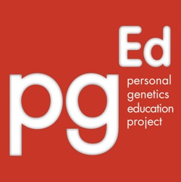
Scientific themes in
personal genetics
Personal Genetics Education Project (pgEd)
Harvard Medical School
www.pged.org
2016

Slide 2
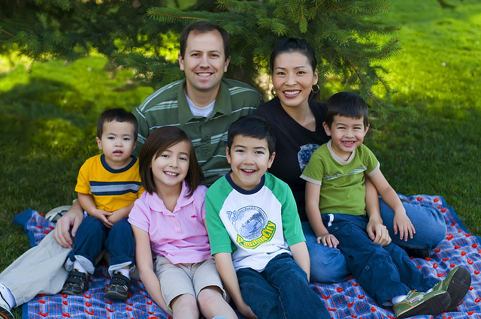
Your genome is your unique code of DNA that carries the information that affects your traits, including your appearance, health and behavior.
Each of us inherited half of our genome from our mother and half from our father, and this is why we often share traits with our parents.
As a result, siblings who share parents often share traits.
Image: Scott Barlow, CC BY-NC-ND 2.0
Notes:
Image: “Sunday Portrait” by Scott Barlow (http://www.flickr.com/photos/barl0w/3036412907, accessed Feb 4, 2016). Available under an Attribution-NonCommercial-NoDerivs 2.0 Generic license (http://creativecommons.org/licenses/by-nc-nd/2.0/).
Slide notes: Slides 2 and 3 give a brief introduction to DNA and the human genome. To explore these concepts more deeply, the Genetic Science Learning Center at the University of Utah offers a number of resources, including a multimedia Tour of The Basics (http://learn.genetics.utah.edu/content/basics/).

Slide 3
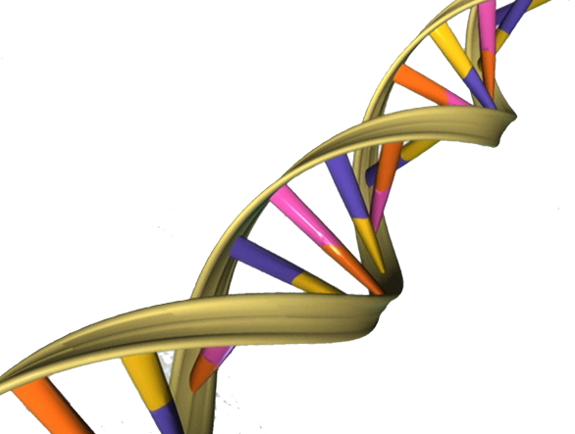
DNA is a chemical made up of a chain of bases. There are 4 types of bases – A, C, G and T.
In humans, our genome consists of ~6 billion bases.
Chains of bases are called chromosomes. The number of chromosomes and the order of bases along each chromosome are very important.
Each chromosome carries segments of DNA, known as genes, that are the blueprints to make proteins.
Notes:
Image: “DNA Double Helix” by Apers0n via Wikimedia Commons (https://commons.wikimedia.org/wiki/File:DNA_Double_Helix.png, accessed Feb 4, 2016).
Slide notes: Slides 2 and 3 give a brief introduction to DNA and the human genome. To explore these concepts more deeply, the Genetic Science Learning Center at the University of Utah offers a number of resources, including a multimedia Tour of The Basics (http://learn.genetics.utah.edu/content/basics/).

Slide 4
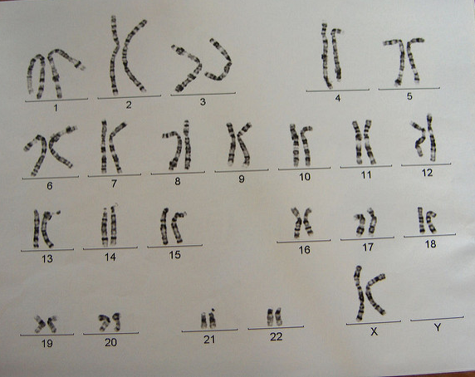
In general, we each have 23 pairs of chromosomes. One chromosome from each pair comes from our mother and one from our father.
Therefore, we typically inherit two copies of each gene. Our genomes contain approximately 20,000 genes.
Genome sequencing determines the order of the 6 billion bases of our genome and can reveal information about our traits.
Image: Esther Dyson, CC BY-NC 2.0
Notes:
Image: “genes on parade” by Esther Dyson (http://www.flickr.com/photos/edyson/38312588, accessed Feb 4, 2016). Available under an Attribution-NonCommercial 2.0 Generic license (http://creativecommons.org/licenses/by-nc/2.0/). pgEd cropped out the border of the image.
Slide notes: This image shows a karyotype, the chromosomes from a single cell of an individual. Commonly, we each have 23 pairs of chromosomes, each pair differing from the other pairs in terms of length and overall order of bases.
One of the pairs of chromosomes has a strong influence on our biological sex, and so the chromosomes of this pair, named X and Y, are called the sex chromosomes. Most females carry two copies of the X chromosome (XX), and most males carry one X and one Y chromosome (XY). Intersex individuals may be XX or XY, or they may carry one sex chromosome or three or more sex chromosomes. As more genomes are sequenced, some expect to find more variation related to sex chromosomes than originally understood. One of the hopes is that this information will allow us as a society to think more broadly about sex, biology and gender. A person’s sex chromosomes do not necessarily determine a person’s gender identity. People who identify as transgender may feel their gender identity conflicts with their biological sex.
The chromosomes of the rest of the genome are simply numbered 1 through 22, with two copies of each in most individuals. These 22 chromosomes are sometimes called autosomes.
One chromosome of each pair comes from our mother and one from our father. Therefore, in general, we also have two copies of each gene, one from our mother and one from our father. It is estimated that our genomes contain approximately 20,000 genes.
Due to remarkable advances in technology, scientists can now determine the order of the 6 billion bases of our genome along the X, Y and chromosomes 1 through 22. This is referred to as genome sequencing. As the cost of sequencing decreases, it is becoming possible for large numbers of people to have their genomes sequenced. Sometimes, the sequence of bases in specific regions of the human genome can be correlated to specific traits, leading to great interest in personal genome sequencing among scientists, physicians and the general public.

Slide 5
Genetic diversity
Our genomes are over 99% identical.
Remaining <1% difference => GENETIC VARIATION
Terminology:
How do we talk about our genetic differences?
MUTATIONS
VARIANTS
Notes:
Slide notes: It turns out humans have a lot in common, sharing over 99% of our DNA. The less than 1% that differs between any two individuals is referred to as genetic variation. It is these small differences between individuals that contribute to the wonderful diversity in the human population.
It may be helpful for students to discuss the terminology that is used to talk about genetic differences between individuals. A mutation is simply a change in one’s DNA sequence and is not necessarily bad nor good. Mutations contribute to the genetic diversity among us, allowing some individuals to better tolerate certain kinds of foods, endure changes in altitude and fight off infection. While some mutations are associated with negative outcomes such as disease, other mutations have no observable impact on our health or, in some cases, may even be beneficial. The term “variant” refers to all of these outcomes and is increasingly helpful to describe our genetic differences as personal genome sequencing becomes more commonplace.

Slide 6
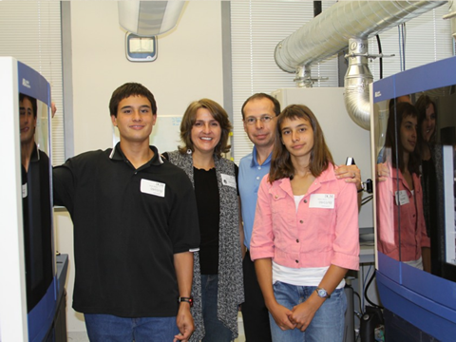
The Beery twins, Noah and Alexis
http://dystonia.thebeerys.com/
Notes:
Image: Retty Beery, The Beerys Dystonia Support Site Web Site (http://dystonia.thebeerys.com/, accessed Jan 25, 2016)
Slide notes: Genome sequencing has already had real-world impacts on patients, including twins Alexis and Noah Beery. The twins exhibited a number of developmental delays and were diagnosed with cerebral palsy at the age of two. Their mother, Retta, never felt that this diagnosis explained all of their symptoms, particularly since their symptoms worsened over the course of the day. Through their mother’s research and advocacy, the twins were diagnosed at age 5 with a genetic disorder called dopa-responsive dystonia and began taking a medication that seemed to successfully treat the condition. However, some symptoms persisted and escalated, particularly for Alexis, including serious breathing problems. The Beery family had the twins' genomes sequenced, leading to the identification of a mutation in the SPR gene which, when disrupted, causes deficiencies in two neurotransmitters, dopamine and serotonin. Upon treatment to restore both dopamine and seratonin, the twins’ symptoms quickly improved, permitting them to resume full, active lives.

Slide 7
Pedigrees depict family history
Joe
Retta
Zach
Noah
Alexis
Notes:
Slide notes: A pedigree is a way to draw a family tree to look at traits that appear to run in a family. A great deal of information can be captured in one drawing. Here is a simple pedigree looking at a single trait. More extensive pedigrees can also be drawn to include more traits, such as family health histories. (To learn more about drawing family health histories, visit www.genome.gov/Pages/Education/Modules/YourFamilyHealthHistory.pdf.) Briefly, men are drawn as squares and women as circles. Individuals with the trait being examined are shaded, whereas individuals without the trait are open. In slides 7-9, pedigrees are used to illustrate important principles in personal genetics.
The pedigree in this slide represents the story of the Beery family. The following are important scientific points to make:
1) Rare genetic variants (or mutations) in the SPR gene are responsible for Alexis and Noah’s condition. These variants were identified by sequencing the twins’ genomes.
2) In general, people have 2 copies of SPR gene. Retta and Joe are carriers of the SPR mutation. Retta carries an SPR mutation in one of her two SPR genes; Joe carries a different SPR mutation in one of his two SPR genes (To learn more, see: www.genome.gov/27544763). Alexis and Noah inherited mutations in both copies of their SPR genes, one from each of their parents, and, as a result, developed this rare condition. This is an example of recessive inheritance.
3) There was a 1 in 4 chance that each child would inherit SPR mutations from both parents. However, families are small from a statistical perspective. Out of the 3 Beery children, 2 inherited SPR mutations from both parents.
4) Since Noah and Alexis are not identical twins, they had the same chance as any brother and sister to inherit SPR mutations from both of their parents.
5) Noah and Alexis did not show identical symptoms. This might be explained by other differences in their genetic make-up and/or environmental factors.

Slide 8
Pedigrees depict family history
Example: A family with inherited breast cancer susceptibility (BRCA1 variant).
Steven
Maria
age 60
breast cancer
XX
Chris
Vanessa
Emily
Angela
Malcolm
Ashley
Notes:
Slide notes: There are many families where multiple individuals suffer from cancer. Sometimes, this is due to inheritance of a genetic variant which confers increased cancer risk. For example, certain mutations in the BRCA1 gene confer an increased risk for developing breast and ovarian cancer. According to the National Cancer Institute, women who inherit a single copy of one of these BRCA1 variants have a 55-65% chance of developing breast cancer by age 70. Note, this is an example of dominant inheritance (http://www.cancer.gov/about-cancer/causes-prevention/genetics/brca-fact-sheet).
In the fictional family in this pedigree, the mother Maria was diagnosed with breast cancer at age 60. When she was diagnosed, she learned that she carried a mutation in the BRCA1 gene that put her at increased risk for cancer. What are the implications for Maria’s children?
1. Vanessa is adopted, indicated by the dashed lines and bracket. Since Vanessa is not related genetically to Maria, she cannot inherit the BRCA1 mutation from her. Since she does not know about her biological parents’ genes, Vanessa has the same risk for breast cancer as other women in the population. Approximately 12% of women in the United States are estimated to develop breast cancer in their lifetime (roughly 1 in 8 women). Many of these breast cancer cases are thought to be “spontaneous,” i.e. not due to an inherited predisposition.
2. Emily, Ashley and Angela have a 50% chance of inheriting the BRCA1 mutation from Maria. If they have inherited this variant, then they would be at increased risk for breast and ovarian cancer, and they could pass this variant on to their children. If not, they would have same risk for breast cancer as their sister Vanessa and other women in the population.
3. If Malcolm inherited the BRCA1 mutation, as a male, he would have a modestly increased cancer risk. Like his siblings, he would be able to pass this mutation onto his children and therefore his future daughters could be in this high risk group.
4. Chris is an individual who considers himself transgender, represented in the pedigree by the diamond symbol. Chromosomally, Chris carries two X chromosomes, which makes him genetically female. This means that, like his sisters, Chris would be at high risk for breast and ovarian cancer if he inherited the BRCA1 mutation from Maria.

Slide 9
Pedigrees depict family history
Example: A family with inherited breast cancer susceptibility (BRCA1 variant).
Steven
Maria
age 60
breast cancer
XX
Chris
Vanessa
Emily
Angela
Malcolm
Ashley
Justin
age 55
breast cancer
age 45
ovarian cancer
age 32
surgery
Chloe
Notes:
Slide notes: This slide shows a pedigree from the same family 20 years later.
1. Vanessa was diagnosed with breast cancer at age 55. Since Vanessa is not genetically related to Maria, her cancer is unrelated to the cancer being passed down in this pedigree. Instead, any genetic risks factors that she might have were inherited from her biological parents who are not depicted here.
2. Angela has not developed breast cancer but, at age 45, was diagnosed with ovarian cancer. She learned that she inherited the BRCA1 mutation from Maria. This makes the point that two women with the same BRCA1 variant can have different outcomes, e.g. different age of diagnosis, different type of cancer and some women with this mutation will not develop cancer.
3. Ashley underwent genetic testing and found out that she carries the BRCA1 mutation. After her daughter Chloe was born, Ashley underwent preventative surgeries to remove her breasts and ovaries. As a result, her risk for cancer is substantially reduced. She knows that Chloe, now 3 years old, has a 50% chance of inheriting the BRCA1 mutation, but doesn’t know if and when Chloe should get tested.

Slide 10
A major goal of genetics research is to
understand how your DNA influences your traits
?
Appearance
Health
Behavior
Image credits:
(left) Apers0n, via Wikimedia Commons
(right) Jason Mrachina, CC BY-NC-ND 2.0
Notes:
Image (left): “DNA Double Helix” by Apers0n via Wikimedia Commons (https://commons.wikimedia.org/wiki/File:DNA_Double_Helix.png, accessed Feb 4, 2016).
Image (right): “A New Day Brings New Opportunity” by Jason Mrachina (http://www.flickr.com/photos/w4nd3rl0st/67892270, accessed Feb 4, 2016). Available under an Attribution-NonCommercial-NoDerivs 2.0 license (http://creativecommons.org/licenses/by-nc-nd/2.0/).
Slide notes: A major goal of genetics research is to understand the relationship between people’s genetic information (or genotype) and their traits (or phenotype).
Your genotype is your complete heritable genetic identity; it is your unique genome that would be revealed by personal genome sequencing. However, the word genotype can also refer just to a particular gene or set of genes carried by an individual. For example, if you carry a mutation that is linked to high cholesterol, you may refer to your genotype just with respect to this mutation without consideration of all the other gene variants that you may carry.
In contrast, your phenotype is a description of your actual physical characteristics. This includes straightforward visible characteristics like your height and eye color, but also your overall health, your disease history and even your behavior and general disposition.
By analyzing the genomic sequences (genotypes) and characteristics (phenotypes) of many people, personal genome sequencing has the potential to link specific traits to specific genes. The most obvious benefit of these analyses will be to better understand the interplay of nature and nurture in known diseases, with the hope that they would lead to better treatments, cures, preventative measures and healthier generations of children.

Slide 11
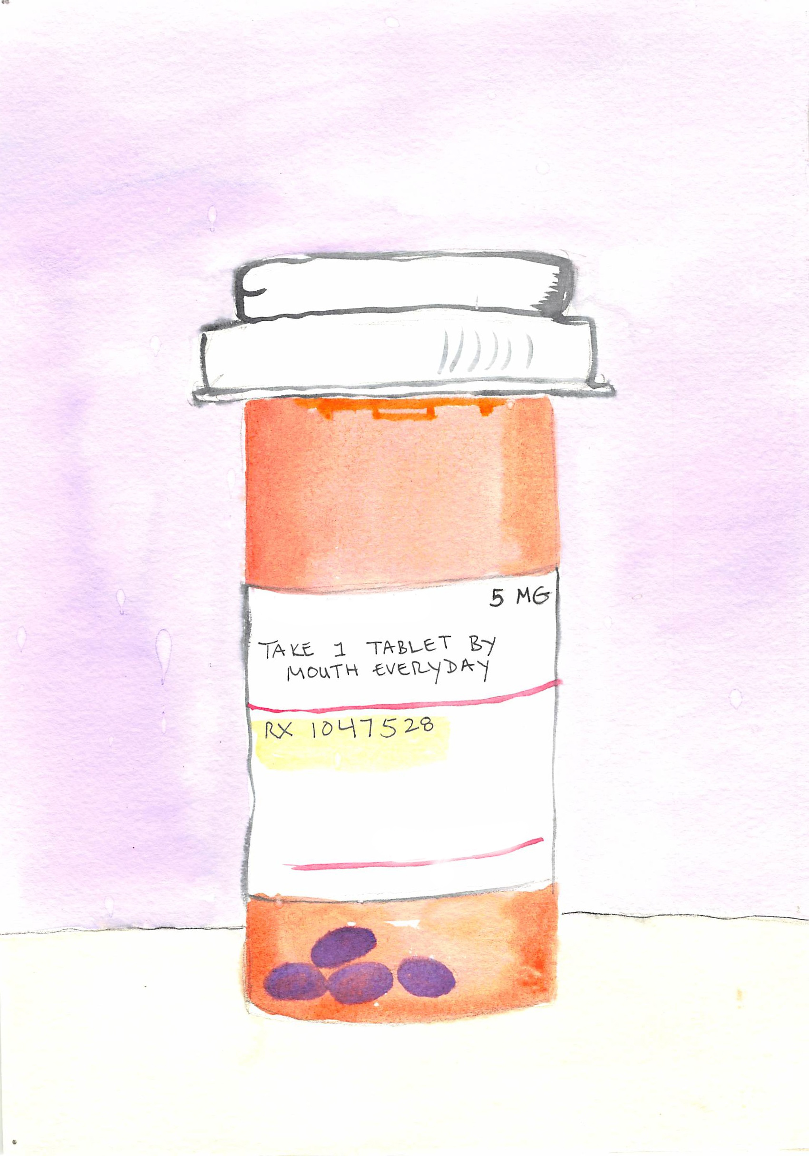
Drug response
Our DNA can impact
how we respond to certain
medications.
Some medications may
help or harm a patient
depending on that person’s
genetic makeup.
Notes:
Image: Personal Genetics Education Project (Dana Waring)
Slide notes: Notably, the field of pharmacogenomics is one area where there have already been many successes. Our DNA can impact how we respond to certain drugs as well as how we metabolize certain drugs. The goal is to use information about a person’s genetic make-up to identify medications that will be most effective with minimal side effects.

Slide 12
Even identical twins are different:
DNA alone does not determine who we are
Appearance
Health
Behavior
Environment and
Social Factors
Image credits:
(top, left) Apers0n, via Wikimedia Commons
(bottom, left): Scott Barlow, CC BY-NC-ND 2.0
(right) Jason Mrachina, CC BY-NC-ND 2.0
Notes:
Image (top, left): ““DNA Double Helix” by Apers0n via Wikimedia Commons (https://commons.wikimedia.org/wiki/File:DNA_Double_Helix.png, accessed Feb 4, 2016).
Image (bottom, left): “Sunday Portrait” by Scott Barlow (http://www.flickr.com/photos/barl0w/3036412907, accessed Feb 4, 2016). Available under an Attribution-NonCommercial-NoDerivs 2.0 Generic license (http://creativecommons.org/licenses/by-nc-nd/2.0/).
Image (right): “A New Day Brings New Opportunity” by Jason Mrachina (http://www.flickr.com/photos/w4nd3rl0st/67892270, accessed Feb 4, 2016). Available under an Attribution-NonCommercial-NoDerivs 2.0 license (http://creativecommons.org/licenses/by-nc-nd/2.0/).
Slide notes: One of the most important points to make to students is that your physical, mental and behavioral states are influenced both by your genetic make-up and by the unique circumstances in which you have lived your life, including everything that has ever happened to you. We often refer to these two inputs as “nature,” the unique genome you carry, and “nurture,” the environment in which you have lived your life. For example, height is influenced by the action of at least 180 regions in one’s genome in addition to environmental factors, including diet as well as maternal and childhood health. To read more about research exploring the genetic basis of height, see Alla Katsnelson’s June 2010 article “Genetics Tells Tall Tales” in Nature (http://www.nature.com/news/2010/100620/full/465998a.html) and the September 2010 article “Scientists stack up new genes for height” in the University of North Carolina School of Medicine News (http://www.med.unc.edu/www/newsarchive/2010/september/scientists-stack-up-new-genes-for-height).
Scientists are still far from having identified all the genes that contribute to our physical, mental and behavioral traits. Many scientists are now focusing also on interactions between genes and environment and how that relationship may impact traits and behaviors.

Slide 13
Complex relationship between
your DNA and environment
Examples:
PKU (phenylketonuria):
A genetic disease with an
environmental cure (diet).
Inherited cancer susceptibility:
Women with same BRCA1 variant
differ in whether they develop
cancer, type of cancer and age
of onset.
Type 2 Diabetes:
Common disease with
environmental and genetic
contributions.
Environment and
Social Factors
Image credits:
(top) Apers0n, via Wikimedia Commons
(bottom): Scott Barlow, CC BY-NC-ND 2.0
Notes:
Image (top): “DNA Double Helix” by Apers0n via Wikimedia Commons (https://commons.wikimedia.org/wiki/File:DNA_Double_Helix.png, accessed Feb 4, 2016).
Image (bottom): “Sunday Portrait” by Scott Barlow (http://www.flickr.com/photos/barl0w/3036412907, accessed Feb 4, 2016). Available under an Attribution-NonCommercial-NoDerivs 2.0 Generic license (http://creativecommons.org/licenses/by-nc-nd/2.0/).
Slide notes: This slide uses three examples to illustrate how our traits are influenced by a complex interaction between our genes and environment.
The first example is a genetic condition known as phenylketonuria (PKU). People with PKU cannot break down the amino acid, phenylalanine, that is especially high in protein-rich foods. As a result, babies with this disease accumulate high levels of phenylalanine in their blood, leading to severe mental retardation at a few months of age. The cause of this disease is entirely genetic, often as a result of a mutation in the enzyme that breaks down phenylalanine. However, if diagnosed early, these symptoms can be prevented by putting patients on a special diet with low levels of phenylalanine for the rest of their lives. Therefore, by an environmental change, the consequences of this genetic disease can be almost entirely avoided. For this reason, most states test for PKU as a part of mandatory newborn screening programs. For more on PKU, see the National Human Genome Research Institute page: http://www.genome.gov/25020037.
The second example is hereditary forms of breast cancer. Many women with the same high risk BRCA1 variant develop breast cancer or ovarian cancer. Some women develop both and some never get the disease, even if they live to an advanced age. These differences between women of the same genotype become more pronounced if we consider the differences in age at which they are diagnosed. The reason is that other genetic and environmental factors are involved in the disease. To read more about breast cancer, BRCA1 and other risk factors, see the American Cancer Society page: www.cancer.org/cancer/breastcancer/detailedguide/breast-cancer-risk-factors.
The third example is type 2 diabetes. The primary risk factor for this disease is being overweight. This disease often appears to run in families for two reasons. First, there is a genetic contribution. Several genes are known to affect a person’s predisposition for type 2 diabetes, although any one genetic variant has only modest effects on risk, in contrast to the above two examples, in which specific genetic variants are more highly correlated with disease. Second, diet and exercise habits are often learned at home, so individuals in the same family may be more likely to share the same practices. To learn more about research exploring the genetic basis of type 2 diabetes, see the December 2013 article “Genetic link to Type 2 diabetes found” in the University of Southern California News (http://news.usc.edu/58038/usc-scientists-contribute-to-new-type-2-diabetes-discovery/).

Slide 14
DNA: Your personal health risk forecast
(an analogy)
A weather forecast makes predictions about if it will rain.
Your DNA may have predictions about you (for example, your risk for developing a disease), but it is not a crystal ball. Your future cannot be predicted with certainty.
Notes:
Slide notes: This series of slides draws an analogy between the health information that you might learn from an analysis of your DNA and a weather forecast. The goal is to illustrate to students that DNA does not determine one’s future (slides 14, 15 and 16), that interpretations of genetic variants may change over time as research advances (slide 17) and that people can make lifestyle choices based on information they learn about their genetic make-up (slide 18).

Slide 15
DNA: Your personal health risk forecast
(an analogy)
Sometimes it rains when the weather forecast predicts less than 10% chance of rain.
If your risk for a certain disease is 90%, this means 10 people out of 100 on average will not develop the disease. If your risk is 1%, 1 person in 100 is expected to get sick.
Notes:
Slide notes: This series of slides draws an analogy between the health information that you might learn from an analysis of your DNA and a weather forecast. The goal is to illustrate to students that DNA does not determine one’s future (slides 14, 15 and 16), that interpretations of genetic variants may change over time as research advances (slide 17) and that people can make lifestyle choices based on information they learn about their genetic make-up (slide 18).

Slide 16
DNA: Your personal health risk forecast
(an analogy)
The forecast does not always predict how hard it will rain.
Even for a disease like cystic fibrosis that is caused by variants in a single gene, the severity of symptoms can vary between individuals who have the same version of the CFTR gene. This is due to additional genetic and environmental factors.
Notes:
Slide notes: This series of slides draws an analogy between the health information that you might learn from an analysis of your DNA and a weather forecast. The goal is to illustrate to students that DNA does not determine one’s future (slides 14, 15 and 16), that interpretations of genetic variants may change over time as research advances (slide 17) and that people can make lifestyle choices based on information they learn about their genetic make-up (slide 18).

Slide 17
DNA: Your personal health risk forecast
(an analogy)
The weather forecast might predict a 10% chance of rain, a 30% chance or a 90% chance. Forecasts often change based on new information.
In some cases, your DNA might suggest a strong risk of disease. For other diseases, your risk might be lower. As new risk factors are found, these numbers might change.
Notes:
Slide notes: This series of slides draws an analogy between the health information that you might learn from an analysis of your DNA and a weather forecast. The goal is to illustrate to students that DNA does not determine one’s future (slides 14, 15 and 16), that interpretations of genetic variants may change over time as research advances (slide 17) and that people can make lifestyle choices based on information they learn about their genetic make-up (slide 18).

Slide 18
DNA: Your personal health risk forecast
(an analogy)
If there is a 50% chance of rain, you might decide to take an umbrella when you go out.
Knowing you are at increased risk for a disease may influence your choices, especially if lifestyle
changes can prevent the disease.
Notes:
Slide notes: This series of slides draws an analogy between the health information that you might learn from an analysis of your DNA and a weather forecast. The goal is to illustrate to students that DNA does not determine one’s future (slides 14, 15 and 16), that interpretations of genetic variants may change over time as research advances (slide 17) and that people can make lifestyle choices based on information they learn about their genetic make-up (slide 18).

Slide 19
There are multiple ways to talk about a statistic
1 in 10 people
10% chance
3 students in your class of 30
3-fold lower risk,
assuming the population risk is 3-in-10
Notes:
Slide notes: Risk is communicated in many ways, and this language can affect how we perceive the statistics. This slide illustrates several ways of describing a 10% risk. This is the same as saying “one in 10 individuals.” If there are 30 students in your class, 10% means approximately three students. These are absolute terms.
Risk can also be talked about in a relative sense, often in comparison to a group of people or population. For example, imagine there is a new treatment that is reported to reduce an individual’s risk for disease 3-fold. In order to understand what this means, we need to have a reference. You do some research and find out that the baseline risk for the disease is 30%, meaning 3 in 10 individuals on average will develop the disease. In this case, individuals who use the new treatment will only have a 1 in 10 chance of developing the disease (a 10% risk).
How might you react if you find out that you are at 3-fold decreased risk for a disease? If the population risk is 3 in 1,000 (or 0.3%), a 3-fold decrease means that your risk is 1 in 1000 (or 0.1%). If, instead, the population risk is 6 in 10 (60%), then a 3-fold decrease would mean that your risk is 2 in 10 (20%). Would you react differently to this news? Whenever we hear a relative risk, it is important to consider what the baseline risk of the population is in order to make informed decisions based on these statistics.

Slide 20
Image credits
Slides 2, 12 (bottom, left), 13 (bottom, left): “Sunday Portrait” by Scott Barlow (http://www.flickr.com/photos/barl0w/3036412907, accessed Feb 4, 2016). Available under an Attribution-NonCommercial-NoDerivs 2.0 Generic license (http://creativecommons.org/licenses/by-nc-nd/2.0/).
Slides 3, 10 (left), 12 (top, left), 13 (top): “DNA Double Helix” by Apers0n via Wikimedia Commons (https://commons.wikimedia.org/wiki/File:DNA_Double_Helix.png, accessed Feb 4, 2016).
Slide 4: “genes on parade” by Esther Dyson (http://www.flickr.com/photos/edyson/38312588, accessed Feb 4, 2016). Available under an Attribution-NonCommercial 2.0 Generic license (http://creativecommons.org/licenses/by-nc/2.0/). pgEd cropped out the border of the image.
Slide 6: Retty Beery, The Beerys Dystonia Support Site Web Site (http://dystonia.thebeerys.com/, accessed Jan 25, 2016)
Slides 10 (right), 12 (right): “A New Day Brings New Opportunity” by Jason Mrachina (http://www.flickr.com/photos/w4nd3rl0st/67892270, accessed Feb 4, 2016). Available under an Attribution-NonCommercial-NoDerivs 2.0 license (http://creativecommons.org/licenses/by-nc-nd/2.0/).
Slide 11: Personal Genetics Education Project (Dana Waring)

