Slide 1
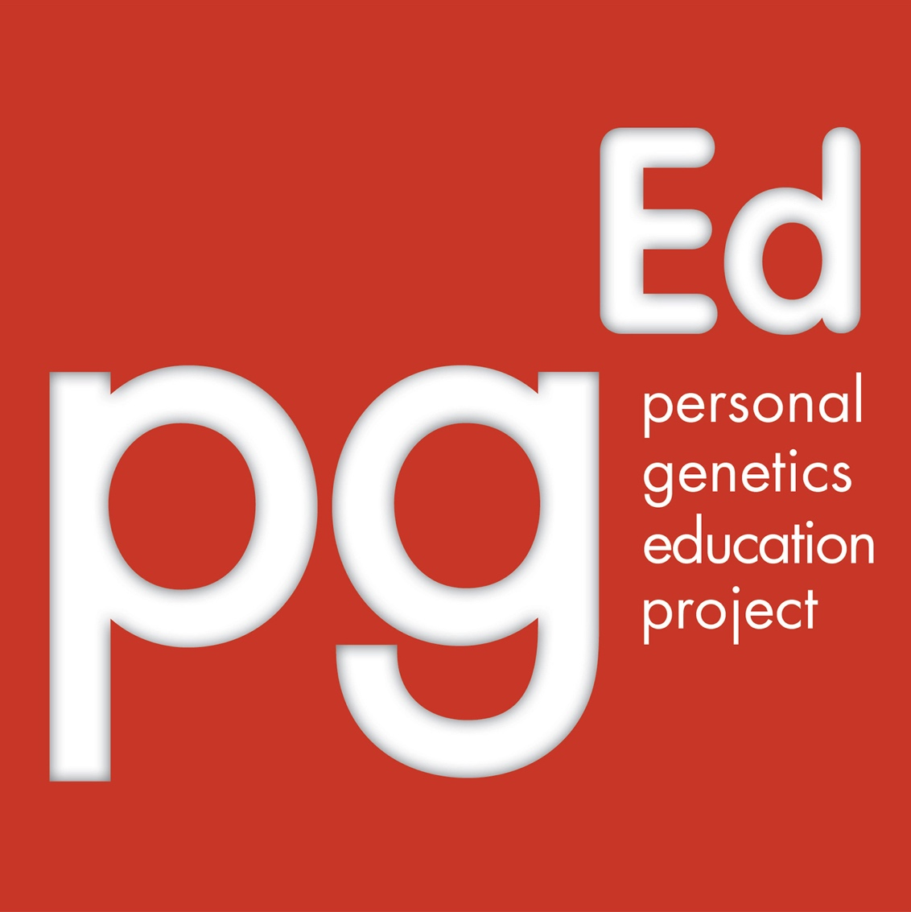
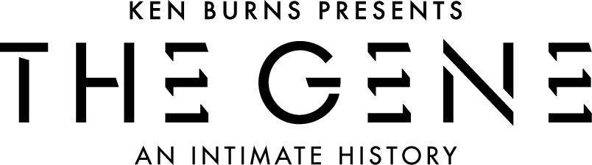

Genome Editing and CRISPR
Adapted for PBS LearningMedia in partnership with WETA for use with:
2020

Slide 2
Do Now: Discuss the following with the person (or people) next to you:
Imagine you’ve been offered a deal from a genomics company. You can get a free genome sequence – an analysis of all your DNA that includes a report of your ancestry, traits and a medical profile. The medical profile tells you about diseases for which you have a low risk of getting, and also those you have a high risk of getting.
Are you interested? Why or why not?
Notes:
The questions for this “Do Now” activity will help students begin to consider the topics covered in the lesson. In this “Do Now” activity, teachers should expect a wide range of answers. You may want to discuss some of the information ahead of the activity, or use this background to further add content and details to what you hear as students share their conversations.
Genetic analysis aims to inform an individual about his or her predispositions for various traits, including potential for developing diseases, by “reading” the nucleotide letters (A, T, G, C) of the individual’s DNA. From there, it can also provide estimates of the likelihood of passing along certain traits to one’s children. Examples of genetic analyses include the genetic tests that people might undergo before or during the course of pregnancy, or the tests for determining the basis of diseases. Increasingly, genetic analyses may involve sequencing an individual's genome. Learning about one’s genetic information can come with excitement and opportunities as well as a host of questions and confusion. It can impact family members and one’s own outlook, and open up new and unexpected information in terms of ancestry and health.
However, genetic analysis is just that – a look at what’s in your DNA. On the horizon are technologies that may one day make it possible, after having a look at your genome, to modify or change your DNA. In theory, this could be accomplished in a number of ways, such as using a virus as a “vehicle” to send new genetic material to a cell, or techniques where existing pieces of DNA are “cut” and new ones are “pasted” in. Once the new genetic material is inserted, the cellular machinery that copies and reads DNA would, presumably, treat it like it would any other piece of sequence.
A couple of concepts about genetic analysis and modification may be useful for students to know:
Differences in the number and location of cells that need to be analyzed or modified.
The genome in every cell in an individual’s body is essentially identical - with a few notable exceptions: for example, the reproductive cells and the mutations acquired by each cell in a person’s lifetime. With these caveats in mind, in theory, the DNA of virtually any cell can be analyzed to provide information about the whole body. This is why genetic analysis is often carried out on cells from easily accessible sources, such as saliva or blood. There is also ongoing research that aims to make it possible to analyze the genome sequence of single cells.
On the other hand, in order to modify traits or treat diseases, genetic changes will often need to be made to many cells at once, and the right kinds of cells. In some cases, modifying a small subset of cells may be enough (such as the stem cells in bone marrow that give rise to most of the body’s blood cells). In other cases, a significant portion of cells in the relevant tissue or organ may need to be modified. This presents technical challenges for safely targeting the changes to a sufficiently high number of the right cells and making changes to the desired part of the genome with minimal mistakes to the rest of the cell’s DNA.
2) There are two categories of genetic modifications with different ethical considerations.
The cells in our body fall into two broad categories – somatic and germline. Somatic cells, the ones that make up the majority of our body, contain both sets of genetic materials we got from our biological parents. If you were to change the DNA of somatic cells, those genetic changes do not affect the genomes of future generations. Germline cells, such as sperm and eggs, are the cells that give rise to the offspring during the reproductive process. Changes made to germline cells, including the intended modification as well as any mistake or unexpected changes made during the process, will have the chance of being inherited in the genomes of subsequent generations. Whether a genetic change is made to somatic cells or the germline is an important distinction because of the ethical questions about making changes to a genome that will be passed on to future generations. Currently, scientists believe that genetic changes can be made to somatic cells without affecting the germline.

Slide 3
Do Now: Discuss the following with the person (or people) next to you:
For the first 100 volunteers, the company is offering to ”correct” several of the disease-related genes found by the analysis. Imagine this were a very new procedure approved by the government for safety, but without a great deal of long-term study.
Would you volunteer for this added service?
(This service is not currently available and will not be in the near future, so use your imagination.)
Notes:
The questions for this “Do Now” activity will help students begin to consider the topics covered in the lesson. In this “Do Now” activity, teachers should expect a wide range of answers. You may want to discuss some of the information ahead of the activity, or use this background to further add content and details to what you hear as students share their conversations.
Genetic analysis aims to inform an individual about his or her predispositions for various traits, including potential for developing diseases, by “reading” the nucleotide letters (A, T, G, C) of the individual’s DNA. From there, it can also provide estimates of the likelihood of passing along certain traits to one’s children. Examples of genetic analyses include the genetic tests that people might undergo before or during the course of pregnancy, or the tests for determining the basis of diseases. Increasingly, genetic analyses may involve sequencing an individual's genome. Learning about one’s genetic information can come with excitement and opportunities as well as a host of questions and confusion. It can impact family members and one’s own outlook, and open up new and unexpected information in terms of ancestry and health.
However, genetic analysis is just that – a look at what’s in your DNA. On the horizon are technologies that may one day make it possible, after having a look at your genome, to modify or change your DNA. In theory, this could be accomplished in a number of ways, such as using a virus as a “vehicle” to send new genetic material to a cell, or techniques where existing pieces of DNA are “cut” and new ones are “pasted” in. Once the new genetic material is inserted, the cellular machinery that copies and reads DNA would, presumably, treat it like it would any other piece of sequence.
A couple of concepts about genetic analysis and modification may be useful for students to know:
Differences in the number and location of cells that need to be analyzed or modified.
The genome in every cell in an individual’s body is essentially identical - with a few notable exceptions: for example, the reproductive cells and the mutations acquired by each cell in a person’s lifetime. With these caveats in mind, in theory, the DNA of virtually any cell can be analyzed to provide information about the whole body. This is why genetic analysis is often carried out on cells from easily accessible sources, such as saliva or blood. There is also ongoing research that aims to make it possible to analyze the genome sequence of single cells.
On the other hand, in order to modify traits or treat diseases, genetic changes will often need to be made to many cells at once, and the right kinds of cells. In some cases, modifying a small subset of cells may be enough (such as the stem cells in bone marrow that give rise to most of the body’s blood cells). In other cases, a significant portion of cells in the relevant tissue or organ may need to be modified. This presents technical challenges for safely targeting the changes to a sufficiently high number of the right cells and making changes to the desired part of the genome with minimal mistakes to the rest of the cell’s DNA.
2) There are two categories of genetic modifications with different ethical considerations.
The cells in our body fall into two broad categories – somatic and germline. Somatic cells, the ones that make up the majority of our body, contain both sets of genetic materials we got from our biological parents. If you were to change the DNA of somatic cells, those genetic changes do not affect the genomes of future generations. Germline cells, such as sperm and eggs, are the cells that give rise to the offspring during the reproductive process. Changes made to germline cells, including the intended modification as well as any mistake or unexpected changes made during the process, will have the chance of being inherited in the genomes of subsequent generations. Whether a genetic change is made to somatic cells or the germline is an important distinction because of the ethical questions about making changes to a genome that will be passed on to future generations. Currently, scientists believe that genetic changes can be made to somatic cells without affecting the germline.

Slide 4
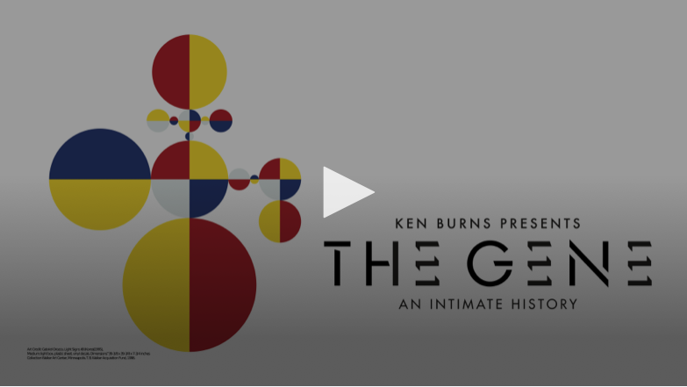
Watch this clip from
The Gene: An Intimate History
https://ny.pbslearningmedia.org/resource/9795d5d3-2b03-4d50-b193-ae6eb918392f/genome-editing-and-crispr/
Notes:
We recommend pausing on this slide to show students the accompanying clip from The Gene: An Intimate History.
https://ny.pbslearningmedia.org/resource/9795d5d3-2b03-4d50-b193-ae6eb918392f/genome-editing-and-crispr/

Slide 5
What is CRISPR?
(Clustered regularly interspaced short palindromic repeats)
A genome editing technique that:
  Targets a specific section of DNA
  Makes a precision cut/break at the target site
  Can do one of two things:
      Makes a gene non-functional
      Replace one version of a gene with another
What are the potential applications of CRISPR
to human health?
Notes:
What is CRISPR? In the past decade, scientists began to develop techniques known as “genome editing.” Genome editing allows scientists to make changes to a specific “target” site in the genome. One of the techniques that have generated the most excitement, due to its efficiency and ease of use, is called “CRISPR.” CRISPR stands for “clustered regularly interspaced short palindromic repeats.” It is akin to a primitive immune system that bacteria use to protect themselves against viruses. Scientists have since been able to take components of the CRISPR system and use it as an experimental tool.
Generally speaking, genome editing techniques such as CRISPR can be used to do one of two things. First, they can be used to make a gene nonfunctional (e.g., to shut down a gene that is causing disease, such as a gene that a cancer cell requires to grow). They can also be used to replace one version of a gene with another (e.g., to replace a faulty or broken copy of a gene with a working copy). Other researchers are experimenting with modified versions of CRISPR that, instead of modifying the DNA sequence at the target site, deliver additional molecular tools to turn a target gene “on” or “off.”
For a more detailed description of the mechanism of how CRISPR works, see supplemental slide #15.
"CRISPR's Most Exciting Uses Have Nothing to Do With Gene-Editing," by Ed Yong, January 2016, The Atlantic.
How does CRISPR work?
CRISPR is a self-defense mechanism that bacteria use to protect their genomes against viruses. It works by making cuts to DNA at specific genomic sites. Scientists have harnessed this system for use as a tool to make targeted DNA changes in a variety of organisms, including in human cells.

Slide 6
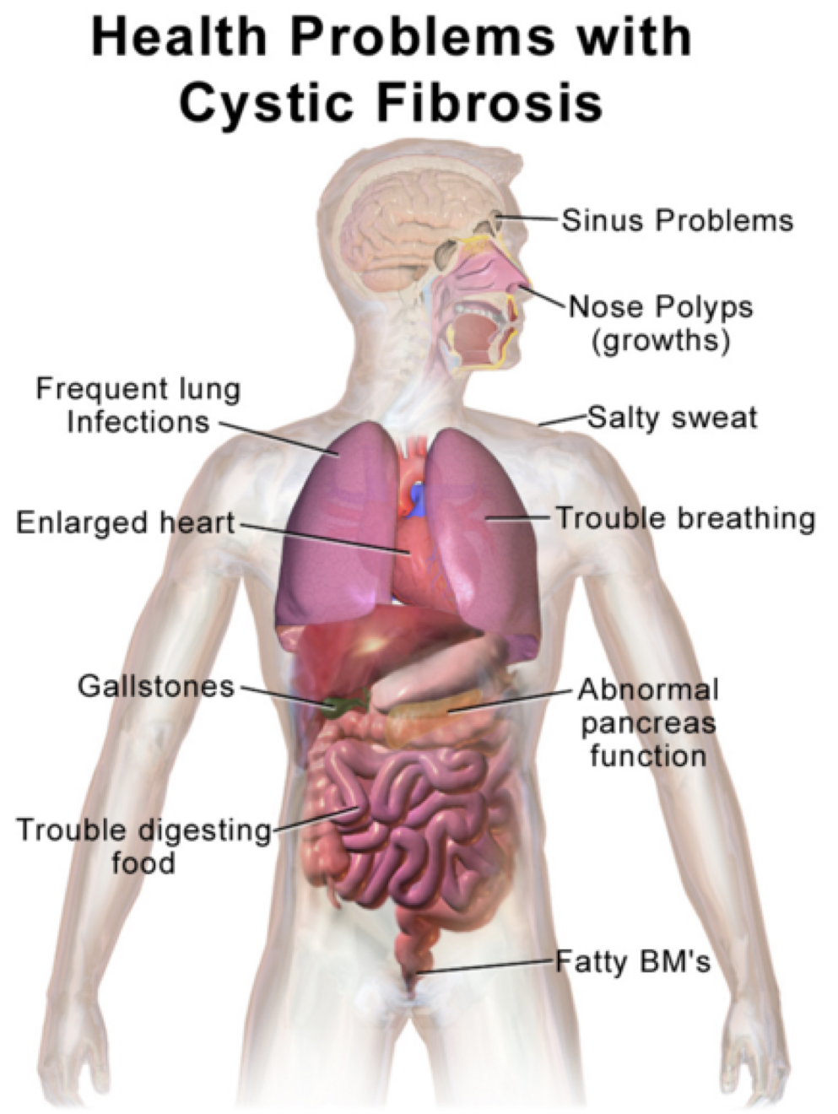
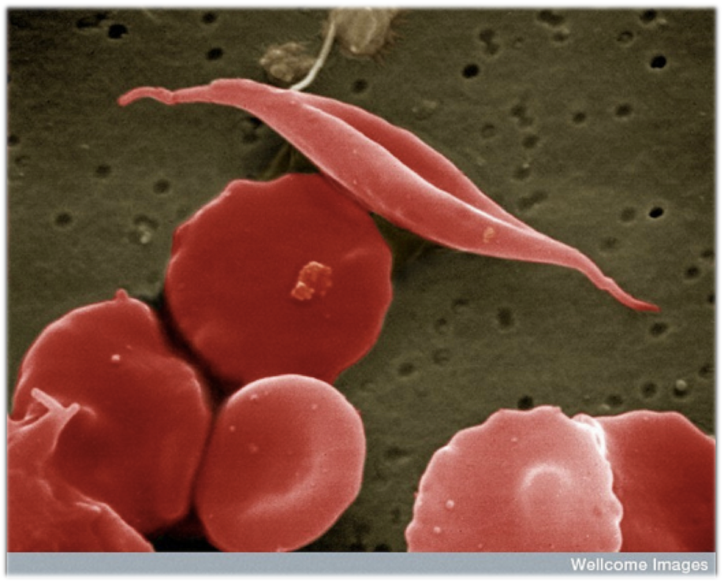
What is Gene Therapy?
Research is on-going to develop gene therapies for conditions such as cystic fibrosis and sickle cell disease
Image: Blausen.com staff, CC BY 3.0
Image: Wellcome Images, CC BY-NC-ND 2.0
Notes:
What is gene therapy? Using genetic technology to directly treat the genetic causes of diseases, known as “gene therapy,” has long been an aspiration for physicians, scientists and patients. Some diseases, such as cystic fibrosis or sickle cell anemia, are relatively well-understood to be caused by variants in single genes. If the disease-causing gene can be corrected or replaced, then the hope is to perhaps cure the disease or at least prevent the disease from worsening. However, this is more difficult for more complex conditions, such as heart disease, diabetes and many forms of cancer, which result from the interplay among many genes and between the genes and the environment.
Gene therapy has been attempted since the 1990s. So far, a limited number of gene therapy treatments have been approved by safety and regulatory agencies, such as the US Food and Drug Administration. Most of the approved treatments work by adding a new or extra copy of a gene. With advances in genome editing, it is now possible to consider more targeted approaches for gene therapy - for example, directly altering an individual’s original copies of a gene. Genome editing-based gene therapy can also be used in other ways, such as adding a new gene to a specific spot in the genome or inactivating genes that may otherwise trigger immune responses to a therapy. Note that, while a number of clinical trials are in progress around the world, none of these approaches have been approved for clinical use in humans as of February 2020.
"FDA approves first gene therapy for an inherited disease," by Laurie McGinley, December 2017, Washington Post.
"Gene Therapy Arrives," by Jim Daley, January 2020, Scientific American.
The following two conditions may potentially be treated by gene therapy:
Cystic Fibrosis (CF): CF is a genetic disorder where thick, sticky mucus in the respiratory pathways lead to breathing problems, developmental delays and infections. CF is caused by mutations in one gene called CFTR. Treatments have been very hard to find, and CF has been one of the most anticipated targets for gene therapy. One of the main challenges for gene therapy is to be able to safely and effectively make the desired genetic changes to all the cells that need the gene to function. In the case of CF, all the cells in the lungs and sweat glands may need functional CFTR in order to properly produce mucus or other secretions. While no therapies have yet been approved for use, in recent years there have been some promising experimental results in mice and pigs, where the major symptoms of the disease have been reversed.
"Gene therapy: promising candidate for cystic fibrosis," November 2015, Science Daily.
"Gene therapy for cystic fibrosis lung disease," September 2016, Science Daily.
Sickle Cell Disease (SCD): SCD is a genetic condition characterized by mutations in the oxygen-carrying proteins in red blood cells, called hemoglobin. SCD causes hemoglobin proteins to stick together and lead to the red blood cells turning into a sickle shape. SCD occurs because of mutations in the “adult hemoglobin” gene, which is responsible for making hemoglobin from the time we are babies onwards through adulthood. Gene therapy may be possible for SCD by directly repairing the mutations in this gene. Another promising approach takes advantage of a second hemoglobin gene that functions in fetuses and then gets turned off shortly after we are born. This hemoglobin gene, called the “fetal hemoglobin” gene, is not affected by mutations that cause SCD. So, one potential gene therapy would treat SCD by turning on the fetal hemoglobin gene and turning off the adult version. Experiments using this approach seem to work well in mice, and clinical trials in humans began in 2019.
"Gene therapy for sickle cell moves closer as scientists clear unexpected obstacle," by Sharon Begley, September 2016, STAT News.
"CRISPR deployed to combat sickle-cell anaemia," by Heidi Ledford, October 2016, Nature.
"Sickle–Cell Patients See Hope in CRISPR," by Antonio Regalado, August 2017, MIT Technology Review.
New gene therapy shows promise for patients with sickle cell disease," by Karen Weintraub, March 2019, WBUR.
Image (right): “B0000521 SEM sickled and other red blood cells” by Wellcome Images, Credit: EM Unit, UCL Medical School, Royal Free Campus (https://www.flickr.com/photos/wellcomeimages/7112270353/, accessed Jan 12, 2017). Available under a Creative Commons Attribution-NonCommercial-NoDerivs 2.0 Generic License (https://creativecommons.org/licenses/by-nc-nd/2.0/). No changes made.
Image (left): “Blausen gallery 2014” by Blausen.com staff, Wikiversity Journal of Medicine (https://commons.wikimedia.org/wiki/File:Blausen_0286_CysticFibrosis.png, accessed Jan 12, 2017). Available under a Creative Commons Attribution 3.0 Unported License (https://creativecommons.org/licenses/by/3.0/deed.en). No changes made.

Slide 7
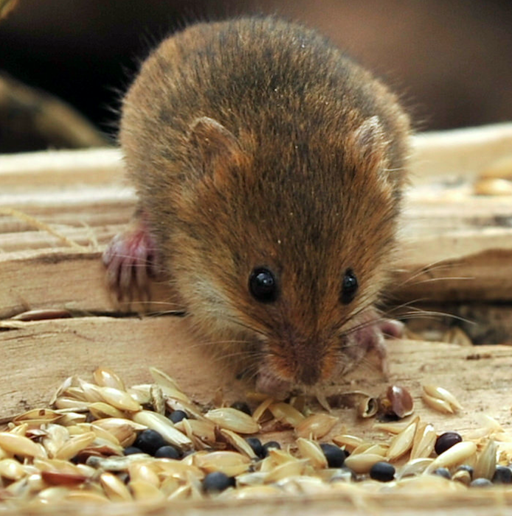
Researchers have used genome editing to cure a type of liver disease in adult mice
This type of research is an important step towards developing new gene therapies in humans
Image: Lex McKee, CC BY-NC 2.0
Notes:
Researchers have used genome editing to cure a type of liver disease in adult mice. Scientists are studying how to use CRISPR to treat diseases in animal models, as an important step in the research process towards applications in humans. For example, CRISPR has successfully been used in adult mice to reverse a liver disease called type I tyrosinemia. This disease, which affects 1 in 100,000 people, is caused by mutations in a single gene called FAH. The livers of people with this disease are unable to break down a specific amino acid, which can lead to liver failure. Scientists injected the CRISPR system along with working copies of the FAH gene into the veins of the diseased mice. In 0.4% of liver cells in these mice, the faulty FAH gene was successfully replaced with working copies. These edited cells then multiplied and replaced the cells with the faulty FAH gene, and eventually accounted for 33% of liver cells in the animals. This was enough to restore the lost function to the liver, allowing the liver to break down the proteins it previously could not – and led the research team to declare that they had “cured” type I tyrosinemia in adult mammals. While this treatment has not been tested in humans and trials are not yet underway, the concept that replacing a piece of DNA could lead to a profound improvement of a serious, often fatal genetic disorder in a mammal brings hope to many.
Details about this study can be found in Anne Trafton’s piece "Erasing A Genetic Mutation" in MIT News (March 2014).
CRISPR is also being investigated as a tool to fight other diseases in humans, such as cancer. For more, see (1) "First CRISPR trial gets green light from US panel," by Sara Reardon, June 2016, Nature and "CRISPR gene-editing tested in a person for the first time," by David Cyranoski, November 2016, Nature.
Image: “Harvest Mouse (7)” by Lex McKee (https://www.flickr.com/photos/lex-photographic/16744172269, accessed Jan 13, 2017). Available under a Creative Commons Attribution-NonCommercial 2.0 Generic License (https://creativecommons.org/licenses/by-nc/2.0/). No changes made.

Slide 8



The possibility of changing your DNA
Engineered T cells are transfused into the patient
T cells from patient or donor are edited so that they will target cancer cells and will not trigger immune rejection
Right direction for your business!
Adapted from https://www.mskcc.org/blog/car-t-cell-therapy-growing-area-research
Layla Richards: the first success of genome editing-based gene therapy
Notes:
The case of Layla Richards symbolizes the potential promise of genome engineering for treating diseases. Diagnosed at 14 weeks old with leukemia, a type of cancer that affects blood and bone marrow, Layla Richards was 11 months old when all conventional treatments had failed. Layla became the first child to be treated for leukemia via donated immune cells that were genetically engineered specifically for her body and type of cancer - a kind of treatment called immunotherapy. The cells, called CAR-T cells, were engineered to attack Layla’s cancer cells. The cells were also altered to ensure Layla’s immune system would not perceive them as dangerous and reject them. The transplant was a success, and as of the most recent report in early 2017, Layla remained cancer-free.
“A Groundbreaking Gene-Editing Therapy Eliminated Cancer in Two Infants,” by Kristen Brown, January 2017, Gizmodo.
Image: Adapted from https://www.mskcc.org/blog/car-t-cell-therapy-growing-area-research

Slide 9
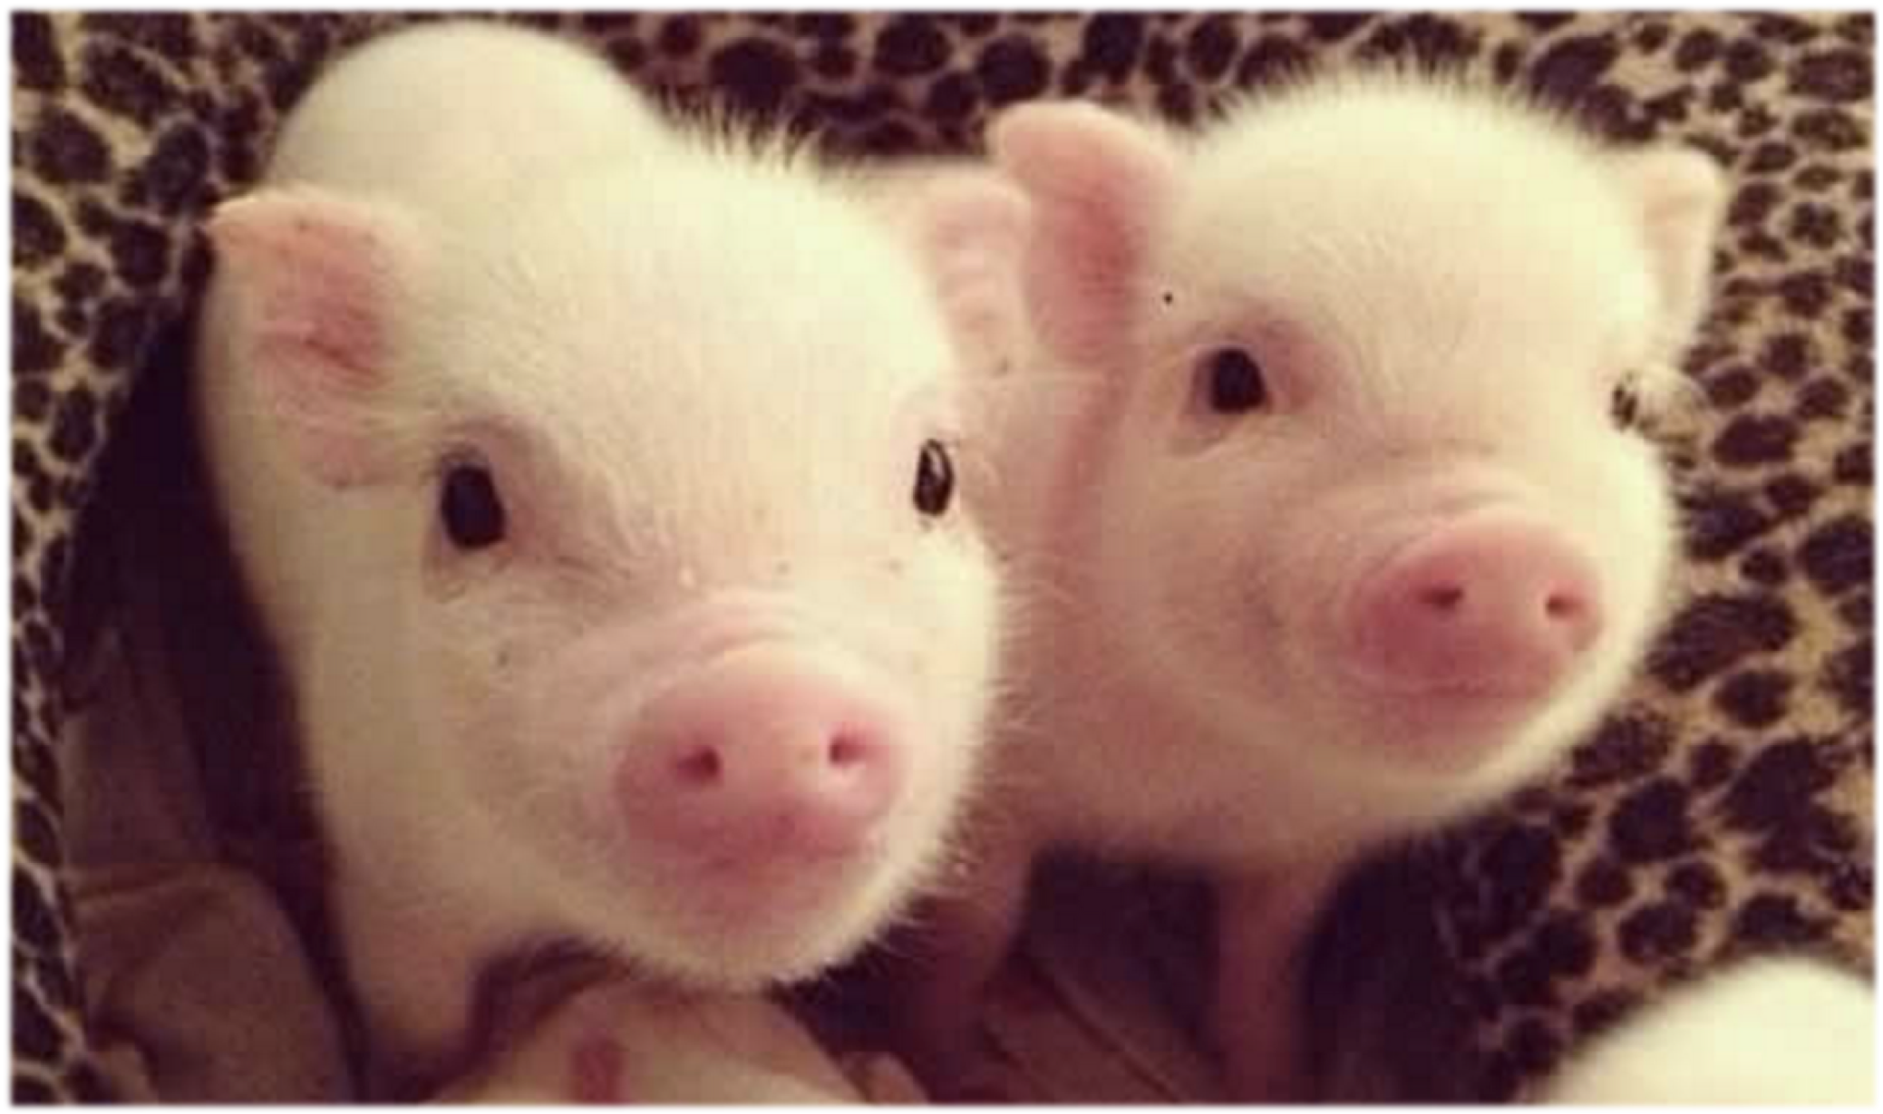
Might genome editing one day lead to a solution to the global shortage of organs?
Image: Maidiel1, CC BY-SA 4.0
Notes:
Might genome editing one day lead to a solution to global shortage of organs? In addition to carrying out gene therapy in patients, scientists are exploring other ways of using genome editing to impact human health. The following two slides look at some examples.
There is a massive shortage of organs for people who need donations, and pigs hold a great deal of promise as possible donors, as many pig organs and human organs are similar in size and structure. However, serious challenges persist for potential recipients due to risks of immune rejection and viral infection. Scientists are using CRISPR to alter pig genomes in an effort to address these issues. To prevent tissue rejection, researchers removed several pig genes that trigger a human immune response and introduced new genes that regulate blood clotting and inhibit the immune response. Additionally, the team used genome editing to disable viruses that are embedded in the pig genome (called porcine endogenous retroviruses or PERVs). By making these edits to lower the risk of an immune response or infection, people may be more likely to respond well to a transplanted organ from a pig. Increased availability of organs for transplantation could potentially save thousands of lives annually.
The pigs that have undergone genome edits are reported to be healthy and preliminary results seem to indicate that organs from these animals are significantly less likely to trigger an immune response in humans than those of unmodified pigs. To further test whether these modified pig organs will be safe and suitable for eventual transplantation into humans, the research team has started transplanting these pig organs into monkeys.
For more, see "Eyeing organs for human transplants, companies unveil the most extensively gene-edited pigs yet," by Kelly Servick, December 2019, Science.
While pork producers have shown interest in joining efforts to supply engineered pig organs for human transplantation, this approach raises a number of social and ethical concerns. Animal rights activists worry about the harming and exploiting of animals. The choice of animals in which the organs are produced may present cultural or religious challenges for certain communities. There are also questions about whether the organs will be available to patients in a fair and equitable fashion. Others worry about the first group of people who agree to such a transplant – will human bodies accept these organs, long term? Will the organs actually function for a length of time that justifies the risks and expense?
Image: “Cerditos” by Maidiel1 (https://commons.wikimedia.org/wiki/File:Chanchitos.jpg, accessed Jan 13, 2017). Available under a Creative Commons Attribution-ShareAlike 4.0 International License (https://creativecommons.org/licenses/by-sa/4.0/deed.en). No changes made.

Slide 10
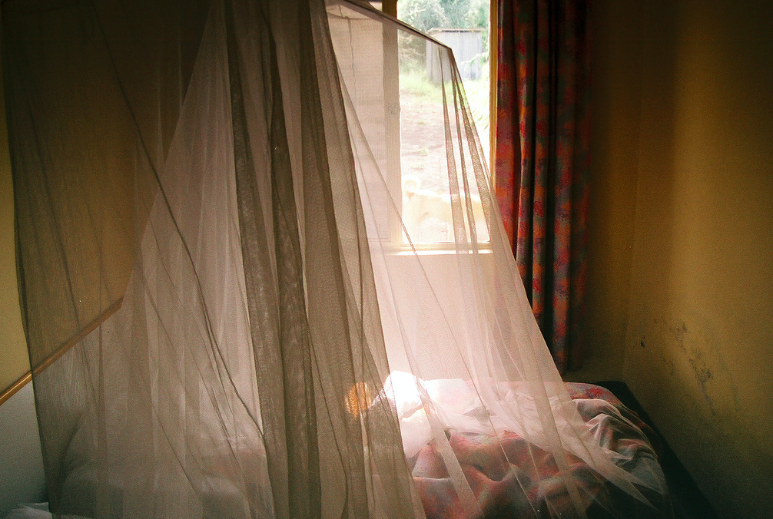
Should genome editing be used in the hopes of reducing malaria?
Image: YoHandy, CC BY-NC-ND 2.0
Notes:
Should genome editing be used in the hopes of reducing malaria? Each year, hundreds of millions of people get sick from diseases that are spread by mosquitoes, and outbreaks of Zika, dengue and yellow fever since the early 2010s highlight the problem. One of the mosquito-borne diseases that lead to the most suffering worldwide is malaria. In 2015, more than 200 million people had the disease, and more than 400,000 people died from it (World Health Organization: Malaria Fact Sheet).
Some scientists are investigating the possibility of curbing these mosquito-borne diseases by genetically modifying the mosquitoes, such that they become less able to either reproduce or to carry the disease-causing microbes. The general idea is to release modified mosquitoes (usually male, which do not bite and thus cannot spread disease) into the environment so that they will mate with the wild mosquitoes.
Modifying mosquitoes to change their reproductive ability and population size may have potentially unpredictable ecosystem-wide effects, e.g., on other animals that may rely on the mosquitoes for food, or plants that may depend on the insects for pollination. In order to balance the potential public health benefits with the ecological effects of this intervention, researchers, policymakers and other stakeholders are calling for more research before any genetically modified mosquito is widely released into the environment.
"Meet the Moralist Policing Gene Drives, a Technology That Messes with Evolution," by Antonio Regalado, June 2016, MIT Technology Review.
"Field trial of genetically modified mosquitoes gets approval in Florida," by Andrew Joseph, November 2016, STAT News.
Image: “Malaria room” by YoHandy (https://www.flickr.com/photos/thefinessimo/2164822357, accessed Jan 13, 2017). Available under a Creative Commons Attribution-NonCommercial-NoDerivs 2.0 Generic License (https://creativecommons.org/licenses/by-nc-nd/2.0/). No changes made.

Slide 11
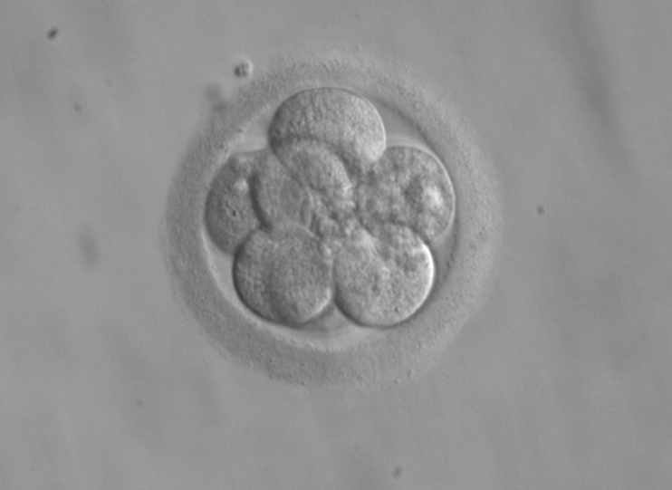
CRISPR is moving fast, but are we?
2015: A research group used CRISPR to make genetic changes in non-viable human embryos
2017: CRISPR used to make genetic changes in viable human embryos
Image: ekem (courtesy: RWJMS IVF Program), public domain
Notes:
CRISPR is moving fast, but are we? In April 2015, a research team in Sun Yat-sen University in China reported that they had used CRISPR to perform genome editing in human embryos. The embryos used in the research were “non-viable” and could not have developed into a fetus. Since then, other labs in China, the United States and the United Kingdom have performed genome editing in viable human embryos. Because a genetic change made to an early-stage embryo could affect all cells in the future individual, including the germ cells, this is a form of germline genetic modification. This has led to discussion and debate worldwide about whether germline editing in humans is appropriate, and whether or how society should proceed with such research and possible application.
Critics emphasize the technical and ethical issues with making changes to the genome that can be passed down to offspring. There are concerns that any unforeseen effect in the editing process can become inherited. Other questions are being asked — do we have the right to alter the genome of our future generations? Would the editing of certain diseases or disabilities lead to stigmatization of people who are living with those diseases or disabilities? And who gets to decide what are considered diseases or disabilities that should be edited? Are there religious questions and perspectives that can inform the discussion? At the same time, proponents of germline editing emphasize the benefits in terms of alleviating suffering. These include the potential to eliminate diseases such as Huntington’s disease, a debilitating neurological condition caused by a single gene variant. They also argue that humans have long been altering the lives and genetics of our offspring without their explicit consent, through procedures such as genetic counseling and preimplantation genetic diagnosis.
"A debate: Should we edit the human germline?" by Patrick Skerrett, November 2015, STAT News.
"Gene-editing research in human embryos gains momentum," by Ewen Callaway, April 2016, Nature.
"God and the genome: A geneticist seeks allies among the faithful," by Andrew Joseph, October 2016 STAT News.
Image: “8-cell human embryo, day 3” by ekem, Courtesy: RWJMS IVF Program (https://commons.wikimedia.org/wiki/File:Embryo,_8_cells.jpg, accessed Jan 13, 2017). Public domain.

Slide 12

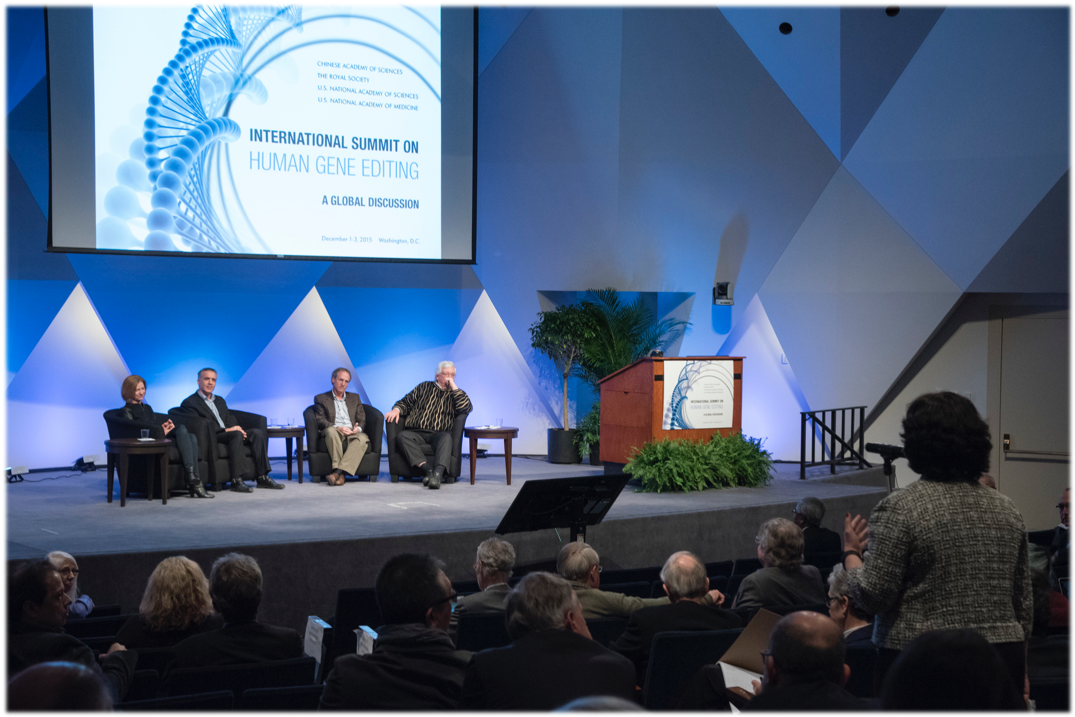
What is the path forward?
Safety – ethics – informed consent – human and ecological health
Image: Bjoertvedt, CC BY-SA 3.0
December 2015: International Summit on Human Gene Editing (Washington, DC)
Image: The National Academies, CC BY-NC-SA 2.0
Notes:
What is the path forward? The following two slides introduce the classroom activity that allows students to practice gathering information to make informed choices and policy decisions on a personal and societal level.
In December 2015, the United States National Academies, the United Kingdom Royal Academy, and the Chinese Academy of Sciences convened scientists, social scientists, ethicists, and other stakeholders for an International Summit on Human Gene Editing in Washington, DC. A statement released at the end of the summit emphasized that it would be “irresponsible” at this time to proceed with the clinical use of germline editing, but did not recommend banning the technique, instead suggesting that research should continue. Since then, a number of meetings and working groups have continued to move the conversation forward.
In February 2017, an expert panel convened by the US National Academies issued its report on human genome editing. It recommended that clinical research on germline modification to treat “serious disease or condition” should be allowed to proceed once a number of criteria are met, including more research on safety and efficacy, stringent oversight, and continuing public conversation about societal benefits and risks. At the same time, the report urges that genome editing for nonmedical “enhancement” should not proceed without further societal discussion.
Currently, germline modification is illegal in many European countries and in Canada, and federal funding in the US cannot be used for such work. As of February 2020, researchers in the UK, Sweden and China have gotten approval to perform genome editing in human embryos for research purposes only (in addition, existing laws or guidelines in these countries only allow research on embryos up to 14 days after fertilization).
Image (left): “International Human Gene Editing Summit 2015”, by The National Academies (https://www.flickr.com/photos/nationalacademyofsciences/23225911589/, accessed Jan 13, 2017). Available under a Creative Commons Attribution-NonCommercial-ShareAlike 2.0 Generic License (https://creativecommons.org/licenses/by-nc-sa/2.0/). No changes made.
Image (right): “US Congress on Capitol Hill, Washington DC”, by Bjoertvedt (https://commons.wikimedia.org/wiki/File:US_Congress_02.jpg, accessed Jan 13, 2017). Available under a Creative Commons Attribution-ShareAlike 3.0 Unported License (https://creativecommons.org/licenses/by-sa/3.0/deed.en). No changes made.

Slide 13
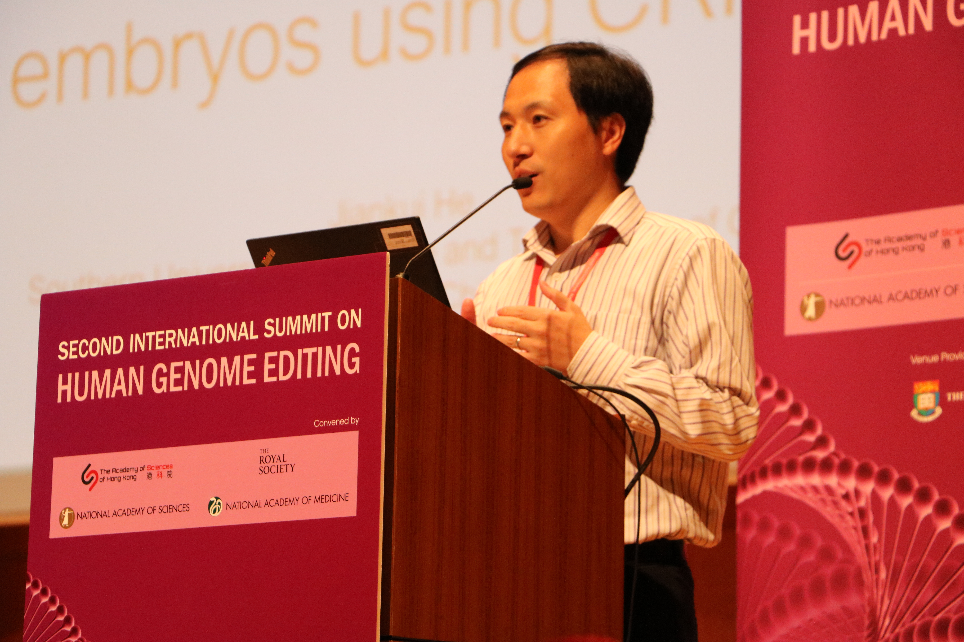
2018: Claims of CRISPR being used to edit genomes of twin girls
Image: The National Academies, CC BY-NC-SA 2.0
Notes:
Claims of CRISPR being used to edit genomes of twin girls. In November 2018, Dr. Jiankui He of Southern University of Science and Technology in Shenzhen, China announced that two children had been born whose genes were edited in the embryo stage. In an attempt to confer immunity to HIV infection, he genetically modified the CCR5 gene in embryos created via in-vitro fertilization (IVF). The current report is the first one of human beings being born with their DNA purposely altered in a lab to possess certain traits. He presented the research at the Second International Summit on Human Genome Editing, two days after the news broke.
In addition to the issues that this case raised about informed consent and the ethics of germline modification in humans, there are also scientific questions to consider. While changing CCR5 may confer immunity to some strains of HIV, a person could still be infected by other strains. There is also growing evidence that the genetically modified CCR5 gene might have unintended consequences, such as an increased susceptibility to infection by influenza and West Nile virus. This story highlights the challenges of using CRISPR and other genome editing tools, given that our biology is highly complex and that scientists’ understanding of genetics is ever-evolving.
For a deeper dive into this story, see pgEd’s lesson on "Claims of CRISPR Being Used to Edit Genomes of Twin Girls Born in 2018".
"He Jiankui, embryo editing, CCR5, the London patient, and jumping to conclusions," by Henry T. Greely, April 2019, STAT.
"Gene edits to ‘CRISPR babies’ might have shortened their life expectancy," by Sara Reardon, June 2019, Nature.
Before beginning the activity in Part 3, students should be aware of where regulation of genetic modification currently stands. These materials are up to date as of February 2020. As this is a rapidly developing area, you will find the most updated version of this lesson plan on pgEd's website.
Image: “Second International Summit on Human Genome Editing, Hong Kong, Day Two, Nov. 28”, by National Academy of Sciences (https://www.flickr.com/photos/nationalacademyofsciences/46085235431/, accessed Jan 15, 2019). Available under a Creative Commons Attribution-NonCommercial-ShareAlike 2.0 Generic License (https://creativecommons.org/licenses/by-nc-sa/2.0/). No changes made.

Slide 14
Supplemental Slide

Slide 15

Mechanism of CRISPR gene editing system
gRNA
Cas9
repair template
DNA repair
Gene Silencing
Gene Editing
Notes:
How does CRISPR work? When used as an experimental tool for genome editing, the CRISPR system has two main components:
A targeting system that finds the right place in the genome to cut. This is achieved by a molecule called a guide RNA (gRNA), which has the same genetic sequence as the target genomic site.
A component for making the actual cut to the DNA. This consists of a DNA-cutting enzyme (the technical term is a “nuclease”) called Cas9.
When both of these components are delivered into a cell, the gRNA will bind to the target genomic site through complementary base pairing (meaning, A’s will bind to T’s and G’s will bind to C’s). In the process, the gRNA helps bring in Cas9 to the target site to make a cut to the DNA double helix. The cell’s natural DNA repair mechanism will close this gap, but because the process is not perfect, a few DNA bases will be added or deleted. This renders the original gene – e.g., a gene variant linked to cancer, or one related to HIV infection – nonfunctional.
CRISPR can also be used to replace an undesired version of a gene (e.g., one that causes a disease) with a desired copy. In this case, the desired version of the target gene can be placed into the cell along with the gRNA and Cas9. The cell will then use this alternate sequence as a template to repair the broken DNA through the process of “homologous recombination,” copying the new sequence into the genome.

Slide 16
Image credits
Slide 4: Ken Burns Presents The Gene: An Intimate History (https://ny.pbslearningmedia.org/resource/9795d5d3-2b03-4d50-b193-ae6eb918392f/genome-editing-and-crispr/, accessed May 11, 2020)
Slide 6: (right) “B0000521 SEM sickled and other red blood cells” by Wellcome Images, Credit: EM Unit, UCL Medical School, Royal Free Campus (https://www.flickr.com/photos/wellcomeimages/7112270353/, accessed Jan 12, 2017). Available under a Creative Commons Attribution-NonCommercial-NoDerivs 2.0 Generic License (https://creativecommons.org/licenses/by-nc-nd/2.0/). No changes made.
(left) “Blausen gallery 2014” by Blausen.com staff, Wikiversity Journal of Medicine (https://commons.wikimedia.org/wiki/File:Blausen_0286_CysticFibrosis.png, accessed Jan 12, 2017). Available under a Creative Commons Attribution 3.0 Unported License (https://creativecommons.org/licenses/by/3.0/deed.en). No changes made.
Slide 7: “Harvest Mouse (7)” by Lex McKee (https://www.flickr.com/photos/lex-photographic/16744172269, accessed Jan 13, 2017). Available under a Creative Commons Attribution-NonCommercial 2.0 Generic License (https://creativecommons.org/licenses/by-nc/2.0/). No changes made.
Slide 8: Adapted from https://www.mskcc.org/blog/car-t-cell-therapy-growing-area-research
T cell image from “The Hematopoietic System of the Bone Marrow” by OpenStax College (https://commons.wikimedia.org/wiki/File:2204_The_Hematopoietic_System_of_the_Bone_Marrow_new.jpg, accessed Oct 16, 2018). Available under a Creative Commons Attribution 3.0 Unported license (https://creativecommons.org/licenses/by/3.0/deed.en). Image cropped.
Intravenous bag image from “Intravenous (IV) Bag Flat Icon Vector” by VideoPlasty.com (https://commons.wikimedia.org/wiki/File:Intravenous_(IV)_Bag_Flat_Icon_Vector.svg, accessed Oct 16, 2018). Available under a Creative Commons Attribution-ShareAlike 4.0 International license (https://creativecommons.org/licenses/by-sa/4.0/deed.en).
Slide 9: “Cerditos” by Maidiel1 (https://commons.wikimedia.org/wiki/File:Chanchitos.jpg, accessed Jan 13, 2017). Available under a Creative Commons Attribution-ShareAlike 4.0 International License (https://creativecommons.org/licenses/by-sa/4.0/deed.en). No changes made.

Slide 17
Image credits
Slide 10: “Malaria room” by YoHandy (https://www.flickr.com/photos/thefinessimo/2164822357, accessed Jan 13, 2017). Available under a Creative Commons Attribution-NonCommercial-NoDerivs 2.0 Generic License (https://creativecommons.org/licenses/by-nc-nd/2.0/). No changes made.
Slide 11: “8-cell human embryo, day 3” by ekem, Courtesy: RWJMS IVF Program (https://commons.wikimedia.org/wiki/File:Embryo,_8_cells.jpg, accessed Jan 13, 2017). Public domain.
Slide 12: (left) “International Human Gene Editing Summit 2015”, by The National Academies (https://www.flickr.com/photos/nationalacademyofsciences/23225911589/, accessed Jan 13, 2017). Available under a Creative Commons Attribution-NonCommercial-ShareAlike 2.0 Generic License (https://creativecommons.org/licenses/by-nc-sa/2.0/). No changes made.
(right) “US Congress on Capitol Hill, Washington DC”, by Bjoertvedt (https://commons.wikimedia.org/wiki/File:US_Congress_02.jpg, accessed Jan 13, 2017). Available under a Creative Commons Attribution-ShareAlike 3.0 Unported License (https://creativecommons.org/licenses/by-sa/3.0/deed.en). No changes made.
Slide 13: “Second International Summit on Human Genome Editing, Hong Kong, Day Two, Nov. 28”, by National Academy of Sciences (https://www.flickr.com/photos/nationalacademyofsciences/46085235431/, accessed Jan 15, 2019). Available under a Creative Commons Attribution-NonCommercial-ShareAlike 2.0 Generic License (https://creativecommons.org/licenses/by-nc-sa/2.0/). No changes made.

