Slide 1
Introduction to Personal Genetics
2019 edition

Slide 2
New advances in genetics are becoming personal
Learning about our DNA can offer:
Insights about our health, behavior, family history and other traits.
Information with personal, social and familial impact.
Improved health care.
Complicated questions about how to use genetics personally and as a society.
Challenges about how to ensure fairness and equity in genetic advances.
Notes:
This slide introduces students to the field of personal genetics, highlighting the potential personal and societal impacts of widespread DNA analysis. It sets the stage for the upcoming discussions about developments in genetic technologies and applications for healthcare, ancestry explorations, and the criminal justice system. In this case, “personal genetics” is used as a broad term to capture the many choices that individuals may face as healthcare consumers and as members of society.
While learning about your DNA is highly personal, the ability to do so raises many questions about how we as a society should handle access to genetic information. For example, if you learn about your risk for Alzheimer‘s disease, this may raise concerns for your biological relatives, who might not want to know anything about their risk for Alzheimer’s disease. Might easy access to genetic predispositions affect dating relationships? Should insurance companies be able to know information about your DNA? Would everyone have equal access to personal genetic information and the benefits of new genetic technologies? These are a few of the issues that this lesson will explore.

Slide 3
Do Now: Discuss the following with the person (or people) next to you:
What are the potential health benefits to knowing about your genetic make-up?
What are the possible downsides to knowing?
Aside from health and medical information, what else might you be curious to learn about from your DNA?
Notes:
The questions for this “Do Now” activity will help students begin to consider the topics covered in the lesson.
Have students answer the following questions individually or in pairs and then share their answers in a brief classroom discussion.
You can expect students to answer question one with ideas related to taking steps to prevent or seek early treatment for a potential health condition. You may suggest that even if they learned of conditions without a current treatment, they could choose to become active in clinical trials or advocacy.
For question two, students frequently raise concerns related to privacy and discrimination, as well as the emotional burden of learning about one’s genetic information. This can be an opportunity to tell students about the Genetic Information Nondiscrimination Act (GINA), a federal law in the United States which forbids the use of genetic information to discriminate against people in the areas of employment and health insurance. pgEd’s lesson “Genetics, Jobs and Your Rights” focuses on the protections extended by GINA.
Students often suggest genetics will give them definitive life-altering answers, often including a specific cause of death. It is important to clarify these misconceptions and instead emphasize the concept of genetic complexity. Remind students that genes are part of a much more complex story in concert with the environment, and scientists still have much to learn about the links between a person’s genetic make-up, their environment, and their health.
For the third question, students frequently mention learning about their ancestry and finding biological relatives.

Slide 4
The field of genetics is rapidly changing
TECHNOLOGY ADVANCES
LOWER
COST
INCREASED
ACCESS
Notes:
Technological advances that have lowered the cost of genome analysis are paving the way for people to have greater access to genetic information. This slide sets up the main ideas in slides 5-6, which provide examples of rapid advances in technology that are changing how readily people can access genetic information. For example, when the Human Genome Project was “completed” in 2003, it cost 3 billion dollars and took about 13 years. (Note: though the project ended, over a decade later in 2019, there remain several sections of the genome that have not been mapped.) In 2019, sequencing a human genome can cost as little as $700-$1,000 US and can be done in a matter of days, sometimes less. Additional time and expense may be required for interpreting clinical genome sequences as well as consulting with medical professionals (e.g., physicians, genetic counselors).

Slide 5
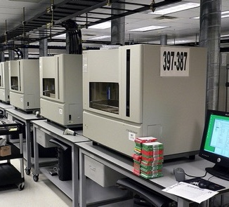
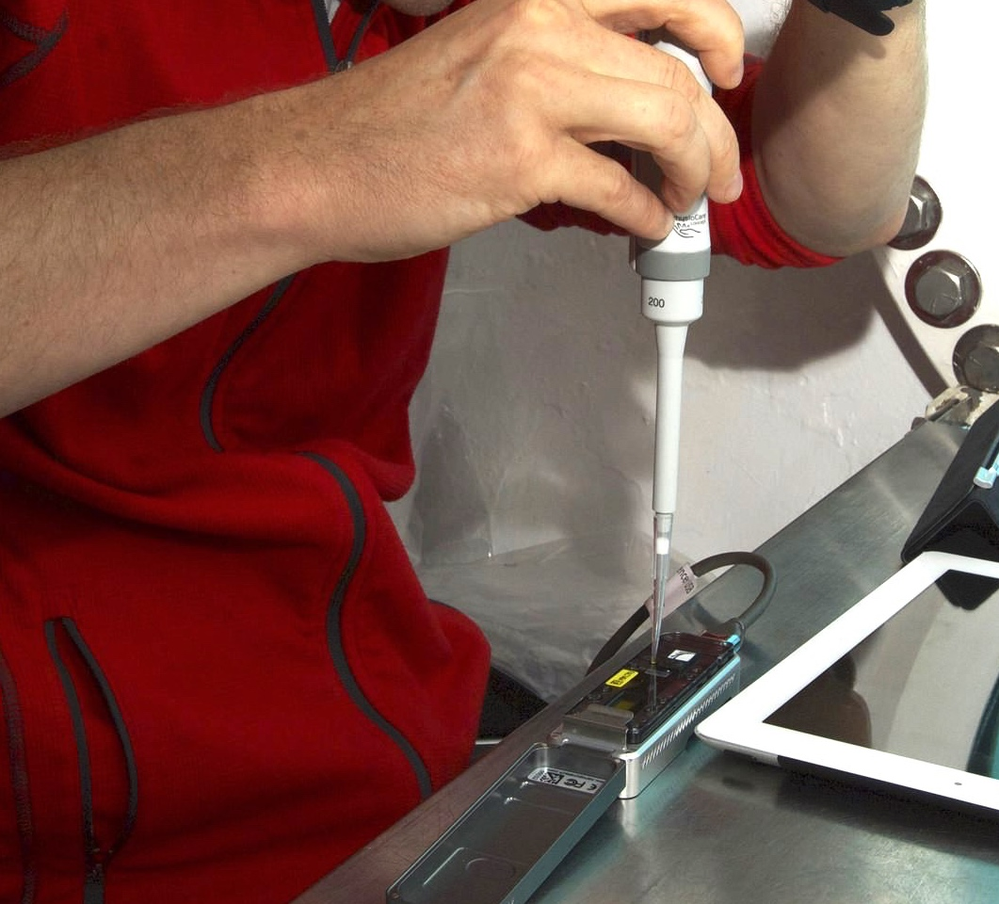
Technology out of the lab and into the world: Rapid, portable DNA analysis is on the horizon
2002
2019
Applied Biosystems 3730 DNA Analyzers
MinION DNA Sequencer
Jurvetson, CC BY 2.0
NASA
Notes:
The machines that sequence DNA are becoming smaller and more accessible. The first sequence of the human genome was achieved with hundreds of sequencing machines working for years. Now a single machine can sequence a full human genome in a matter of days. To make the technology more accessible, sequencing machines are now smaller and more affordable. For example, some companies (e.g., Genapsys and Oxford Nanopore) are developing DNA analysis machines, capable of providing a partial analysis (rather than a full genome sequence), that are the size of a loaf of bread, a bar of soap, or a USB drive.
One hope is that easily transported, handheld genome sequencers can be useful in emergency medical situations, whether it be a rapid diagnosis in an emergency room or to track the spread of a virus (such as Ebola, as was done during a recent outbreak). For more on genetics and Ebola, see the NIH’s article here: https://www.nih.gov/news-events/nih-research-matters/genetics-2014-ebola-outbreak
Image (left): “Riding Shotgun” by Steve Jurvetson (http://www.flickr.com/photos/jurvetson/57080968/, accessed Jan 25, 2016). Available under a Creative Commons Attribution 2.0 Generic license (https://creativecommons.org/licenses/by/2.0/).
Image (right): NASA (https://www.jpl.nasa.gov/news/news.php?feature=7056, accessed on Feb 7, 2019). Public domain.

Slide 6
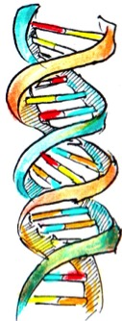
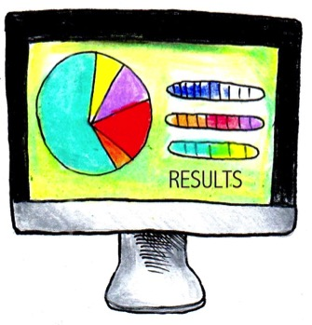
Genetic testing for sale: What is direct-to-consumer genetic testing and how does it work?
1. Order kit online.
2. Spit into tube
and send to lab.
3. The lab
analyzes DNA.
4. Customer
receives results.
Image: Personal Genetics Education Project (Patricia Hautea)
Notes:
Genetic testing kits are for sale online and in pharmacies and department stores in the US. These so-called “direct-to-consumer” (DTC) tests from for-profit companies offer a range of services from ancestry and health risk information to information about other personal traits. Some of these can be purchased without a doctor’s request or participation, while others require consulting with a doctor or genetic counselor about results. Samples are collected usually in the form of spit in tubes, which are then analyzed in a lab, and results are returned to customers by logging onto a website. Some of these products look at areas of the genome that commonly differ between individuals, known as single nucleotide polymorphisms (SNPs).
Decreasing costs means some companies are now offering more comprehensive analyses by reading the full sequences of specific genes, or even providing a full genome sequence. These products may provide information about risk for cancer or other conditions, or carrier status for genetic variants that, if inherited from both parents, can cause serious diseases in their children. Other tests offer an analysis of your possible ancestry, or may provide interesting but not particularly consequential information about your traits, such as whether or not you’re likely to sneeze when in bright sunlight or if you are likely to enjoy the taste of cilantro.
There has been much debate over DTC genetic testing since it first emerged in the early 2000s. These testing kits have made personal genetic information more accessible than ever before and millions of individuals have sent in their DNA samples seeking information about their traits, ancestry, and health. While many people are excited to learn about their genetic make-up and believe they have the right to know whatever information may be in their DNA, others are concerned about the safety of providing individuals with genetic health information without the supervision of a healthcare professional. Worries persist that individuals will misinterpret results, feel a false sense of security, or make medical decisions based on the limited information provided by these tests. Concerns about the safety and accuracy of these tests have also led some federal and state regulators to push for them to be considered medical devices and subject to extensive rules about safety and quality.
See pgEd’s lesson on “Consumer Genetics” for more information.
Image: Personal Genetics Education Project (Patricia Hautea)

Slide 7
How is personal genetics affecting real people?
Medicine & Health
Ancestry & Identity
Society
Notes:
Technological and scientific advances in genetics are impacting healthcare and medicine, adding exciting and complicated layers to concepts of identity and history, and having an impact on public life – particularly, the criminal justice system. These topics will be addressed in subsequent slides (see Parts 2-4).

Slide 8
Part 2
Personalized Medicine

Slide 9
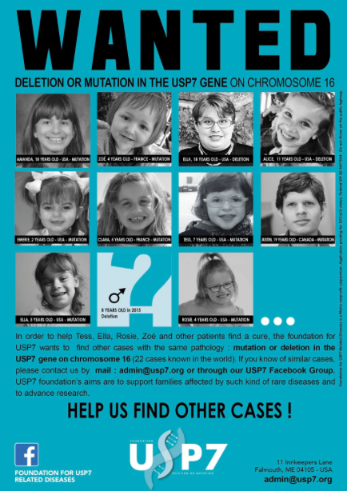
Genetic testing:
Solving medical mysteries & connecting families
Notes:
One major use of genetic testing is to determine whether an illness is genetic, with the hope of identifying a cure or treatment plan. Others find a long-sought-after answer when visits to specialists failed to yield a diagnosis. This slide highlights an example of how families with rare genetic disorders are seeking to connect with others to share medical resources and emotional support. It is also an example of how families can take action, even when faced with a medical condition that doesn’t yet have a well-established path of treatment.
This slide highlights the story of Tess Bigelow, a young girl whose genome was analyzed in search of a genetic cause for a number of complex health issues and developmental delays. The analysis revealed a change in her USP7 gene that caused it to malfunction. Disorders of the USP7 gene are very rare, so Tess’s father, Bo, made a social media post in search of others children with the same genetic variant as Tess. The following day, someone who saw Bo’s post connected him with a researcher studying this gene, and Bo learned that there were seven other children known to have the same condition. The Bigelow family have become activists, in addition to champions for Tess and her medical journey, seeking to find and connect families all over the world who might be affected by this genetic variant. They launched a foundation and created a community of other affected families in hopes of one day finding enough patients to populate a research study. The Bigelow family tells their story here: http://www.portlandrootsmedia.com/tess-genetic-mystery/
Image: “Wanted” poster courtesy of Bo Bigelow, founder USP7 foundation, http://www.usp7.org

Slide 10
Personal choices based on genetic information
Actor Angelina Jolie reveals she chose to undergo a double mastectomy.
Jolie had a genetic test and found she carried a mutation in the BRCA1 gene. Doctors estimated there was a very high chance she would get breast cancer.
Gage Skidmore, CC BY-SA 2.0
Image: Gage Skidmore, CC BY 2.0
Notes:
One reason people seek genetic testing is to identify future health risks. In May 2013, actor Angelina Jolie revealed that she had undergone a double mastectomy because she carries a mutation in the BRCA1 gene that greatly increases her risk of breast and ovarian cancer. Some believe a preemptive double mastectomy was a dramatic and potentially unnecessary choice since Jolie neither had cancer nor knew with certainty that she ever would, but according to Jolie’s op-ed “My Medical Choice” in the New York Times, her chances of developing breast cancer dropped significantly as a result of the surgery. This is a great way to engage students with a real-life example of a well-known person who used the results of a genetic test to inform a major medical decision aimed to reduce her risk of disease. Jolie’s advocacy, alongside many others, includes the goal of making genetic testing more accessible to all who want it. To learn more about breast cancer, BRCA1 and other risk factors, see the following link from the American Cancer Society: www.cancer.org/cancer/breastcancer/detailedguide/breast-cancer-risk-factors
Image: “Angelina Jolie” by Gage Skidmore (https://www.flickr.com/photos/gageskidmore/4860509634/, accessed Jan 25, 2016). Available under a Creative Commons Attribution-ShareAlike 2.0 Generic license (https://creativecommons.org/licenses/by-sa/2.0/).

Slide 11
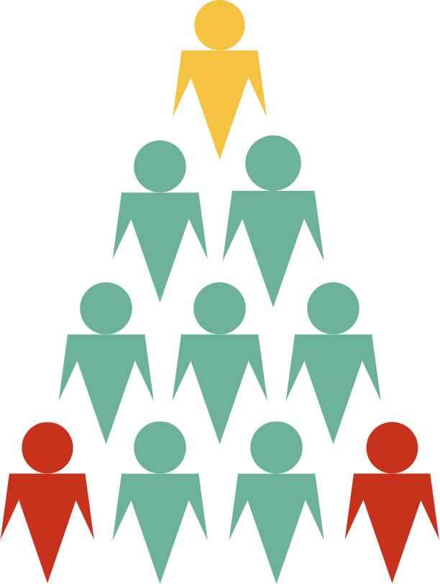
Genetics can determine safety and effectiveness of certain medications
CYP2D6 gene, involved in converting codeine to morphine - 100 known variants and counting!
Typical metabolizer - medication works as expected
Slow metabolizer - gets very little effect from the medicine
Rapid metabolizer - standard dose of medication can be lethal
Adapted from http://www.ensrmedical.com/pharmacogenetics/
Notes:
People may learn how their DNA affects their response to certain drugs. Certain genes control the rate at which a person’s body metabolizes a drug, and this can affect the dosage or whether the medicine is prescribed at all. A specific example is codeine, an opioid drug frequently prescribed for pain. Codeine is metabolized by the body into morphine with the help of an enzyme called CYP2D6. Variants in the CYP2D6 gene can dramatically affect how quickly an individual metabolizes this drug, and it can have serious, sometimes lethal, consequences if the dosage is not calibrated correctly. The FDA has cleared genetic tests to determine if a person is a rapid metabolizer (including a DTC test that was approved in November 2018), but as of 2019 they are not routinely used in the clinic.
For more information, read “Why Codeine is Dangerous in Some Kids after Tonsillectomy,” by David Kroll, February 2013, Forbes. From the article:
“…A small percentage of people are born with a single-letter change in their DNA for this enzyme that causes the codeine-to-morphine reaction go faster. These people are called ultra-rapid metabolizers.
Being an ultra-rapid metabolizer sounds like a good thing. But if you are and take codeine, you convert much more of it to morphine than in most people. If you're a kid with breathing problems from swollen tonsils and/or adenoids and are an ultra-rapid metabolizer, and are getting codeine for post-operative pain, the usual therapeutic dose is potentially lethal.”
The main point to emphasize to students is that the goal is to use information about a person’s genetic make-up to identify medications that will be effective with minimal side effects, reduce negative health effects and lower costs. Another example teachers may want to introduce to their students is the risk of taking hormonal birth control, such as “the pill,” for people who have a family history of a particular blood clotting condition caused by the genetic variant called Factor V Leiden. More here from the Mayo Clinic: https://www.mayoclinic.org/diseases-conditions/factor-v-leiden/symptoms-causes/syc-20372423. For more on genetics and medicine, see pgEd’s lesson on “Personalized Medicine.”

Slide 12
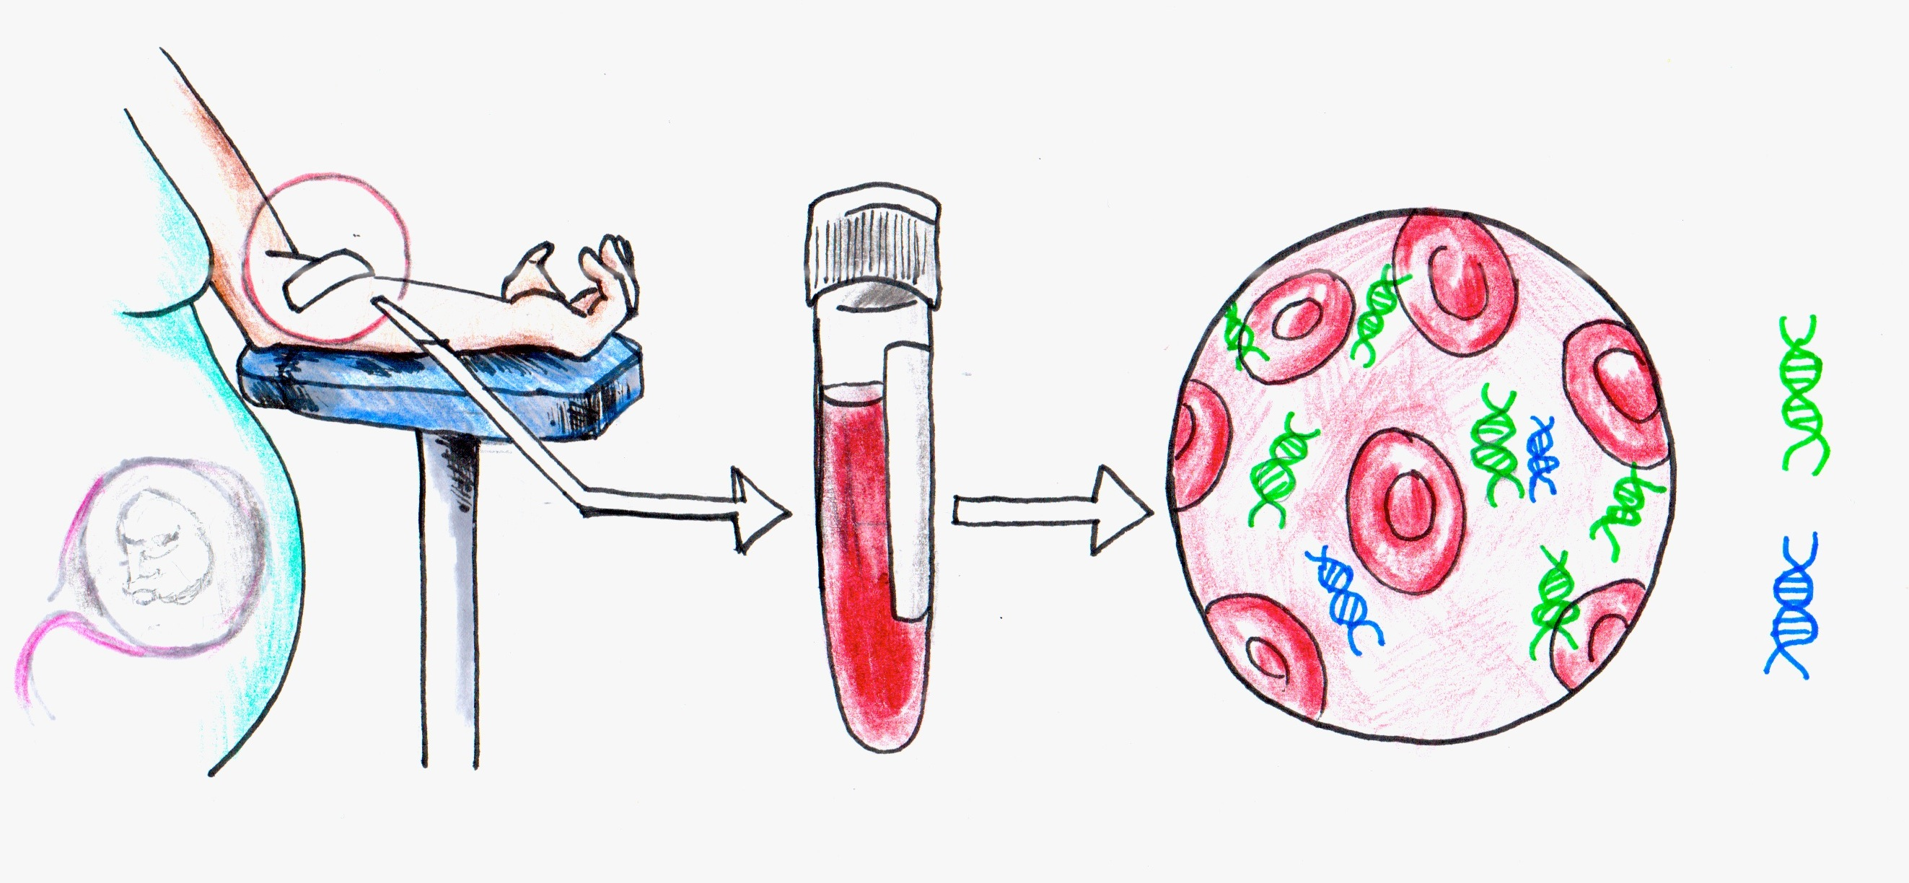
Genetic testing during pregnancy: More information and at an earlier date
Image: Personal Genetics Education Project (Patricia Hautea)
Non-invasive prenatal testing (NIPT) involves analyzing a blood sample taken from a pregnant person to learn about traits of the fetus.
This test looks at small pieces of DNA that circulate in the pregnant person’s bloodstream.
Some of these pieces of DNA come from cells of the placenta that broke open and can reveal information about the developing fetus.
Notes:
DNA testing can be used to learn about future generations. It is now possible to analyze DNA from a fetus through a test performed on a blood sample from the pregnant person. This test, known as non-invasive prenatal testing (NIPT), makes information about the genetic make-up of a fetus available at earlier stages of pregnancy than ever before.
In depth: How does NIPT work? All of us have small fragments of DNA, released from cells in our body, that circulate in our bloodstream. When a person is pregnant, a small fraction of this cell-free DNA originates from cells of the placenta, an organ formed by embryonic cells that connects the developing embryo (and later fetus) to the uterus and facilitates the exchange of gases, nutrients, and waste products. By obtaining a blood sample from the arm of the pregnant person, physicians and researchers can analyze its cell-free DNA to reveal information about the developing fetus. For this reason, this test can also be referred to as “cell-free fetal DNA testing
Image: Personal Genetics Education Project (Patricia Hautea)

Slide 13
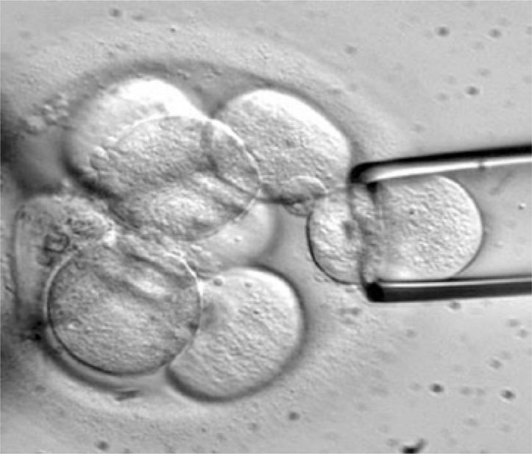
Reproductive technology opens the door to analyze embryos for certain genetic traits
Eggs, harvested from ovaries, can be combined with sperm in a petri dish in a process called in-vitro fertilization (IVF).
After 3-5 days of development, one or more cells can be removed from the embryo and assessed for certain traits in a process called pre-implantation genetic diagnosis (PGD).
Biazotti et al. (2015), CC BY 4.0
Notes:
Genetic testing can be used to learn about the genetic makeup of embryos created by in vitro fertilization (IVF). First, teachers may need to introduce their students to IVF, a process in which sperm and eggs are fertilized outside of the body in a petri dish, and then implanted to the uterus with the hope of an ensuing pregnancy. The first baby was born via IVF in 1978.
In some cases, a genetic testing technique called preimplantation genetic diagnosis (PGD) is performed prior to transferring embryos to the uterus. For PGD, one or more cells are removed from embryos created by IVF, and DNA from these cells is then tested for various genetic markers. First performed in 1990, PGD is often used in an effort to avoid genetic disorders, including deadly or debilitating childhood diseases such as Tay-Sachs and cystic fibrosis, as well as adult–onset diseases such as Huntington’s disease and breast cancer. In some parts of the world, including the United States, PGD can also be used for non-medical sex selection based on parental preference.
Access to IVF and PGD remains quite limited due to cost. In 2019, the average cost of IVF and PGD, combined, is $20,000-30,000 US. While this procedure is covered by public health care systems in some other countries, fewer than a third of US states (covering just less than half of the US population) mandate insurance coverage for infertility treatments. For many people without health insurance, the procedure remains a distant prospect.
Image: Biazotti et al. (2015), CC BY 4.0

Slide 14
The possibility of changing your DNA
Engineered T cells are transfused into the patient
T cells from patient or donor are edited so that they will target cancer cells and will not trigger immune rejection
Right direction for your business!
Adapted from https://www.mskcc.org/blog/car-t-cell-therapy-growing-area-research
Layla Richards: the first success of genome editing-based gene therapy
Notes:
The case of Layla Richards symbolizes the potential promise of genome engineering for treating diseases. Diagnosed at 14 weeks old with leukemia, a type of cancer that affects blood and bone marrow, Layla Richards was 11 months old when all conventional treatments had failed. Layla became the first child to be treated for leukemia via donated immune cells that were genetically engineered specifically for her body and type of cancer - a kind of treatment called immunotherapy. The cells, called CAR-T cells, were engineered to attack Layla’s cancer cells. The cells were also altered to ensure Layla’s immune system would not perceive them as dangerous and reject them. The transplant was a success, and as of the most recent report in early 2017, Layla remained cancer-free.
See “A Groundbreaking Gene-Editing Therapy Eliminated Cancer in Two Infants,” by Kristen Brown, January 2017, Gizmodo here: https://gizmodo.com/a-groundbreaking-gene-editing-therapy-eliminated-cancer-1791661795
Image: Adapted from https://www.mskcc.org/blog/car-t-cell-therapy-growing-area-research

Slide 15
Part 3
Genetics & Ancestry
Notes:
Ancestry testing is another dimension of personal genetics. In 2019, DNA ancestry tests often cost $100 US or less. For some, genetics can add a layer of information onto decades or centuries of records of family history. Others, whether because of adoption, migration, or other family circumstances such as donor-assisted conception, might be seeking unknown relatives from all over the world. For example, because of the history of slavery in the US, many people of African ancestry do not know in what part of Africa their ancestors lived. DNA testing may provide some information towards filling in these gaps and may allow people to feel more connected to a past of which they were previously unaware. On the other hand, DNA testing can also complicate or even contradict a person’s sense of identity if results are unexpected or unwelcome. At the same time, some ethnic groups, particularly many Indigenous American nations, place a greater emphasis on cultural belonging and familial lineage rather than genetic ancestry when considering questions of ethnic identity.

Slide 16
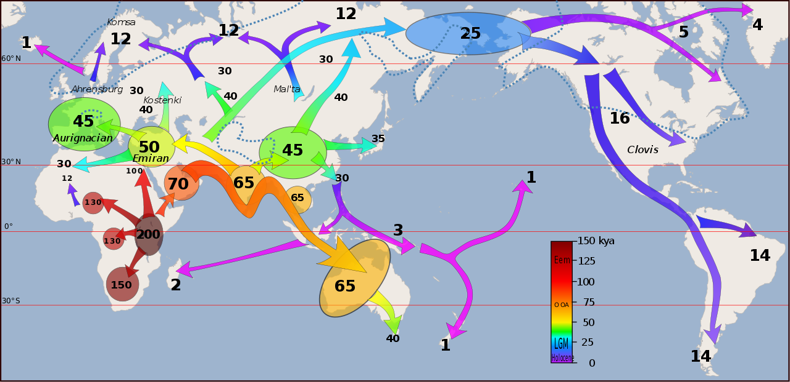
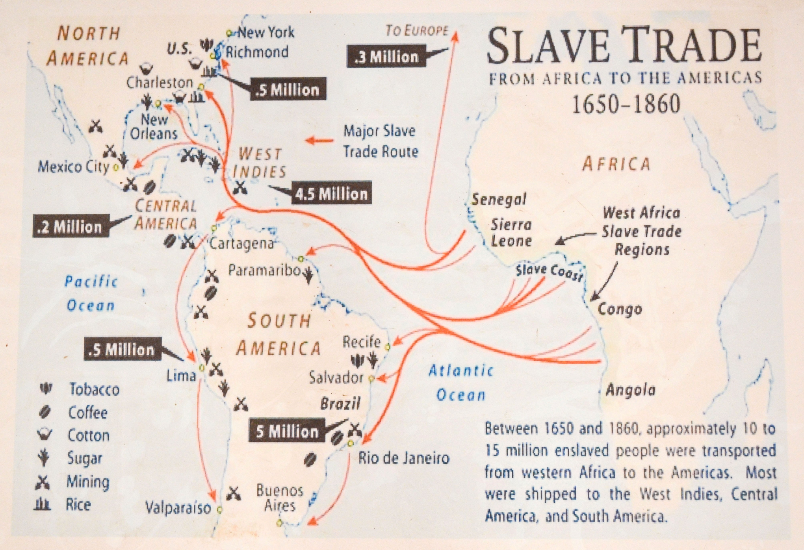
Ancestry testing can:
Answer questions
Reveal thrilling and/or painful histories
Connect people to their past
Dbachmann, CC BY-SA 4.0
jbdodane, CC BY 2.0
Notes:
Images may appear blurry, but should project clearly.
These maps illustrate the point that while some people’s ancestry can be seen via a world map looking at human migration patterns in the ancient past, others will see the history of their families more clearly in a map of the slave trade.
Using a combination of the archaeological record and DNA analysis, scientists have been able to track human movements out of Africa, believed to have started around 60,000-70,000 years ago, to eventually most areas of the world (except for Antarctica). The top-left image illustrates current understanding of ancient human migration across the globe, showing the approximate date when a particular island or part of a continent is believed to have been first inhabited by humans. Importantly, this map doesn’t show the subsequent migration of different populations to areas that were already inhabited (e.g., the expansion of peoples speaking Indo-European languages from southern Russia into Europe and India, or the migration of Bantu-speaking peoples from central Africa into southern Africa, both of which occurred within the past few thousand years).
The second map illustrates the most common transatlantic slave trade routes during the 17th-19th centuries. During this time, 10-15 million people were forcibly moved from one part of the world to another. Today, there are many more millions of descendants of this slave trade whose genealogical and cultural history have been impacted by this forced migration. Taken together, these maps illustrate some of the many historical events that have shaped the genetic ancestry of populations across the world today.
Image (left): “Peopling of the world (recent out of Africa and Upper Paleolithic)” by Dbachmann (https://en.wikipedia.org/wiki/File:Early_migrations_mercator.svg, accessed Oct 4, 2018). Available under a Creative Commons Attribution Attribution-ShareAlike 4.0 International license (https://creativecommons.org/licenses/by-sa/4.0/deed.en).
Image (right): “Slave trade from Africa to the Americas” by jbdodane (https://commons.wikimedia.org/wiki/File:Slave_trade_from_Africa_to_the_Americas_(8928374600).jpg, accessed Oct 4, 2018). Available under a Creative Commons Attribution 2.0 Generic license (https://creativecommons.org/licenses/by/2.0/).

Slide 17
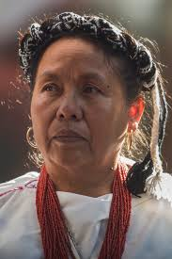
The many faces of Mexico
EneasMx, CC BY-SA 4.0
AlejandroLinaresGarcia, CC BY-SA 3.0
sanity_94, CC BY 2.0
Notes:
This slide illustrates the complex relationship between nationality, ethnicity, ancestry, and physical traits seen in countries formed as a result of European colonization, such as Mexico and the US. Such countries are not ethnically-uniform, but are instead multicultural and multiethnic countries with varied percentages of ancestral origins in their populations. National/ethnic identities such as “Mexican” can encompass dozens of languages and cultures, a mix of ancestries (including African, Indigenous American, European and/or Asian ancestry), and a wide diversity of traits. The variation in traits such as skin color is seen on this slide. In the US, many people of Mexican and other Latin American origins may identify or be identified as “Latino.” The term “Latino” came into use largely as a category in the US Census; it does not easily map onto common notions of race and geography and is not broadly used across the globe.
Image (left): “The elected representative indigenous spokeswomen by National Indigenous Congress (CNI) for the Mexican general election, 2018, for which she will run as an independent candidate for the Presidency of Mexico” by EneasMx (https://commons.wikimedia.org/wiki/File:Marichuy.jpg, accessed Oct 4, 2018). Available under a Creative Commons Attribution Attribution-ShareAlike 4.0 International license (https://creativecommons.org/licenses/by-sa/4.0/deed.en).
Image (center): “Friends at Punta Maldonada, Cuajinicuilapa, Guerrero” by AlejandroLinaresGarcia (https://commons.wikimedia.org/wiki/File:PuntaMaldonada64.JPG, accessed Oct 4, 2018). Available under a Creative Commons Attribution-Share Alike 3.0 Unported license (https://creativecommons.org/licenses/by-sa/3.0/deed.en).
Image (right): “Selena Quintanilla Memorial Banner” by sanity_94 (https://www.flickr.com/photos/sanity94/8072711601, accessed Oct 4, 2018). Available under a Creative Commons Attribution 2.0 Generic license (https://creativecommons.org/licenses/by/2.0/). Image cropped.

Slide 18
DNA ancestry tests can provoke a wide range of emotions for people. Why?
https://youtu.be/Ah2fcqmSO3c (BuzzFeed)
https://youtu.be/lltW_13Nvps (NHGRI)
Caveats:
This is not an endorsement of companies or the field of DTC genetics tests.
There is controversy about accuracy of results
Results can vary between companies
Notes:
The topics covered in slides 15-17 are brought to life in two videos in which young people are learning about their genetic ancestry via direct-to-consumer genetic tests. Both videos include people reflecting on how their results from a DNA ancestry test might fill in important pieces of their personal story, give them a sense of belonging, or differ from their family stories and concepts of ethnicity and identity. Also, both videos mention the history of colonization and slavery, and how painful that can be within families. The two videos both reinforce the idea that people are more alike than different from a genetic perspective.
The two videos differ in several ways. The video “Black People Get Their DNA Tested” from BuzzFeed News specifically mentions they are using a 23andMe product. (Important note: While we have included this video, pgEd does not recommend for or against any specific product.) We also see the interactions between family members as they process the information they’ve received. Lastly, this video contains some images about current political matters in the US - including immigration and the Black Lives Matter movement - through the lens of how genetic testing could remind people of our common humanity. In the NIH-produced video, “Who do we think we are?”, you will see a more classroom-style approach, with more context about how DNA tests work, the history of human migration, and a discussion about the risks related to discovering unexpected information.
After watching either video, remind students that ancestry results can vary widely between companies, and rather than being definitive, are often a reflection of whose DNA is included in the database and how these “reference” samples are divided up into ethnicities or geographic regions. Many ancestry databases are over-represented with samples from people of European descent, leading to less precise results for people of non-European descent. pgEd advises teachers to watch both videos and decide which one (if not both of them) will meet your needs.
Video (left): “Black People Get Their DNA Tested” by Buzzfeed
Video (right): “Who do we think we are?” produced by 42o North Media for NHGRI

Slide 19
Part 4
Societal Implications of Genetics
Notes:
Personal genetics is also impacting law enforcement and privacy practices, and is a microcosm of larger debates about trust, access, and transparency in science. The following slides provide brief examples of these ideas, and highlight 1) past failures in research ethics, 2) new law enforcement techniques, 3) the struggle for healthcare access, and 4) new models of community participation in genetics.

Slide 20
“Golden State Killer” suspect arrested in April 2018
The search was aided by a DNA match from a database created to find relatives for family history/genealogy hobbyists.
Photo via Sacramento county policy department
Notes:
In the US, suspects are being identified not just through criminal databases - but also genealogy databases designed for researchers and hobbyists. After failing to find a match in the government-created databases, investigators in “The Golden State Killer” case uploaded what they believed to be the notorious rapist and murderer’s DNA to an open-source genealogy database, called GEDmatch. GEDmatch is a privately-created database that welcomes people to upload their DNA analysis from private companies like 23andMe or Ancestry.com, in the hopes of building a large community for people seeking familial connections. Law enforcement found a genetic connection in the database – a distant cousin of the suspected killer. Using genealogical research to construct a family tree, investigators narrowed down the possible suspects and, with additional DNA testing, an arrest was made. Joseph James DeAngelo is under arrest for the crimes and is awaiting trial as of June 2019.
This case is an example of how quickly a new technique can take hold. Though GEDmatch was not developed to be a legal tool, in the months after the arrest of the suspected “Golden State Killer”, law enforcement agencies used the database to make arrests in several other “cold cases.” Some people have reacted positively to this news by saying that any and all methods are justified in the pursuit of solving crimes. Others have voiced concern regarding the fact that if even one biological relative uploads their DNA to a genealogy database like GEDmatch, then some of their shared DNA is also part of a system that is now being used for law enforcement reasons. Additionally, decisions about law enforcement access to the GEDmatch database is largely in the hands of two private citizens who founded the organization.
In May 2019, GEDmatch changed its terms of service so that DNA profiles are now by default opted out of use for law enforcement investigations. Users are able to opt-in if they wish to do so. As of June 2019, only 5% of the 1 million members of GEDmatch have opted-in. In December 2019 it was announced that GEDmatch was taken over by the forensic genomics firm Verogen.
“How a Tiny Database Became the Police’s Go-To Genealogy Database” by Sarah Zhang, June 2018, The Atlantic: https://www.theatlantic.com/science/archive/2018/06/gedmatch-police-genealogy-database/561695/

Slide 21
Healthcare access is key to personal genetics being shared fairly
Percent of Non-elderly Adults in US who did not Receive or Delayed Care in past 12 months by Race/Ethnicity (2014)
Data from Kaiser Family Foundation analysis of CDC Behavior Risk Factor Surveillance System (2014)
Notes:
This slide highlights that fact that many people in the US, across ethnicities, cannot access the healthcare services they need. This remains a pervasive problem, and one that should be included in the discussion of how the potential of personal genetics to improve health remains out of reach for many until these underlying issues of access and economics are addressed.
Data from Kaiser Family Foundation analysis of CDC Behavior Risk Factor Surveillance System (2014): https://www.kff.org/report-section/key-facts-on-health-and-health-care-by-race-and-ethnicity-section-2-health-access-and-utilization/

Slide 22
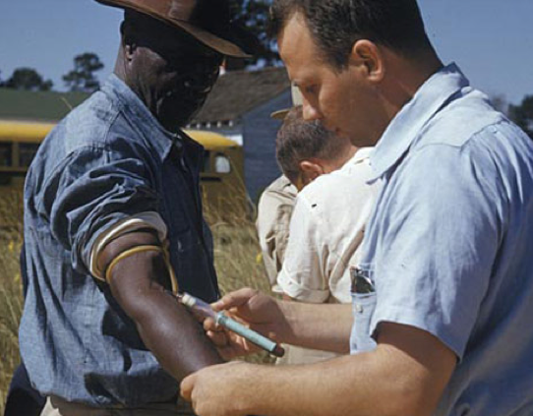
The Tuskegee Syphilis Study 1932-1972
1934
First papers suggest health effects of untreated syphilis.
1936
Major paper published. Study criticized because it is not known if men are being treated. Local physicians asked to assist with study and not to treat men. Decision was made to follow the men until death.
1940
Efforts made to hinder men from getting treatment ordered under the military draft effort.
1945
Penicillin accepted as treatment of choice for syphilis.
1947
USPHS establishes “Rapid Treatment Centers” to treat syphilis; men in study are not treated, but syphilis declines.
1962
Beginning in 1947, 127 black medical students are rotated through unit doing the study.
1968
Concern raised about ethics of study by Peter Buxtun and others.
1969
CDC reaffirms need for study and gains local medical societies’ support (AMA and NMA chapters officially support continuation of study.)
1972
First news articles condemn studies.
Study ends.
Image: Centers for Disease Control and Prevention, Public Domain
Timeline via
http://www.cdc.gov/tuskegee/timeline.htm
Notes:
The Tuskegee Syphilis Study serves to illustrate past breaches of trust in medical research.
The Tuskegee Syphilis Study, a study of the natural course of untreated syphilis, was run by the US Public Health Service from 1932-1972. Over 600 disenfranchised African American men were enrolled in the study and were to receive free healthcare and burial insurance. Many of the men were not told they were part of a study, nor where they informed about the risks or advised that they could leave the study. Even though penicillin was the standard drug given to treat syphilis by 1947, it was withheld from the men in the study. The study came to an end in 1972 after it was reported in the press. It is considered one of the most egregious human experiments in the US, because the men were not properly consented and treatment was withheld. Many of the men died, 40 of their wives were infected as well, and 19 children were born with congenital syphilis. President Clinton formally apologized to the survivors in 1997. The Belmont Report, produced by a national commission that was formed in part to reckon with how the Tuskegee study was ever allowed to happen, altered informed consent protocols and oversight of research involving human subjects. Read more: “How the Public Learned about the Tuskegee Syphilis Study” in Time. (http://time.com/4867267/tuskegee-syphilis-study/)
Other examples teachers might wish to expand on include the American eugenics movement (full pgEd lesson plan at http://pged.org/lesson-plans/#eugenics), the story of Henrietta Lacks (http://www.lacksfamily.net/henrietta.php), or the abuses by Dr. Marion Sims(https://www.history.com/news/the-father-of-modern-gynecology-performed-shocking-experiments-on-slaves), considered a pioneer in women’s reproductive medicine but whose work relied on brutally painful and repetitive surgeries on enslaved women during the 1850s in the US.
These histories, which have created distrust and fear of biomedical researchers, are one reason for the much lower rate of participation in clinical research or drug trials among ethnic minority communities than white communities. Researchers continue to strive to increase the diversity of research participants by increasing awareness and building trust with these communities. For more, see:
“To advance medicine’s future, the NIH tries to win the trust of communities mistreated in the past,” by Lev Facher, September 2017, STAT News. (https://www.statnews.com/2017/09/22/nih-precision-medicine-all-of-us/)
Image: Center for Disease Control and Protection, Public Domain
Timeline: http://www.cdc.gov/tuskegee/timeline.htm

Slide 23
Diné (Navajo Nation) setting their own terms: Making decisions regarding their participation in genetic research
Navajo Nation reconsiders ban on genetic research
Tribal leaders are developing a policy for genetic research and data sharing, potentially ending a 15-year moratorium
Sara Reardon, Nature (Oct 6th, 2017)
Proposed policy included power for Nation to:
Approve or reject research proposals
Maintain control over the samples
dbking, CC-BY 2.0
“To us, any part of ourselves is sacred. Scientists say it’s just DNA. For an Indian, it is not just DNA, it’s a part of a person, with a deep religious significance. It is part of the essence of a person.” – Frank Dukepoo, Hopi geneticist
Erin Blakemore, History (Nov 3, 2017)
Notes:
Collaboration between researchers and communities that emphasizes trust, access and transparency is an emerging model in genetic research. An example of this approach to genetic research is being implemented by the Diné (also known as the Navajo Nation). Navajo leaders have proposed lifting the ban on genetic research that the nation had put in place since 2002 so their community can benefit from advances in genetics. Tribal leaders are devising a new model of participation in research to avoid potentially unwanted or inappropriate use of their DNA. In this model, Navajo Nation would have the power to approve or reject research studies and retain control over their DNA samples. They are also conducting public meetings and hearings to gather input.
Another example is the formation of an advisory panel at the National Institutes of Health giving the descendants of Henrietta Lacks a voice in the use of their relative’s genetic material in research. A collaborative approach is also being used in Massachusetts, New Zealand and sub-Saharan Africa where genetic technologies are being considered to solve environmental issues with insect-borne disease and invasive species. Projects such as “Responsive Science” (https://www.responsivescience.org/) are creating new models of collaboration with communities, placing the wishes of the people living in the impacted areas in the center of the discussions about if and how a project will proceed.
Image: “Navajo Nation flag” by dbking (https://flic.kr/p/8tW3e9, accessed Oct 4, 2018). Available under a Creative Commons Attribution 2.0 Generic license (https://creativecommons.org/licenses/by/2.0/).
Quote from: https://www.history.com/news/why-the-navajo-nation-banned-genetic-research

Slide 24
Four Corners Activity

Slide 25
I want to find out my likelihood of developing a disease only if there are ways to prevent or treat it.

Slide 26
When people undergo genetic testing, they should be required to get counseling from a doctor or genetic counselor because they will not be able to handle the results.

Slide 27
People should have the right to learn whatever they want about their DNA because it is their own body.

Slide 28
Parents undergoing in vitro fertilization should have the option to screen embryos for mutations likely to cause a serious disease.

Slide 29
Parents should be able to choose a child’s traits, such as eye color and sex, for non-medical reasons.

Slide 30
Employers should use genetic information to make hiring or firing decisions about employees.

Slide 31
Parents should be able to find out whatever they would like about their children’s DNA before they turn 18.

Slide 32
I would want to know if someone I was dating had a strong genetic predisposition to a serious disease.

Slide 33
Image credits
Slide 5: (left) “Riding Shotgun” by Steve Jurvetson (http://www.flickr.com/photos/jurvetson/57080968/, accessed Jan 25, 2016). Available under a Creative Commons Attribution 2.0 Generic license (https://creativecommons.org/licenses/by/2.0/). (right) NASA (https://www.jpl.nasa.gov/news/news.php?feature=7056, accessed on Feb 7, 2019). Public domain.
Slide 6: Personal Genetics Education Project (Patricia Hautea).
Slide 9: “Wanted” poster courtesy of Bo Bigelow, founder USP7 foundation (https://www.usp7.org/, accessed Oct 4, 2018).
Slide 10: “Angelina Jolie” by Gage Skidmore (https://www.flickr.com/photos/gageskidmore/4860509634/, accessed Jan 25, 2016). Available under a Creative Commons Attribution-ShareAlike 2.0 Generic license (https://creativecommons.org/licenses/by-sa/2.0/).
Slide 11: Adapted from http://www.ensrmedical.com/pharmacogenetics/
Slide 12: Personal Genetics Education Project (Patricia Hautea).
Slide 13: Figure 2 from Biazotti MC et al., Preimplantation genetic diagnosis for cystic fibrosis: a case report (2015). Published in Einstein (São Paulo), 13(1), 110-113. (https://dx.doi.org/10.1590/S1679-45082015RC2738, accessed Jan 25, 2016). Available under a Creative Commons Attribution 4.0 International license (https://creativecommons.org/licenses/by/4.0/deed.en).
Slide 14: Adapted from https://www.mskcc.org/blog/car-t-cell-therapy-growing-area-research
T cell image from “The Hematopoietic System of the Bone Marrow” by OpenStax College (https://commons.wikimedia.org/wiki/File:2204_The_Hematopoietic_System_of_the_Bone_Marrow_new.jpg, accessed Oct 16, 2018). Available under a Creative Commons Attribution 3.0 Unported license (https://creativecommons.org/licenses/by/3.0/deed.en). Image cropped.
Intravenous bag image from “Intravenous (IV) Bag Flat Icon Vector” by VideoPlasty.com (https://commons.wikimedia.org/wiki/File:Intravenous_(IV)_Bag_Flat_Icon_Vector.svg, accessed Oct 16, 2018). Available under a Creative Commons Attribution-ShareAlike 4.0 International license (https://creativecommons.org/licenses/by-sa/4.0/deed.en).

Slide 34
Image credits
Slide 16: (left) “Peopling of the world (recent out of Africa and Upper Paleolithic)” by Dbachmann (https://en.wikipedia.org/wiki/File:Early_migrations_mercator.svg, accessed Oct 4, 2018). Available under a Creative Commons Attribution Attribution-ShareAlike 4.0 International license (https://creativecommons.org/licenses/by-sa/4.0/deed.en).
(right) “Slave trade from Africa to the Americas” by jbdodane (https://commons.wikimedia.org/wiki/File:Slave_trade_from_Africa_to_the_Americas_(8928374600).jpg, accessed Oct 4, 2018). Available under a Creative Commons Attribution 2.0 Generic license (https://creativecommons.org/licenses/by/2.0/).
Slide 17: (left) “The elected representative indigenous spokeswomen by National Indigenous Congress (CNI) for the Mexican general election, 2018, for which she will run as an independent candidate for the Presidency of Mexico” by EneasMx (https://commons.wikimedia.org/wiki/File:Marichuy.jpg, accessed Oct 4, 2018). Available under a Creative Commons Attribution Attribution-ShareAlike 4.0 International license (https://creativecommons.org/licenses/by-sa/4.0/deed.en).
(center) “Friends at Punta Maldonada, Cuajinicuilapa, Guerrero” by AlejandroLinaresGarcia (https://commons.wikimedia.org/wiki/File:PuntaMaldonada64.JPG, accessed Oct 4, 2018). Available under a Creative Commons Attribution-Share Alike 3.0 Unported license (https://creativecommons.org/licenses/by-sa/3.0/deed.en).
(right) “Selena Quintanilla Memorial Banner” by sanity_94 (https://www.flickr.com/photos/sanity94/8072711601, accessed Oct 4, 2018). Available under a Creative Commons Attribution 2.0 Generic license (https://creativecommons.org/licenses/by/2.0/). Image cropped.
Slide 20: Photo via Sacramento county police department
Slide 22: “An African American male is tested and treated during the Tuskegee Study of Untreated Syphilis in the Negro Male” by the Center for Disease Control and Prevention (https://commons.wikimedia.org/wiki/File:Tuskegee_syphilis_experiment_venipuncture.jpg, accessed Oct 4, 2018). Public Domain.
Slide 23: “Navajo Nation flag” by dbking (https://flic.kr/p/8tW3e9, accessed Oct 4, 2018). Available under a Creative Commons Attribution 2.0 Generic license (https://creativecommons.org/licenses/by/2.0/).

