Slide 1
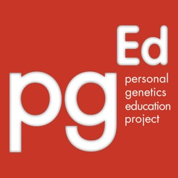
Genome editing and CRISPR
Personal Genetics Education Project (pgEd)
Harvard Medical School
www.pged.org
2017

Slide 2
Do now: 5 minute discussion with a partner: 1. You’ve been offered a deal from a genomics company. You can get a free genome sequence – an analysis of all your DNA that includes a report of your ancestry, traits and a medical profile. The medical profile tells you about diseases for which you have a low risk of getting, and also those you have a high risk of getting. Are you interested? Why or why not? 2. For the first 100 volunteers, the company is offering to ”correct” several of the disease-related genes found by the analysis. Imagine this were a very new procedure approved by the government for safety, but without a great deal of long term study. Would you volunteer for this added service? (Note: This service is not currently available and will not be in the near future, so use your imagination.)
Notes:
Slide notes: In this “Do Now” activity, teachers should expect a wide range of answers. You may want to discuss some of the information ahead of the activity, or use this background to further add content and details to what you hear as students share their conversations.
Genetic analysis aims to inform an individual about his or her predispositions for various traits, including potential for developing diseases, by “reading” the nucleotide letters (A, T, G, C) of the individual’s DNA. From there, it can also provide estimates of the likelihood of passing along certain traits to one’s children. Examples of genetic analyses include the genetic tests that people might undergo before or during the course of pregnancy, or the tests for determining the basis of diseases. Increasingly, genetic analyses may involve sequencing an individual's genome. Learning about one’s genetic information can come with excitement and opportunities as well as a host of questions and confusion. It can impact family members, one’s own outlook, and open up new and unexpected information in terms of ancestry and health.
However, genetic analysis is just that – a look at what’s in your DNA. On the horizon are technologies that may one day make it possible, after having a look at your genome, to modify or change your DNA. In theory, this could be accomplished in a number of ways, such as using a virus as a “vehicle” to send new genetic material to a cell, or techniques where existing pieces of DNA are “cut” and new ones are “pasted” in. Once the new genetic material is inserted, the cellular machinery that copies and reads DNA would, presumably, treat it like it would any other piece of sequence.
A couple of concepts about genetic analysis and modification may be useful for students to know:
1) Differences in the number and location of cells that need to be analyzed or modified.
The genome in every cell in an individual’s body is essentially identical - with a few notable exceptions: for example, the reproductive cells and the mutations acquired by each cell in a person’s lifetime. With these caveats in mind, in theory, the DNA of virtually any cell can be analyzed to provide information about the whole body. This is why genetic analysis is often carried out on cells from easily accessible sources, such as saliva or blood. There is also ongoing research that aims to make it possible to analyze the genome sequence of single cells.
On the other hand, in order to modify traits or treat diseases, genetic changes will often need to be made to many cells at once, and the right kinds of cells. In some cases, modifying a small subset of cells may be enough (such as the stem cells in bone marrow that give rise to most of the body’s blood cells). In other cases, a significant portion of cells in the relevant tissue or organ may need to be modified. This presents technical challenges for safely targeting the changes to a sufficiently high number of the right cells, and making changes to the desired part of the genome with minimal mistakes to the rest of the cell’s DNA.
2) There are two categories of genetic modifications with different ethical considerations.
The cells in our body fall into two broad categories – somatic and germline. Somatic cells, the ones that make up the majority of our body, contain both sets of genetic materials we got from our biological parents. If you were to change the DNA of somatic cells, those genetic changes do not affect the genomes of future generations. Germline cells, such as sperm and eggs, are the cells that give rise to the offspring during the reproductive process. Changes made to germline cells, including the intended modification as well as any mistake or unexpected changes made during the process, will have the chance of being inherited in the genomes of subsequent generations. Whether a genetic change is made to somatic cells or the germline is an important distinction because of the ethical questions about making changes to a genome that will be passed on to future generations. Currently, scientists believe that genetic changes can be made to somatic cells without affecting the germline.

Slide 3
What is CRISPR?
(Clustered regularly interspaced short palindromic repeats)
A genome editing technique that:
Targets a specific section of DNA
Makes a precise cut/break at the target site
Can do one of two things:
Makes a gene nonfunctional
Replace one version of a gene with another
What are the potential applications of CRISPR to human health?
Notes:
Slide notes: In the past decade, scientists began to develop techniques known as “genome editing.” Genome editing allows scientists to make changes to a specific “target” site in the genome. One of the techniques that has generated the most excitement, due to its efficiency and ease of use, is called “CRISPR.” CRISPR stands for “clustered regularly interspaced short palindromic repeats.” It is akin to a primitive immune system that bacteria use to protect themselves against viruses. Scientists have since been able to take components of the CRISPR system and use it as an experimental tool.
Generally speaking, genome editing techniques such as CRISPR can be used to do one of two things. First, they can be used to make a gene nonfunctional (e.g., to shut down a gene that is causing disease, such as a gene that a cancer cell requires to grow). They can also be used to replace one version of a gene with another (e.g., to replace a faulty or broken copy of a gene with a working copy.) Note that neither of these approaches is currently available for clinical use in humans.
For a more detailed description of the mechanism of how CRISPR works, see the Sidebar on page 35 of the lesson plan. For an animation of the mechanism, see the Supplemental Slide (slide 11).

Slide 4
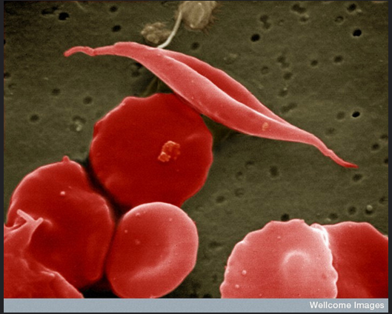
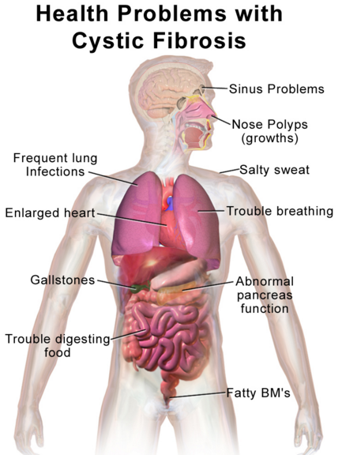
What is gene therapy?
Wellcome Images, CC BY-NC-ND 2.0
Research is on-going to develop
gene therapies for conditions such as cystic fibrosis and sickle cell disease
Blausen.com staff, CC BY 3.0
Notes:
Slide notes: Using genetic technology to directly treat the genetic causes of diseases, known as “gene therapy,” has long been an aspiration for physicians, scientists and patients. Some diseases, such as cystic fibrosis or sickle cell anemia, are relatively well-understood to be caused by variants in single genes. If the disease-causing gene can be corrected or replaced, then the hope is to perhaps cure the disease or at least prevent the disease from worsening. However, this is more difficult for more complex conditions, such as heart disease, diabetes and many forms of cancer, which result from the interplay among many genes and between the genes and the environment.
Gene therapy has been attempted since the 1990s. Less than a handful of these treatments have so far been approved by safety and regulatory agencies, such as the US Food and Drug Administration. All of the approved treatments work by adding one or more working copies of a gene to a person whose own copies of the gene are not functioning properly. On the other hand, gene therapy based on genome editing techniques such as CRISPR makes it possible to directly alter an individual’s original copies of a gene. Genome editing-based gene therapy can also be used in other ways, such as adding a new gene to a specific spot in the genome.
The following are two examples of conditions that may potentially be treated by gene therapy:
Cystic Fibrosis (CF): CF is a genetic disorder where thick, sticky mucus in the respiratory pathways lead to breathing problems, developmental delays and infections. CF is caused by mutations in one gene called CFTR. Treatments have been very hard to find, and CF has been one of the most anticipated targets for gene therapy. One of the main challenges for gene therapy is to be able to safely and effectively make the desired genetic changes to all the cells that need the gene to function. In the case of CF, all the cells in the lungs and sweat glands may need functional CFTR in order to properly produce mucus or other secretions. While no therapies have yet been approved for use, in recent years there have been some promising experimental results in mice and pigs, where the major symptoms of the disease have been reversed.
Sickle Cell Disease (SCD): SCD is a genetic condition characterized by mutations in the oxygen-carrying proteins in red blood cells, called hemoglobins. SCD causes hemoglobin proteins to stick together and lead to the red blood cells turning into a sickle shape. SCD occurs because of mutations in the “adult hemoglobin” gene, which is responsible for making hemoglobin from the time we are babies onwards through adulthood. Gene therapy may be possible for SCD by directly repairing the mutations in this gene. There is also another promising approach, which could take advantage of a second hemoglobin gene that functions in fetuses and then gets turned off shortly after we are born. This hemoglobin gene, called the “fetal hemoglobin” gene, is not affected by mutations that cause SCD. So, one potential gene therapy would treat SCD by turning on the fetal hemoglobin gene and turning off the adult version. Experiments using this approach seem to work well in mice, and clinical trials in humans are likely to begin soon.
Images: (left) “B0000521 SEM sickled and other red blood cells” by Wellcome Images, Credit: EM Unit, UCL Medical School, Royal Free Campus (https://www.flickr.com/photos/wellcomeimages/7112270353/, accessed Jan 12, 2017). Available under a Creative Commons Attribution-NonCommercial-NoDerivs 2.0 Generic License (https://creativecommons.org/licenses/by-nc-nd/2.0/). No changes made.
(right) “Blausen gallery 2014” by Blausen.com staff, Wikiversity Journal of Medicine (https://commons.wikimedia.org/wiki/File:Blausen_0286_CysticFibrosis.png, accessed Jan 12, 2017). Available under a Creative Commons Attribution 3.0 Unported License (https://creativecommons.org/licenses/by/3.0/deed.en). No changes made.

Slide 5
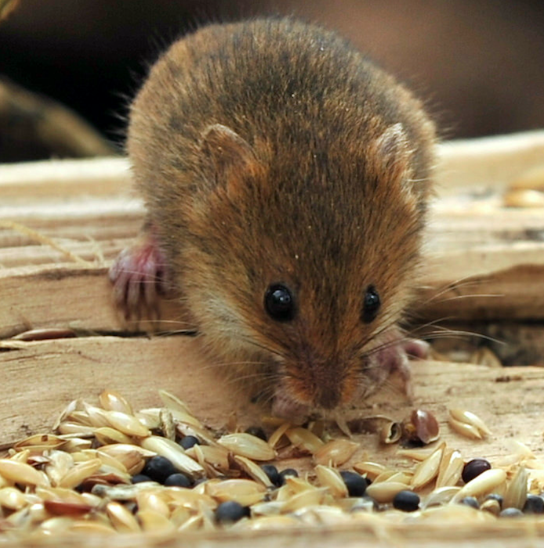
Researchers have used genome editing to cure a type of liver disease in adult mice
Lex McKee, CC BY-NC 2.0
This type of research is an important step towards
developing new gene therapies in humans
Notes:
Slide notes: Scientists are studying how to use CRISPR to treat diseases in animal models, as an important step in the research process towards applications in humans. For example, CRISPR has successfully been used in adult mice to reverse a liver disease called type I tyrosinemia. This disease, which affects 1 in 100,000 people, is caused by mutations in a single gene called FAH. The livers of people with this disease are unable to break down a specific amino acid, which can lead to liver failure. Scientists injected the CRISPR system along with working copies of the FAH gene into the veins of the diseased mice. In 0.4% of liver cells in these mice, the faulty FAH gene was successfully replaced with working copies. These edited cells then multiplied and replaced the cells with the faulty FAH gene, and eventually accounted for 33% of liver cells in the animals. This was enough to restore the lost function to the liver, allowing the liver to break down the proteins it previously could not – and led the research team to declare that they had “cured” type I tyrosinemia in adult mammals. While this treatment has not been tested in humans and trials are not yet underway, the concept that replacing a piece of DNA could lead to a profound improvement of a serious, often fatal genetic disorder in a mammal brings hope to many.
Image: “Harvest Mouse (7)” by Lex McKee (https://www.flickr.com/photos/lex-photographic/16744172269, accessed Jan 13, 2017). Available under a Creative Commons Attribution-NonCommercial 2.0 Generic License (https://creativecommons.org/licenses/by-nc/2.0/). No changes made.

Slide 6
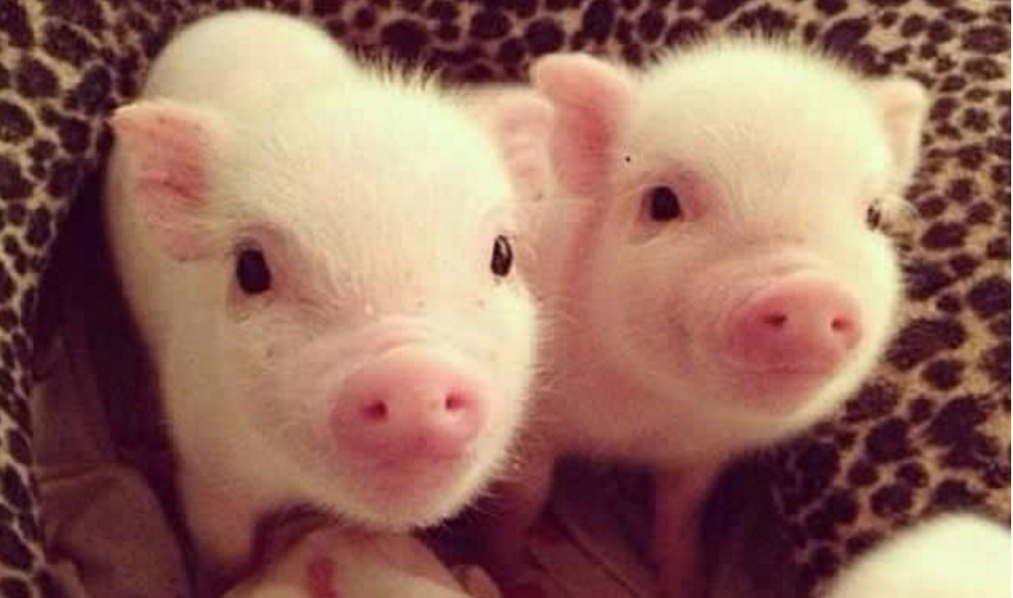
Might genome editing one day lead to a
solution to the global shortage of organs?
Maidiel1, CC BY-SA 4.0
Notes:
Slide notes: There is a massive shortage of organs for people who need donations, and pigs hold a great deal of promise as possible donors, as many pig organs and human organs are similar in size and structure. However, serious challenges persist for potential recipients due to risks of immune rejection and viral infection. Scientists are using CRISPR to alter pig genomes in an effort to address these issues. In October 2015, scientists used CRISPR on pig embryos to disable 62 viruses that are embedded in the pig genome (called porcine endogenous retroviruses, or PERVs). Separately, the same team also altered 20 genes that could cause an immune response and blood clotting in humans when pig tissues are transplanted into human recipients; by altering these genes such that they will no longer provoke an immune response, people may be more likely to respond well to a transplanted organ from a pig. A lower risk of infection or an immune response means a better chance for the donor’s body to accept the transplanted organ. An increased availability of organs for transplantation could potentially save thousands of lives annually.
The study in pigs is newsworthy in part because of the number of edited genes – indeed, 62 is the largest published number of genes altered by CRISPR in an organism to date. Additionally, despite the large number of CRISPR alterations, the embryos did not show signs of damage, and the cells continued to grow normally in the lab. All of this work was done on cells; no live animals have resulted from this work yet.
Engineering animal organs for transplanting into humans raises a number of ethical concerns. Animal rights activists worry about the harming and exploiting of animals. There are also concerns about whether the organs will be available to patients in a fair and equitable fashion. Others worry about the first group of people who agree to such a transplant – will human bodies accept these organs, long term? Will the organs actually function for a length of time that justifies the risks and expense?
Image: “Cerditos” by Maidiel1 (https://commons.wikimedia.org/wiki/File:Chanchitos.jpg, accessed Jan 13, 2017). Available under a Creative Commons Attribution-ShareAlike 4.0 International License (https://creativecommons.org/licenses/by-sa/4.0/deed.en). No changes made.

Slide 7
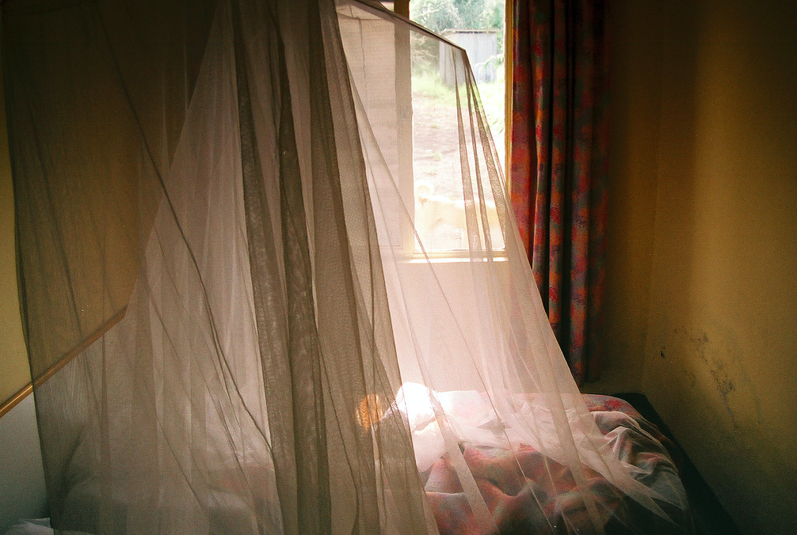
Should genome editing be used in
the hopes of reducing malaria?
Infant surrounded by malaria bed net. Ghana. Photo: © Arne Hoel / World Bank Flickr user: World Bank Photo Collection
YoHandy, CC BY-NC-ND 2.0
Notes:
Slide notes: Each year, hundreds of millions of people get sick from diseases that are spread by mosquitoes, and outbreaks of Zika, dengue and yellow fever since the early 2010s highlight the problem. One of the mosquito-borne diseases that lead to the most suffering worldwide is malaria. In 2015, more than 200 million people had the disease, and more than 400,000 people died from it.
Some scientists are investigating the possibility of curbing these mosquito-borne diseases by genetically modifying the mosquitoes, such that they become less able to either reproduce or to carry the disease-causing microbes. The general idea is to release modified mosquitoes (usually male, which do not bite and thus cannot spread disease) into the environment so that they will mate with the wild mosquitoes.
Modifying mosquitoes to change their reproductive ability and population size may have potentially unpredictable ecosystem-wide effects, e.g., on other animals that may rely on the mosquitoes for food, or plants that may depend on the insects for pollination. In order to balance the potential public health benefits with the ecological effects of this intervention, researchers, policymakers and other stakeholders are calling for more research before any genetically modified mosquito is widely released into the environment.
Image: “Malaria room” by YoHandy (https://www.flickr.com/photos/thefinessimo/2164822357, accessed Jan 13, 2017). Available under a Creative Commons Attribution-NonCommercial-NoDerivs 2.0 Generic License (https://creativecommons.org/licenses/by-nc-nd/2.0/). No changes made.

Slide 8
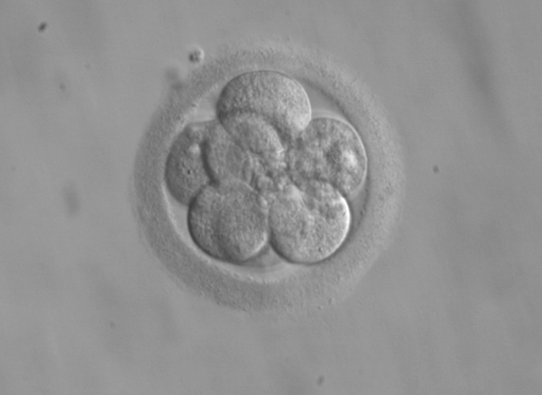
2015: A research group used CRISPR to make genetic changes in non-viable human embryos
ekem (courtesy: RWJMS IVF Program), public domain
Notes:
Slide notes: In April 2015, a research team in Sun Yat-sen University in China reported that they had used CRISPR to perform genome editing in human embryos. The embryos used in the research were “non-viable” and could not have developed into a fetus. Because a genetic change made to an early-stage embryo could affect all cells in the future individual, including the germ cells, this is a form of germline genetic modification. This has led to discussion and debate worldwide about whether germline editing in humans is appropriate, and whether or how society should proceed with such research and possible application.
Critics emphasize the technical and ethical issues with making changes to the genome that can be passed down to offspring. There are concerns that any unforeseen effect in the editing process can become inherited. Other questions are being asked — do we have the right to alter the genome of our future generations? Would the editing of certain diseases or disabilities lead to stigmatization of people who are living with those diseases or disabilities? And who gets to decide what are considered diseases or disabilities that should be edited? Are there religious questions and perspectives that can inform the discussion? At the same time, proponents of germline editing emphasize the benefits in terms of alleviating suffering. These include the potential to eliminate diseases such as Huntington’s disease, a debilitating neurological condition caused by a single gene variant. They also argue that humans have long been altering the lives and genetics of our offspring without their explicit consent, through procedures such as genetic counseling and preimplantation genetic diagnosis.
Image: “8-cell human embryo, day 3” by ekem, Courtesy: RWJMS IVF Program (https://commons.wikimedia.org/wiki/File:Embryo,_8_cells.jpg, accessed Jan 13, 2017). Public domain.

Slide 9
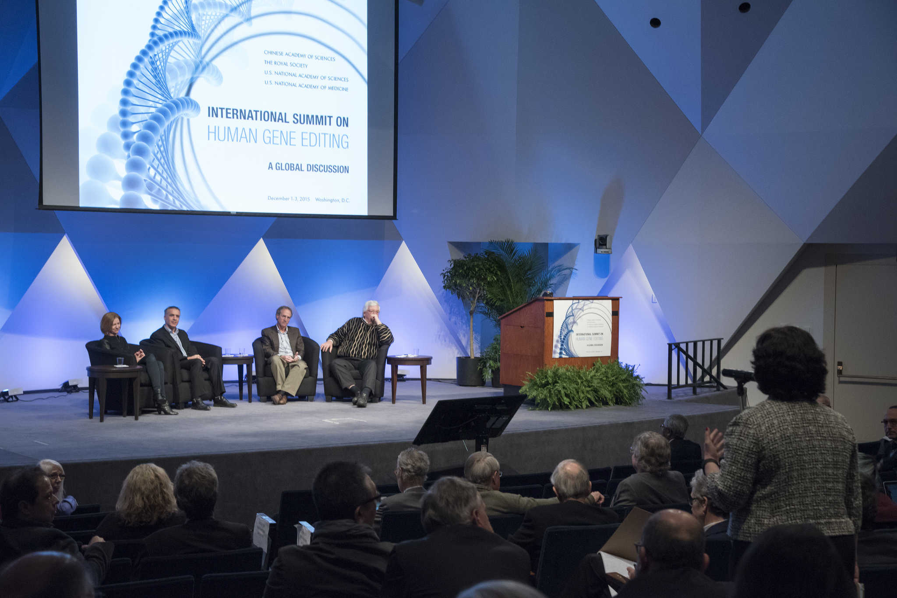
What is the path forward?
Safety – ethics – informed consent –
human and ecological health
December 2015: International Summit on Human Gene Editing (Washington, DC)
Bjoertvedt, CC BY-SA 3.0
National Academy of Sciences, CC BY-NC-SA 2.0
Notes:
Slide notes: This slide introduces the classroom activity that allows students to practice gathering information to make informed choices and policy decisions on a personal and societal level.
In December 2015, the United States National Academies, the United Kingdom (UK) Royal Academy, and the Chinese Academy of Sciences convened scientists, social scientists, ethicists, and other stakeholders for an International Summit on Human Gene Editing in Washington, DC. A statement released at the end of the summit emphasized that it would be “irresponsible” at this time to proceed with the clinical use of germline editing, but did not recommend banning the technique, instead suggesting that research should continue. Since then, a number of meetings and working groups have continued to move the conversation forward.
Currently, germline genetic modification is illegal in many European countries and in Canada, and federal funding in the United States cannot be used for such work. As of January 2017, researchers in the UK, Sweden and China have gotten approval to perform genome editing in human embryos for research purposes only (in addition, existing laws or guidelines in these countries only allow research on embryos up to 14 days after fertilization).
Images: (left) “International Human Gene Editing Summit 2015”, by National Academy of Sciences (https://www.flickr.com/photos/nationalacademyofsciences/23225911589/, accessed Jan 13, 2017). Available under a Creative Commons Attribution-NonCommercial-ShareAlike 2.0 Generic License (https://creativecommons.org/licenses/by-nc-sa/2.0/). No changes made.
(right) “US Congress on Capitol Hill, Washington DC”, by Bjoertvedt (https://commons.wikimedia.org/wiki/File:US_Congress_02.jpg, accessed Jan 13, 2017). Available under a Creative Commons Attribution-ShareAlike 3.0 Unported License (https://creativecommons.org/licenses/by-sa/3.0/deed.en). No changes made.

Slide 10
Supplemental slide

Slide 11
DNA template with desired sequence
Cas9 nuclease with guide RNA
DNA base to be changed
DNA edited to desired sequence
Mechanism of CRISPR gene editing system
Notes:
Slide notes: How does CRISPR work?
CRISPR is a self-defense mechanism that bacteria use to protect their genomes against viruses. It works by making cuts to DNA at specific genomic sites. Scientists have harnessed this system for use as a tool to make targeted DNA changes in a variety of organisms, including in human cells.
When used as an experimental tool for genome editing, the CRISPR system has two main components:
1) A targeting system that finds the right place in the genome to cut. This is achieved by a molecule called a guide RNA (gRNA), which has the same genetic sequence as the target genomic site.
2) A component for making the actual cut to the DNA. This consists of a DNA-cutting enzyme (the technical term is a “nuclease”) called Cas9.
When both of these components are delivered into a cell, the gRNA will bind to the target genomic site through complementary base pairing (meaning, A’s will bind to T’s and G’s will bind to C’s). In the process, the gRNA helps bring in Cas9 to the target site to make a cut to the DNA double helix. The cell’s natural DNA repair mechanism will close this gap, but because the process is not perfect, a few DNA bases will be added or deleted. This renders the original gene – e.g., a gene variant linked to cancer, or one related to HIV infection – nonfunctional.
CRISPR can also be used to replace an undesired version of a gene (e.g., one that causes a disease) with a desired copy. In this case, the desired version of the target gene can be placed into the cell along with the gRNA and Cas9. The cell will then use this alternate sequence as a template to repair the broken DNA through the process of “homologous recombination,” copying the new sequence into the genome.

Slide 12
Image credits
Slide 4: (left) “B0000521 SEM sickled and other red blood cells” by Wellcome Images, Credit: EM Unit, UCL Medical School, Royal Free Campus (https://www.flickr.com/photos/wellcomeimages/7112270353/, accessed Jan 12, 2017). Available under a Creative Commons Attribution-NonCommercial-NoDerivs 2.0 Generic License (https://creativecommons.org/licenses/by-nc-nd/2.0/). No changes made.
(right) “Blausen gallery 2014” by Blausen.com staff, Wikiversity Journal of Medicine (https://commons.wikimedia.org/wiki/File:Blausen_0286_CysticFibrosis.png, accessed Jan 12, 2017). Available under a Creative Commons Attribution 3.0 Unported License (https://creativecommons.org/licenses/by/3.0/deed.en). No changes made.
Slide 5: “Harvest Mouse (7)” by Lex McKee (https://www.flickr.com/photos/lex-photographic/16744172269, accessed Jan 13, 2017). Available under a Creative Commons Attribution-NonCommercial 2.0 Generic License (https://creativecommons.org/licenses/by-nc/2.0/). No changes made.
Slide 6: “Cerditos” by Maidiel1 (https://commons.wikimedia.org/wiki/File:Chanchitos.jpg, accessed Jan 13, 2017). Available under a Creative Commons Attribution-ShareAlike 4.0 International License (https://creativecommons.org/licenses/by-sa/4.0/deed.en). No changes made.
Slide 7: “Malaria room” by YoHandy (https://www.flickr.com/photos/thefinessimo/2164822357, accessed Jan 13, 2017). Available under a Creative Commons Attribution-NonCommercial-NoDerivs 2.0 Generic License (https://creativecommons.org/licenses/by-nc-nd/2.0/). No changes made.
Slide 8: “8-cell human embryo, day 3” by ekem, Courtesy: RWJMS IVF Program (https://commons.wikimedia.org/wiki/File:Embryo,_8_cells.jpg, accessed Jan 13, 2017). Public domain.
Slide 9: (left) “International Human Gene Editing Summit 2015”, by National Academy of Sciences (https://www.flickr.com/photos/nationalacademyofsciences/23225911589/, accessed Jan 13, 2017). Available under a Creative Commons Attribution-NonCommercial-ShareAlike 2.0 Generic License (https://creativecommons.org/licenses/by-nc-sa/2.0/). No changes made.
(right) “US Congress on Capitol Hill, Washington DC”, by Bjoertvedt (https://commons.wikimedia.org/wiki/File:US_Congress_02.jpg, accessed Jan 13, 2017). Available under a Creative Commons Attribution-ShareAlike 3.0 Unported License (https://creativecommons.org/licenses/by-sa/3.0/deed.en). No changes made.

